Slide 1



ICICI Bank Limited

Slide 2

Reservation Summary
Month | Reservations | Room Nights | Reservation Value
January 2024 | 4892 | 13950 | ₹ 28842020.00
February 2024 | 5388 | 16833 | ₹ 34945922.00
March 2024 | 4414 | 16080 | ₹ 24061646.00

Slide 3
Customer Feedback
Month | Reservations | Feedback Received | Average Ratings for Hotel | Average _x000D_ Ratings for GH
January 2024 | 441 | 61 | None | None
February 2024 | 549 | 82 | None | None
March 2024 | 440 | 53 | None | None

Slide 4
Traveller Profile
Month | Guest Volume with <2000 Rate Band | Guest Volume with 2000-5000 Rate Band | Guest Volume with >5000 Rate Band
January 2024 | 2510 | 2557 | 336
February 2024 | 2533 | 2820 | 416
March 2024 | 2360 | 2216 | 309

Slide 5
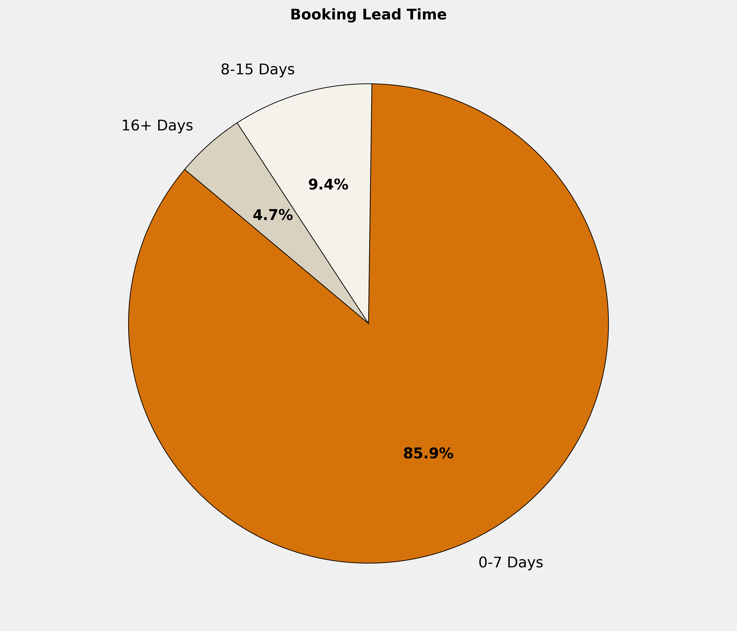
Booking Lead Time
🔹 85.9% of the bookings are made in 0-7 Days. More structured booking planning can optimize costs, ensure availability, and enhance the overall booking experience.

Slide 6
Top 10 Cities by Bookings
City | Reservations | Room Nights | Reservation Value | ADR
Hyderabad | 559 | 6684 | ₹ 446064.00 | ₹ 209.84
Mumbai | 551 | 2283 | ₹ 3175709.00 | ₹ 2868.81
New Delhi And NCR | 172 | 501 | ₹ 1201335.00 | ₹ 3394.76
Jaipur | 77 | 748 | ₹ 1847332.00 | ₹ 4727.81
Bengaluru | 69 | 206 | ₹ 468400.00 | ₹ 4663.77
Lucknow | 67 | 206 | ₹ 1076929.00 | ₹ 6637.39
Chandigarh | 59 | 242 | ₹ 1348473.00 | ₹ 12119.44
Vadodara | 59 | 199 | ₹ 793546.00 | ₹ 5655.86
Chennai | 53 | 153 | ₹ 225376.00 | ₹ 1827.21
Cochin | 44 | 204 | ₹ 800342.00 | ₹ 5006.09

Slide 7
Top 10 Properties by Bookings
Property | Reservations | Room Nights | Reservation Value | ADR
ICICI GH Gachibowli Hyderabad | 509 | 6524 | ₹ 0.00 | ₹ 0.00
ICICI GH Oasis Mumbai | 238 | 859 | ₹ 0.00 | ₹ 0.00
ICICI GH Mistry Apartments Mumbai | 184 | 950 | ₹ 0.00 | ₹ 0.00
ICICI GH Oasis Delhi | 102 | 272 | ₹ 0.00 | ₹ 0.00
ICICI GH Shivam Chennai | 36 | 106 | ₹ 0.00 | ₹ 0.00
ICICI GH Seasons Vista Highlands Bangalore | 29 | 92 | ₹ 0.00 | ₹ 0.00
ICICI GH Seasons Apartments Bangalore | 26 | 95 | ₹ 0.00 | ₹ 0.00
Hotel Presidency Cochin | 21 | 107 | ₹ 515263.00 | ₹ 7098.10
Nirwana Hometel Jaipur | 21 | 404 | ₹ 1098000.00 | ₹ 3116.67
Fairfield By Marriott Lucknow | 20 | 43 | ₹ 214199.00 | ₹ 5225.65

Slide 8
Grade Wise Bookings
Grade | Reservations | Guest Volume | Room Nights | Reservation Value
HS2 | 1680 | 1722 | 4468 | ₹ 7783921.00
RS8 | 721 | 722 | 1372 | ₹ 3016914.00
RS10 | 679 | 682 | 1202 | ₹ 2334842.00
HS1 | 490 | 494 | 1594 | ₹ 2537103.00
RS3 | 307 | 307 | 617 | ₹ 1205150.00
 | 185 | 216 | 1064 | ₹ 1192376.00
RS4 | 136 | 136 | 263 | ₹ 903715.00
HG1 | 58 | 59 | 486 | ₹ 36500.00
DS4 | 53 | 53 | 117 | ₹ 127897.00
NA | 47 | 53 | 279 | ₹ 4398145.00

Slide 9
Thank You
🔗 Click here to login to the Interactive Dashboard
Username: C218 Password: 123123

