Slide 1



Jana Small Finance Bank Ltd

Slide 2

Reservation Summary
Month | Reservations | Room Nights | Reservation Value
January 2024 | 48 | 83 | ₹ 329797.00
February 2024 | 56 | 129 | ₹ 395512.00
March 2024 | 77 | 122 | ₹ 495050.00

Slide 3
Customer Feedback
Month | Reservations | Feedback Received | Average Ratings for Hotel | Average _x000D_ Ratings for GH
January 2024 | 441 | 61 | None | None
February 2024 | 549 | 82 | None | None
March 2024 | 440 | 53 | None | None

Slide 4
Traveller Profile
Month | Guest Volume with <2000 Rate Band | Guest Volume with 2000-5000 Rate Band | Guest Volume with >5000 Rate Band
January 2024 | 3 | 32 | 14
February 2024 | 2 | 53 | 1
March 2024 | 1 | 62 | 14

Slide 5
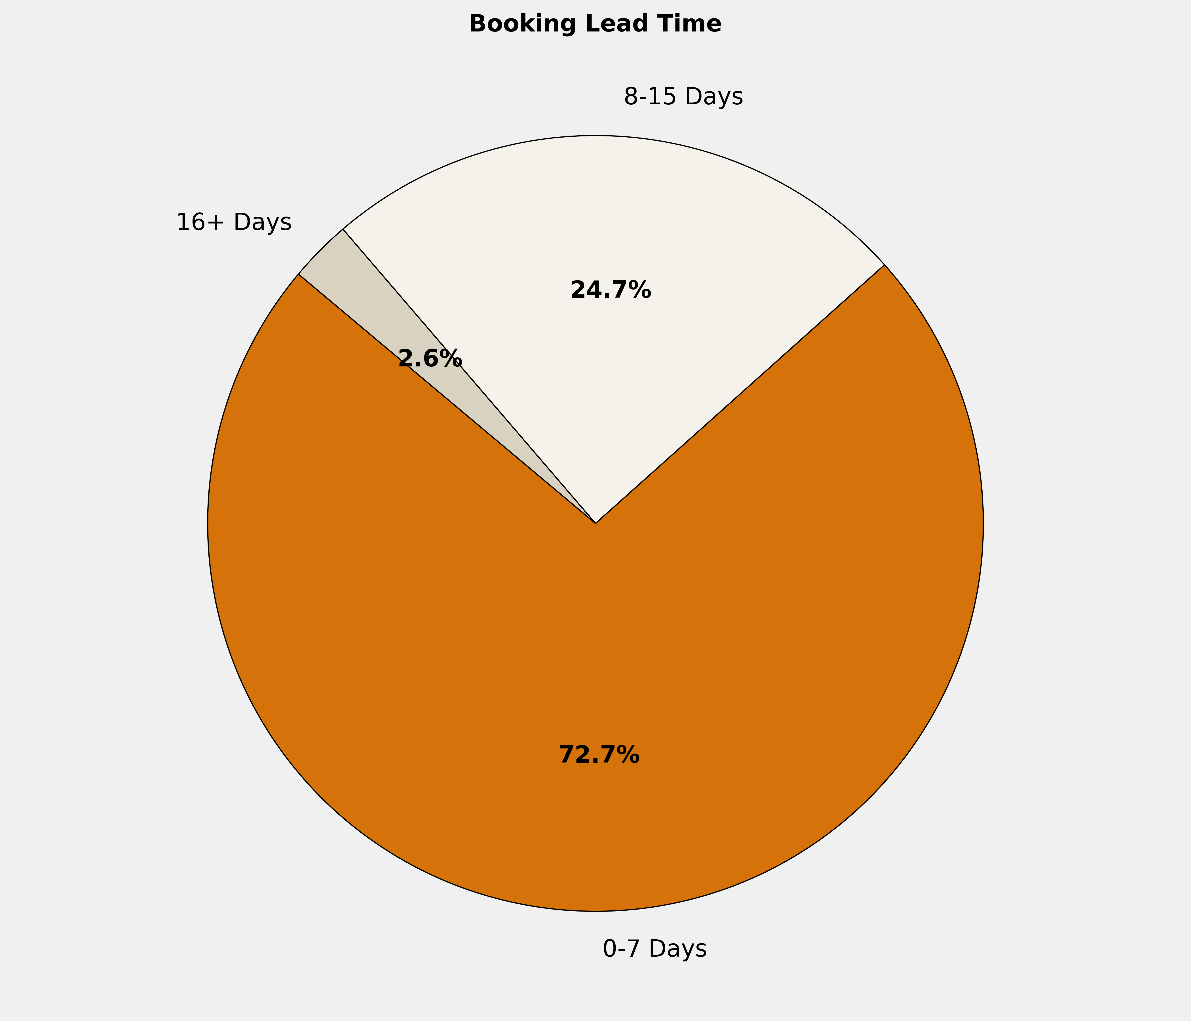
Booking Lead Time
🔹 72.7% of the bookings are made in 0-7 Days. More structured booking planning can optimize costs, ensure availability, and enhance the overall booking experience.

Slide 6
Top 10 Cities by Bookings
City | Reservations | Room Nights | Reservation Value | ADR
Jaipur | 6 | 10 | ₹ 62299.00 | ₹ 6066.50
Indore | 5 | 9 | ₹ 40900.00 | ₹ 4520.00
Ranchi | 5 | 11 | ₹ 41800.00 | ₹ 3800.00
Salem | 5 | 10 | ₹ 30000.00 | ₹ 3000.00
Nashik | 3 | 5 | ₹ 13660.00 | ₹ 2886.67
Pune | 3 | 6 | ₹ 28320.00 | ₹ 4480.00
Bhubaneshwar | 2 | 2 | ₹ 7700.00 | ₹ 3850.00
Bhilwara | 2 | 2 | ₹ 7300.00 | ₹ 3650.00
Chandigarh | 2 | 3 | ₹ 15200.00 | ₹ 4800.00
Chennai | 2 | 3 | ₹ 21276.00 | ₹ 6694.00

Slide 7
Top 10 Properties by Bookings
Property | Reservations | Room Nights | Reservation Value | ADR
Hotel Sivaraj Holiday Inn Salem | 5 | 10 | ₹ 30000.00 | ₹ 3000.00
Le Lac Sarovar Portico Ranchi | 5 | 11 | ₹ 41800.00 | ₹ 3800.00
Sayaji Hotel Indore | 3 | 5 | ₹ 21500.00 | ₹ 4300.00
Holiday Inn Express Nashik Indira Nagar | 2 | 2 | ₹ 6160.00 | ₹ 3080.00
Lords Plaza Surat | 2 | 4 | ₹ 14000.00 | ₹ 3500.00
Maya Inns ltd Jalandhar | 2 | 3 | ₹ 8500.00 | ₹ 2750.00
Sarovar Portico Jaipur | 2 | 3 | ₹ 10500.00 | ₹ 3500.00
Hotel Anjushree - Ujjain | 1 | 1 | ₹ 4700.00 | ₹ 4700.00
Ginger Hotel Lucknow | 1 | 1 | ₹ 3200.00 | ₹ 3200.00
Fortune Pandiyan | 1 | 3 | ₹ 19500.00 | ₹ 6500.00

Slide 8
Grade Wise Bookings
Grade | Reservations | Guest Volume | Room Nights | Reservation Value
 | 69 | 69 | 111 | ₹ 414157.00
NA | 3 | 3 | 4 | ₹ 44217.00
3B | 2 | 2 | 3 | ₹ 11400.00
3E | 1 | 1 | 2 | ₹ 15776.00
2B | 1 | 1 | 1 | ₹ 4000.00
3A | 1 | 1 | 1 | ₹ 5500.00

Slide 9
Thank You
🔗 Click here to login to the Interactive Dashboard
Username: C2375 Password: 123123

