Slide 1



TI Cycle of India

Slide 2

Reservation Summary
Month | Reservations | Room Nights | Reservation Value
January 2024 | 441 | 667 | ₹ 1690664.00
February 2024 | 549 | 745 | ₹ 1844450.00
March 2024 | 440 | 714 | ₹ 2271325.00

Slide 3
Customer Feedback
Month | Reservations | Feedback Received | Average Ratings for Hotel | Average _x000D_ Ratings for GH
January 2024 | 441 | 61 | None | None
February 2024 | 549 | 82 | None | None
March 2024 | 440 | 53 | None | None

Slide 4
Traveller Profile
Month | Guest Volume with <2000 Rate Band | Guest Volume with 2000-5000 Rate Band | Guest Volume with >5000 Rate Band
January 2024 | 88 | 379 | 2
February 2024 | 152 | 423 | 0
March 2024 | 98 | 393 | 14

Slide 5
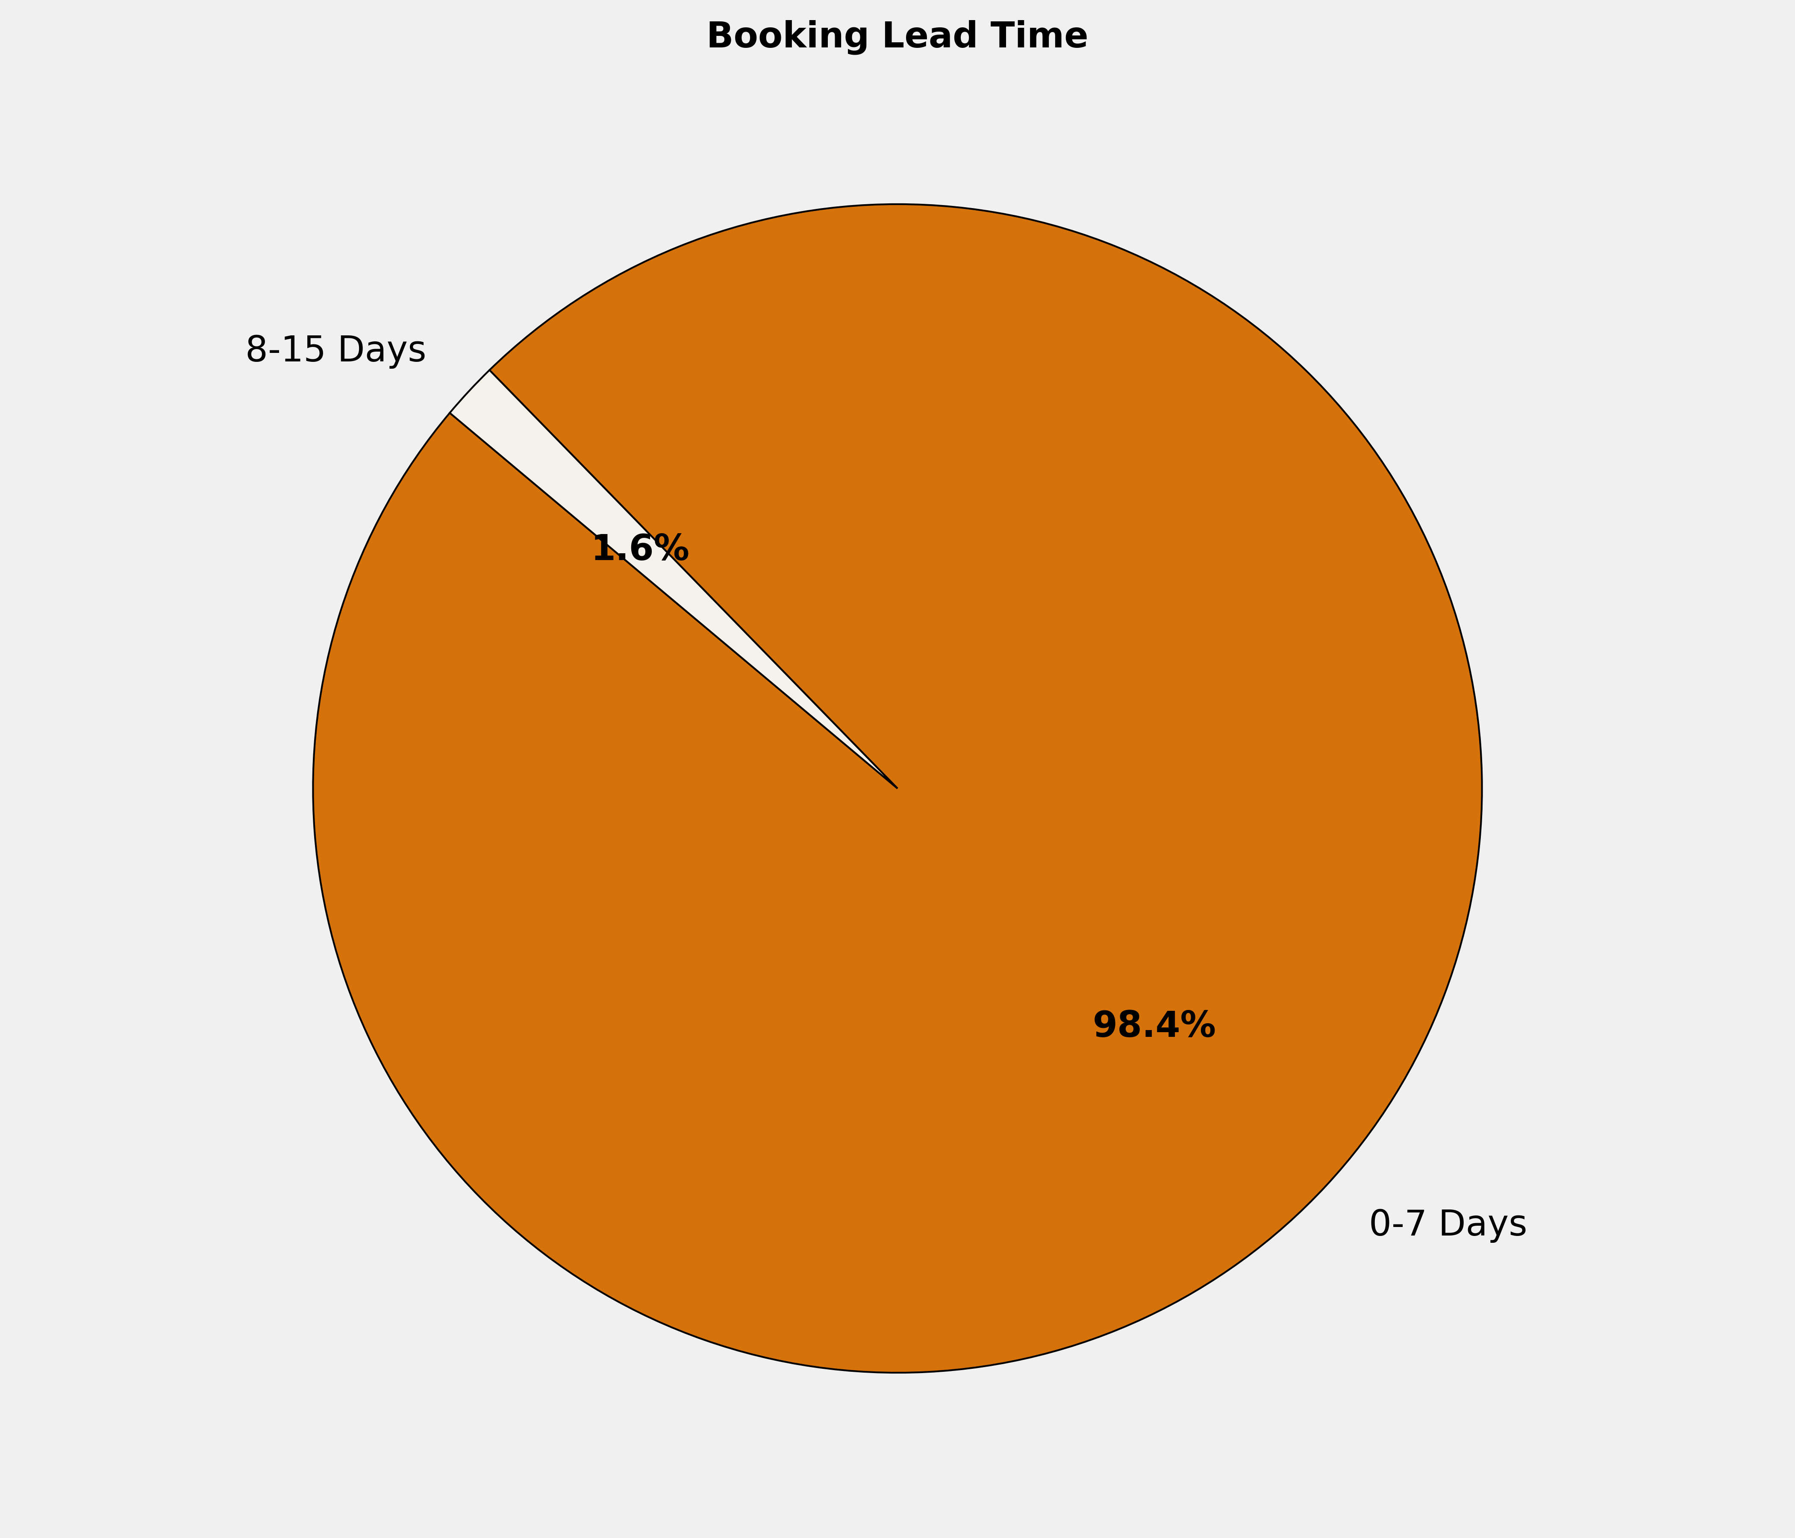
Booking Lead Time
🔹 98.4% of the bookings are made in 0-7 Days. More structured booking planning can optimize costs, ensure availability, and enhance the overall booking experience.

Slide 6
Top 10 Cities by Bookings
City | Reservations | Room Nights | Reservation Value | ADR
Kolkata | 26 | 67 | ₹ 378796.00 | ₹ 9611.13
Chennai | 24 | 64 | ₹ 156937.00 | ₹ 3065.83
Rajpura | 22 | 62 | ₹ 173110.00 | ₹ 4142.00
Pune | 9 | 20 | ₹ 45371.00 | ₹ 2564.78
Berhampore | 7 | 7 | ₹ 13938.00 | ₹ 1991.14
Varanasi | 6 | 6 | ₹ 15806.00 | ₹ 2634.33
Agra | 5 | 5 | ₹ 14815.00 | ₹ 2963.00
Kota | 5 | 5 | ₹ 12559.00 | ₹ 2511.80
Ludhiana | 5 | 9 | ₹ 27518.00 | ₹ 3550.33
Mumbai | 5 | 51 | ₹ 324270.00 | ₹ 14415.00

Slide 7
Top 10 Properties by Bookings
Property | Reservations | Room Nights | Reservation Value | ADR
Eagle Motel , Rajpura , Punjab Estb.1977 | 21 | 60 | ₹ 166482.00 | ₹ 4181.43
Emirates Residency - Chennai | 11 | 27 | ₹ 55305.00 | ₹ 2416.36
Hotel Niharika | 7 | 18 | ₹ 41900.00 | ₹ 3728.57
Hotel Sonali Bangla - Berhampore | 7 | 7 | ₹ 13938.00 | ₹ 1991.14
Park Prime - Kolkatta | 7 | 17 | ₹ 46080.00 | ₹ 3542.57
K-Square | 6 | 14 | ₹ 43400.00 | ₹ 3100.00
Hotel Crown Inn - Panvel | 4 | 4 | ₹ 8509.00 | ₹ 2127.25
HOTEL KDM PALACE | 4 | 4 | ₹ 8000.00 | ₹ 2000.00
Hotel Swarn Towers | 4 | 5 | ₹ 16400.00 | ₹ 3280.00
Satyadeep Inn | 4 | 5 | ₹ 9565.00 | ₹ 1913.00

Slide 8
Grade Wise Bookings
Grade | Reservations | Guest Volume | Room Nights | Reservation Value
MG1 | 120 | 129 | 185 | ₹ 481027.00
SS2 | 66 | 70 | 95 | ₹ 202560.00
MG2 | 58 | 64 | 101 | ₹ 258095.00
SS3 | 45 | 45 | 51 | ₹ 104142.00
MG4 | 37 | 37 | 61 | ₹ 209562.00
MG3 | 35 | 35 | 48 | ₹ 141235.00
SS1 | 35 | 38 | 48 | ₹ 103979.00
MG4A | 16 | 16 | 26 | ₹ 86924.00
SS5 | 14 | 14 | 16 | ₹ 33582.00
MG5A | 11 | 11 | 16 | ₹ 63890.00

Slide 9
Thank You

