Slide 1



TI Cycle of India

Slide 2

Reservation Summary
Month | Reservations | Room Nights | Reservation Value
May 2024 | 560 | 826 | 2182967.00
June 2024 | 572 | 802 | 2020245.00
July 2024 | 620 | 916 | 2349132.00

Slide 3
Customer Feedback
Month | Reservations | Feedback Received | Average Ratings for Hotel | Average Ratings for GH
April 2024 | 822 | 1 | None | None
March 2024 | 765 | 3 | None | None
May 2024 | 827 | 25 | 3.233333 | None

Slide 4
Traveller Profile
Month | Guest Volume with <2000 Rate Band | Guest Volume with 2000-5000 Rate Band | Guest Volume with >5000 Rate Band
April 2024 | 118 | 439 | 2
May 2024 | 111 | 479 | 2
June 2024 | 126 | 480 | 1
July 2024 | 184 | 490 | 3

Slide 5
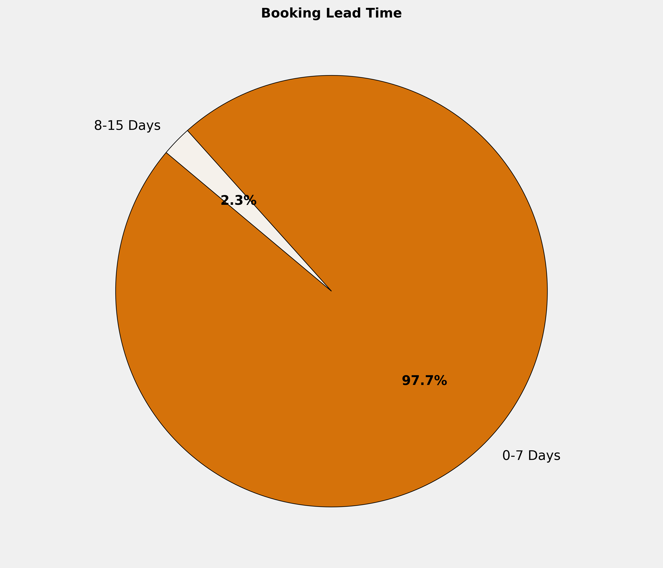
Booking Lead Time
🔹 97.7% of the bookings are made in 0-7 Days. More structured booking planning can optimize costs, ensure availability, and enhance the overall booking experience.

Slide 6
Top 10 Cities by Bookings
City | Reservations | Room Nights | Reservation Value | ADR
Chennai | 20 | 52 | ₹ 154835.00 | ₹ 2403.42
Ghaziabad | 12 | 14 | ₹ 30840.00 | ₹ 2253.33
Gorakhpur | 11 | 11 | ₹ 23621.00 | ₹ 2147.36
Indore | 11 | 23 | ₹ 70072.00 | ₹ 2915.73
Pune | 11 | 29 | ₹ 42489.00 | ₹ 729.95
Zirakpur | 11 | 14 | ₹ 38999.00 | ₹ 2785.64
New Delhi And NCR | 10 | 31 | ₹ 80535.00 | ₹ 2302.50
Coimbatore | 10 | 21 | ₹ 41650.00 | ₹ 2014.10
Ahmedabad | 10 | 14 | ₹ 47573.00 | ₹ 3230.45
Daman | 8 | 8 | ₹ 22480.00 | ₹ 2810.00

Slide 7
Top 10 Properties by Bookings
Property | Reservations | Room Nights | Reservation Value | ADR
Hotel Rainbow Ghaziabad | 10 | 12 | ₹ 24600.00 | ₹ 2080.00
JP Hotel Chennai | 9 | 20 | ₹ 70400.00 | ₹ 3418.18
Satyadeep Inn | 9 | 9 | ₹ 18608.00 | ₹ 2067.56
Best Western Plus Indore | 8 | 18 | ₹ 56000.00 | ₹ 2933.33
Eagle Motel , Rajpura , Punjab Estb.1977 | 7 | 27 | ₹ 83658.00 | ₹ 3102.67
Hotel Niharika | 6 | 11 | ₹ 29930.00 | ₹ 2496.11
Hotel Ocean Inn Daman | 6 | 6 | ₹ 17200.00 | ₹ 2866.67
Lords Inn Zirakpur | 5 | 5 | ₹ 19000.00 | ₹ 3800.00
Hotel Grand Palace,Coimbatore | 5 | 11 | ₹ 16698.00 | ₹ 1518.00
HOTEL GRAND SR | 5 | 7 | ₹ 15340.00 | ₹ 2191.43

Slide 8
Grade Wise Bookings
Grade | Reservations | Room Nights | Reservation Value | ADR
MG1 | 161 | 217 | ₹ 544665.00 | ₹ 2267.33
SS2 | 85 | 119 | ₹ 240474.00 | ₹ 2039.31
MG2 | 73 | 107 | ₹ 289711.00 | ₹ 2425.38
NA | 69 | 96 | ₹ 247189.00 | ₹ 2602.57
MG3 | 63 | 82 | ₹ 245765.00 | ₹ 2860.32
SS3 | 56 | 75 | ₹ 162880.00 | ₹ 2185.89
SS1 | 52 | 56 | ₹ 116141.00 | ₹ 2066.85
MG4 | 39 | 63 | ₹ 204811.00 | ₹ 3229.69
MG4A | 31 | 45 | ₹ 143556.00 | ₹ 3165.71
MG5A | 8 | 14 | ₹ 49544.00 | ₹ 3476.50

Slide 9
Thank You

