Slide 1



TI Cycle of India

Slide 2

Reservation Summary
Month | Reservations | Room Nights | Reservation Value
September 2024 | 530 | 776 | 2073357.00
October 2024 | 510 | 699 | 1842117.00
November 2024 | 616 | 855 | 2197973.00

Slide 3
Customer Feedback
Month | Reservations | Feedback Received | Average Ratings for Hotel | Average Ratings for GH
August 2024 | 835 | 48 | 3.548000 | 4.343750
July 2024 | 865 | 79 | 3.638095 | 4.437500
September 2024 | 765 | 53 | 3.048484 | 4.612500

Slide 4
Traveller Profile
Month | Guest Volume with <2000 Rate Band | Guest Volume with 2000-5000 Rate Band | Guest Volume with >5000 Rate Band
August 2024 | 120 | 488 | 5
September 2024 | 138 | 433 | 3
October 2024 | 107 | 427 | 0
November 2024 | 159 | 495 | 5

Slide 5
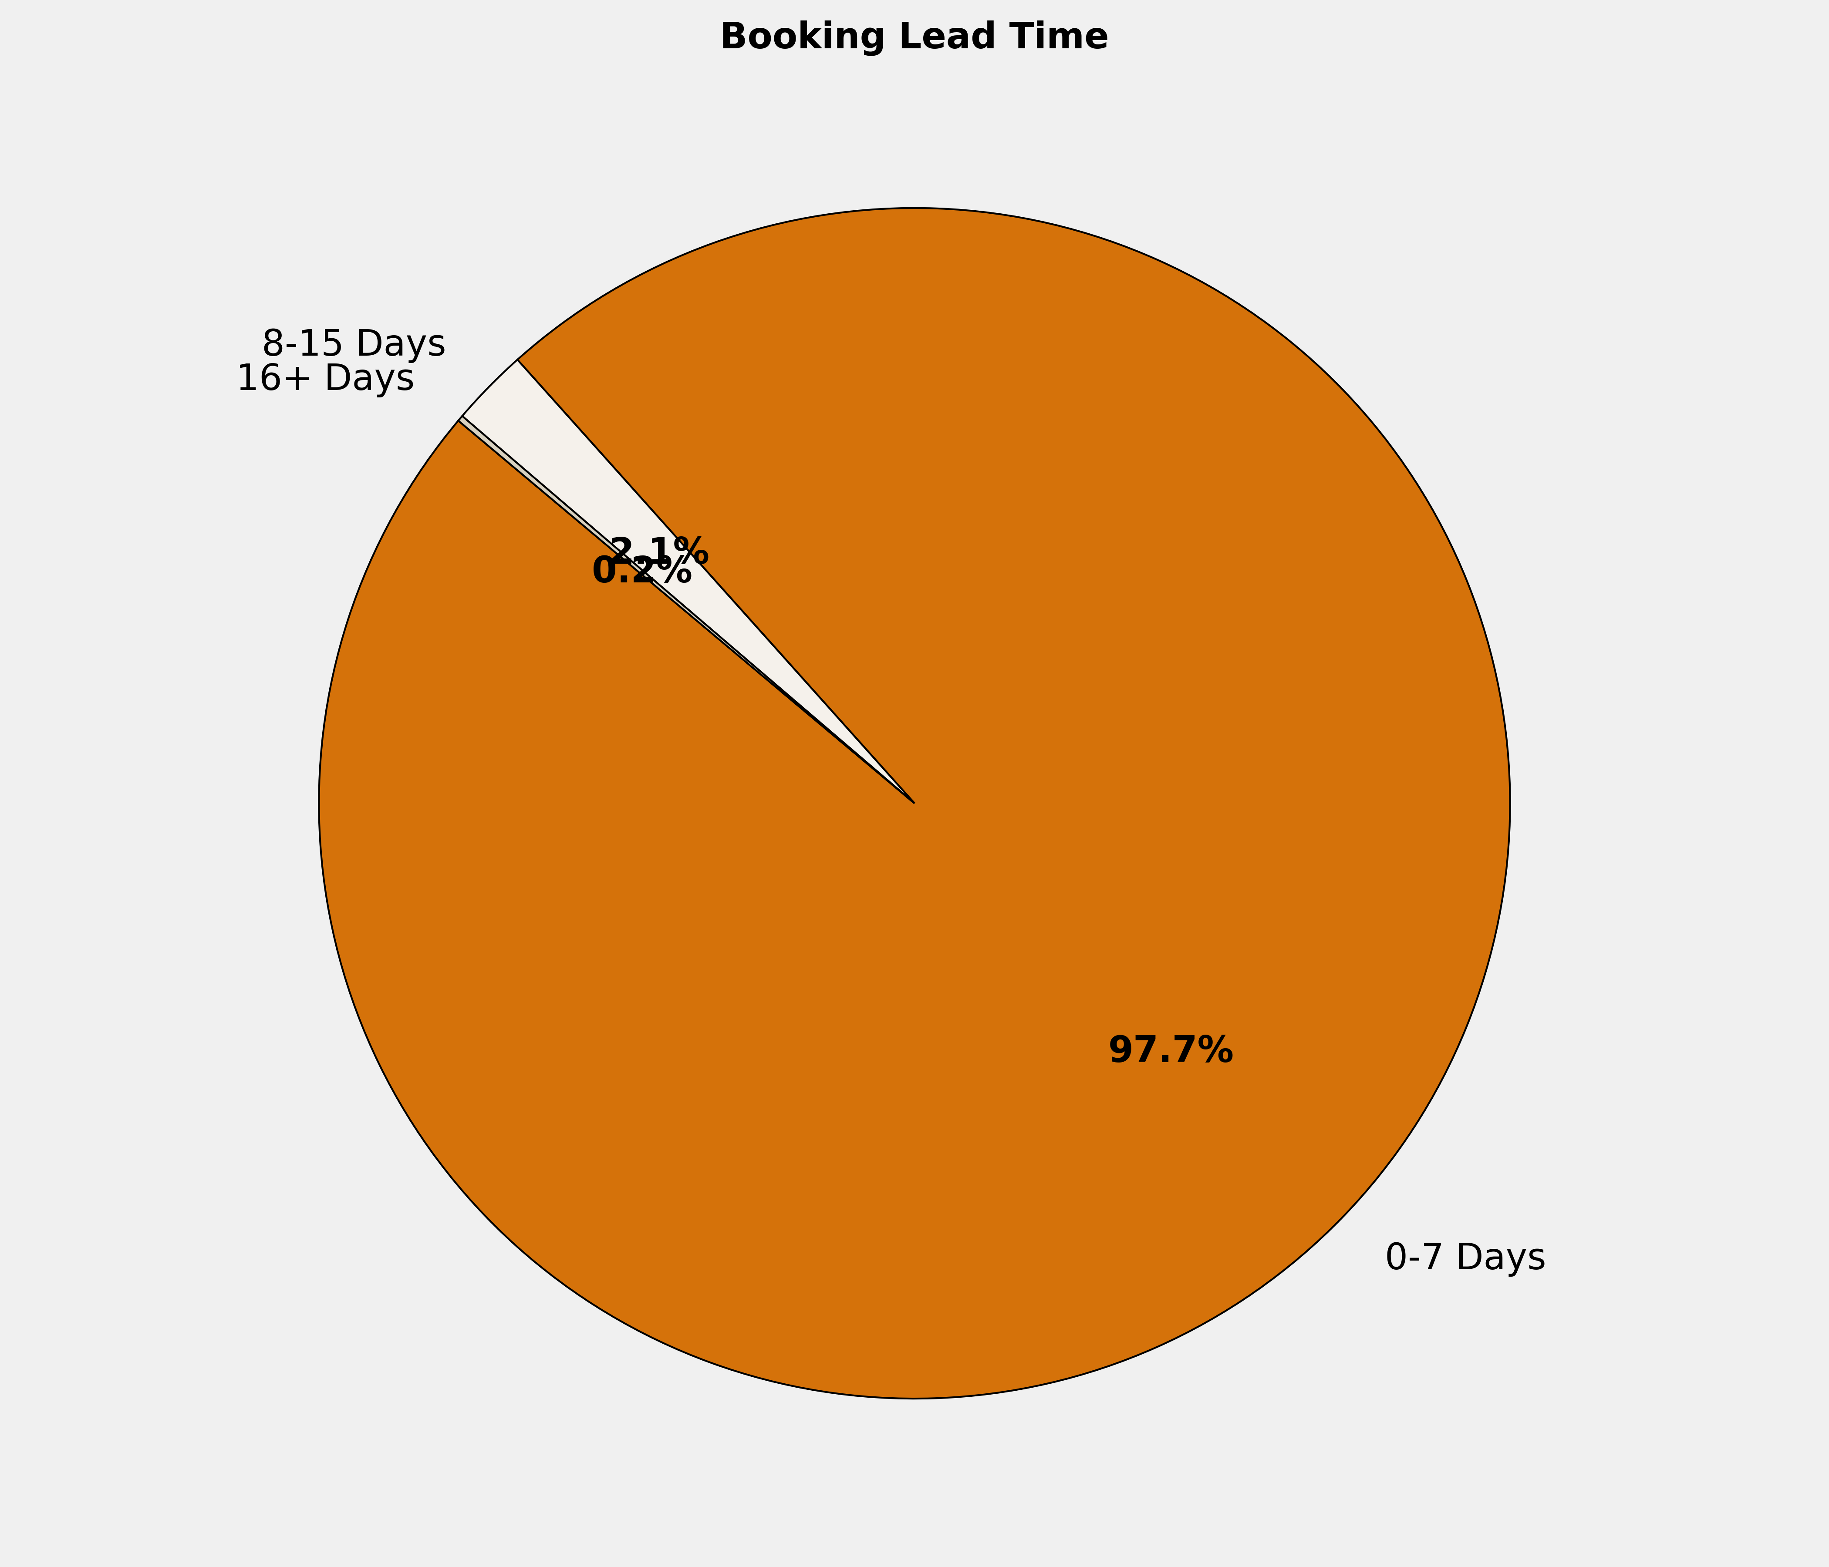
Booking Lead Time
🔹 97.7% of the bookings are made in 0-7 Days. More structured booking planning can optimize costs, ensure availability, and enhance the overall booking experience.

Slide 6
Top 10 Cities by Bookings
City | Reservations | Room Nights | Reservation Value | ADR
Chennai | 18 | 33 | ₹ 75600.00 | ₹ 1900.00
Rajpura | 17 | 39 | ₹ 119233.00 | ₹ 2649.35
Ghaziabad | 13 | 21 | ₹ 43600.00 | ₹ 2083.33
Bengaluru | 12 | 17 | ₹ 50945.00 | ₹ 3059.06
Gorakhpur | 11 | 13 | ₹ 29776.00 | ₹ 2248.00
Hubli | 11 | 13 | ₹ 37900.00 | ₹ 2790.91
Madurai | 10 | 16 | ₹ 37458.00 | ₹ 2257.90
Thiruvananthapuram | 10 | 11 | ₹ 28315.00 | ₹ 2527.20
Varanasi | 9 | 10 | ₹ 25821.00 | ₹ 2582.10
Pune | 9 | 12 | ₹ 4900.00 | ₹ 272.22

Slide 7
Top 10 Properties by Bookings
Property | Reservations | Room Nights | Reservation Value | ADR
Eagle Motel , Rajpura , Punjab Estb.1977 | 17 | 39 | ₹ 119233.00 | ₹ 2649.35
Hotel Rainbow Ghaziabad | 12 | 19 | ₹ 35900.00 | ₹ 1957.14
TII GH CHENNAI IIIC | 9 | 9 | ₹ 0.00 | ₹ 0.00
TII GH PUNE-EMINENCE | 8 | 10 | ₹ 0.00 | ₹ 0.00
Satyadeep Inn | 7 | 8 | ₹ 16820.00 | ₹ 2002.86
SALUJA RESIDENCY | 6 | 7 | ₹ 16021.00 | ₹ 2288.71
The Oaks Comforts | 6 | 7 | ₹ 18900.00 | ₹ 2616.67
Gautam Hotel | 6 | 6 | ₹ 14165.00 | ₹ 2360.83
Hotel Diamond's Pearl,Visakhapatnam | 5 | 5 | ₹ 9956.00 | ₹ 1991.20
Hotel ONN - Ludhiana | 5 | 7 | ₹ 19600.00 | ₹ 2800.00

Slide 8
Grade Wise Bookings
Grade | Reservations | Room Nights | Reservation Value | ADR
MG1 | 183 | 223 | ₹ 540758.00 | ₹ 2379.84
MG2 | 81 | 122 | ₹ 316766.00 | ₹ 2600.72
MG3 | 73 | 96 | ₹ 283923.00 | ₹ 2811.73
SS2 | 72 | 89 | ₹ 189264.00 | ₹ 2149.92
NA | 57 | 94 | ₹ 242221.00 | ₹ 2784.66
SS3 | 47 | 57 | ₹ 114249.00 | ₹ 1995.91
MG4 | 43 | 54 | ₹ 153588.00 | ₹ 2841.58
SS1 | 37 | 39 | ₹ 77148.00 | ₹ 1971.57
MG4A | 21 | 35 | ₹ 116011.00 | ₹ 3196.57
Salesofficer | 8 | 8 | ₹ 21734.00 | ₹ 2716.75

Slide 9
Thank You

