Slide 1



Tube Investments Of India Ltd

Slide 2

Reservation Summary
Entity | Reservations | Guest Volume | Room Nights | Reservation Value
Shanthi Gears Limited | 5 | 7 | 18 | ₹ 14300.00
TI CLEAN MOBILITY PRIVATE LIMITED | 4 | 4 | 6 | ₹ 0.00
TI Corporate (TICO) | 47 | 47 | 267 | ₹ 380595.00
TI Cycle of India | 440 | 505 | 714 | ₹ 2271325.00
TI Diamond Chains | 54 | 58 | 148 | ₹ 168892.00
TI Metal Forming | 40 | 41 | 131 | ₹ 248058.00
Tube Products of India | 99 | 107 | 409 | ₹ 666370.00

Slide 3
Top Cities with ADR(Entity Wise)
Entity | City | Reservations | ADR
Shanthi Gears Limited | Chennai | 4 | ₹ 900.00
TI CLEAN MOBILITY PRIVATE LIMITED | Chennai | 3 | ₹ 0.00
TI Corporate (TICO) | Chennai | 25 | ₹ 2619.08
TI Cycle of India | Kolkata | 26 | ₹ 9611.13
TI Diamond Chains | Chennai | 25 | ₹ 291.12
TI Metal Forming | Pune | 9 | ₹ 663.44
Tube Products of India | Chennai | 21 | ₹ 1872.14

Slide 4
Top Properties with ADR(Entity Wise)
Entity | Property | Reservations | ADR
Shanthi Gears Limited | TII GH CHENNAI IIIC | 1 | ₹ 0.00
TI CLEAN MOBILITY PRIVATE LIMITED | TII GH CHENNAI IIIC | 3 | ₹ 0.00
TI Corporate (TICO) | DESHNA ABODE | 18 | ₹ 1642.22
TI Cycle of India | Eagle Motel , Rajpura , Punjab Estb.1977 | 21 | ₹ 4181.43
TI Diamond Chains | TII GH CHENNAI IIIC | 16 | ₹ 0.00
TI Metal Forming | TII GH PUNE-EMINENCE | 7 | ₹ 0.00
Tube Products of India | TII GH PUNE-EMINENCE | 11 | ₹ 0.00

Slide 5
Customer Feedback
Entity | Reservations | Feedback Received | Average Ratings for Hotel | Average Ratings for GH
Shanthi Gears Limited | 5 | 0 | None | None
TI CLEAN MOBILITY PRIVATE LIMITED | 4 | 0 | None | None
TI Corporate (TICO) | 47 | 0 | None | None
TI Cycle of India | 440 | 0 | None | None
TI Diamond Chains | 54 | 0 | None | None
TI Metal Forming | 40 | 0 | None | None
Tube Products of India | 99 | 0 | None | None

Slide 6
Traveller Profile
Entity | Guest Volume with <2000 Rate Band | Guest Volume with 2000-5000 Rate Band | Guest Volume with >5000 Rate Band
Shanthi Gears Limited | 6 | 1 | 0
TI CLEAN MOBILITY PRIVATE LIMITED | 4 | 0 | 0
TI Corporate (TICO) | 28 | 13 | 6
TI Cycle of India | 98 | 393 | 14
TI Diamond Chains | 37 | 18 | 3
TI Metal Forming | 18 | 23 | 0
Tube Products of India | 52 | 54 | 1

Slide 7
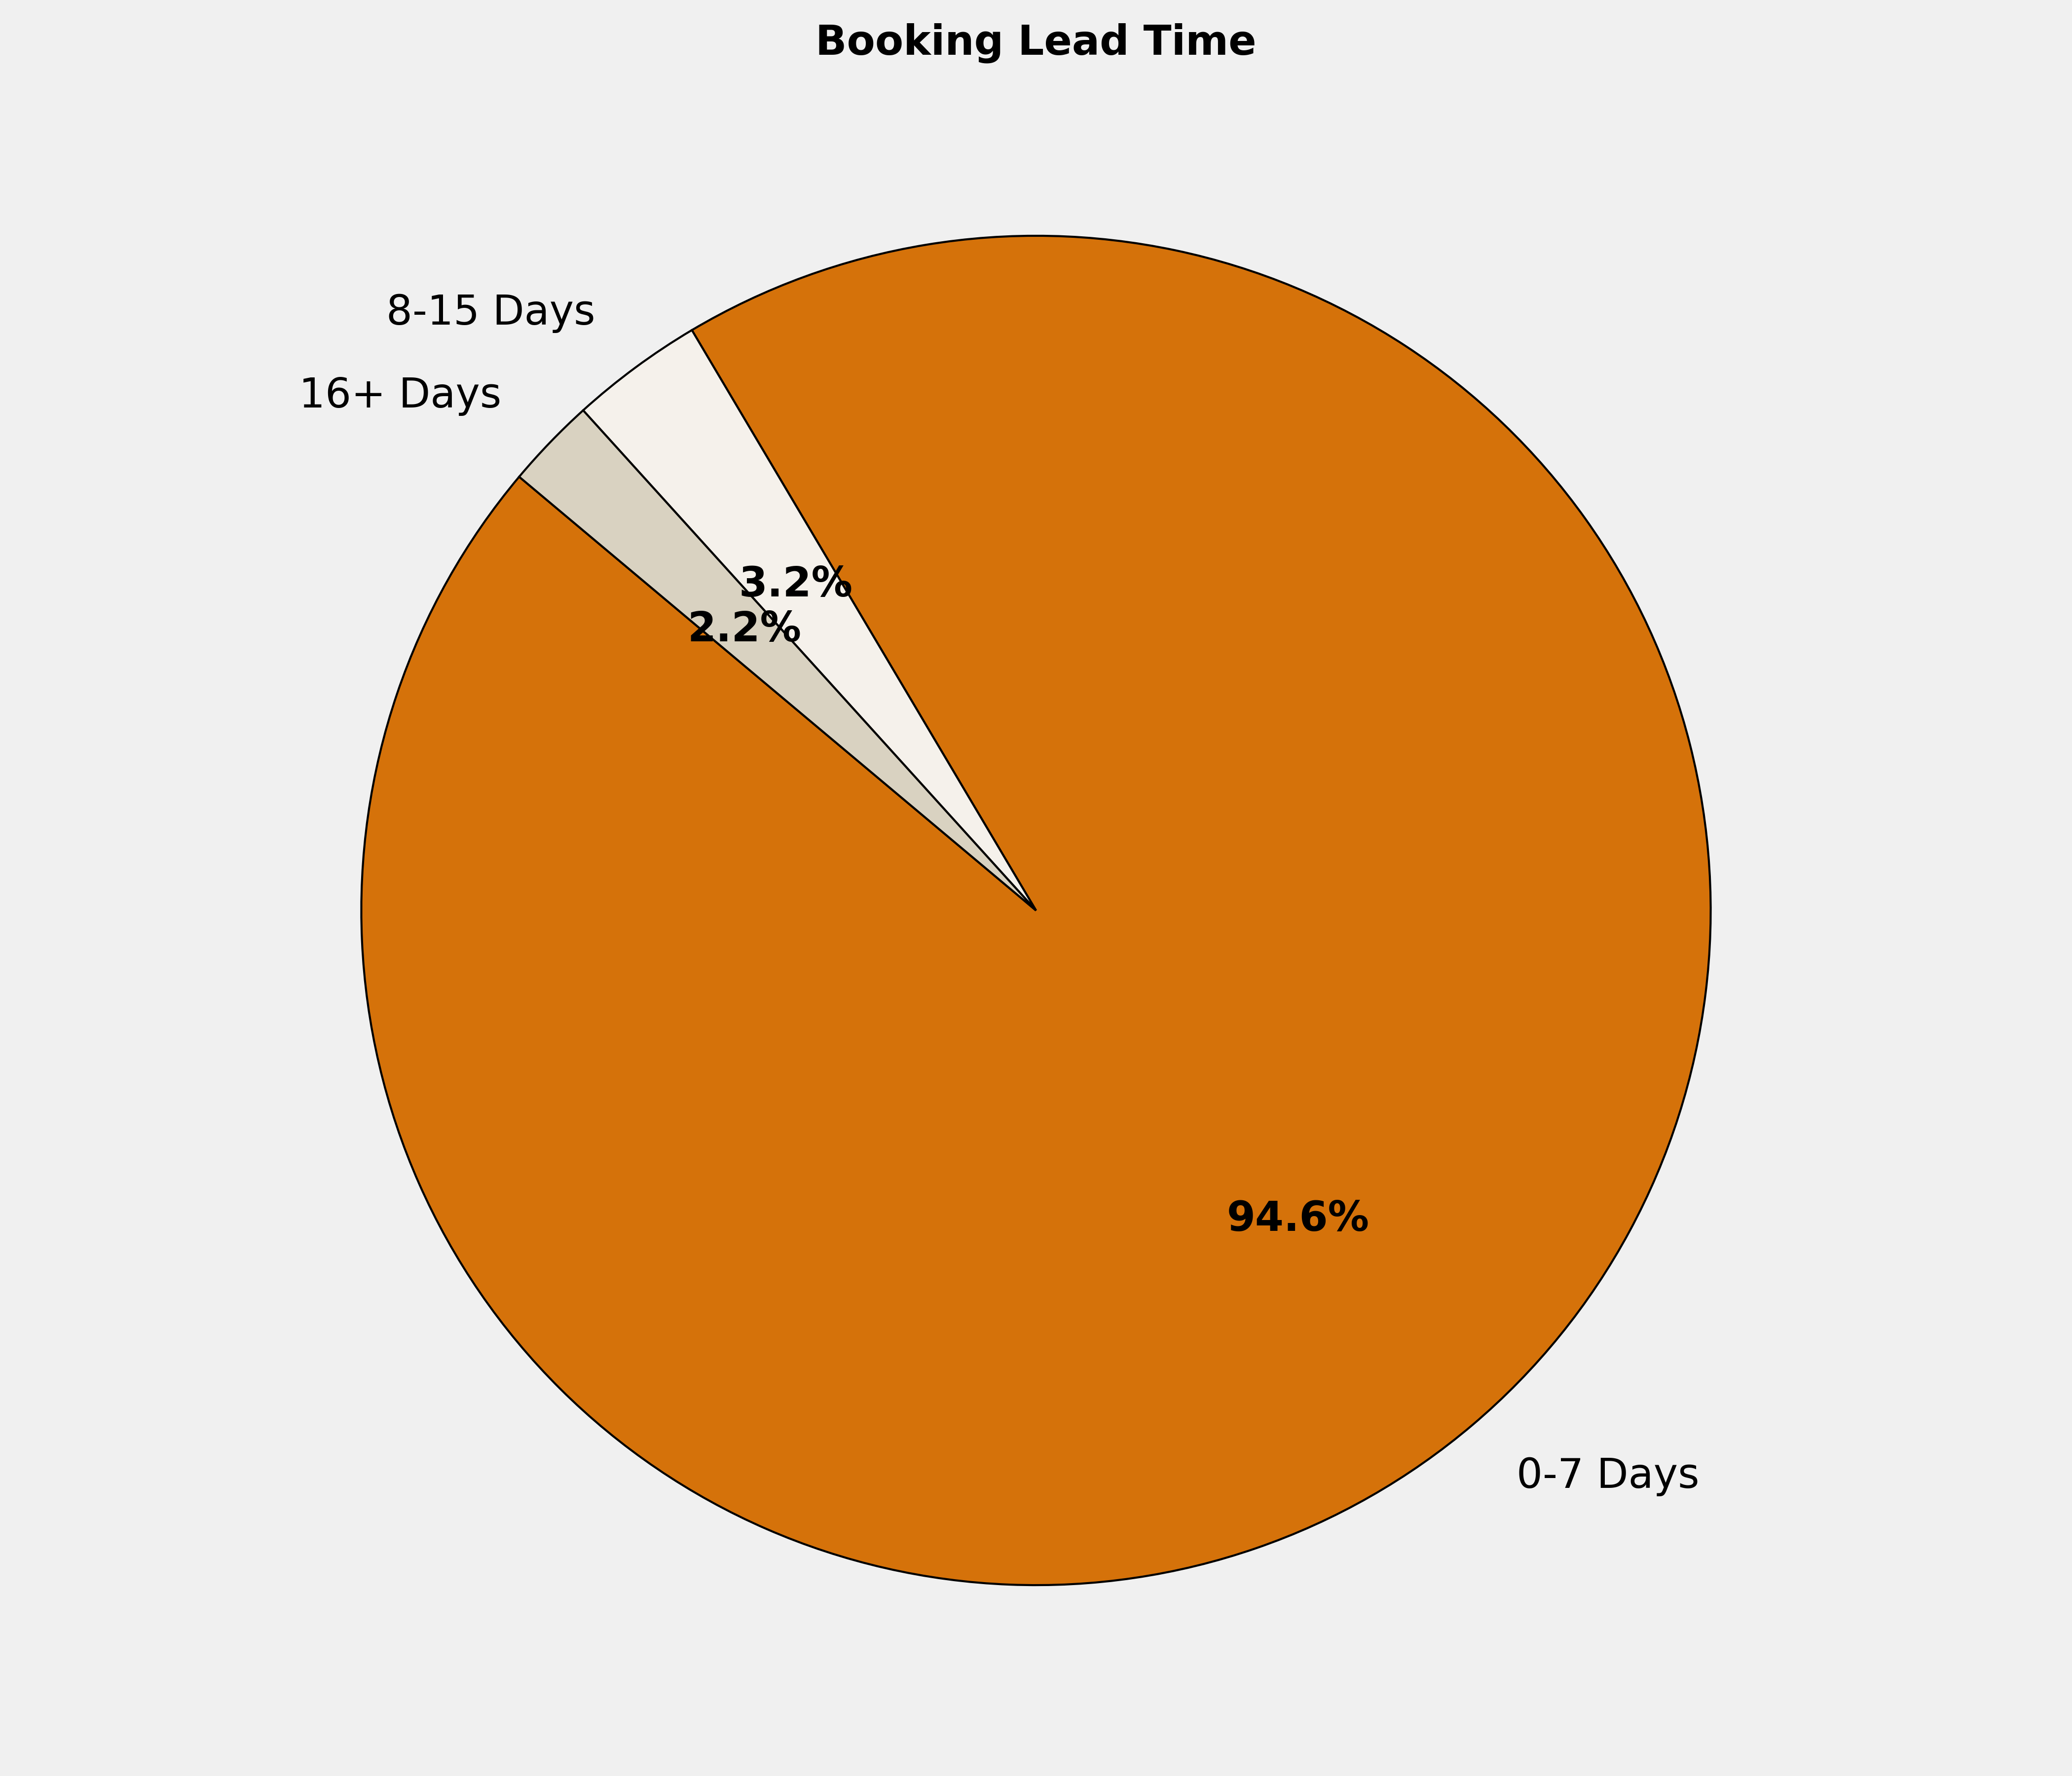
Booking Lead Time
🔹 94.6% of the bookings are made in 0-7 Days. More structured booking planning can optimize costs, ensure availability, and enhance the overall booking experience.

Slide 8
Top 10 Cities by Bookings
City | Reservations | Room Nights | Reservation Value | ADR
Chennai | 108 | 538 | ₹ 537291.00 | ₹ 1847.94
Pune | 56 | 110 | ₹ 129824.00 | ₹ 1386.93
Rajpura | 29 | 81 | ₹ 238086.00 | ₹ 4119.90
Kolkata | 27 | 69 | ₹ 385828.00 | ₹ 9414.52
Vadodara | 15 | 60 | ₹ 140938.00 | ₹ 2705.33
Bawal | 14 | 52 | ₹ 88150.00 | ₹ 1695.79
Gurugram | 12 | 76 | ₹ 158866.00 | ₹ 2549.92
Secunderabad | 12 | 42 | ₹ 95004.00 | ₹ 2714.17
Mumbai | 11 | 64 | ₹ 385222.00 | ₹ 12006.29
Bengaluru | 10 | 20 | ₹ 62975.00 | ₹ 3161.10

Slide 9
Top 10 Properties by Bookings
Property | Reservations | Room Nights | Reservation Value | ADR
TII GH CHENNAI IIIC | 32 | 113 | ₹ 0.00 | ₹ 0.00
TII GH PUNE-EMINENCE | 31 | 66 | ₹ 0.00 | ₹ 0.00
Eagle Motel , Rajpura , Punjab Estb.1977 | 28 | 79 | ₹ 231458.00 | ₹ 4148.68
DESHNA ABODE | 27 | 120 | ₹ 187840.00 | ₹ 1651.85
Hotel Kanishk, Bawal | 14 | 52 | ₹ 88150.00 | ₹ 1695.79
Emirates Residency - Chennai | 12 | 33 | ₹ 68835.00 | ₹ 2402.92
HOTEL GURUGRAM MANESAR | 12 | 76 | ₹ 158866.00 | ₹ 2549.92
Seven A Luxury Hotel ecil | 12 | 42 | ₹ 95004.00 | ₹ 2714.17
TII Chennai - RWD Ambattur | 10 | 197 | ₹ 0.00 | ₹ 0.00
The Hotel Airport Vadodara | 9 | 31 | ₹ 58650.00 | ₹ 2627.78

Slide 10
Reservation Summary – Last 3 Months
Entity | January Reservations | January Room Nights | January Reservation Value | February Reservations | February Room Nights | February Reservation Value | March Reservations | March Room Nights | March Reservation Value
CELLESTIAL E-TRAC PRIVATE LIMITED | 1 | 1 | ₹ 2850 | 0 | 0 | ₹ 0 | 0 | 0 | ₹ 0
IPL Tech Electric Pvt Ltd | 1 | 2 | ₹ 4500 | 0 | 0 | ₹ 0 | 0 | 0 | ₹ 0
Lotus Surgicals Pvt Ltd | 0 | 0 | ₹ 0 | 1 | 2 | ₹ 0 | 0 | 0 | ₹ 0
Shanthi Gears Limited | 5 | 12 | ₹ 9000 | 3 | 7 | ₹ 0 | 5 | 18 | ₹ 14300
TI CLEAN MOBILITY PRIVATE LIMITED | 9 | 9 | ₹ 0 | 2 | 7 | ₹ 0 | 4 | 6 | ₹ 0
TI Corporate (TICO) | 72 | 382 | ₹ 782132 | 47 | 183 | ₹ 351583 | 47 | 267 | ₹ 380595
TI Cycle of India | 441 | 667 | ₹ 1690664 | 549 | 745 | ₹ 1844450 | 440 | 714 | ₹ 2271325
TI Diamond Chains | 41 | 98 | ₹ 169455 | 39 | 104 | ₹ 183458 | 54 | 148 | ₹ 168892
TI Metal Forming | 19 | 101 | ₹ 143518 | 28 | 72 | ₹ 155728 | 40 | 131 | ₹ 248058
Tube Products of India | 70 | 368 | ₹ 504724 | 73 | 334 | ₹ 459459 | 99 | 409 | ₹ 666370

Slide 11
Thank You

