Slide 1



Tube Investments Of India Ltd

Slide 2

Reservation Summary
Entity | Reservations | Guest Volume | Room Nights | Reservation Value
3XPER Innoventure Limited | 3 | 3 | 3 | ₹ 15000.00
CG Semi Private Limited | 13 | 13 | 25 | ₹ 185470.00
E I D PARRY INDIA LIMITED | 8 | 12 | 16 | ₹ 57851.00
Shanthi Gears Limited | 3 | 3 | 3 | ₹ 13649.00
TI CLEAN MOBILITY PRIVATE LIMITED | 1 | 1 | 2 | ₹ 0.00
TI Corporate (TICO) | 75 | 84 | 288 | ₹ 519788.00
TI Cycle of India | 620 | 677 | 916 | ₹ 2349132.00
TI Diamond Chains | 89 | 89 | 194 | ₹ 464175.00
TI Metal Forming | 17 | 17 | 29 | ₹ 84314.00
TIVOLT ELECTRIC VEHICLES PRIVATE LIMITED | 2 | 2 | 8 | ₹ 0.00
Tube Products of India | 71 | 76 | 346 | ₹ 420755.00

Slide 3
Top Cities with ADR(Entity Wise)
Entity | City | Reservations | ADR
3XPER Innoventure Limited | Hyderabad | 3 | ₹ 5000.00
CG Semi Private Limited | Ahmedabad | 45 | ₹ 3056.59
E I D PARRY INDIA LIMITED | Hyderabad | 14 | ₹ 2747.54
Shanthi Gears Limited | Chennai | 104 | ₹ 856.49
TI CLEAN MOBILITY PRIVATE LIMITED | Chennai | 140 | ₹ 2307.33
TI Corporate (TICO) | Hindupur | 20 | ₹ 1747.80
TI Cycle of India | Guntur | 68 | ₹ 2517.56
TI Diamond Chains | Hyderabad | 46 | ₹ 3410.76
TI Metal Forming | Hyderabad | 10 | ₹ 2248.53
TIVOLT ELECTRIC VEHICLES PRIVATE LIMITED | Pune | 3 | ₹ 0.00
Tube Products of India | Hyderabad | 16 | ₹ 3102.31

Slide 4
Top Properties with ADR(Entity Wise)
Entity | Property | Reservations | ADR
3XPER Innoventure Limited | Deccan Serai Hotel | 3 | ₹ 5000.00
CG Semi Private Limited | Hilton Chennai | 2 | ₹ 11300.00
E I D PARRY INDIA LIMITED | Hotel Citrine | 1 | ₹ 1200.00
Shanthi Gears Limited | The Residency Chennai | 1 | ₹ 6000.00
TI CLEAN MOBILITY PRIVATE LIMITED | TII Chennai - RWD Ambattur | 4 | ₹ 0.00
TI Corporate (TICO) | Hometel Chandigarh | 19 | ₹ 3762.91
TI Cycle of India | Ambrosia Sarovar Portico - Haridwar | 3 | ₹ 2400.00
TI Diamond Chains | Ambrosia Sarovar Portico - Haridwar | 1 | ₹ 3500.00
TI Metal Forming | Ambrosia Sarovar Portico - Haridwar | 9 | ₹ 2566.67
TIVOLT ELECTRIC VEHICLES PRIVATE LIMITED | TII GH PUNE-EMINENCE | 3 | ₹ 0.00
Tube Products of India | Hotel Gardeenia Comfortes | 1 | ₹ 2750.00

Slide 5
Customer Feedback
Entity | Reservations | Feedback Received | Average Ratings for Hotel | Average Ratings for GH
3XPER Innoventure Limited | 3 | 2 | 4.400000 | None
CG Semi Private Limited | 13 | 0 | None | None
Shanthi Gears Limited | 3 | 0 | None | None
TI CLEAN MOBILITY PRIVATE LIMITED | 1 | 0 | None | None
TI Corporate (TICO) | 75 | 3 | 4.200000 | None
TI Cycle of India | 620 | 31 | 2.658064 | None
TI Diamond Chains | 89 | 8 | 4.160000 | None
TI Metal Forming | 17 | 4 | 4.800000 | 1.000000
TIVOLT ELECTRIC VEHICLES PRIVATE LIMITED | 2 | 0 | None | None
Tube Products of India | 71 | 7 | 3.200000 | 5.000000

Slide 6
Traveller Profile
Entity | Guest Volume with <2000 Rate Band | Guest Volume with 2000-5000 Rate Band | Guest Volume with >5000 Rate Band
3XPER Innoventure Limited | 0 | 3 | 0
CG Semi Private Limited | 0 | 2 | 11
E I D PARRY INDIA LIMITED | 0 | 10 | 2
Shanthi Gears Limited | 1 | 0 | 2
TI CLEAN MOBILITY PRIVATE LIMITED | 1 | 0 | 0
TI Corporate (TICO) | 29 | 44 | 11
TI Cycle of India | 184 | 490 | 3
TI Diamond Chains | 19 | 69 | 1
TI Metal Forming | 1 | 16 | 0
TIVOLT ELECTRIC VEHICLES PRIVATE LIMITED | 2 | 0 | 0
Tube Products of India | 31 | 39 | 6

Slide 7
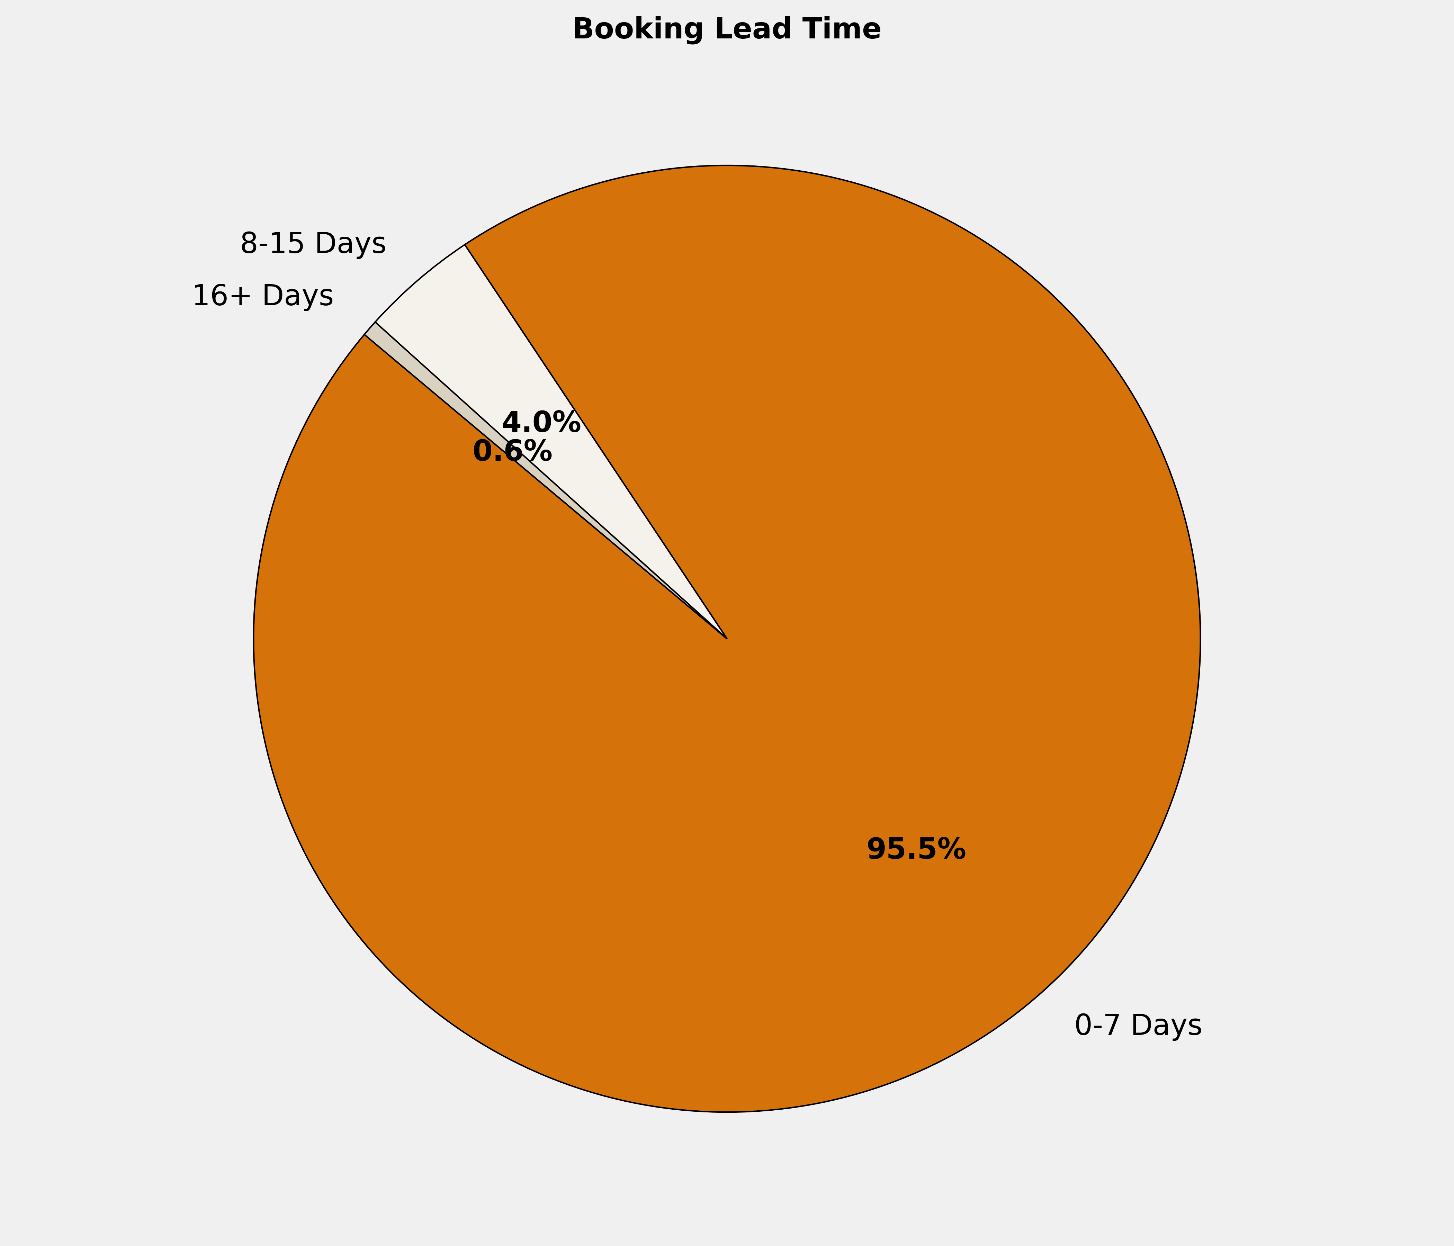
Booking Lead Time
🔹 95.5% of the bookings are made in 0-7 Days. More structured booking planning can optimize costs, ensure availability, and enhance the overall booking experience.

Slide 8
Top 10 Cities by Bookings
City | Reservations | Room Nights | Reservation Value | ADR
Chennai | 102 | 527 | ₹ 519404.00 | ₹ 1960.10
Pune | 35 | 78 | ₹ 123586.00 | ₹ 1161.36
Hyderabad | 28 | 66 | ₹ 215886.00 | ₹ 3013.83
Ahmedabad | 21 | 29 | ₹ 114619.00 | ₹ 3726.41
Bengaluru | 19 | 42 | ₹ 136144.00 | ₹ 2653.36
Coimbatore | 19 | 48 | ₹ 128458.00 | ₹ 2470.37
Hubli | 13 | 17 | ₹ 49181.00 | ₹ 2906.23
Indore | 13 | 26 | ₹ 82552.00 | ₹ 3036.82
Ghaziabad | 12 | 14 | ₹ 30840.00 | ₹ 2253.33
New Delhi And NCR | 12 | 35 | ₹ 102535.00 | ₹ 2702.19

Slide 9
Top 10 Properties by Bookings
Property | Reservations | Room Nights | Reservation Value | ADR
TII GH CHENNAI IIIC | 29 | 126 | ₹ 0.00 | ₹ 0.00
DESHNA ABODE | 19 | 79 | ₹ 132900.00 | ₹ 1689.47
JP Hotel Chennai | 19 | 40 | ₹ 150400.00 | ₹ 3695.24
TII GH PUNE-EMINENCE | 18 | 37 | ₹ 0.00 | ₹ 0.00
Emirates Residency - Chennai | 13 | 40 | ₹ 93400.00 | ₹ 1686.36
Eagle Motel , Rajpura , Punjab Estb.1977 | 12 | 37 | ₹ 115494.00 | ₹ 3182.40
Hotel Rainbow Ghaziabad | 10 | 12 | ₹ 24600.00 | ₹ 2080.00
Satyadeep Inn | 9 | 9 | ₹ 18608.00 | ₹ 2067.56
Best Western Plus Indore | 8 | 18 | ₹ 56000.00 | ₹ 2933.33
TII Chennai - RWD Ambattur | 8 | 210 | ₹ 0.00 | ₹ 0.00

Slide 10
Reservation Summary – Last 3 Months
Entity | May Reservations | May Room Nights | May Reservation Value | June Reservations | June Room Nights | June Reservation Value | July Reservations | July Room Nights | July Reservation Value
3XPER Innoventure Limited | 0 | 0 | 0.00 | 0 | 0 | 0.00 | 3 | 3 | 15000.00
CG Semi Private Limited | 2 | 7 | 47200.00 | 6 | 10 | 81905.00 | 13 | 25 | 185470.00
E I D PARRY INDIA LIMITED | 1 | 6 | 28800.00 | 1 | 2 | 14000.00 | 8 | 16 | 57851.00
Lotus Surgicals Pvt Ltd | 1 | 2 | 0.00 | 0 | 0 | 0.00 | 0 | 0 | 0.00
MOSHINE ELECTRONICS PRIVATE LIMITED | 1 | 2 | 0.00 | 2 | 8 | 43992.00 | 0 | 0 | 0.00
Shanthi Gears Limited | 11 | 33 | 3899.00 | 29 | 45 | 154723.00 | 3 | 3 | 13649.00
TI CLEAN MOBILITY PRIVATE LIMITED | 0 | 0 | 0.00 | 1 | 13 | 0.00 | 1 | 2 | 0.00
TI Corporate (TICO) | 61 | 212 | 423564.00 | 59 | 167 | 327736.00 | 75 | 288 | 519788.00
TI Cycle of India | 560 | 826 | 2182967.00 | 572 | 802 | 2020245.00 | 620 | 916 | 2349132.00
TI Diamond Chains | 60 | 207 | 274802.00 | 68 | 176 | 348292.00 | 89 | 194 | 464175.00
TI Metal Forming | 27 | 61 | 112872.00 | 18 | 43 | 78037.00 | 17 | 29 | 84314.00
TIVOLT ELECTRIC VEHICLES PRIVATE LIMITED | 0 | 0 | 0.00 | 0 | 0 | 0.00 | 2 | 8 | 0.00
Tube Products of India | 99 | 308 | 536106.00 | 72 | 272 | 431520.00 | 71 | 346 | 420755.00

Slide 11
Thank You

