Slide 1

TECHNOLOGY TRENDS & DEVELOPER DEMOGRAPHICS ANALYSIS
By: Mythili Kiran

Slide 2



OUTLINE
Executive Summary
Introduction
Methodology
Results
Visualization – Charts
Dashboard
Discussion
Findings & Implications
Conclusion
Appendix

Slide 3

EXECUTIVE SUMMARY
This analysis examines developer technology trends using Stack Overflow survey data. Results show continued dominance of Python, SQL, and JavaScript, rising cloud and open-source database adoption, and a positive relationship between experience, compensation, and job satisfaction.

Slide 4

INTRODUCTION
Purpose: Analyze current and future technology trends.
Audience: Data professionals and technology leaders.
Value: Supports skill and hiring decisions.

Slide 5

METHODOLOGY
Data Sources:
Stack Overflow Developer Survey
Web-scraped HTML dataset
Public REST API
Tools:
SQL, Python, IBM Cognos Analytics
Steps:
Cleaning and preprocessing
Normalization and transformation
Analysis and visualization

Slide 6
RESULTS
Languages: JavaScript, SQL, and Python lead adoption
Databases: PostgreSQL and MySQL dominate usage
Platforms: AWS, Azure, and Google Cloud are most used
Demographics: Majority of developers are primarily aged 25–44

Slide 7
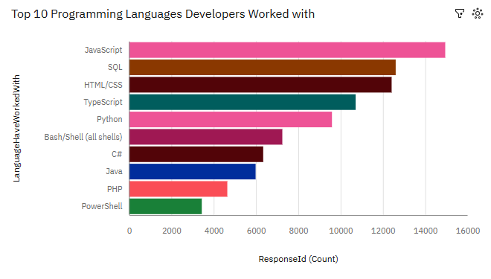
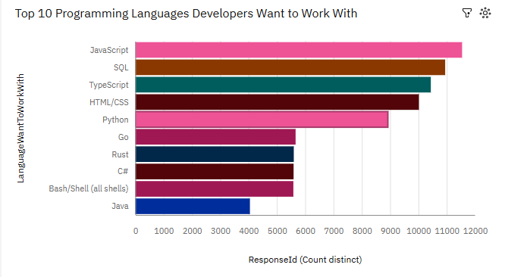
PROGRAMMING LANGUAGE TRENDS
Current Year
Next Year

Slide 8
PROGRAMMING LANGUAGE TRENDS - FINDINGS & IMPLICATIONS
Findings
JS, SQL, Python lead
TypeScript rising
Go, Rust emerging
Implications
Strong demand for core skills
Shift toward modern stacks
Need for ongoing learning

Slide 9
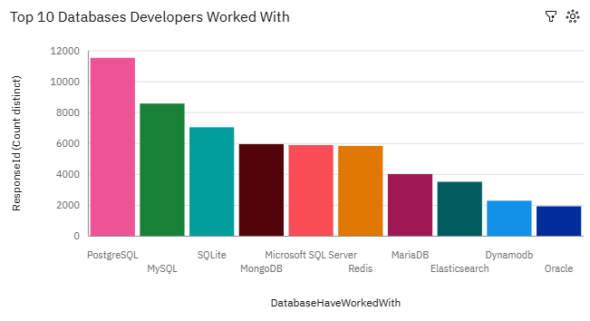
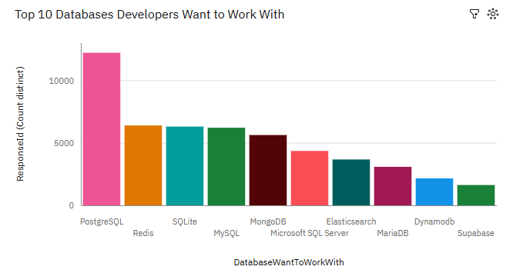
DATABASE TRENDS
Current Year
Next Year

Slide 10
DATABASE TRENDS - FINDINGS & IMPLICATIONS
Findings
PostgreSQL, MySQL lead
MongoDB popular
Redis growing
Implications
SQL skills remain essential
NoSQL adoption increasing
Focus on scalability & speed

Slide 11

DASHBOARD
Current Technology Usage​
Future Technology Trends​
Demographics
https://github.com/mythiliskiran/in-demand-developer-skills-analysis/blob/b8bbecda9ac9856b8fbe468095664da2bd9723f5/building_a_dashboard/Stack%20Overflow%20Survey%20dashboard.pdf

Slide 12
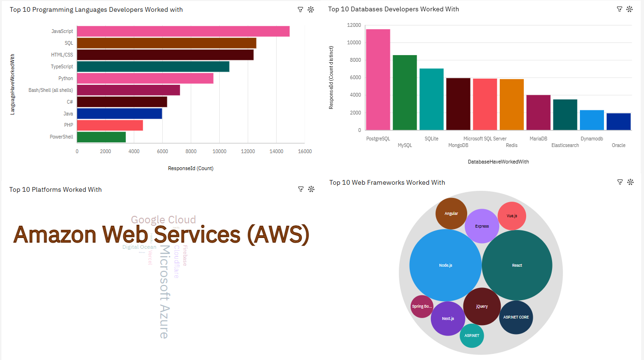
CURRENT TECHNOLOGY USAGE

Slide 13
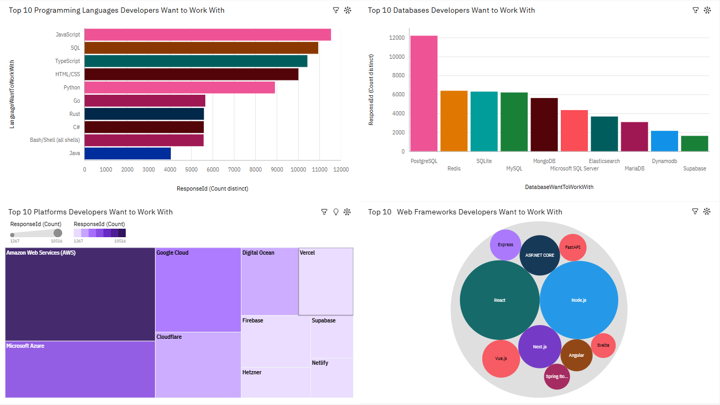
FUTURE TECHNOLOGY TRENDS

Slide 14
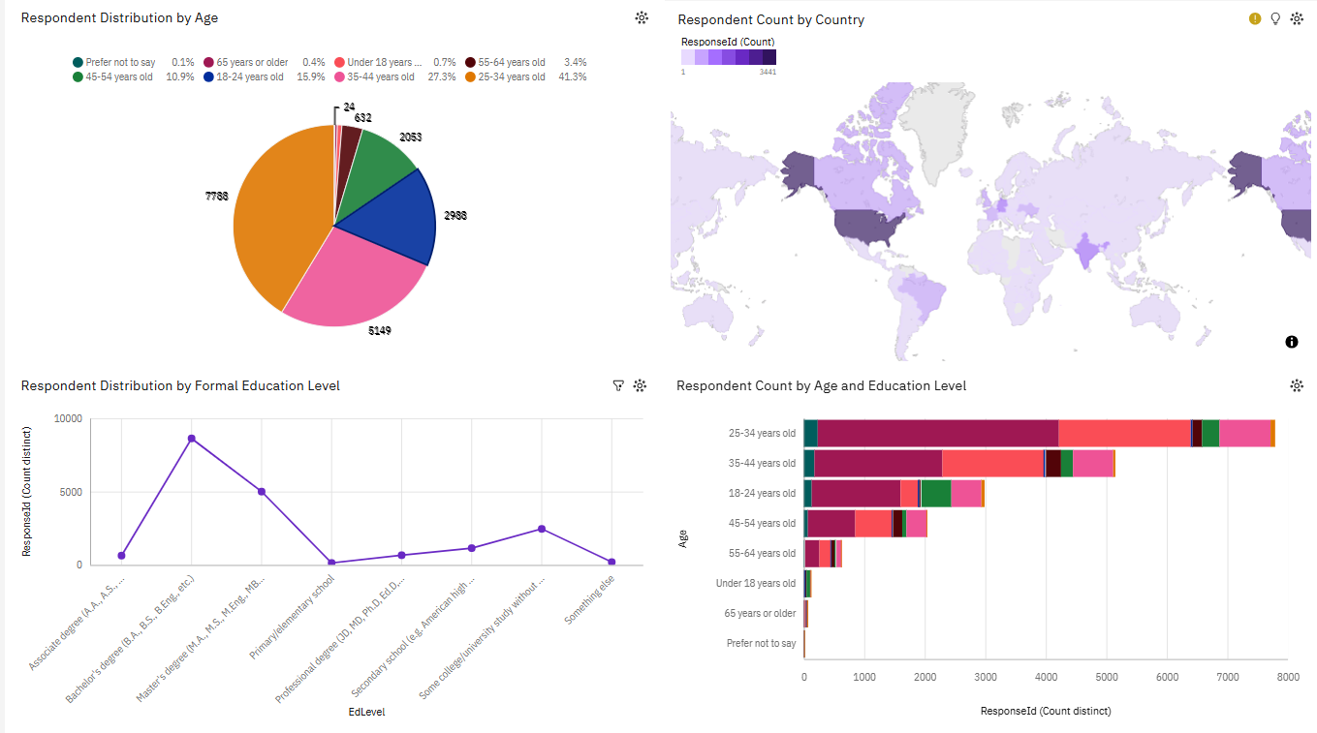
DEMOGRAPHICS

Slide 15
DISCUSSION
Core technologies remain dominant across roles
Cloud adoption reflects industry scalability needs
Emerging tools show gradual, not disruptive, growth
Skills demand driven by both stability and innovation

Slide 16
OVERALL FINDINGS & IMPLICATIONS
Findings
JavaScript, SQL, Python dominate usage
Cloud platforms widely adopted
Relational + NoSQL databases both important
Implications
Core technical skills remain essential
Cloud and data skills drive demand
Continuous upskilling is critical

Slide 17

CONCLUSION
Core programming and database technologies remain essential
Cloud platforms play a central role in modern development
Emerging tools signal evolving industry needs
Continuous learning is key to staying relevant

Slide 18
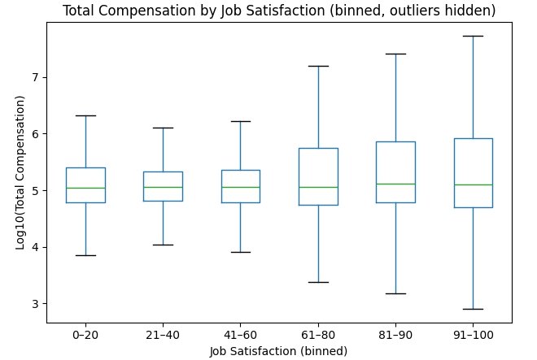
APPENDIX A – COMPENSATION VS JOB SATISFACTION
Median compensation shows a slight upward trend with higher job satisfaction, while salary variability increases at higher satisfaction levels.

Slide 19
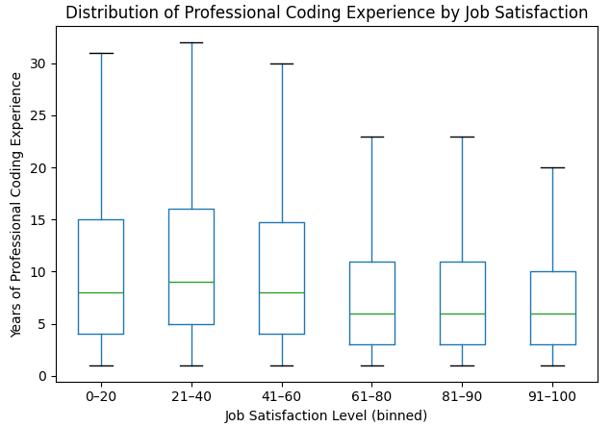
APPENDIX B – EXPERIENCE VS JOB SATISFACTION
Higher job satisfaction groups tend to have slightly fewer years of professional coding experience, with wider experience ranges at lower satisfaction levels.

Slide 20
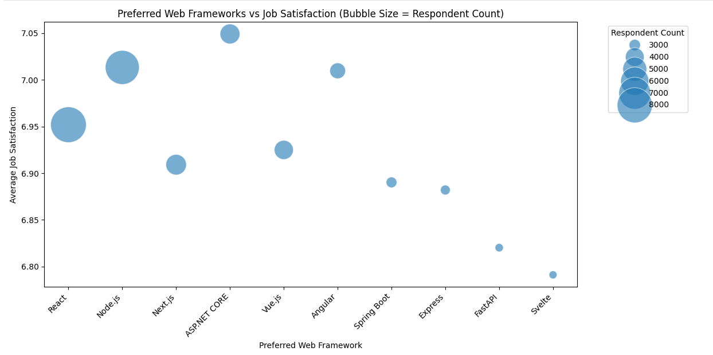
APPENDIX C – PREFERRED WEB FRAMEWORKS JOB SATISFACTION
The bubble plot shows that although some web frameworks are more popular than others, average job satisfaction remains relatively similar across framework preferences.

Slide 21
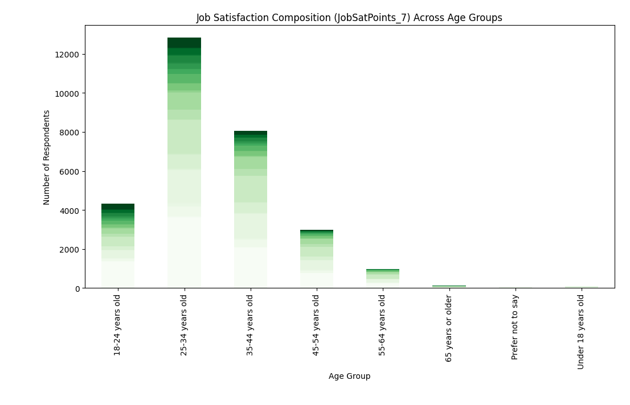
APPENDIX D – JOB SATISFACTION ACROSS AGE GROUPS
Job satisfaction is highest in volume among mid-career respondents, with comparable satisfaction distributions across age groups.

Slide 22
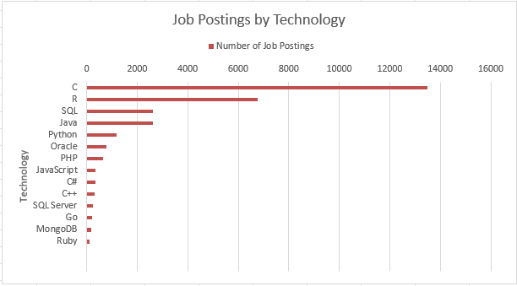
APPENDIX E – JOB POSTINGS

Slide 23
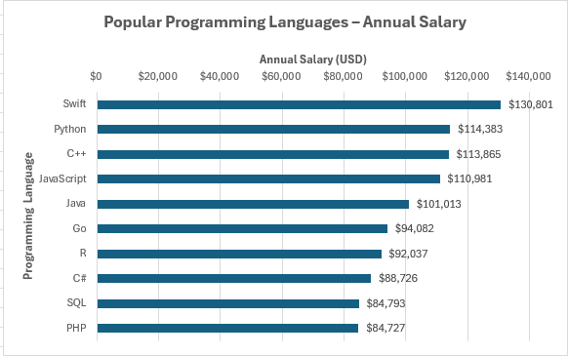
APPENDIX F – POPULAR LANGUAGES

