Slide 1
ODRL2.0: A Rights Expression Language and a Policy Language Tutorial: Rights and Licenses for Linked Data within the European Semantic Web Conference 2014 ESWC14
Víctor Rodríguez-Doncel
Ontology Engineering Group
Universidad Politécnica de Madrid (Spain)
Hersonissos (Greece)
2014.05.26

Slide 2
Contents
What is ODRL
ODRL2.0 Core Model
ODRL2.0 Common Vocabulary
ODRL2.0 Profiles
Advanced ODRL 2.0
Encodings
Examples
ODRL 2.0 for Linked Data

Slide 3

What is ODRL
ODRL: Open Digital Rights Language
ODRL1.1
ODRL created in 2000 as a Rights Expression Language, having in mind DRM (Digital Rights Management)
Among others, adopted by OMA (Open Mobile Alliance) for media content protection and management
XML language, consisting of Assets, Rights and Parties
ODRL2.0
Specification in April 2012
Currently a W3C Community Group
Adopted by the eBook and news industry
More focused on being a policy language
Specified as UML, serializations as XML, RDF (draft) and JSON (draft)

Slide 4
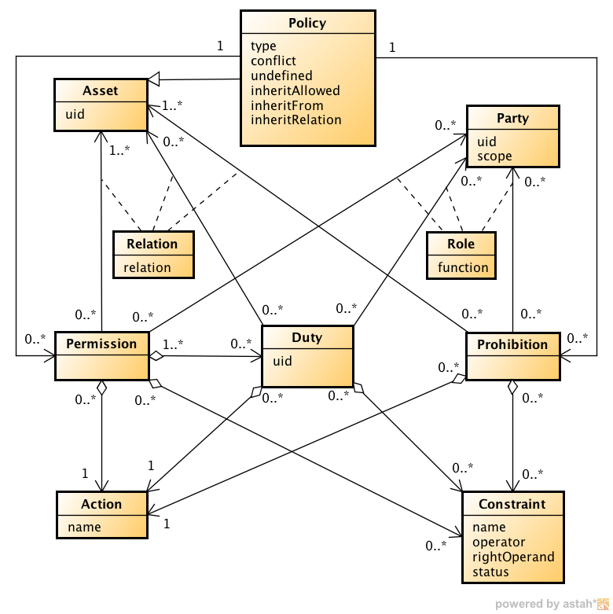
ODRL 2.0 Core Model
http://www.w3.org/community/odrl/two/model/
4

Slide 5
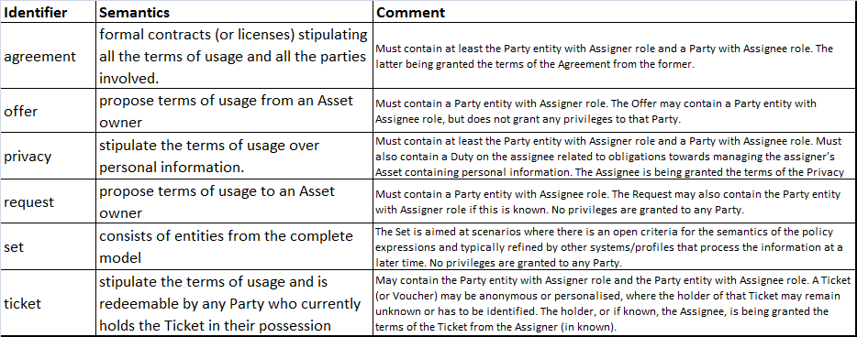
ODRL 2.0 Core Model
Types of policies

Slide 6
ODRL 2.0 Core Model
Main elements
A Policy contains Permissions and Prohibitions
Permissions and Prohibitions to act an Action, executed over an Asset by a Party
A Permission may imply Duties, and can be limited by Constraints
Constraints have a name (e.g. count), an operator (e.g. leq), a right operand (e.g. ‘5’) and possibly an status (e.g. ‘3’). The example reads: “The action may be exercised 5 times, and currently it has already been executed 3”

Slide 7
ODRL2.0 Common Vocabulary
Provides with common vocabulary
60 actions, to be used in permissions, prohibitions and duties:
copy, delete, modify, inform, pay, share…
30 constraints: language, count, dateTime, industry, media, spatial, etc.
A dozen of operators: eq, gt, isPartOf, isAnyOf, isAllOf, etc.
7 kinds of roles: assigner, assignee…
6 scopes for the roles: individual, all, group,
Asset/relation: target (asset upon which the action is performed), output

Slide 8
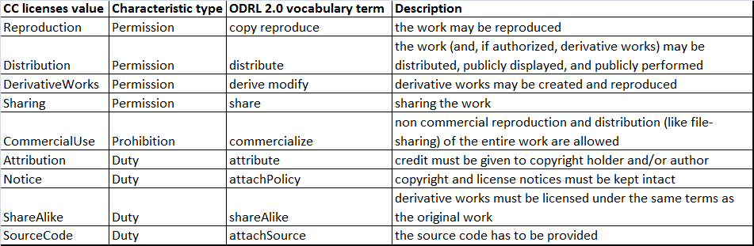
ODRL2.0 Profiles: CreativeCommons
CreativeCommons profile (draft)
It aims to express the core Creative Commons semantics in ODRL 2.0
http://www.w3.org/community/odrl/work/cc/

Slide 9

ODRL2.0 Profiles: RightsML
RightsML 1.1 profile
IPTC: International Press Telecommunications Council
RightsML is IPTC’s Rights Expression Language for the media industry, based on ODRL
It does not add any features to the Core Model.
A subset of ODRL Common Vocabulary terms is recommended, some terms are redefined
Core
Profile
Vocab
http://www.iptc.org/std/RightsML/1.1/RightsML_1.1EP2-spec_1.pdf

Slide 10
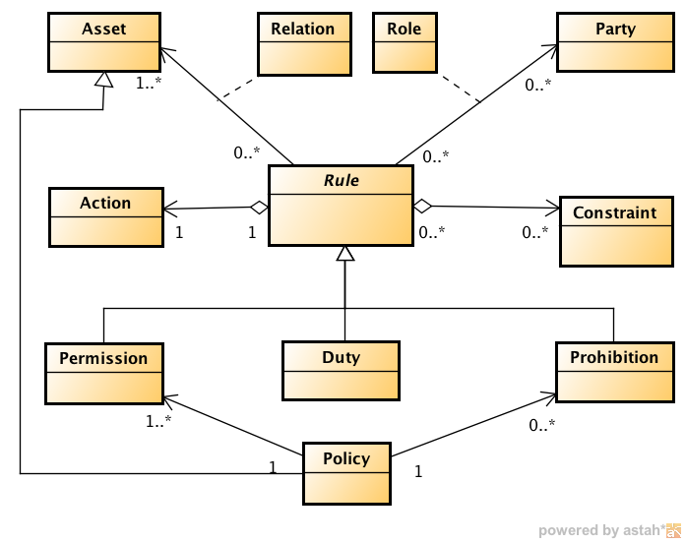
Advanced ODRL2.0 (informative)
Boolean operators
Extended Relations may tie Permission, Prohibition, Duty, and Constraint entities together with an AND, OR or XOR relationship.
Rule as an abstraction
Superclass Permission, Prohibition and Duty

Slide 11
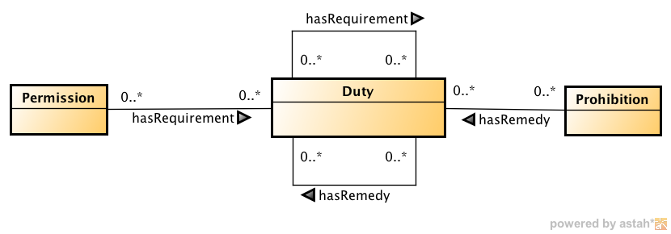
Advanced ODRL2.0
Conflict management
The precedence between policies can be declared
Default handling of policies
Inheritance in policies:
Policies can be inherited
Subsequent policies can be defined (nextPolicy)
Useful to impose restrictions on re-distribution
Remedies (informative)

Slide 12
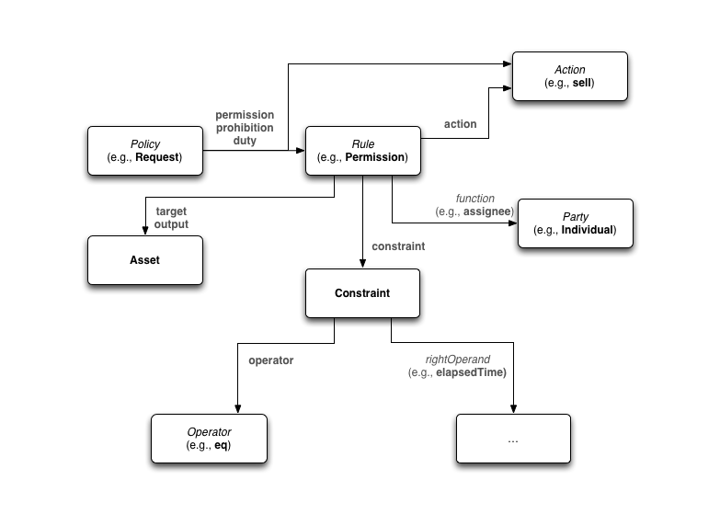
ODRL2.0 Encodings
XML encoding
The only finished specification
JSON encoding
Suitable to be embedded in XMP
RDF encoding
Based on the ODRL Ontology

Slide 13
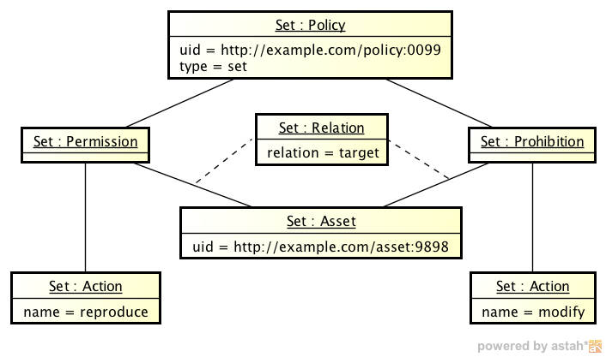
Examples
A first example of ODRL RDF policy
@base <http://example.com/> .
@prefix odrl: <http://w3.org/ns/odrl/2/> .
@prefix dct: <http://purl.org/dc/terms/> .
</asset:9898> dct:license </policy:0099> .
</policy:0099>
a odrl:Set;
odrl:permission odrl:reproduce ;
odrl:prohibition odrl:modify .
The Dublin Core license element can introduce the poliy
The Set element asserts the permissions and prohibitions
Equivalent, verbose version
</policy:0099>
a odrl:Set;
odrl:permission [
a odrl:Permission ;
odrl:target </asset:9898> ;
odrl:action odrl:reproduce
] ;
odrl:prohibition [
a odrl:Prohibition ;
odrl:target </asset:9898> ;
odrl:action odrl:modify
] .
In the absence of assignee, it means “all”

Slide 14
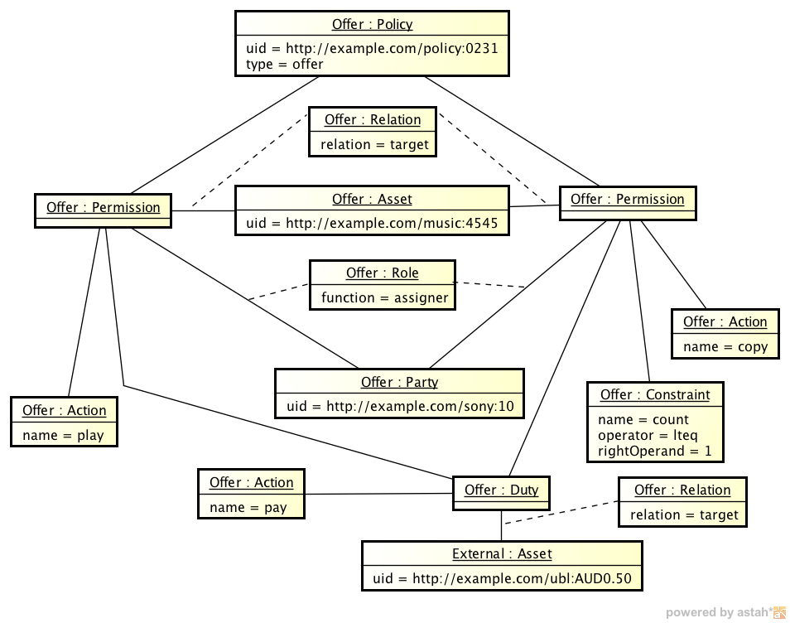
Examples
Example of Offer
</policy:0231>
a odrl:Offer ;
odrl:permission [
a odrl:Permission ;
odrl:target </music:4545> ;
odrl:assigner </sony:10> ;
odrl:action odrl:play ;
odrl:duty _:requirements
] ;
odrl:permission [
a odrl:Permission ;
odrl:target </music:4545> ;
odrl:assigner </sony:10> ;
odrl:action odrl:copy ;
odrl:duty _:requirements ;
odrl:constraint [
a odrl:Constraint ;
odrl:count 1 ;
odrl:operator odrl:lteq
]
] .
_:requirements
a odrl:Duty ;
odrl:action odrl:pay ;
odrl:target </ubl:AUD0.50> .
</sony:10> a odrl:Party .
The offer is personalized
Payment

Slide 15
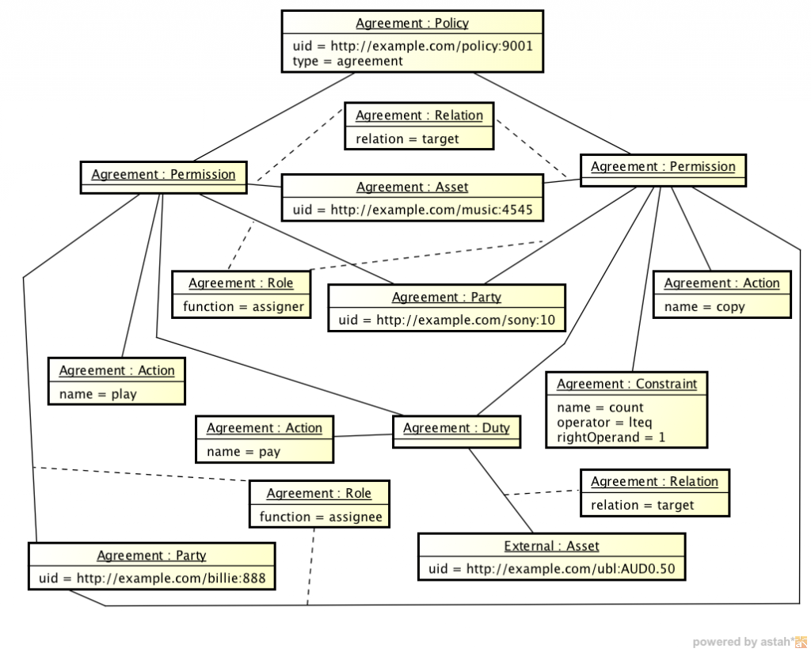
Examples
Example of agreement
</policy:9001>
a odrl:Agreement ;
odrl:permission [
a odrl:Permission ;
odrl:target </music:4545> ;
odrl:assigner </sony:10> ;
odrl:assignee </billie:888> ;
odrl:action odrl:play ;
odrl:duty _:requirements
] ;
odrl:permission [
odrl:target </music:4545> ;
odrl:assigner </sony:10> ;
odrl:assignee </billie:888> ;
odrl:action odrl:copy ;
odrl:duty _:requirements ;
odrl:constraint [
a odrl:Constraint ;
odrl:count 1 ;
odrl:operator odrl:lteq
]
] .
_:requirements
a odrl:Duty ;
odrl:action odrl:pay ;
odrl:target </ubl:AUD0.50> .
</sony:10> a odrl:Party .
</billie:888> a odrl:Party .
Multiple constraints are understood as “all of them must be satisfied”

Slide 16
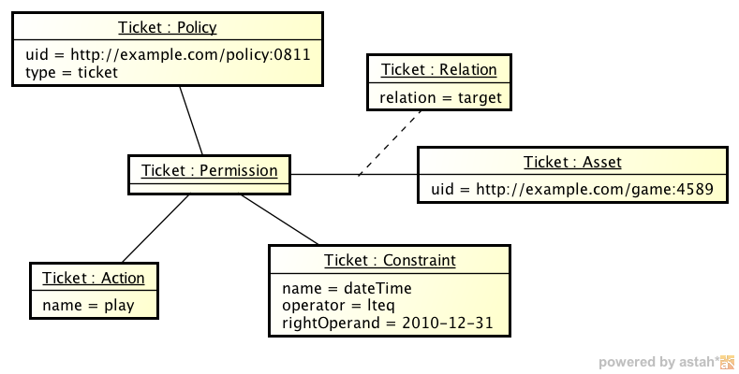
Examples
Example of ticket
A ticket is a token: expresses the play permission for the target asset; any valid holder of this ticket may exercise this permission before the end of the year.
@base <http://example.com/> .
@prefix odrl: <http://w3.org/ns/odrl/2/> .
@prefix xsd: <http://www.w3.org/2001/XMLSchema#> .
</policy:0811>
a odrl:Ticket ;
odrl:permission [
a odrl:Permission ;
odrl:action odrl:play ;
odrl:target </game:4589> ;
odrl:constraint [
a odrl:Constraint ;
odrl:operator odrl:lteq ;
odrl:dateTime "2014-12-31"^^xsd:date
]
] .

Slide 17
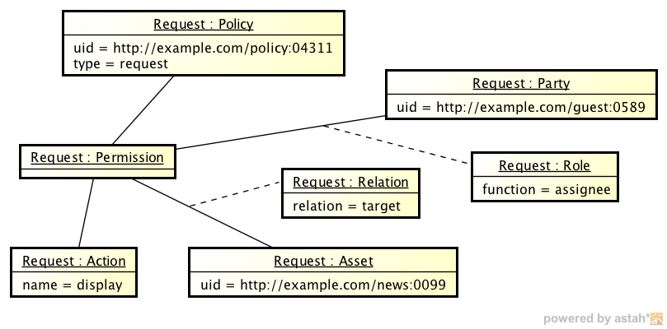
Examples
Example of request
The Party has requested the Permission to display the target Asset
@base <http://example.com/> .
@prefix odrl: <http://w3.org/ns/odrl/2/> .
</policy:04311>
a odrl:Request ;
odrl:permission [
a odrl:Permission ;
odrl:action odrl:display ;
odrl:assignee </guest:0589> ;
odrl:target </news:0099>
] .
</guest:0589> a odrl:Party .
Notes:
Yet, there is nothing like the XACML PDP

Slide 18
ODRL 2.0 for Linked Data
ODRL 2.0 policies can be used to govern access to Linked Data
Example of access to Linked Data for a price (15EUR for the dataset or 0.01EUR for a triple thereof)
@prefix gr: <http://purl.org/goodrelations/> .
@prefix dcat: <http://www.w3.org/ns/dcat#> .
<http://salonica.dia.fi.upm.es/ldr/policy/cdaddba4-fc2e-4ee0-a784-e62f1db259bf>
a odrl:Set ;
rdfs:label "License Offering Paid Linked Data" ;
odrl:permission [ a odrl:Permission ;
odrl:target <http://example.org/dataset/ds01> ;
odrl:action odrl:reproduce ;
odrl:duty [ a odrl:Duty ;
rdfs:label "Pay" ;
gr:UnitOfMeasurement dcat:Dataset ;
gr:amountOfThisGood "1" ;
odrl:action odrl:pay ;
odrl:target "15,00 EUR"
]
] , [ a odrl:Permission ;
odrl:action odrl:reproduce ;
odrl:target <http://example.org/dataset/ds01> ;
odrl:duty [ a odrl:Duty ;
rdfs:label "Pay" ;
gr:UnitOfMeasurement rdf:Statement ;
gr:amountOfThisGood "1" ;
odrl:action odrl:pay ;
odrl:target "0,01 EUR"
]
] ..
The target can be an ontology, a dataset, a SPARQL endpoint…
…or a SPARQL query itself or a triple pattern: {mysubject, ?p , ?o}
Tutorial in the next door: Schema.org & GoodRelations The Web of Data for E-Commerce for Researchers and Practitioners

Slide 19
ODRL 2.0 for Linked Data
Resources can be provided with provenance and flexible licenses. For example,
specifying availability only for research institutions of a territory.
@prefix rdf: <http://www.w3.org/1999/02/22-rdf-syntax-ns#> .
@prefix rdfs: <http://www.w3.org/2000/01/rdf-schema#> .
@prefix dcat: <http://www.w3.org/ns/dcat#> .
@prefix dct: <http://purl.org/dc/terms/> .
@prefix odrl: <http://www.w3.org/ns/odrl/2/> .
@prefix prov: <http://www.w3.org/ns/prov#> .
<http://example-lr.com> a dcat:Dataset ;
dct:license [ a odrl:Policy;
rdfs:comment “Gives access to the resource to Spanish research institutions.
Redistributing or transforming the work is forbidden” ;
odrl:permission [ a odrl:Permission;
odrl:action odrl:reproduce;
odrl:constraint [ a odrl:Constraint;
odrl:industry “Research”
],
[ a odrl:Constraint;
odrl:location “ES”
}
] ;
odrl:prohibition [ a odrl:Prohibition;
odrl:action odrl:derive, odrl:distribute
] ;
];
prov:wasGeneratedBy [
prov:endedAtTime "Thu Apr 03 00:07:07 CEST2014"^^xsd:date ;
prov:wasAssociatedWith “http://lr-provider.com"
] .
Provenance information together with licenses and digital signature provides a strong mechanism of TRUST
Notes:
This license has been slightly simplified due to space reasonsodrl:operator odrl:lteq should be present in the constraints.

Slide 20
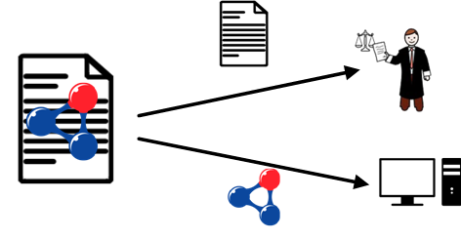
ODRL: rights and policies language

Slide 21
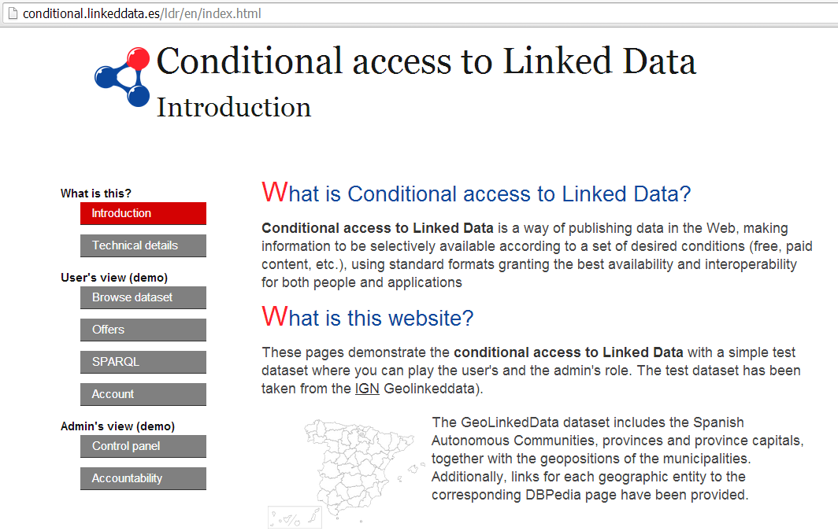
ODRL to conditionally serve Linked Data
One example of ODRL being used to conditionally grant access to Linked Data
http://conditional.linkeddata.es/

Slide 22
ODRL2.0: A Rights Expression Language and a Policy Language Tutorial: Rights and Licenses for Linked Data within the European Semantic Web Conference 2014 ESWC14
Víctor Rodríguez-Doncel
Ontology Engineering Group
Universidad Politécnica de Madrid (Spain)
Hersonissos (Greece)
2014.05.26

Slide 23
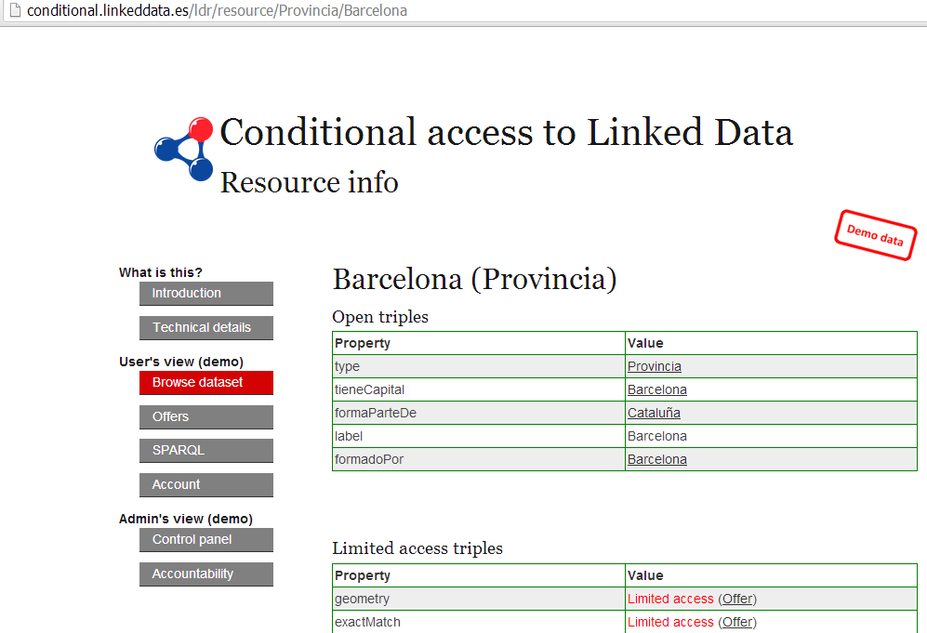
ODRL to conditionally serve Linked Data

Slide 24
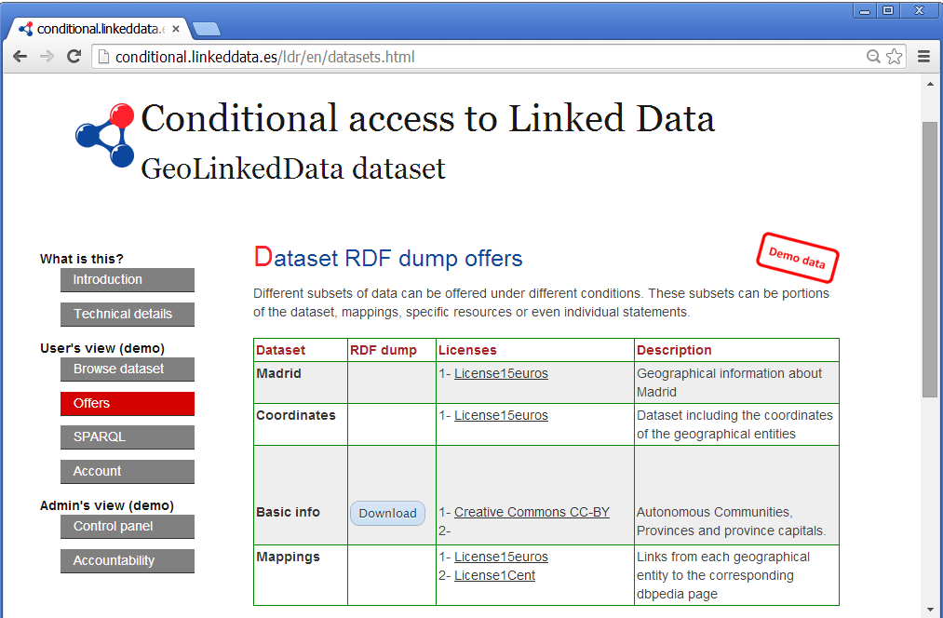

Slide 25
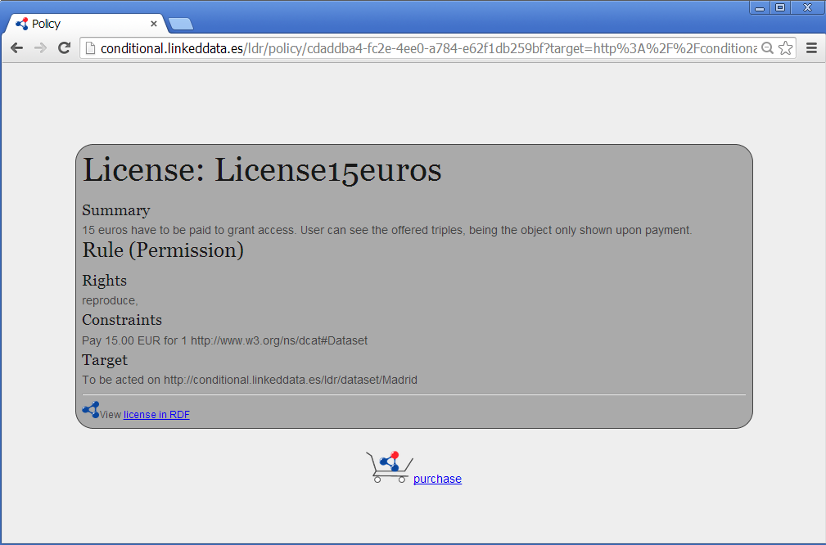
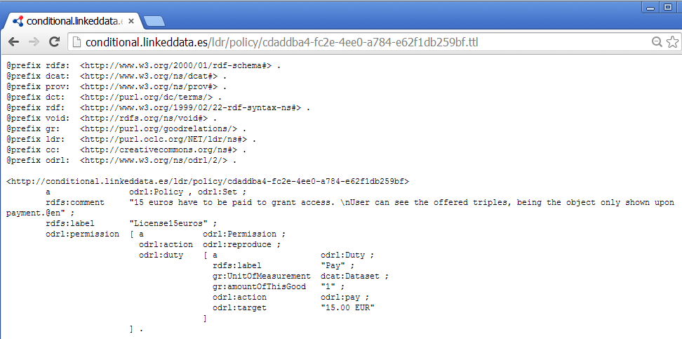

Slide 26
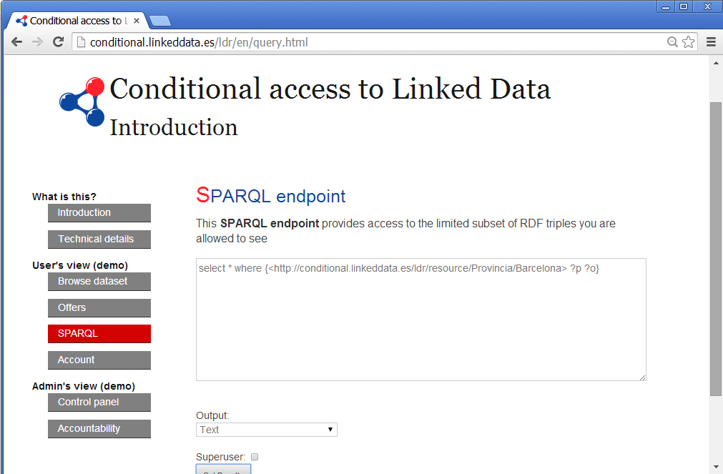
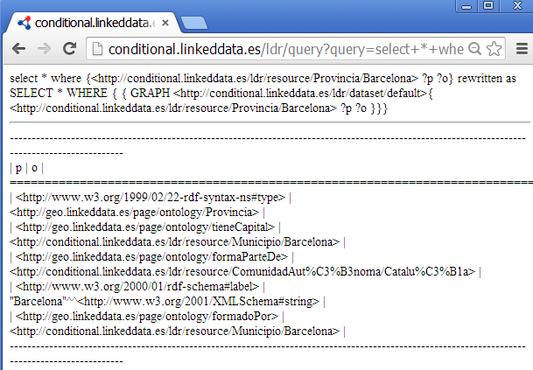

Slide 27
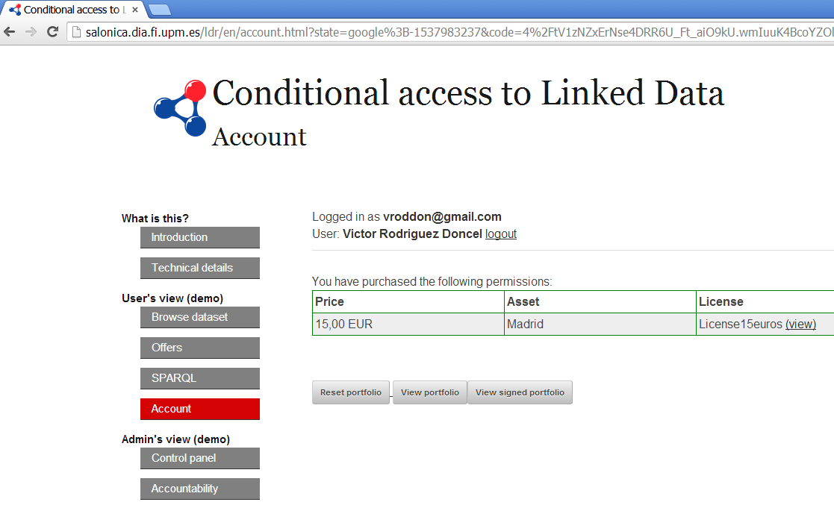

Slide 28
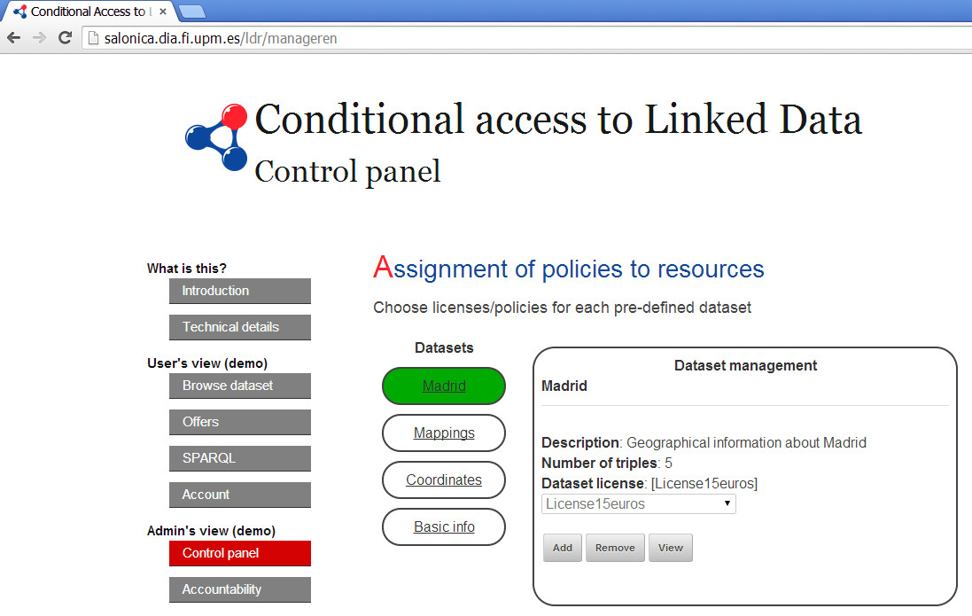

Slide 29

/
Notes:
http://licensius.com/
http://delicias.dia.fi.upm.es/~vrodriguez

