Slide 1


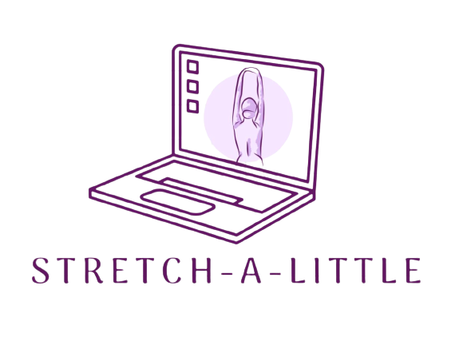
Take a break from your computer
Members –
Rishita Danduga
Keerthi Ramidi
Mythreye Pasula
Sangeetha Chelikani
Kuan-Ju Chen
By Team Bulls

Slide 2
Existing Problem
In today’s era, people are mostly stuck to computers for education, work, gaming or any other purposes
Prolonged hours of sitting especially near a computer can lead to many health issues like muscle tension, reduced physical activity, etc.
Many health trackers/reminders exist in the market, but they usually lack what the users want – customization, awareness, user-friendly interfaces (this is based on our user interviews)
The current applications want the users to cater to its design rather than the application catering to the users needs

Slide 3
Importance
It is important to prompt the users to take breaks based on their preferences
Prompting the users to take a break is essential to enhance the over-all health, well-being and productivity of people who regularly use the computers
It is important to maintain a balance between screen time and physical activity by ultimately contributing to their overall mental and physical well-being
It is also important that people stretch frequently to help improve their physical activity and stay fit

Slide 4
SOLUTION
Our solution, Stretch-a-Little, includes what the users want and few other features we deemed would be necessary based on our research
Our solution is a desktop application, as the users wanted to see prompts on the systems they are using rather than on an additional device
The users will have to sign up, setup their custom settings (standing goals) to be notified. Once logged in, they will be receiving the notifications accordingly
They also get to see some basic quick stretches to perform on the home screen
They are also given an option to opt-in/out to see any articles related to stretches or health related articles
Another unique feature in our application is to opt-in for voice prompts
By including what the users want, we aim to achieve less user frustration and more health benefits to the users

Slide 5
End-Users
Our desktop application’s target users are anyone with prolonged computer usage
The end users are diverse and could include:
Office workers: Spend a significant time in office working on computers
Students: High school/college students involved in extensive computer-based education
Gamers: Who play video games for a prolonged time on computers
Remote workers/Freelancers: Who work from home and rely heavily on computers professionally
People with sedentary lifestyles: Spend a lot of time on computers for personal and leisure activities

Slide 6
Prototype
We used FIGMA to come up with our high-fidelity protype
We included the features the users would like to see in our prototype
A glimpse on our application

Slide 7
THANK YOU

