Slide 1

Distributed Dataset Statistics using MPI
Parallel Computing Lab — Evaluation 1
Parallel Model: MPI
ROLL NO. | NAME | USN
167 | MYTHRI GADED | 01FE24BCI031
165 | AKSHATA PATIL | 01FE24BCI088
5TH SEMESTER
PGC - PARALLEL AND GPU COMPUTING
GUIDE : SHRUSHTI GANI

Slide 2
CHECKPOINT 1: PROBLEM + ALGORITHM + DESIGN
Problem Definition:
Calculate sum, average, maximum and minimum of a dataset
using parallel processing with MPI.
Sequential Approach
Generate dataset
Calculate sum
Calculate average
Find maximum
Find minimum
Display results
08-10-2026
Department of Computer Science and Engineering

Slide 3
MPI Parallel Design
Dataset
↓
MPI_Scatter()
↓
Process 0 | Process 1 | Process 2 | Process 3
↓ ↓ ↓ ↓
Local Statistics
↓
MPI_Reduce()
↓
Global Statistics
Key MPI functions
MPI_Init() → MPI_Scatter() → Local computation → MPI_Reduce() → MPI_Finalize()
08-10-2026
Department of Computer Science and Engineering

Slide 4
#include <mpi.h>
#include <iostream>
#include <vector>
#include <algorithm>
#include <numeric>
#include <cstdlib>
using namespace std;
int main(int argc, char* argv[]) {
// Start MPI
MPI_Init(&argc, &argv);
// Get process ID and total number of processes
int rank, size;
MPI_Comm_rank(MPI_COMM_WORLD, &rank);
MPI_Comm_size(MPI_COMM_WORLD, &size);
// Start execution timer
double start_time = MPI_Wtime();
// Dataset size
int n = 1000;
// Allow dataset size to be given from command line
if (argc > 1) {
n = atoi(argv[1]);
}
// Create dataset
vector<int> data(n);
// Fill dataset with values from 1 to 100 repeatedly
for (int i = 0; i < n; i++) {
data[i] = (i % 100) + 1;
}
ADD MPI CPP CODE
08-10-2026
Department of Computer Science and Engineering

Slide 5
CHECKPOINT 2: IMPLEMENTATION
Working Parallel Implementation
Language: C++
Parallel Model: MPI
MPI: Open MPI
Important implementation
MPI_Comm_rank(MPI_COMM_WORLD, &rank);
MPI_Comm_size(MPI_COMM_WORLD, &size);
MPI_Scatter(...);
MPI_Reduce(..., MPI_SUM, ...);
MPI_Reduce(..., MPI_MAX, ...);
MPI_Reduce(..., MPI_MIN, ...);
Compilation:
mpic++ mpi_statistics.cpp -o mpi_statistics
Execution:
mpirun -np 4 ./mpi_statistics 100000
08-10-2026
Department of Computer Science and Engineering

Slide 6
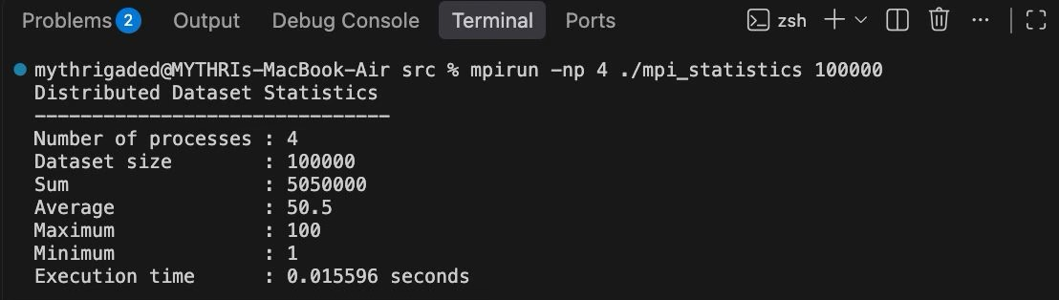
CHECKPOINT 2: WORKING OUTPUT
MPI Execution — 4 Processes
Dataset:
100,000 elements
Result Verification
Statistic | Result
Sum | 50,50,000
Average | 50.5
Maximum | 100
Minimum | 1
08-10-2026
Department of Computer Science and Engineering

Slide 7
CHECKPOINT 3: EXPERIMENTS
Experiments Performed
We tested:
Different dataset sizes
1,000
10,000
100,000
Different MPI process counts
1 process
2 processes
4 processes
8 processes
mpirun -np 1 ./mpi_statistics 100000
mpirun -np 2 ./mpi_statistics 100000
mpirun -np 4 ./mpi_statistics 100000
mpirun -np 8 ./mpi_statistics 100000
08-10-2026
Department of Computer Science and Engineering

Slide 8
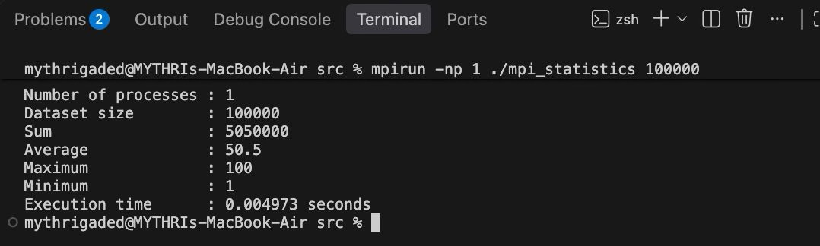
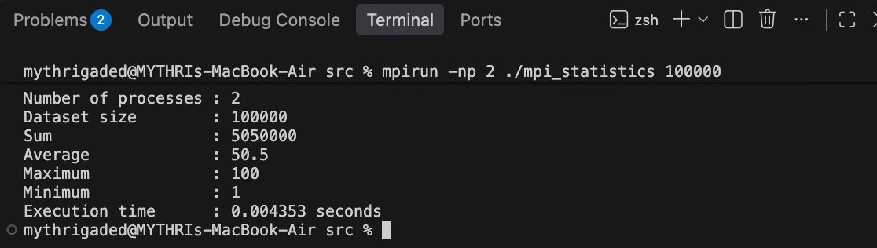
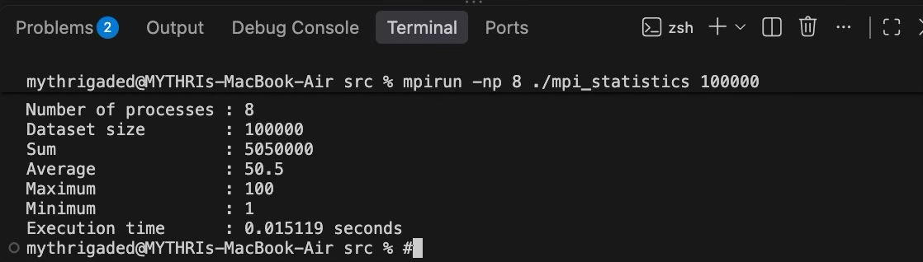
08-10-2026
Department of Computer Science and Engineering

Slide 9
CHECKPOINT 3 + RESULTS TABLE
Performance Data Collected
For 100,000 elements:
Configuration | Processes | Execution Time
Sequential | — | 0.00346217 s
MPI | 1 | 0.004973 s
MPI | 2 | 0.004275 s
MPI | 4 | 0.015596 s
MPI | 8 | 0.015119 s
Timing Method :
Sequential:
high_resolution_clock::now()
MPI:
MPI_Wtime()
08-10-2026
Department of Computer Science and Engineering

Slide 10
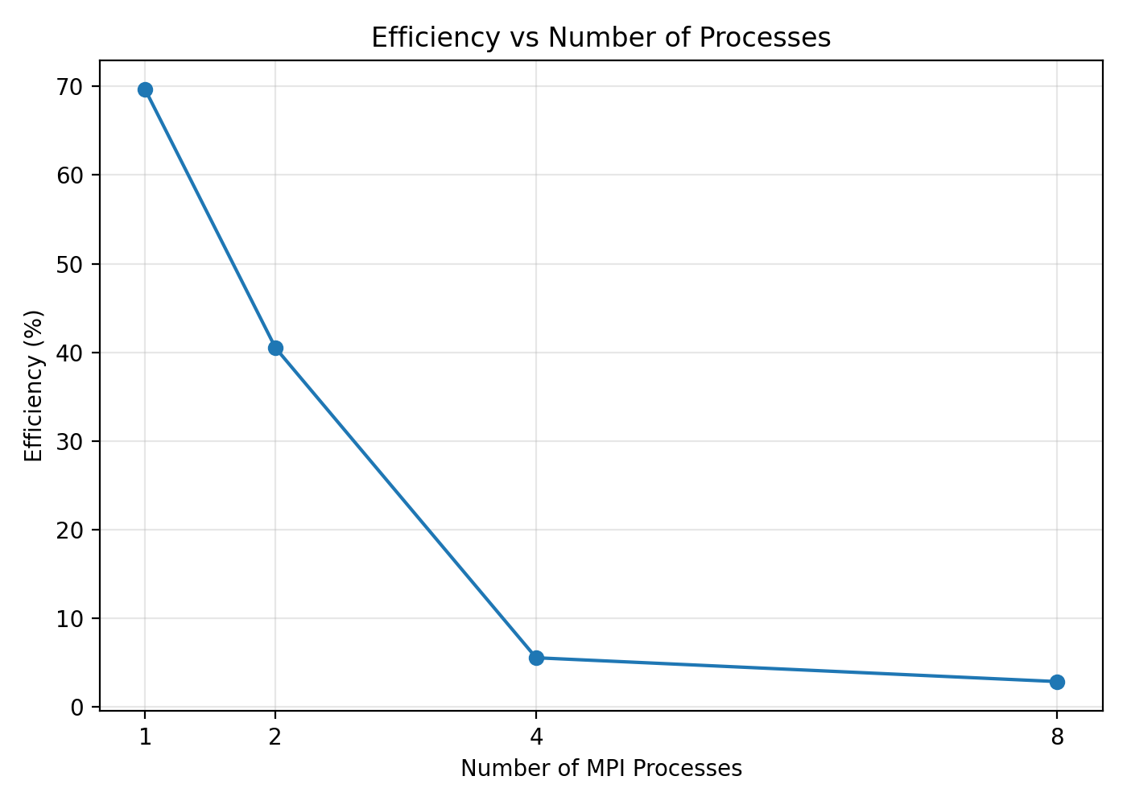
CHECKPOINT 4: GRAPHS
08-10-2026
Department of Computer Science and Engineering

Slide 11
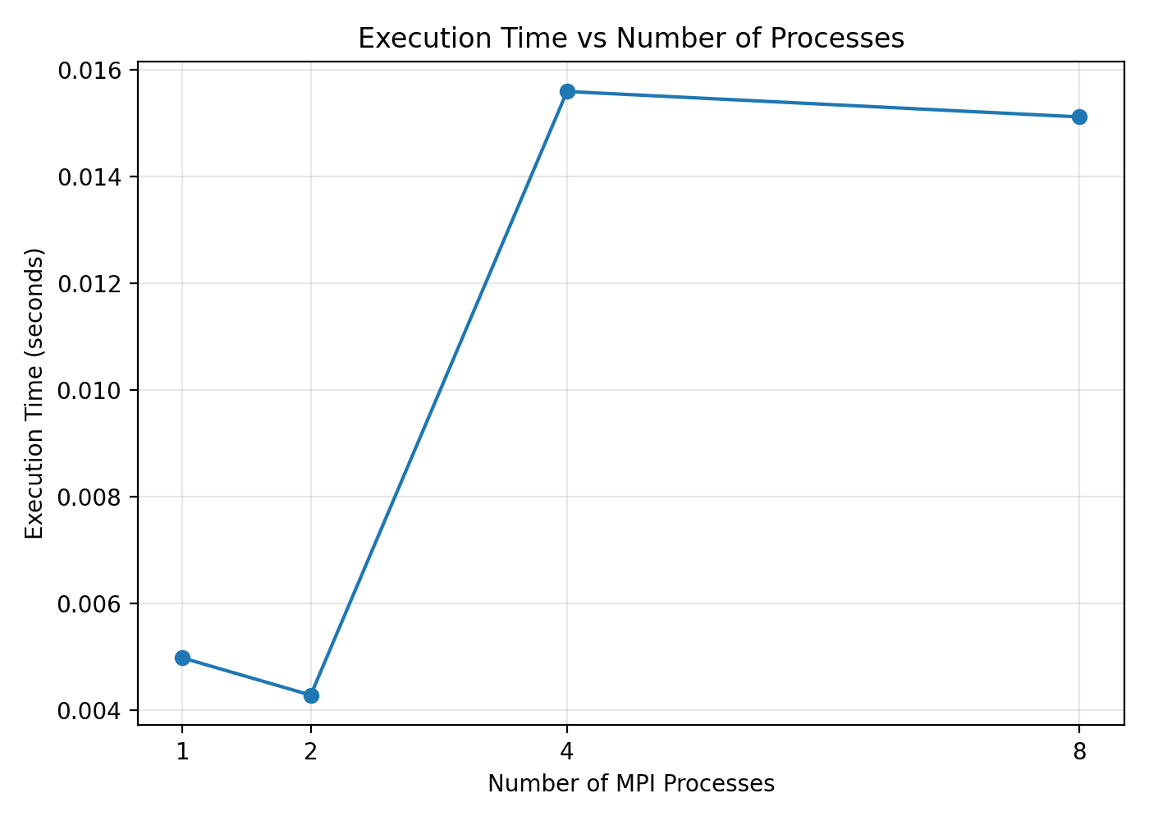
08-10-2026
Department of Computer Science and Engineering

Slide 12
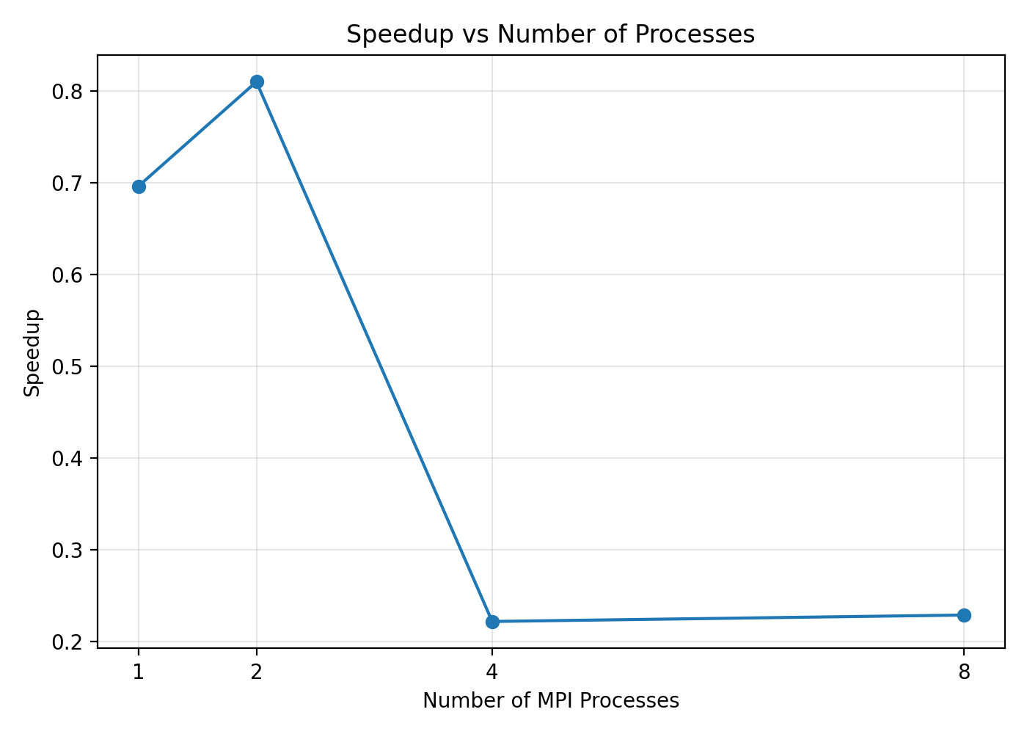
08-10-2026
Department of Computer Science and Engineering

Slide 13
CHECKPOINT 4: ANALYSIS
Processes | Speedup | Efficiency
1 | 0.6962 | 69.62%
2 | 0.8099 | 40.49%
4 | 0.2220 | 5.55%
8 | 0.2290 | 2.86%
Observations
Sequential execution was faster for this experiment.
MPI did not achieve speedup over sequential execution.
Increasing the number of processes did not continuously reduce execution time.
Efficiency decreased as process count increased.
MPI communication and process-management overhead affected performance.
The experiment was executed locally on one machine.
08-10-2026
Department of Computer Science and Engineering

Slide 14
CHECKPOINT 5: DEMONSTRATION
Final Demonstration
mpirun -np 4 ./mpi_statistics 100000
Expected result
Sum : 5050000
Average : 50.5
Maximum : 100
Minimum : 1
Demonstration proves:
✅ MPI program compiles and runs
✅ Multiple processes are created
✅ Dataset is distributed
✅ Local statistics are calculated
✅ Results are reduced
✅ Final statistics are correct
✅ Execution time is measured
CONCLUSION:
Successfully implemented and evaluated distributed dataset statistics using MPI, tested multiple process configurations, measured execution time, speedup and efficiency, and analyzed the performance.
08-10-2026
Department of Computer Science and Engineering

Slide 15
THANK YOU
08-10-2026
Department of Computer Science and Engineering

