Slide 1
UNIT-IV: Data Visualization: Introduction, Types of data visualization, Data for visualization: , Data encodings, Retinal variables, mapping variables to encodings, Visual encodings

Slide 2
Introduction
Data Visualization is defined as the pictorial representation of the data to provide the fact based analysis to decision-makers.
Typically text data might not be able to reveal the pattern or trends needed to recognize data.
In the digital age, data visualization is an essential tool for making complex data understandable, actionable, and accessible.
Whether you’re a marketer, data scientist, or business analyst, understanding the different types of data visualizations can help you tell compelling data stories and make informed decisions.

Slide 3
What is Data Visualization?
Data visualization refers to the graphical representation of information and data.
Using visual elements like charts, graphs, and maps, it provides an accessible way to see and understand patterns, trends, and outliers.

Slide 4
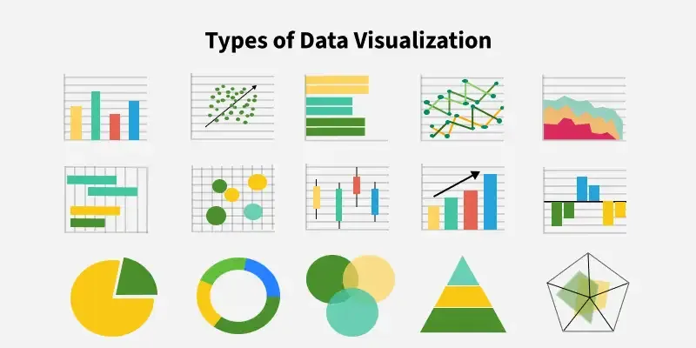

Slide 5
Why Data Visualization is Important
Simplifies complex data: Allows non-technical audiences to understand.
Enhances decision-making: Helps stakeholders make informed decisions quickly.
Highlights insights: Makes it easier to spot trends and outliers

Slide 6
Types of data visualization
Data visualization is broadly classified into different types.
They are:
Temporal
Hierarchical
Network
Multidimensional

Slide 7
Types of data visualization
Data visualization is broadly classified into different types.
They are:
Temporal:
Temporal visualizations are used for data that has a time component and is linear.
Purpose: Best suited for showing trends or patterns over time.
Example Use Cases: Stock prices, sales data, temperature over time.
Common Types of Temporal Visualizations:
Scatter Plots: Dots represent individual data points.
Pie Charts: Circular charts where each sector’s arc represents a percentage.
Line Graphs: Data points connected by lines to show trends over time.

Slide 8
Cont..
Scatter Plot:
A scatter plot uses dots to represent individual data points. It shows the relationship between two variables, with one variable on the x-axis and the other on the y-axis. It is commonly used to visualize correlations or patterns in data.
Pie Chart:
A pie chart is a circular statistical graphic divided into slices to illustrate numerical proportions. Each slice's size is proportional to the percentage or value it represents, making it useful for showing the relative size of categories.
Line Graph:
A line graph uses points connected by lines to represent data. It is often used to visualize trends over time or continuous data, helping to identify patterns, increases, or decreases.

Slide 9
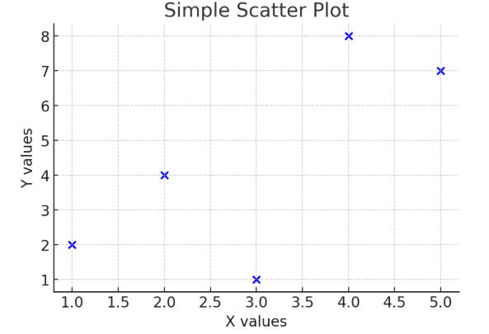
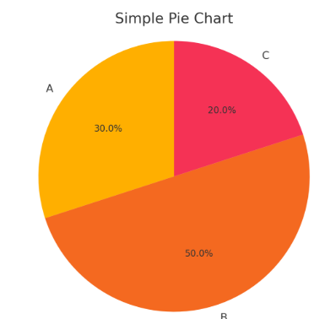
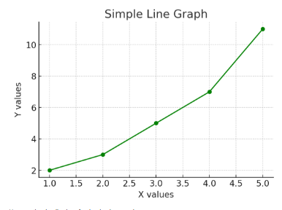
Here are the visualizations for the simple examples:
Scatter Plot: Plots five points with (x, y) values of (1,2), (2,4), (3,1), (4,8), and (5,7).
Pie Chart: Shows three categories (A, B, and C) with percentages of 30%, 50%, and 20%.
Line Graph: Displays a line connecting five points with (x, y) values of (1,2), (2,3), (3,5), (4,7), and (5,11).

Slide 10
Cont..
II. Hierarchical: Represents data that is structured in a tree-like format, showing relationships within a hierarchy.
Purpose: Best for visualizing data with parent-child relationships or classifications.
Example Use Cases: Organization charts, file directories, and taxonomy data.
Common Types of Hierarchical Visualizations:
1.Tree Diagrams: Displays data starting from a single point and branching out like a tree.
Purpose: It is commonly used to represent family trees, organizational structures, and decision-making processes
Tree Maps: Represents hierarchical data using rectangles. The size of the rectangles reflects the value.
Purpose: It is used for visualizing large datasets like sales figures, population distribution, or storage usage

Slide 11
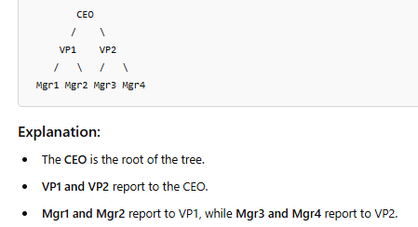
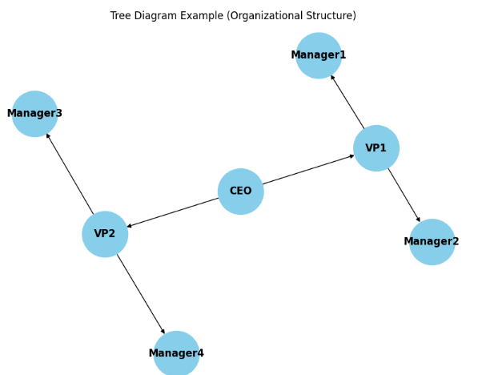
Tree Diagram

Slide 12
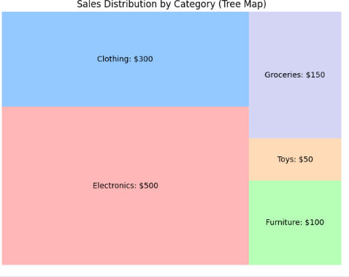
Tree Map
Let's consider sales data for five product categories:
Electronics: $500
Clothing: $300
Furniture: $100
Toys: $50
Groceries: $150

Slide 13
Cont..
III. Network: Shows the relationships between different datasets using nodes and connections.
Purpose: Best for visualizing interconnected data points.
Example Use Cases: Social network analysis, web analytics, and supply chain connections.
Common Types of Network Visualizations:
Matrix Charts: Displays relationships between data points using grids or matrices.
A matrix chart uses a grid format to show relationships between different variables. The values in the cells can represent correlations, frequencies, or other quantitative metrics.
Purpose: often used for correlation matrices, confusion matrices in classification models, or risk assessment.
Example: A Correlation Matrix for variables like Age, Income, and Spending Score.

Slide 14
correlation matrix
A correlation matrix is a table that shows the correlation coefficients between many variables. Each cell in the table displays the correlation between two variables. The values in the matrix range from -1 to +1.
+1: Perfect positive correlation — as one variable increases, the other variable also increases in exact proportion.
-1: Perfect negative correlation — as one variable increases, the other decreases in exact proportion.
0: No correlation — no predictable relationship exists between the variables.
The diagonal of a correlation matrix always contains 1s, because each variable is perfectly correlated with itself.

Slide 15
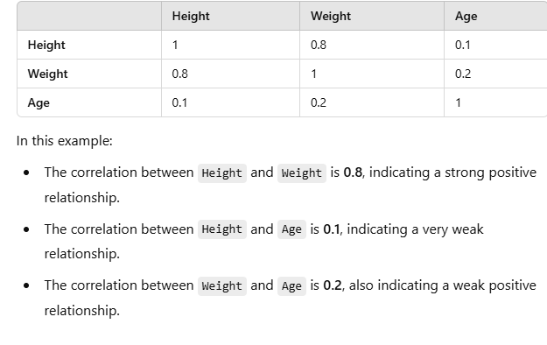
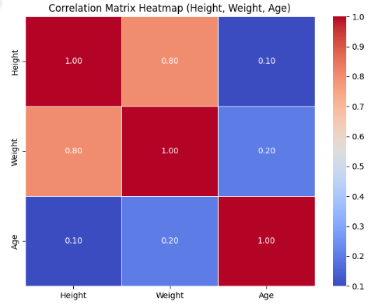
Example of a Correlation Matrix:
Imagine we have a dataset with 3 variables: Height, Weight, and Age

Slide 16
heatmap
A heatmap is a data visualization technique that uses colors to represent different values in a two-dimensional matrix.
It is a two-dimensional visualization of data that uses color to represent numerical values.
It is particularly useful for visualizing large amounts of data and identifying patterns, correlations, or anomalies in data.
The intensity of the color corresponds to the magnitude of the values.

Slide 17
Cont..
2.Word Clouds: Visual representation of text data where the size of each word indicates its frequency.
A word cloud visualizes text data where frequently occurring words appear larger and bolder.
Purpose: Useful for analyzing sentiment in customer reviews, social media analysis, or feedback data.
Example: Analyzing product reviews, words like "Good," "Excellent," or "Expensive" may appear larger depending on their frequency.

Slide 18
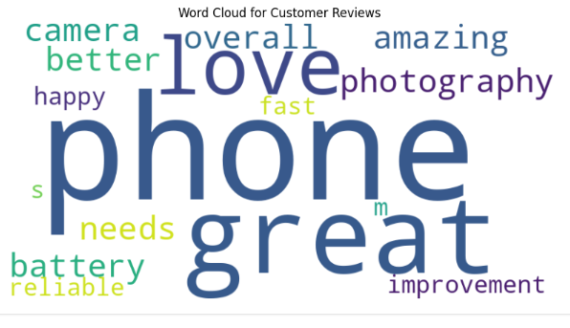
Example Use Case:
Suppose you have a dataset of customer reviews or product feedback, and you want to visualize the most frequently mentioned words. The word cloud will highlight these frequent terms, giving you a sense of which topics are most important or discussed.
Example Data (Customer Reviews):
Let's consider a list of customer reviews:
"I love this phone. It's great for photography."
"The phone is amazing, but the battery could be better."
"Great phone overall, but the camera needs improvement."
"I’m very happy with this phone. It’s fast and reliable.“
Word Cloud Visualization:
We'll generate a word cloud for the sample reviews to see which words appear most frequently.
A Word Cloud is a popular visualization used to represent text data. Words are displayed in various sizes, with the size of each word corresponding to its frequency or importance in the text. Words that appear more frequently are larger, while those that appear less frequently are smaller

Slide 19
Cont..
IV. Multidimensional: Used to visualize data with multiple variables (2 or more dimensions).
Purpose: Useful for analyzing relationships between different variables in complex datasets.
Example Use Cases: Customer segmentation, scientific analysis, and financial modeling.
Common Types of Multidimensional Visualizations:
Scatter Plots: Used for plotting relationships between two variables.
Stacked Bar Graphs: Bar segments are stacked to show part-to-whole relationships. It is useful for visualizing multi-category comparisons across different groups.

Slide 20
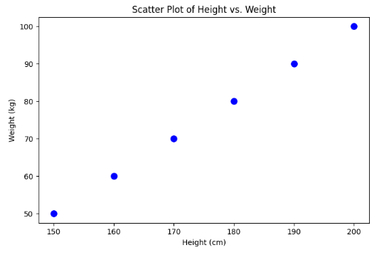
1. Scatter Plot (Two-Dimensional Example)
A scatter plot is used to visualize relationships between two continuous variables.
For example, let's plot Height vs. Weight for a group of individuals.
height = [150, 160, 170, 180, 190, 200]
weight = [50, 60, 70, 80, 90, 100]

Slide 21
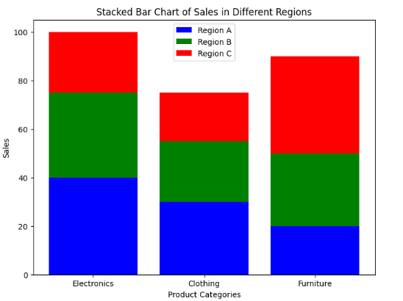
2. Stacked Bar Graph (Three-Dimensional Example)
A stacked bar graph is useful for showing parts of a whole across multiple categories.
For example, let's visualize sales data for different products in different regions.
# Sample Data: Sales of Products in Different Regions
categories = ["Electronics", "Clothing", "Furniture"]
region_A = [40, 30, 20]
# Sales in Region A
region_B = [35, 25, 30]
# Sales in Region B
region_C = [25, 20, 40]
# Sales in Region C
Explanation:
Each bar represents a product category.
The colors within the bar show sales in different regions.
This helps compare the contribution of each region to total sales.

Slide 22
Cont..
V. Geospatial: Represents geographical data using maps.
Purpose: Best for visualizing location-based data.
Example Use Cases: Disease outbreak mapping, delivery route planning, and population density analysis.
Common Types of Geospatial Visualizations:
Flow Maps: Show movement of people, goods, or data from one location to another using arrows.
Choropleth Maps: Represent geographic regions shaded or colored based on a data variable.
Heat Maps: Display data density or intensity using color gradients

Slide 23
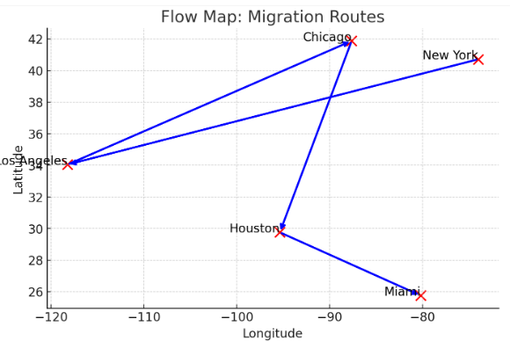
✅ 1. Flow Map: Migration Routes
A Flow Map shows movement between locations using arrows. Here’s an example of migration routes between major US cities.
Flow Map: Shows migration routes between major U.S. cities using arrows.

Slide 24
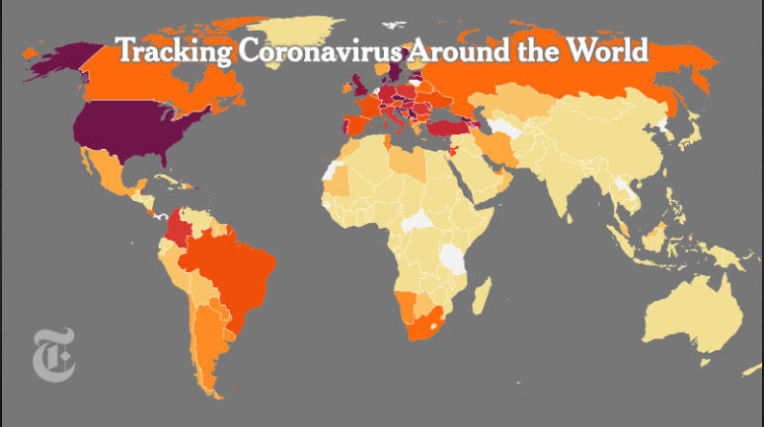
A choropleth map is a map that is shaded according to a range of values presented in a key.
Choropleth maps are popular thematic maps used to represent statistical data through various shading patterns or symbols on predetermined geographic areas (i.e. countries).

Slide 25
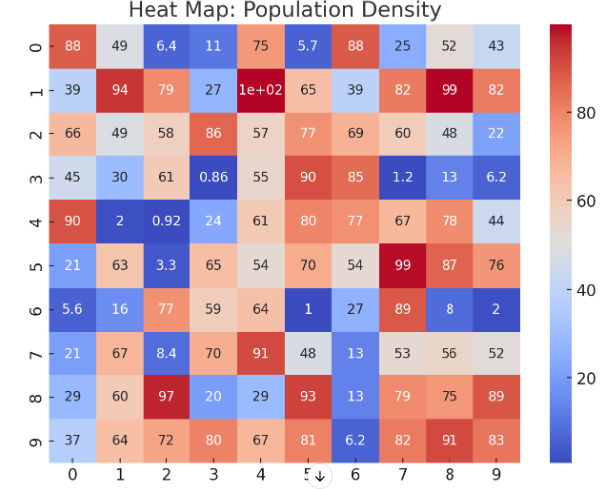
Heat Map: Population Density
A Heat Map visualizes data density using color gradients.
Heat Map: Displays population density using a color gradient. The color intensity of the cell reflects the magnitude of the value:
Darker Red (Coolwarm Scale) → Higher density
Darker Blue (Coolwarm Scale) → Lower density
Numbers inside the cells → Exact data values

Slide 26
Coolwarm scale
The Coolwarm scale is a color gradient used in data visualization to represent numerical values.
It transitions from cool colors (blue) to warm colors (red), making it ideal for heat maps and correlation matrices.
How Coolwarm Works:
Blue (Cooler Colors) → Represents lower values
White (Neutral Color) → Represents mid-range values
Red (Warmer Colors) → Represents higher values

Slide 27
Types of Data Visualization
1. Charts
Line Charts: Ideal for tracking trends over time, like stock prices or website traffic.
Bar Charts: Perfect for comparing quantities across categories, such as revenue per region.
Pie Charts: Best for showing proportions in a dataset (e.g., market share distribution).

Slide 28
Cont..
2. Graphs
Scatter Plots: Showcase relationships or correlations between variables.
Network Graphs: Useful for visualizing connections, such as social media networks.
3. Maps
Heat Maps: Display data density or intensity over a geographical area.
Choropleth Maps: Visualize region-specific data, such as population or election results.

Slide 29
Cont..
4. Tables
Provide precise numerical data in a structured format, great for detailed analysis.
5. Infographics
Combine multiple types of visualizations into a single, narrative-driven image to engage and inform audiences.
6. Dashboards
Interactive tools that integrate various visualizations to provide real-time insights, commonly used in business analytics.

Slide 30
Choosing the Right Visualization
The effectiveness of your visualization depends on the type of data and the message you want to convey.
Comparative Analysis: Bar or line charts.
Relationship Analysis: Scatter plots or bubble charts.
Spatial Analysis: Maps (heat or choropleth)

Slide 31
Best Practices for Data Visualization
Know your audience: Tailor the visualization to their level of expertise.
Keep it simple: Avoid clutter; focus on key data points.
Use appropriate scales: Ensure axis scales accurately represent the data.
Leverage colors effectively: Use contrasting colors to highlight important insights.

Slide 32
Common Tools for Data Visualization
Tableau: Great for interactive dashboards.
Power BI: Ideal for integrating business analytics.
Google Data Studio: Free and easy-to-use.
Excel: Suitable for basic visualizations.

Slide 33
Emerging Trends in Data Visualization
Interactive Dashboards: Allow real-time filtering and customization.
AI-Driven Insights: Automates pattern recognition.
Augmented Reality (AR): Offers immersive data visualization experiences.

Slide 34
Data Types
What are Data Types?
The data type is a classification for data that determines how data can be used by programming languages and data analysis software.
Knowledge of data types is fundamental to visualizing data as the type of data will affect the possible visualizations which may be generated from that data.

Slide 35
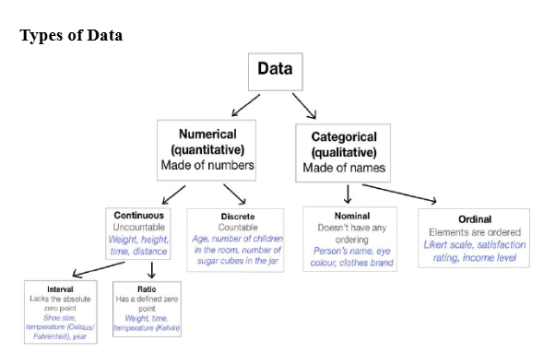

Slide 36
TYPES OF DATA
i. CATEGORICAL DATA: Categorical data represents characteristics. Therefore it can represent things like a person’s gender, language etc. Categorical data can also take on numerical values (Example: 1 for female and 0 for male).
ii. NOMINAL DATA: Nominal values represent discrete units and are used to label variables, that have no quantitative value. Nominal data that has no order. Therefore if you would change the order of its values, the meaning would not change. Example: Gender – Male/Female. To visualize nominal data you can use a pie chart or a bar chart.
iii. ORDINAL DATA: Ordinal values represent discrete and ordered units. It is therefore nearly the same as nominal data, except that it’s ordering matters.

Slide 37
Cont..
This is the main limitation of ordinal data, the differences between the values is not really known. Because of that, ordinal scales are usually used to measure non-numeric features like happiness, customer satisfaction and so on.
Example: Educational Background – 1. Elementary 2. High School 3. Undergraduate 4. Postgraduate. Ordinal data can be visualized with pie and bar charts.

Slide 38
iv. NUMERICAL DATA:
DISCRETE DATA - Discrete data means its values are distinct and separate. In other words, discrete data can only take on certain values. This type of data can’t be measured but it can be counted.
Example: Number of heads in 100 coin flips.
CONTINUOUS DATA - Continuous Data represents measurements and therefore their values can’t be counted but they can be measured.
Example: Height of a person, which can be described by using intervals on the real number line. To visualize continuous data, you can use a histogram or a box-plot

Slide 39
Cont..
INTERVAL DATA - Interval values represent ordered units that have the same difference. Therefore Interval data is used when we have a variable that contains numeric values that are ordered and where we know the exact differences between the values.
Example: Temperature of a given place.
RATIO DATA - Ratio values are also ordered units that have the same difference. Ratio values are the same as interval values, with the difference that they do have an absolute zero.
Examples: height, weight, length.

Slide 40
ENCODING
Encoding in data visualization means translating the data into a visual element on a chart or map through position, shape, size, symbols and color.
Encoding must be done correctly because only then users can understand what is shown in the map or chart.
Most visual relationships can be visually expressed with points, lines and bars.

Slide 41
Cont..
Use of visual elements to represent data in a way that can be easily understood and interpreted by the human eye.
It involves translating data values into visual properties such as:
Position (X, Y-axis)
Size
Color
Shape
Angle
Length
Orientation
Choosing Visual Encoding
The choice of visual encoding depends on: ✅ The type of data ✅ The intended message

Slide 42
Types of Data & Recommended Encodings
Quantitative Data
Best encodings: Position, Length, Angle, Area
Categorical Data
Best encodings: Color (hue), Texture, Shape, Orientation
Highlighting
Use variations in:
Colour (Saturation(completely filled) and Lightness)
Size

Slide 43
Data Encoding
Data encoding is the process of converting raw data into a visual format.
It helps in understanding patterns, trends, and relationships in the data.
We take raw data and map it to visual properties such as:
Position (X, Y-axis)
Size
Color
Shape
Angle
Length

Slide 44
Cont..
Visual encoding is the process of representing data visually using graphical elements such as position, size, shape, color, and texture.
It is a fundamental principle in data visualization, allowing complex information to be translated into visual formats that are easier to understand, compare, and analyze.

Slide 45
Key components of visual encoding
1. Position: The placement of data points on an axis, commonly used in scatter plots and line charts. 2. Length: The size of bars or lines to indicate magnitude in bar charts and line graphs.
3. Angle: Used in pie charts to represent proportional data.
4. Area: The size of a shape, such as bubbles in a bubble chart, to indicate quantitative values. 5. Color: Variations in hue, saturation, and brightness to distinguish categories or highlight differences. 6. Shape: Different geometric forms to differentiate data categories in scatter plots. 7. Texture & Pattern: Used to distinguish data when color differentiation is not sufficient or accessible.

Slide 46
Types
There are several types of visual encoding techniques, each serving different purposes depending on the type of data being represented:
1. Categorical Encoding: Used to differentiate between discrete groups or categories. 2. Quantitative Encoding: Represents numerical values, making comparisons easier. 3. Spatial Encoding: Uses position to represent relationships between data points.
4. Temporal Encoding: Represents time-based changes and trends.
5. Hierarchical Encoding: Organizes data into structured layers

Slide 47
Examples of Visual Encoding
Visual encoding is used across industries to make data more interpretable and actionable. Some notable examples include:
1. Stock Market Analysis: Candlestick charts use color, position, and shape to indicate market trends and volatility.
2. COVID-19 Heat Maps: Color gradients represent infection rates across different regions, helping policymakers allocate resources.
3. Election Maps: Political affiliations are encoded with colors, with intensity indicating voter margins.
4. Sports Performance Analysis: Player statistics are visualized using radar charts, encoding multiple performance metrics.
5. E-commerce & Sales Dashboards: Bar charts, heat maps, and trend lines help businesses analyze customer behavior and revenue trends. 6. Air Traffic Control Systems: Spatial encoding is used to track aircraft positions, ensuring safe navigation.

Slide 48
Example: Bar Chart
Consider sales data for three products:
Product | Sales ($)
Product A | 50,000
Product B | 75,000
Product C | 40,000
Encoded as a bar chart:
X-axis (Position): Product names (A, B, C).
Y-axis (Position): Sales amount ($).
Bar Length: Represents sales value.
Color: Used to differentiate products
Visual Representation: Product B has the tallest bar → highest sales.

Slide 49
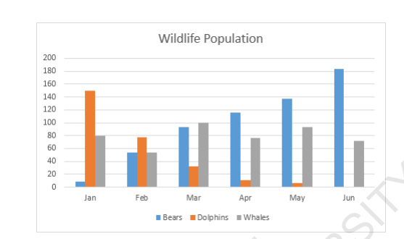
Example: Consider the standard column chart shown Column Chart
. The chart in Fig is encoded in the following ways:
Colour: colour of bears, dolphins, whales
Size: every time animal count increases, the column height increases.
Grouping: Every time month changes, new cluster of columns must be created.
In general, the different ways to encode data are: Size, shape, colour, grouping, area, position, saturation, line pattern, line weight, angle, connections

Slide 50
Retinal variables
Retinal variables are the visual properties (features) of objects that help us perceive differences in data.
We use different visual features to represent data. These features are called retinal variables (or visual encodings).
Note:
Data encoding converts raw data into visuals using position, color, size, etc.
Retinal variables (color, shape, orientation, texture, etc.) help differentiate data.

Slide 51
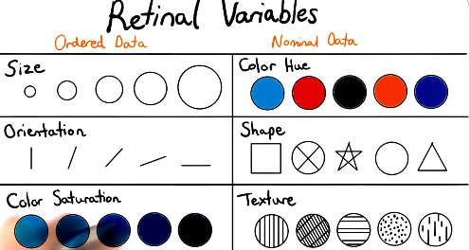

Slide 52
Retinal variables
Retinal Variable | Definition | Example
Position | Location of an object | Points in a scatter plot
Size | How big an object is | Bubble size in a bubble chart
Shape | The form of an object | Circle, square, triangle markers
Color (Hue) | Different colors to categorize data | Red, blue, green for categories
Color (Saturation) | Intensity of a color | Darker colors for higher values
Orientation | Direction or angle of elements | Slopes in a line chart
Texture/Pattern | Different patterns to distinguish data | Dashed vs. solid lines

Slide 53
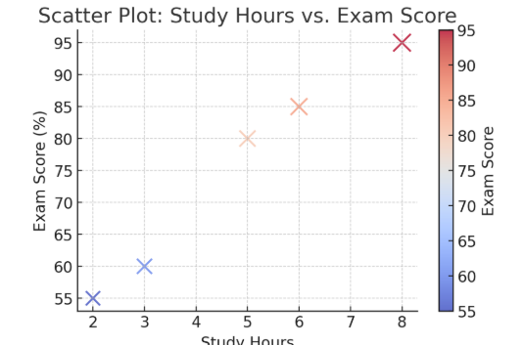
Example 1: Scatter Plot
Use Case: Relationship between study hours and exam scores.
Student | Study Hours | Exam Score (%)
A | 2 | 55
B | 3 | 60
C | 5 | 80
D | 6 | 85
E | 8 | 95
This visualization demonstrates position, color, and size encoding:
X-axis (Position): Study Hours
Y-axis (Position): Exam Score (%)
Color (Hue): Represents exam scores (darker = higher score)
Size: Represents GPA (larger = higher GPA)

Slide 54
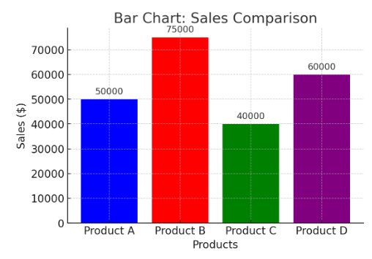
2 Example
Bar Chart: Sales Comparison
This visualization demonstrates length and color encoding:
X-axis (Position): Product categories
Y-axis (Length): Sales in dollars
Color (Hue): Different colors for each product
Grid Lines: Help compare sales values

Slide 55
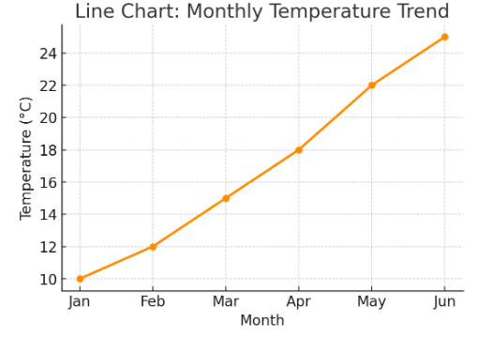
3 Example
Line Chart: Monthly Temperature Trend
This visualization demonstrates position, orientation, and color encoding:
X-axis (Position): Months
Y-axis (Position): Temperature (°C)
Line Orientation: Shows increasing temperature over time
Color (Hue): Orange to highlight the trend

Slide 56
Mapping Variables to Encodings in Data Visualization
Mapping variables to visual encodings means assigning data attributes (e.g., sales, temperature, categories) to visual properties (e.g., position, color, size, shape) so that the data is easy to interpret.

Slide 57
Understanding Visual Encodings
Encoding | Description | Example
Position (X, Y-axis) | Most effective for numerical data. Helps compare values accurately. | Bar charts, Scatter plots
Length | Good for comparing magnitudes. Longer bars = Higher value. | Bar charts
Angle | Used in circular visualizations to compare proportions. | Pie charts
Color (Hue) | Differentiates categories. | Line charts, Categorical heatmaps
Color (Saturation) | Shows intensity (lighter = low, darker = high). | Heatmaps, Choropleth maps
Size | Represents quantity; larger objects mean higher values. | Bubble charts
Shape | Distinguishes categorical values. | Scatter plots, Legends
Texture/Pattern | Useful when color isn't enough. | Bar charts, Grayscale printing
Visual encodings are ways to represent data graphically. Here are the main types of visual encodings and when to use them:

Slide 58
Encodings in Data Visualization
1. Position
Best for: Quantitative comparisons
Example: Scatter plots, bar charts
Reason: Position encodings allow precise comparisons and are generally the most accurate.
2. Length
Best for: Quantitative comparisons, ordering
Example: Bar charts
Reason: Length can be accurately compared, making it effective for showing differences in magnitude.
3. Angle
Best for: Part-to-whole relationships
Example: Pie charts
Reason: Angles are useful for showing proportions within a whole, although they are less precise than length.
4. Area
Best for: Quantitative comparisons
Example: Bubble charts, tree maps
Reason: Area can represent data values, but humans are less accurate at comparing areas than lengths or positions.

Slide 59
Choosing the Right Encodings for Different Data Types
Categorical Data (Regions, Product Types, Genders)
✅ Best encodings: Color, Shape, Position 🔹 Example: Bar charts, Pie charts, Stacked bar charts
Numerical Data (Sales, Population, GDP(Gross Domestic Product.))
✅ Best encodings: Position, Length, Size, Color Intensity 🔹 Example: Scatter plots, Line charts, Heatmaps
Time-Series Data (Stock Prices, Temperature Trends)
✅ Best encodings: Position, Line Orientation, Color 🔹 Example: Line charts, Area charts

Slide 60
Choosing the Right Encoding
Data Type | Best Encoding Methods
Categorical (Names, Types) | Color, Shape
Ordinal (Ranks, Ratings) | Position, Size
Numerical (Sales, Scores) | Position, Length, Color Intensity

Slide 61
Data Encodings
The way raw data is transformed into a form that can be represented visually.
Mapping data types (like numbers or categories) to visual properties (like position, length, or color).
Examples:
Mapping sales numbers to bar lengths
Mapping age groups to different colors in a pie chart
Using the height of bars to show population in different countries
Goal: To convert data into a structure that helps in effective visual communication.

Slide 62
Visual Encodings
The actual visual elements used to represent the data in a chart or graph.
Uses visual properties like:
Position
Length
Angle
Area
Shape
Color
Size
Orientation
Examples:
Length of bars in a bar chart
Angle of slices in a pie chart
Color hues for categories
Bubble sizes in a bubble chart
Goal: To help the human eye understand and interpret the data quickly and accurately.

Slide 63
Difference
Concept | Data Encoding | Visual Encoding
Purpose | Translates data into mappable features | Uses visuals to present the mapped features
Involves | Mapping data to visual properties | Using visual properties like color, shape
Example | Mapping "Sales = 100" to "Bar height = 10cm" | Showing that bar as 10cm tall in the chart

