Slide 1
UNIT-V: Applications of Data Science: Technologies for visualization, Bokeh (Python), recent trends in various data collection and analysis techniques, various visualization techniques, application development methods used in data science.

Slide 2
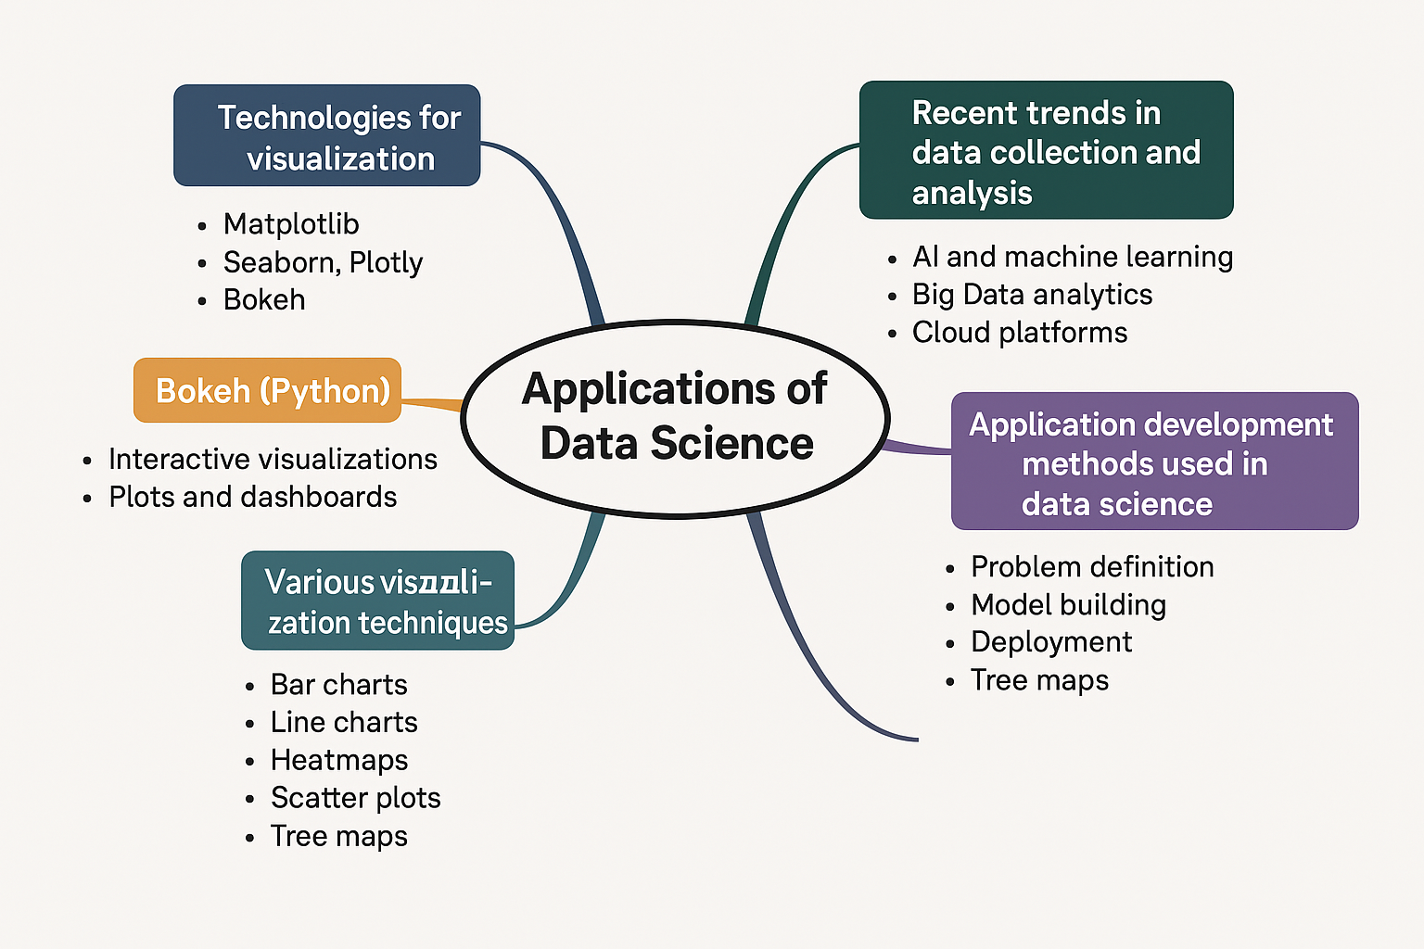
Mind Map

Slide 3
Applications of Data Science
Data science is used to analyze data, find patterns, make predictions, and help decision-making in almost every industry.
1. Healthcare
📊 Predicting diseases early (e.g., diabetes, cancer)
💊 Drug discovery and development
🏥 Hospital resource management
Example: AI models predict patient risk based on symptoms and test reports.

Slide 4
Cont..
🛒 2. Retail & E-commerce
🎯 Personalized recommendations (like Amazon, Flipkart)
📦 Inventory management
💰 Dynamic pricing
Example: Netflix recommends shows based on your watch history.
🎓 3. Education
📊 Student performance tracking
🧠 Personalized learning paths
📚 Dropout prediction
Example: Online learning platforms like Coursera suggest courses based on your interests.

Slide 5
Cont..
🚗 4. Transportation & Logistics
🗺Route optimization (like Google Maps, Uber)
📦 Delivery time prediction
⚙️ Fleet maintenance prediction (A fleet is like a team of cars, trucks, or buses working together for one purpose.)
Example: Amazon uses data to decide the fastest delivery routes.
🌱 5. Agriculture
🌾 Crop yield prediction
☁ Weather-based irrigation suggestions
🐞 Pest detection using image analysis
Example: Smart farming apps use satellite data to help farmers.

Slide 6
🏦 6. Finance & Banking
🔍 Fraud detection
📈 Credit scoring and loan approvals
📊 Stock market forecasting
Example: Banks use machine learning to detect unusual credit card transactions.
7. Media & Entertainment
📺 Content recommendation
📉 Audience behavior analysis
📆 Ad targeting
Example: Spotify recommends songs using your listening history.

Slide 7
8. Business Intelligence
📈 Sales forecasting
🛠 Market analysis
📊 Customer segmentation
Example: Companies use dashboards (Power BI, Tableau) to monitor business growth.

Slide 8
Tools Used in Data Science Applications:
Languages: Python, R, SQL
Libraries: Pandas, Scikit-learn, TensorFlow
Visualization: Bokeh, Plotly, Tableau, Power BI
Big Data: Hadoop, Spark
ML Platforms: AWS SageMaker, Google Cloud ML

Slide 9
Technologies for visualization
Visualization tools help us present complex data in visual form so it's easier to understand patterns, trends, and insights.
Common Tools:
Matplotlib – Basic graphs (bar, pie, line)
Seaborn – Beautiful statistical graphs
Bokeh – Interactive visualizations
Plotly – Interactive charts & dashboards
Tableau / Power BI – Business-oriented visual analytics tools

Slide 10
Bokeh (Python)
Bokeh is a Python library used to create interactive plots and dashboards for web browsers.
used for creating interactive and beautiful visualizations that can be viewed in a web browser.
It helps data scientists and developers turn data into interactive dashboards, charts, and graphs.
Features:
Real-time streaming of data
Interactive tools (zoom, pan, hover)
Web-ready (can be embedded in websites)
Note: Hover means moving your mouse over a data point (like a bar, dot, or line) to see more information about that point.
Pan lets you click and drag your mouse to move or shift the view of the chart or graph.
Zoom lets you focus in on a specific part of a chart or graph by enlarging the view.

Slide 11
Cont..
Use Bokeh when you need:
Interactive visualizations
Web-friendly charts
To share or embed visualizations online
Common Chart Types in Bokeh:
Line chart
Bar chart
Scatter plot
Pie chart (via patches)
Heatmaps(A heatmap uses colors to tell you how high or low values are.)
Interactive dashboards(visual display of important data and key information)

Slide 12
How Bokeh Works (Basic Steps):
Import Bokeh modules
Create a figure (canvas) This is like your blank paper where you’ll draw your chart.
Add charts or shapes (bar, line, circle, etc.)
Show the result in a browser

Slide 13
Key Features of Bokeh:
Feature | Description
📊 Interactive Plots | Zoom, pan, hover, and click on data points
🌐 Web-ready | Plots run in browsers (HTML, JavaScript output)
🔁 Real-time Streaming | Useful for live data dashboards
🧱 Flexible Layouts | Can arrange multiple plots, widgets, and controls
💻 Integrates with | Jupyter Notebook, Flask, Django, etc.

Slide 14
Recent Trends in Data Collection & Analysis
Data Collection Trends:
IoT devices collecting real-time sensor data
Social media data scraping (for sentiment analysis)
APIs for automated data fetching (e.g., Twitter, weather)
Data Analysis Trends:
Use of AI & Machine Learning for predictive insights
Big Data analytics (Hadoop, Spark)
AutoML (automated machine learning)
Cloud platforms (AWS, Azure, GCP) for scalable analysis

Slide 15
1. Recent Trends in Data Collection
a. Internet of Things (IoT)
What: Smart devices like sensors, smartwatches, and home appliances collect real-time data.
Use Case: Smart cities, health monitoring, industrial automation.
Example: Fitbit collecting steps, heart rate, sleep patterns.

Slide 16
Cont..
b. Web Scraping & APIs
What: Automatically collecting data from websites or through APIs (Application Programming Interfaces).
Tools: BeautifulSoup, Scrapy, Tweepy (for Twitter API), News API.
Use Case: Social media analysis, news sentiment tracking.
Example: Collecting tweets about elections to analyze public opinion.

Slide 17
c. Mobile Data Collection
What: Using mobile apps, SMS, or survey tools to collect user data.
Use Case: Surveys, customer feedback, health tracking.
Example: Google Forms collecting student responses via smartphones.

Slide 18
Cont..
d. Big Data Platforms
What: Platforms like Hadoop, Spark, and Kafka collect and store massive amounts of data in real-time.
Use Case: E-commerce logs, streaming services like Netflix, telecom usage data.
e. User-generated Content
What: Data from reviews, forums, social media posts, blogs.
Use Case: Sentiment analysis, product improvement.
Example: Amazon product reviews or YouTube comments.

Slide 19
2. Recent Trends in Data Analysis
a. Artificial Intelligence (AI) & Machine Learning (ML)
What: Using intelligent algorithms to detect patterns, predict outcomes.
Use Case: Fraud detection, recommendation systems, stock price forecasting.
Tools: Scikit-learn, TensorFlow, PyTorch.
b. Automated Machine Learning (AutoML)
What: Automatically selects the best ML models and tunes them.
Use Case: Speeds up model development for non-experts.
Tools: Google AutoML, H2O.ai, Auto-sklearn.

Slide 20
Cont..
c. Cloud Computing & Data Analysis
What: Storing and analyzing data on platforms like AWS, Azure, GCP.
Use Case: Scalable analysis without needing powerful local machines.
d. Real-time Analytics
What: Analyzing data as it comes in (streaming).
Use Case: Monitoring stock markets, live dashboards.
Tools: Apache Kafka, Apache Flink.

Slide 21
Cont..
e. Data Visualization & Storytelling
What: Presenting data insights through graphs and interactive visuals.
Tools: Power BI, Tableau, Bokeh, Plotly.
Use Case: Business reporting, dashboard creation.
f. Privacy-aware Analytics (Data Ethics)
What: Ensuring data collection and usage respects privacy laws like GDPR.
Use Case: Healthcare data analysis, user data security.

Slide 22
The modern data world is:
More connected (IoT, APIs)
More real-time (streaming)
More intelligent (AI, ML)
More visual (dashboards)
More ethical (data privacy laws)

Slide 23
Visualization Techniques
🔹 Based on data type:
Bar Charts – Categorical comparisons
Line Charts – Trends over time
Pie Charts – Part-to-whole relationships
Heatmaps – Pattern detection
Scatter Plots – Relationships between two numeric variables
Tree Maps – Hierarchical data visualization
Word Clouds – Frequency of text data

Slide 24
Various Visualization Techniques in Data Science
Data visualization helps to understand data, find patterns, and make decisions faster. Here are the most commonly used techniques:
Various Visualization Techniques
1. Bar Chart Use: Compare quantities across categories Best For: Categorical data Example: Sales by product type | 2. Line Chart Use: Show trends over time Best For: Time series data Example: Website traffic over a month
3. Area Chart Use: Show cumulative totals over time Looks like: A filled version of line chart Example: Monthly user growth | 4. Pie Chart / Donut Chart Use: Show percentage/parts of a whole Limit: Best for 3-5 categories Example: Market share by company
5. Scatter Plot Use: Show relationships between two variables Best For: Correlation & trend analysis Example: Hours studied vs Exam score | 6. Histogram Use: Show frequency distribution of data Best For: Understanding data spread Example: Age distribution of people
7. Heatmap Use: Show intensity or magnitude Best For: Correlation matrices, location-based data Example: Website click heatmap | 8. Geospatial Map (Geo Map) Use: Display data on maps (location-based insights) Tools: Plotly, Tableau, Power BI Example: COVID-19 spread by country
9. Box Plot Use: Show median, quartiles, outliers in a dataset Example: Compare salaries across departments | 10. Bubble Chart Use: Scatter plot with an extra dimension (bubble size) Example: Country-wise population vs GDP

Slide 25
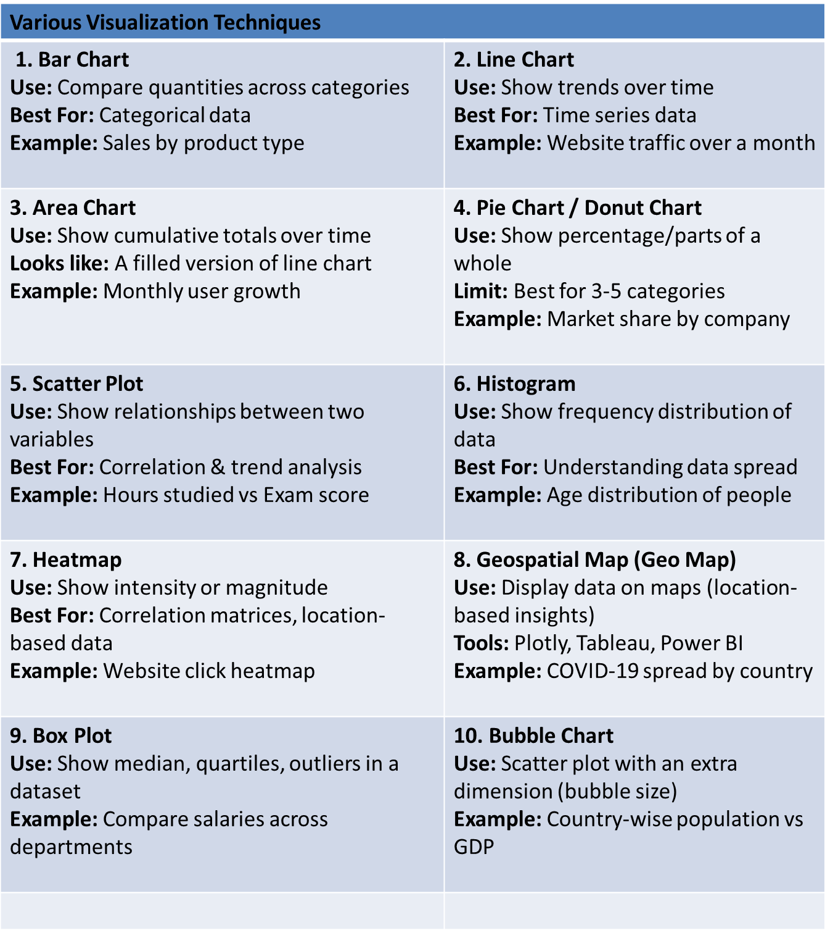

Slide 26
Application Development Methods in Data Science
To build a data science application, we usually follow these development phases:
Phases:
Problem Definition
Data Collection
Data Cleaning & Preprocessing
Exploratory Data Analysis (EDA)
Model Building (ML/Statistical)
Model Evaluation & Optimization
Visualization & Reporting
Deployment (e.g., via Flask, Streamlit, or Django)

Slide 27
Popular Tools for Visualization:
Tool | Good For
Matplotlib / Seaborn (Python) | Basic charts in notebooks
Bokeh / Plotly (Python) | Interactive, web-ready plots
Tableau / Power BI | Business dashboards
Excel | Simple and quick visualizations

Slide 28
Tools & Technologies:
Languages: Python, R
Libraries: Pandas, NumPy, Scikit-learn, TensorFlow, PyTorch
Visualization: Bokeh, Plotly, Dash, Power BI
Deployment: Flask, Streamlit, FastAPI
Cloud: AWS, Azure, Google Cloud

Slide 29
Example Use Case
Goal: Build a heart disease prediction app Steps (CRISP-DM):
Understand the healthcare problem
Collect patient data
Clean and transform the data
Train a classification model
Test model accuracy
Deploy it as a web app using Streamlit

Slide 30
Use Cases
Finance – Stock Price Forecasting
Retail – Customer Segmentation
Real Estate – Price Estimation Tool
Education – Student Performance Dashboard
Logistics – Fleet Optimization
NLP – Sentiment Analysis App

Slide 31
Example-1
Logistics – Fleet Optimization
Use Case: Optimize routes and fuel usage for delivery vehicles.
Data: GPS, delivery times, traffic
Model: Route optimization algorithms (like Dijkstra's)
Application: Live tracking dashboard
Outcome: Saves fuel and delivery time

Slide 32
Example-2
Real Estate – Price Estimation Tool
Use Case: Estimate house prices based on features.
Data: Area, location, no. of bedrooms, etc.
Model: Linear Regression / XGBoost
Application: Interactive web app using Streamlit
Outcome: Helps users find fair property prices

Slide 33
Application Development Methodologies in Data Science Projects
Developing a data science project involves systematic planning, data collection, analysis, modeling, and deployment. Several methodologies have been adapted or specifically designed to manage data science workflows efficiently.

Slide 34
Cont..
The key methodologies include:
1. CRISP-DM (Cross-Industry Standard Process for Data Mining)
Most widely used methodology.
Phases:
Business Understanding – Define objectives and requirements.
Data Understanding – Collect, describe, and explore data.
Data Preparation – Clean, transform, and select data for modeling.
Modeling – Choose and apply modeling techniques.
Evaluation – Assess model effectiveness and verify business goals.
Deployment – Implement the model into production or report results.
Strength: Iterative and flexible approach; suitable for both academic and industrial projects.

Slide 35
Cont..
2. KDD (Knowledge Discovery in Databases)
An older but foundational method.
Phases:
Selection – Choose relevant data.
Preprocessing – Remove noise and handle missing values.
Transformation – Convert data into suitable formats.
Data Mining – Apply algorithms to extract patterns.
Interpretation/Evaluation – Make sense of the patterns.
Focus: Pattern discovery and interpretation.

Slide 36
Cont..
3. Agile Data Science
Based on Agile software development principles.
Emphasizes collaboration, iterative development, and continuous delivery.
Sprint-based approach:
Regular progress reviews.
Incorporates feedback from stakeholders.
Advantage: Allows fast prototyping and frequent updates in dynamic environments.

Slide 37
Cont..
4. SEMMA (Sample, Explore, Modify, Model, Assess)
Developed by SAS Institute.
Focused more on the technical steps of data mining.
Sample – Extract a representative sample.
Explore – Visualize and examine data.
Modify – Clean and transform data.
Model – Apply statistical/machine learning models.
Assess – Evaluate model performance.
Limitation: Less emphasis on business understanding.

Slide 38
Cont..
5. Microsoft Team Data Science Process (TDSP)
Designed for enterprise-level AI and machine learning solutions.
Phases:
Business Understanding
Data Acquisition and Understanding
Modeling
Deployment
Customer Acceptance
Features: Collaborative, cloud-compatible, integrates tools like Azure ML, Git.

Slide 39
Cont..
Choosing the right methodology depends on:
The complexity of the project,
The team structure,
The timeline, and
The goals (research vs. production deployment).

