Slide 1
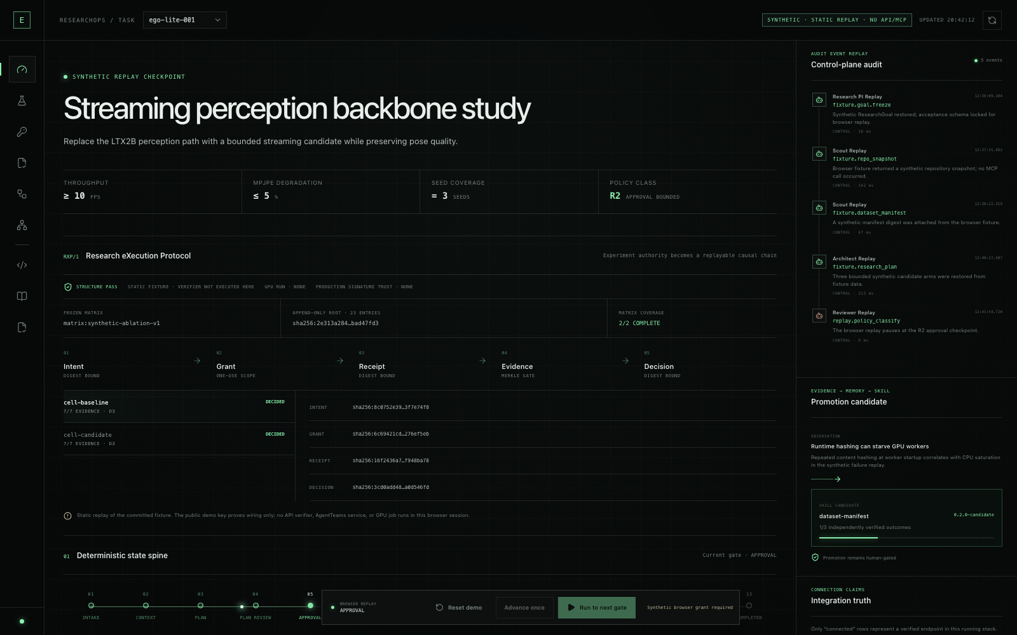
GOAI 2026 复赛｜Agent Infra
EgoAgentOS
ResearchOps / RXP
让 Auto Research 从黑盒对话变成可签发、可验收、可重放的实验协议
吕新科 · 北京邮电大学 · 智能科学与技术
Notes:
[Sources]
- submission/screenshots/semifinal-rxp-cockpit.png
- apps/web/src/App.tsx
- docs/protocols/RXP.md
[Talk track]
20 秒：一句话定义产品；先指出截图是静态 fixture，不是伪装成 live backend。

Slide 2
P0 · 复赛评委意见闭环
从 local proof 升级为 protocol + production-ready
01 · 协作证据
02 · 数据底座
03 · 新协议
Official AgentTeams · 4 Worker resources
PostgreSQL control plane
RXP/1 experiment grant
Controller / Manager / Team / Matrix · LIVE_LOCAL
4 roles · RLS · append-only · LISTEN/NOTIFY
Intent → Grant → Receipt → Evidence → Decision
04 · 严格评测
05 · 评委复现
06 · 事实边界
14 scenarios + 8 acceptance cases
Cockpit + one-click acceptance bundle
PASS / NOT RUN / UNVERIFIED
trace oracle · origin gate · recovery assertions
static replay · local full stack · frozen evidence
workflow / GPU / Nexa / PITR 不冒认
02
Notes:
[Sources]
- User-provided semifinal judge feedback
- docs/judge-feedback-implementation.md
- docs/semifinal-scorecard.md
[Talk track]
35 秒：两条评委意见都已落成代码与本地证据；外部 live 项仍明确标记 NOT RUN / UNVERIFIED。

Slide 3
场景 · Auto Research control gap
AI 会提实验，不等于实验可被相信
面向 AI / 具身研究工程师：把一次研究意图收束为完整矩阵、一次性权限、原始证据与独立 Decision。
BLACK-BOX LOOP
EGOAGENTOS
同一 Agent 提案、执行、算分、写结论
Research control plane
Goal
可信断点
× Scope 漂移
× Matrix 漏跑
× 自评自证
× Crash 后谱系断裂
01
Freeze
能力生成 / 优化层
模型 · 程序 · 轨迹
Intent + MatrixPlan
Code / config
02
Authorize
exact-cell one-time Grant
Dataset
03
Execute
GPU / logs
Receipt + raw Evidence
04
Decide
Metric / claim
independent gate + replay
真实代价不是少写几条命令，而是无法证明：谁授权、跑了哪格、证据是否齐全、失败是否改变结论。
输入：goal / budget / policy｜输出：Decision + evidence root + reusable Skill trace
窄入口：EgoLite streaming perception｜控制面可执行｜workload 与模型增益仍标记 SYNTHETIC
Notes:
[Sources]
- docs/architecture.md
- docs/claims-evidence.md
[Talk track]
25 秒：说明目标用户、四个可信断点和输入输出闭环。

Slide 4
闭环 · 三平面架构
同一 run_id 贯穿完整实验闭环
AgentTeams 管动态协作；RXP 管实验事实；Skill / MCP 管受控动作；PostgreSQL 管生产持久状态。
INTAKE
COLLABORATION PLANE · OFFICIAL AGENTTEAMS ADAPTER
SKILL & TOOL PLANE
Research Goal
Research PI / Manager
EXPERIMENT TRUTH PLANE
01
Discover
6 digest-pinned Skills
ContextBundle
create · decompose · delegate · accept · verify
RXP/1
02
Invoke
3 allowlisted handlers
Scout
Architect
Intent / plan digest
MatrixPlan
Grant / nonce / scope
03
Execute
typed MCP / adapter
Runtime
Evaluator
Human Gate
Receipt / evidence root
04
Verify
independent oracle
Reviewer
Memory candidate
Decision / ledger root
Decision
05
Release
canary / rollback / retire
Project / Task / Room 可重路由；消息只携带引用，不替代 source of truth
Token 是能力凭证，不是聊天许可
Closure = collaboration trace · RXP ledger root · raw artifact digests · independent review
PostgreSQL primary · SQLite dev
append-only evidence
correlated trace
versioned Skills
honest adapters
AgentTeams infra / Matrix = LIVE_LOCAL；workflow / GPU / Nexa / PITR = NOT RUN
04
Notes:
[Sources]
- docs/architecture.md
- docs/judge-feedback-implementation.md
- integrations/agentteams/README.md
- apps/agentteams_bridge/postgres_store.py
[Talk track]
35 秒：协作、实验事实与受控动作共用同一 run_id；PostgreSQL 是 production path，SQLite 只保留 dev fallback。

Slide 5
协议 · RXP/1
RXP/1：一次授权与可验收因果链
它不替代 MCP / A2A / PROV / MLflow；它补齐“谁可跑哪一格、该交什么证据、何时可下结论”。
HUMAN
COLLABORATION CONTEXT · TASK / RUN / CELL CORRELATION
REFERENCE IMPLEMENTATION
Researcher
AgentTeams Manager
RXP CAUSAL CHAIN
01
Schema
7 JSON Schemas
Approver
把 Project / Task / Artifact 映射到同一 RXP run
canonical JSON + append-only ledger
02
Signer
HMAC demo · production trust NONE
Scout
Architect
Intent / MatrixPlan
Judge replay
Grant / exact scope
03
Ledger
23 append-only entries
Runtime
Evaluator
Reviewer
Receipt / Evidence
04
Matrix
2 / 2 cells COMPLETE
Reviewer
Memory
Decision / root
Operator
05
Verifier
tamper / omission / replay fail closed
room 只传 rxp:// 引用；验证器读取 canonical documents
Grant 绑定 plan · cell · budget · expiry · nonce
Decision 只有在 expected cells、receipts、evidence kinds、reviewer independence 全部闭合后生成
MCP · tools
A2A · tasks
PROV · provenance
MLflow · tracking
RXP · acceptance
确定性 fixture：相同输入生成 byte-identical ledger；外部 checkpoint 仍是 production 必需项
05
Notes:
[Sources]
- docs/protocols/RXP.md
- protocols/rxp/schemas/
- tests/protocols/
[Talk track]
45 秒：重点解释 token 是 exact-cell capability，MatrixLedger 防止选择性漏跑。

Slide 6
AgentTeams · LIVE_LOCAL infrastructure
基础设施已联通；科研工作流仍冻结
Bridge 将官方响应、typed Matrix、checkpoint、receipt 与 Decision 绑定同一 run，并可持久化到 PostgreSQL。
PROJECT ROOM
OFFICIAL CONTRACT TRACE
每一步有观察断言
Research PI / Manager
Create
Project API
必须返回 project_id
创建 Project · 分解 DAG · 委派 · 接受 · 验证 · 完成
Decompose
Task DAG
依赖与 expected artifacts
01
Scout
冻结上下文
02
Architect
生成 MatrixPlan
Delegate
>=3 Workers
真实 worker principals
Accept
assignee state
不是 Manager 自演
03
Runtime
领取并执行
04
Evaluator
确定性算分
Verify
Reviewer
与 Runtime 身份分离
05
Reviewer
独立质疑
06
Memory candidate
candidate only
Recover
replan / reassign
原因进入 trace
Finish
Decision
绑定 RXP ledger root
正常：delegate → accept → execute → verify｜异常：conflict→replan · timeout→reassign · crash→resume
Trace contract：sequence + previous_hash + event_hash + typed lifecycle + independent review
CREATE
DECOMPOSE
DELEGATE
ACCEPT
EXECUTE
EXECUTE
RUNTIME
VERIFY
DECIDE
DECIDE →
MEMORY
共享：project_id · task_id · rxp_run_id · cell_id · trace_id · evidence_root
Controller / Manager / 4 Workers / Matrix = LIVE_LOCAL；8 nodes PENDING；GPU NOT_ATTACHED
Notes:
[Sources]
- apps/agentteams_bridge/
- integrations/agentteams/benchmark_adapter.py
- tests/agentteams/
- docs/agentteams-live-runbook.md
[Talk track]
40 秒：展示 PostgreSQL-backed checkpoint、完整 trace 验链与 crash/reassign；没有官方来源证明就不会升级为 live。

Slide 7
Authority · Separation of duties
同一 Agent 不得自评自证
至少 3 个真实 principal；R2 / R3 必须停在人类 checkpoint，恢复后仍沿用同一 correlation chain。
PRINCIPAL MAP
GRANT CONTRACT
一次批准只对应一次精确实验格
>=3 distinct identities
intent_digest
SHA-256
绑定 frozen objective
权限边界先于模型能力
scope
run + cell
不能跨 matrix 复用
MGR
Manager
route / merge
ARC
Architect
plan · no approval
expiry
≤15 minutes
过期即失效
nonce
single-use
原子消费 / replay reject
RUN
Runtime
execute · no verdict
EVA
Evaluator
metric · no artifact edit
receipt
run binding
执行事实反向绑定 Grant
REV
Reviewer
independent gate
HUM
Human
R2/R3 grant
rollback
checkpoint
恢复不覆盖原始失败
audit
hash chain
每次动作可重放
principal conflict / self-review / missing reviewer → structured error + no Decision
HMAC key 仅用于公开 fixture；production signer / key custody 明确不在当前验证范围
INTENT
PLAN
REVIEW
GRANT
BLOCKED
CONSUME
ONCE
RECEIPT
VERIFY
DECIDE /
ARCHIVE
HITL 不是 UI 按钮，而是可审计 state transition + scope-bound capability
负测：missing grant · scope mismatch · expired · replay · self-review · tamper 均 fail closed
Notes:
[Sources]
- docs/security.md
- protocols/rxp/grants.py
- tests/protocols/
[Talk track]
30 秒：同一 Agent 不能自评自证；一次 grant 只允许一个 cell。

Slide 8
Skills · Runtime registry
discover → load → invoke → canary → rollback → retire
6 / 3
6 个 digest-pinned Skill package；3 个 allowlisted deterministic handler；每次调用输出 correlation trace。
EXECUTABLE CORE
RELEASE CONTRACT
RUNTIME PROOF
3 个可运行 handler
skill://name@semver#package_digest
6 packages / 3 executable
ResearchPlan
输入
typed payload + correlation_id + optional version pin
discover：frontmatter + manifest
package digest 防静默替换
01
freeze · budget · falsifiability
输出
result + input/output digest + invocation_id
02
Dataset Manifest
发现
SKILL.md + project manifest · strict SemVer
invoke：ResearchPlan / DatasetManifest / EvidenceGate
SafeRunner = E_NOT_EXECUTABLE
relative path · digest · canonical order
路由
deterministic hash bucket · canary ≤50%
03
EvidenceGate
失败
E_VERSION_PIN · E_PACKAGE_DIGEST · E_NOT_EXECUTABLE
complete kinds · reviewer independence
当前证据
6 focused tests PASS
安全
handler allowlist · owner ≠ reviewer · fail closed
invocation trace
04
SafeRunner
fixed-seed bootstrap · structured errors
GPU dry-run default · shell=False
仅 packaged synthetic_worker
discoverable · generic invoke denied
验证
same correlation + input → same invocation trace
生命周期
draft → canary → active → retired / rollback
+ AblationAnalyzer / ResearchMemory；高风险 runner 不因 registry 而绕过专用 approval path。
当前 reference registry 为进程内状态；production lifecycle persistence 仍需接 control-plane store
复用：robotics / model training / data pipeline 共用合同；handler 保持领域内确定性
Notes:
[Sources]
- skills/
- skill_runtime/
- tests/skills/test_runtime_registry.py
[Talk track]
35 秒：现场 list / invoke；再调用 SafeRunner 展示 E_NOT_EXECUTABLE。

Slide 9
HITL · RXP one-time Grant
实验 token 不是额度：它代表一次可审计、不可重放的实验授权
SYNTHETIC FIXTURE：签名 key 为公开 demo key；结构验证真实，production signature trust = NONE。
冻结一个意图
展开完整矩阵
A · INTENT
B · MATRIX PLAN
1
1
RXP/1
2 cells
2 / 2
23
D3
intent digest
frozen policy
protocol version
baseline + candidate
COMPLETE
ledger entries
evidence gate
目标、预算、接受阈值先 canonicalize；后续对象都反向引用。
MatrixLedger 证明 expected 与 observed 的集合闭合；漏一格不允许 Decision。
人只批准精确 scope
证据齐全才 Decision
C · GRANT
D · ACCEPTANCE
R2
scope
≤15 min
7 / 7
Reviewer
DECIDED
human checkpoint
run + cell
single-use nonce
evidence kinds
independent
only after PASS
Grant 消费后产生 Receipt；重放、换 cell、改 payload、过期都被拒绝。
Decision 绑定 evidence root、matrix root、reviewer 和所有 causal references。
fixture root 可独立 verify；真实 GPU / model gain / production key custody 均不在本页宣称范围
Notes:
[Sources]
- protocols/rxp/demo.py
- protocols/rxp/ledger.py
- protocols/rxp/evidence.py
[Talk track]
35 秒：展示 2/2 完整矩阵和 23-entry ledger；重放同一 token 必须失败。

Slide 10
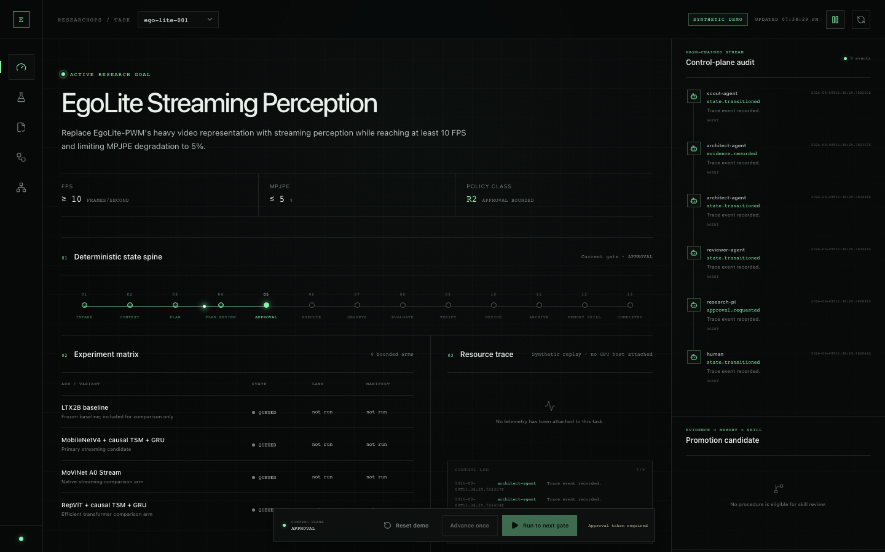
JUDGE REPLAY · CHECKPOINT 1
一条 run
五个闭环对象
Intent → Grant → Receipt → Evidence → Decision；2 / 2 COMPLETE，23-entry append-only ledger。
真实本地 Cockpit · 静态 fixture 如实标记
Notes:
[Sources]
- submission/screenshots/semifinal-rxp-cockpit.png
- apps/web/src/rxpDemoData.ts
[Talk track]
30 秒：在界面中点 baseline / candidate，查看每格 Intent、Grant、Receipt、Decision digest。

Slide 11
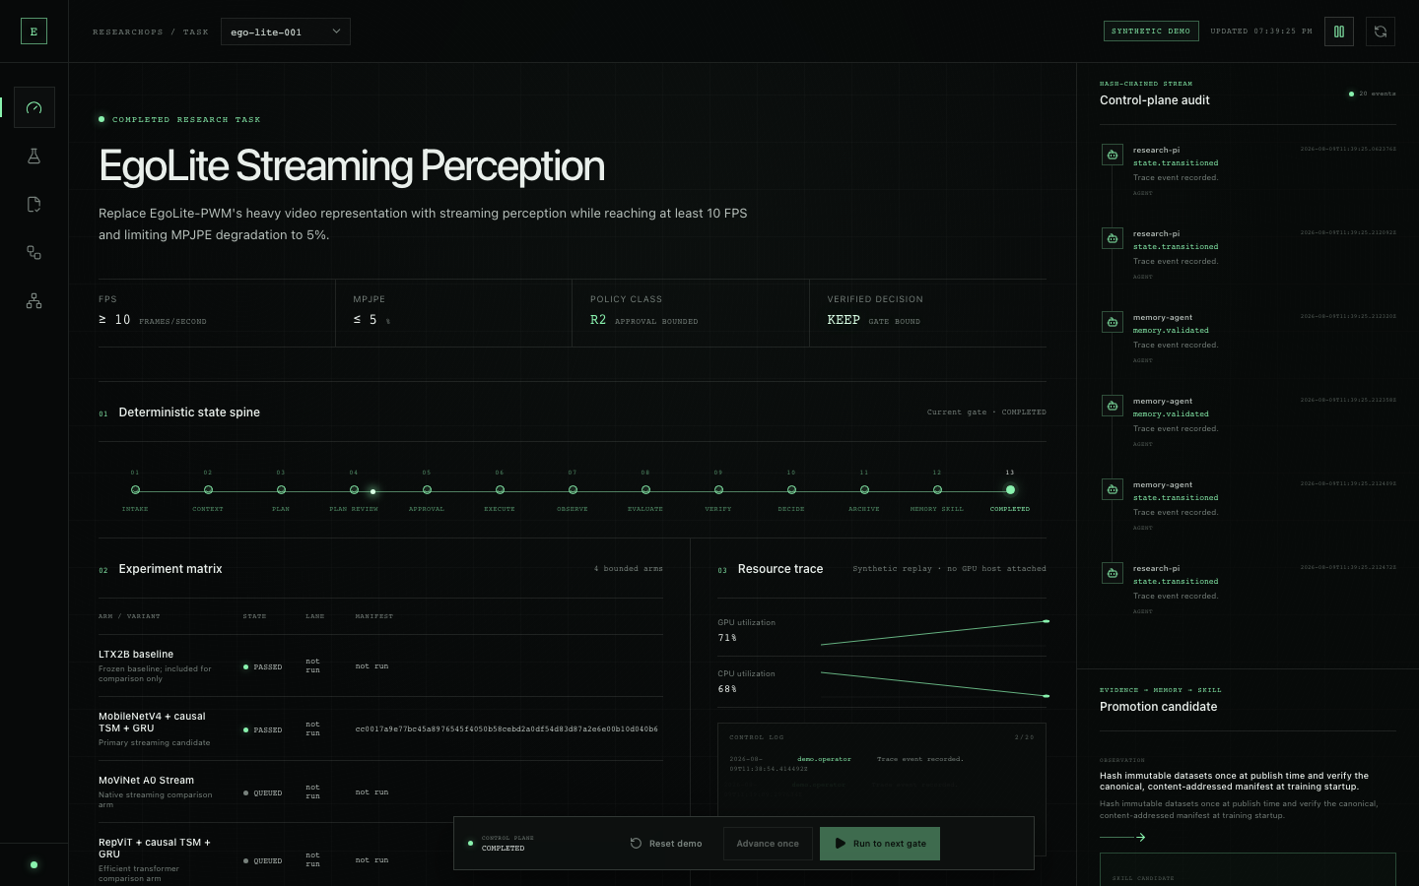
JUDGE REPLAY · CHECKPOINT 2
故障注入
必须改变结局
timeout / conflict / replay / tamper 不能被吞掉：重路由、阻断或 SKIP 必须进入 evidence bundle。
同一 benchmark corpus · independent oracle
Notes:
[Sources]
- benchmarks/corpus/v1/scenarios.json
- benchmarks/oracle.py
- benchmarks/trace_verifier.py
[Talk track]
30 秒：注入一个 fault；观察 route 或 verdict 改变，不能只看脚本退出码。

Slide 12
Evidence · 2026-09-03 最终验收
同一仓库同时给出代码、负测、报告与 release gate
make test：530 PASS / 1 SKIP；full pytest：689 PASS / 1 SKIP；PostgreSQL：38 / 38。
Core + protocol + Skills
React RXP Cockpit
A · LOCAL TESTS
B · FRONTEND
689
Ruff
MyPy
28
Build
0
UI
full pytest PASS
PASS
PASS
Web tests PASS
Vite PASS
console errors
truth labels
API 89 · RXP 26 · Skills 6 · Proof 3 · Benchmark 29 Acceptance 16 · AgentTeams 264 · Experiments 16 · MCP 53 · Web 28
1600×1000 与 390×844 已检查；新增 semifinal acceptance path 可切换。
AgentTeams + PostgreSQL
Strict corpus
C · INTEGRATIONS
D · BENCHMARK
264
38
PENDING
14
3
ORACLE
AgentTeams tests
PostgreSQL 16.14
workflow
attack scenarios
profiles
independent
official infra / Matrix 已 LIVE_LOCAL；科研 workflow、GPU、Nexa / PITR 未运行。
dev gate 证明 local core；release gate 无 live target 时预期非零退出。
证据命令：make test · pytest tests/postgres · freeze_live_local_proof.py · make package
Notes:
[Sources]
- submission/verification-report.md
- docs/evidence/postgres-local-proof-2026-08-29.md
- benchmarks/artifacts/
- semifinal_acceptance/README.md
[Talk track]
35 秒：默认 210 与独立 PG 27 分开计数；任何 official AgentTeams、GPU 或 PolarDB live 结论都不从本地测试外推。

Slide 13
Failure first · Recovery is evidence
异常不是旁支：它必须改变 route、state 或 release verdict
每个 fault 都由 corpus 定义，adapter 输出受独立 oracle 与 schema-aware trace verifier 双重检查。
超时不伪装成功
并发冲突需显式解决
A · TIMEOUT
B · CONFLICT
deadline
cancel
reassign
409
replan
hash
no overwrite
subprocess timeout
structured
observable
optimistic conflict
generation++
preserved
same run
worker 卡住 → timeout event → bounded reassign；没有终态 trace 就不能 PASS。
两条并发链由事务 / expected_version 执法；旧 generation 不可静默覆盖新计划。
重启后不丢 causal chain
篡改与重放直接阻断
C · CRASH / RESUME
D · TAMPER / REPLAY
检查点
restart
resume
nonce
digest
Decision
persist first
fresh process
same trace refs
replay rejected
tamper detected
withheld
SQLite dev 与 PostgreSQL profile 都要求重启后读取 authoritative state。
错误本身进入 evidence bundle；error / omission / timeout 都计入失败率。
同一 correlation：scenario_id · project/task · rxp run/cell · invocation · evidence root · verdict
Notes:
[Sources]
- benchmarks/README.md
- docs/state-machine.md
- tests/benchmarks/
[Talk track]
35 秒：四类故障都必须有结构化终态、恢复动作和相同 correlation。

Slide 14
可迁移 · Database & deployment profiles
协议不绑定某个模型；状态语义在 local 与 production profile 中保持一致
DUAL
SQLite 仅作 dev fallback；PostgreSQL 生产语义已验证；TDSQL Nexa / Agent Memory 云端仍待实证。
可复用控制内核
场景只替换 schema / handler
数据底座分级
RXP + AGENTTEAMS + SKILLS
PORTABLE RECIPES
INTEGRATION TRUTH
01
Model training: arms × seeds
领域 metric / evaluator
由 Skill handler 注入
已验证
PostgreSQL 16 · 38 integration tests
02
Data pipeline: source × transform
资源 adapter
local / Slurm / K8s / cloud
已实现
4 roles · RLS · append-only · LISTEN/NOTIFY
03
Robotics: policy × scene × seed
未验证
TDSQL Nexa · Agent Memory · PITR · cloud IAM
证据 taxonomy
按合规场景扩展
04
Eval: model × benchmark slice
迁移
per-test schema · checksummed apply / verify
人类权限线
R0–R3 policy 配置
回退
explicit SQLite dev only · PG never silent fallback
05
Regulated workflow: maker/checker
06
AutoResearch: hypothesis queue
结论规则
acceptance schema versioned
目标
Nexa preflight + restore / failover drill
共同对象：Intent · Grant · Receipt · Evidence · Decision · MatrixLedger
协议层不读取 secret；执行 adapter 只接短期凭证
所有 profile 共用相同 state / idempotency / evidence invariants；差异只在 capability disclosure
Notes:
[Sources]
- apps/api/postgres_store.py
- apps/api/polardb_preflight.py
- deploy/postgres/security_roles.sql
- docs/postgres-recovery-runbook.md
- docs/polardb-live-acceptance-runbook.md
[Talk track]
30 秒：本地 PostgreSQL 16.14 已验证 27 项；PolarDB、PITR、读写分离和 failover 只能由云端报告升级状态。

Slide 15
开源 · Claim ledger
每一条判断都能落到命令、文件、artifact 或明确的 NOT RUN
Apache-2.0 核心 + schemas + fixtures + benchmark；私有数据、密钥和真实 GPU 权限不进仓库。
现在拥有什么
复赛验收梯子
EVIDENCE LADDER
REPRODUCTION PATH
已运行
local control plane + RXP cockpit
01
make test
LOCAL
unit / contract / negative controls / static checks
API / Web / RXP / Skill registry / strict benchmark；静态页面不冒充后端调用。
02
demo-proof + acceptance
BUNDLE
ledger · raw metrics · Matrix · trace · Decision
已验证
PostgreSQL 16 + AgentTeams LIVE_LOCAL
03
target release gate
FAIL CLOSED
PG 38 + bridge 264；Controller / Manager / 4 Workers / Matrix smoke 已联通。
无 live target → non-zero / SKIP evidence
04
operator live bundle
EXTERNAL
官方 trace + raw metrics + origin attestation
仍未运行
科研 workflow · GPU · Nexa / PITR
SHA-256
05
freeze submission
Project 的 8 nodes 均 PENDING；没有 GPU receipt 与 same-run trace 就不写成闭环成功。
PPT/PDF · demo · package · evidence index
SYNTHETIC：托管 EgoLite 指标；Fashion-MNIST adapter 已实现，但 live origin 仍 UNVERIFIED。
Pages 提供 LIVE_BROWSER 专家规划 + synthetic replay；AgentTeams / PostgreSQL 由 LIVE_LOCAL 证据证明
15
Notes:
[Sources]
- docs/claims-evidence.md
- docs/judge-feedback-implementation.md
- semifinal_acceptance/README.md
- submission/semifinal-evidence-index.md
[Talk track]
25 秒：把已运行、合同已验证与外部 NOT RUN 分层；一键包也不会把 operator assertion 冒充可认证 origin。

Slide 16
Demo · 8 分钟证据路径
请直接复现，不必相信 PPT
吕新科｜北京邮电大学 · 智能科学与技术
演示节奏
评委复现：一个入口，三步复现
ONE RUN · ONE CLOSURE
JUDGE REPLAY
0:00–1:00
① 打开 static cockpit
01
痛点 + 初赛反馈：为什么需要 RXP。
SEE
确认 STATIC REPLAY / CONTRACT IMPLEMENTED / EXTERNAL NOT RUN
1:00–3:00
02
展示 AgentTeams LIVE_LOCAL、冻结 workflow 与 R2 授权合同。
② 运行 local proof
VERIFY
make test · PostgreSQL 38 · LIVE_LOCAL proof
3:00–5:00
03
步进 synthetic run：raw metrics → eval → reviewer → Decision。
③ 检查 release gate
TRUST
5:00–8:00
无可认证 origin 时禁止 live claim；检查 frozen acceptance bundle
04
PG 38/38、Matrix proof、recovery 与 NOT RUN boundary。
附包：judge-feedback-implementation.md · acceptance bundle · evidence index · benchmark artifacts
EgoAgentOS / RXP：让 AI 不只会做实验，而是对实验的权限、完整性与结论负责。
16
Notes:
[Sources]
- docs/judge-feedback-implementation.md
- docs/agentteams-live-runbook.md
- docs/polardb-live-acceptance-runbook.md
- submission/demo-script-8min.md
[Talk track]
20 秒：先复现本地合同，再说明 live acceptance 需要同一 run 的官方协作、GPU、数据库与恢复证据。

