Slide 1
Hints on Using Spark on AWS EC2
ECE 4150
Georgia Tech
(Madisetti, Fall 2021)

Slide 2
Steps to Get Spark Running on AWS
Create an EC2 instance – Use Ubuntu Free Tier Micro. In the Security Settings, use “All Traffic” instead of SSH
SSH into the EC2 instance
Download and Install Anaconda on EC2
> wget http://repo.continuum.io/archive/Anaconda3-4.1.1-Linux-x86_64.sh
> bash Anaconda3-4.1.1-Linux-x86_64.sh
Press Enter when the Bash Shell Opens and You will see an Agreement Form... Keep Hitting enter till it says "Do you approve the Licence Terms"
Say 'yes' -> Then it says "Anaconda will be installed at Present Location"
If you like the location you are in: Hit Enter!
Anaconda will install then … A whole bunch of files and dependencies!!!
> source .bashrc
> jupyter notebook --generate-config

Slide 3
Create Certifications
Create Certifications
> mkdir certs
> cd certs
> sudo openssl req –x509 –nodes –days 365 –newkey rsa: 1024
-keyout mycert.pem –out mycert.pem

Slide 4
Configuring Notebooks
> cd ~/.jupyter/
> edit or vi jupyter_notebook_config.py
Add the following code to jupypter_notebook_config.py
Once configured
While using vim : Hit Esc then
Type :wq and hit enter!

Slide 5
Trouble Shooting Checklist:
If you don’t get the Jupyter notebook running: Make sure you have an https: <EC2 INSTANCE>:8888
If you are getting a permission denied. Its because the EC2 Instance is preventing access.
In order to handle this. We need to change the root of the jupyter library...
This is done using the instruction:
sudo chown -R $USER /home/
sudo chown ubuntu:ubuntu mycert.pem
In the directory where mycert.pem is …

Slide 6
Run Server > jupyter notebook
> jupyter notebook on EC2
> Point laptop browser to https://ec2........... amazonaws.com:8888
Check the AWS Console for the IP address of launched EC2 instance
Check to see if the browser connects to the site… Click through the certificates and disregard the warnings…

Slide 7
JRE & SCALA – Bases for Spark
Install Java RE
> sudo apt-get update
> sudo apt-get install default-jre
Install SCALA
> sudo apt-get install scala

Slide 8
Next Steps
Install py4j
1
> export PATH = $PATH:$HOME/anaconda/bin
> conda install pip
> pip install py4j
Install Spark/Hadoop
2
> wget http://archive.apache.org/dist/spark/spark-2.0.0/spark-2.0.0-bin-hadoop2.7.tgz
3
> sudo tar –zxvf spark-2.0.0-bin-hadoop2.7.tgz
4

Slide 9
Next Steps
Point Python to Spark
> export SPARK_HOME=‘/home/ubuntu/spark-2.0.0-bin-hadoop2.7’
> export PATH=$SPARK_HOME:$PATH
> export PYTHONPATH=$SPARK_HOME/python:$PYTHONPATH
Launch JupyterNotebook
> jupyter notebook
(Alternate way is to launch a PySpark shell)

Slide 10
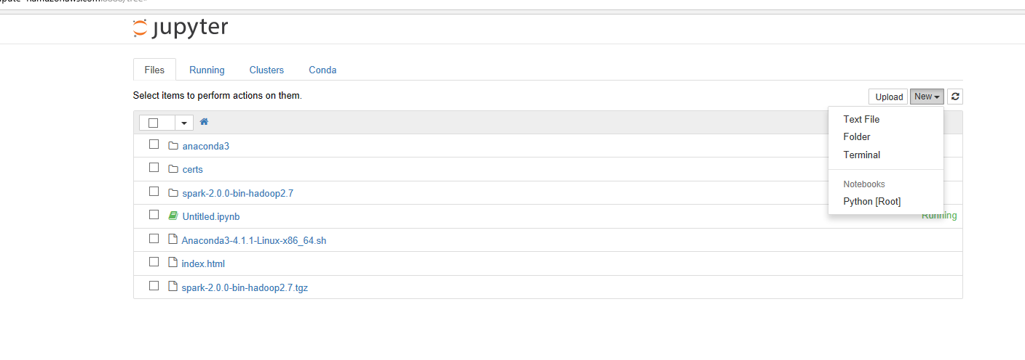
Open a new notebook

Slide 11
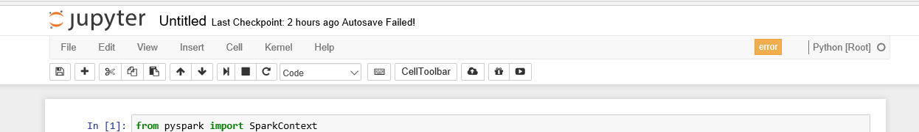

Open a new notebook on the browser
Open the Web browser to the location port 8888, and open a new notebook
Initialize the Spark Environment

Slide 12
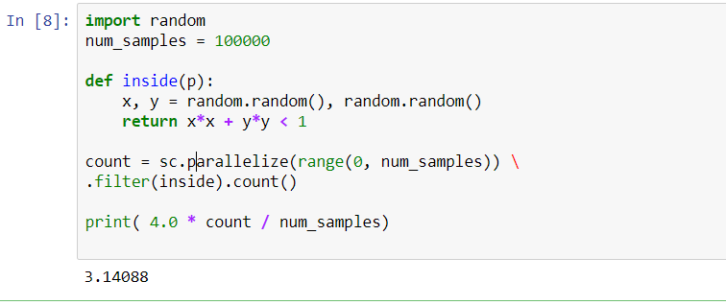
Try Out the Code

Slide 13
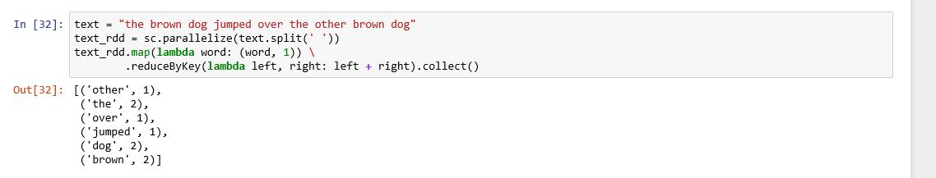
Try This Out

Slide 14
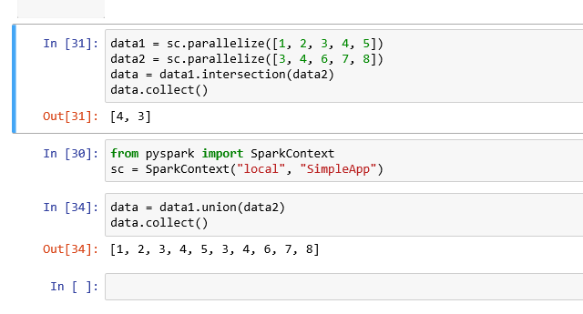
Try This Out.

