Slide 1
T-GCN: A Temporal Graph Convolutional Network for Traffic Prediction
Citation:
L. Zhao et al., "T-GCN: A Temporal Graph Convolutional Network for Traffic Prediction," in IEEE Transactions on Intelligent Transportation Systems, vol. 21, no. 9, pp. 3848-3858, Sept. 2020, doi: 10.1109/TITS.2019.2935152.

Slide 2
Background
Traffic forecasting is a process of analyzing traffic conditions on urban roads, including flow, speed, and density, mining
traffic patterns, and predicting the trends of traffic on roads.
Traffic forecasting has always been a challenge task due to its complex spatial and temporal dependences:

Slide 3
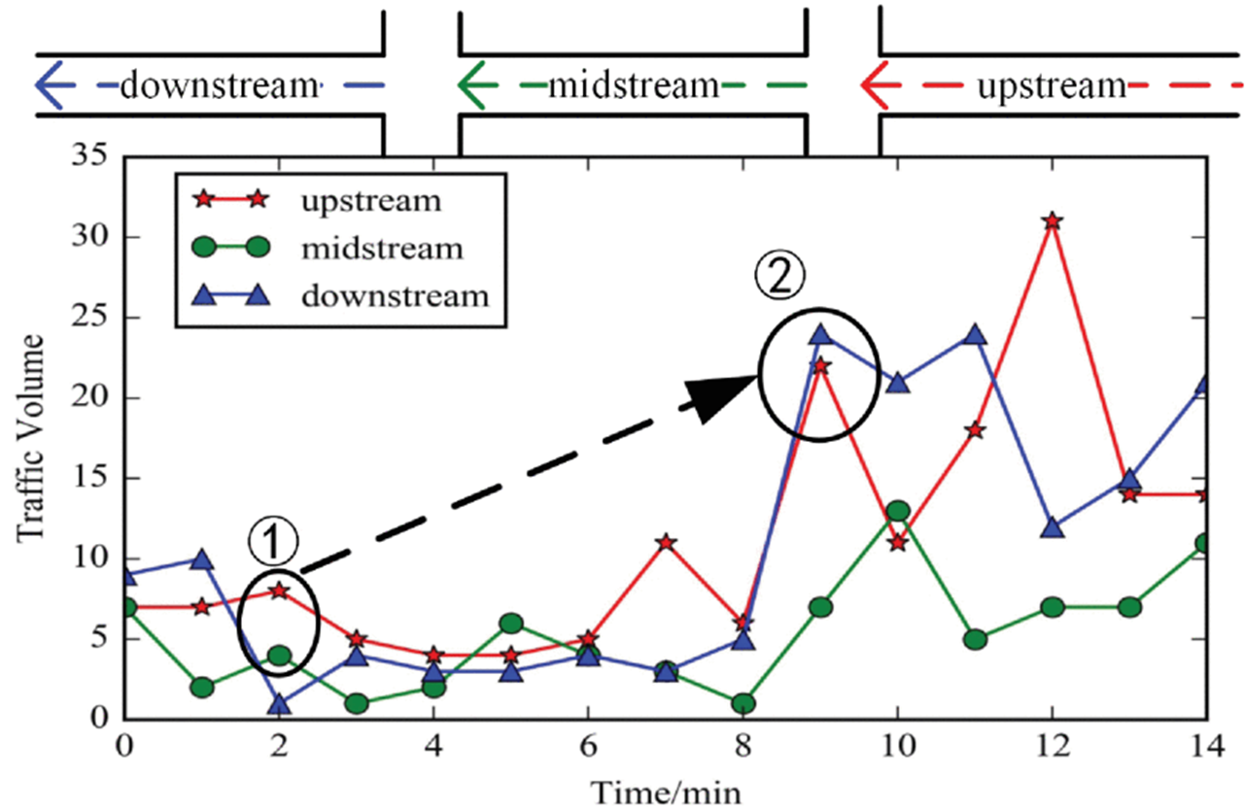
Spatial and Temporal Dependences
Spatial Dependences:
The change in traffic volume is dominated by the topological structure of the urban road network. The traffic status at upstream roads impact traffic status at downstream roads through the transfer effect, and the traffic status at downstream roads impact traffic status at upstream through the feedback effect.
Fig. 1. Spatial dependence is restricted by the topological structure of the road network. Due to the strong influence between adjacent roads, the short-term traffic flow similarity is changed from state ① to state ② .

Slide 4
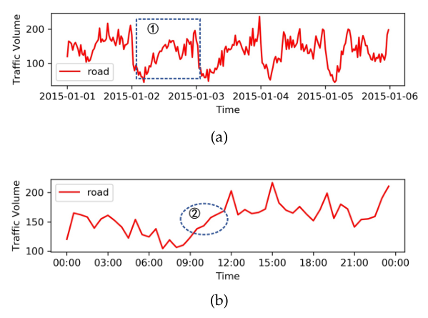
Spatial and Temporal Dependences
Temporal Dependences:
The traffic volume changes dynamically over time and is mainly reflected in periodicity and trend. For example, the traffic volume will be affected by the traffic condition of the previous moment or even longer.
Fig. 2. (a) Periodicity. The traffic volume in the road changes periodically within one week. (b) Trend. The traffic volume in the road has tendency change within one day.

Slide 5
Existing prediction models
Prediction model considering temporal dependences:
Autoregressive Integrated Moving Average (ARIMA) model
Kalman Filtering model
Support Vector Regression Machine (SVRM) model
Partial Neural Network model
Prediction model considering spatial dependences:
“Deep spatio-temporal residual networks for citywide crowd flows prediction,”
“Short-term traffic flow forecasting with spatial-temporal correlation in a hybrid deep learning framework”
“Spatio-temporal recurrent convolutional networks for traffic prediction in transportation networks”

Slide 6
Contribution
A new traffic forecasting method called the temporal graph convolutional network (T-GCN), which is used for traffic forecasting task based on urban road network.
(1) T-GCN integrates GCN and GRU. GCN is used to capture the topological structure of road network and model the spatial dependence. GRU is used to capture the dynamic changes of road traffic data and to model the temporal dependence.
(2) T-GCN model can be used not only for short-term forecasting, but also for long-term traffic forecasting.

Slide 7
Related Work
Existing traffic forecasting methods can be divided into two categories:
the model-driven approach and the data-driven approach
CNN is commonly used for Euclidean data such as images, regular grids, and so on. Such models cannot work under the context of an urban road network with a complex topological structure so in essence they cannot describe the spatial dependence properly.

Slide 8
Related Work
The model-driven approach mainly explains the instantaneous and steady-state relationships among traffic volume, speed, and density. Such methods require comprehensive and detailed system modeling based on prior knowledge.
Examples：
Queuing theory model
The cell transmission model
Traffic velocity model
Microscopic fundamental diagram model

Slide 9
Related Work
Data-driven approaches infer the variation tendency based on statistical regularity of the data and is eventually used to predict and evaluate the traffic state.
Examples:
the historical average model (HA)
The time series model
the linear regression model
the Kalman filtering model
the Autoregressive Integrate Moving Average Model (ARIMA)
Traditional parametric models:
the k-nearest neighbor model
the Fuzzy Logic model
the Bayesian network model
the neural network model

Slide 10







Problem Definition
Definition 1:
V is a set of road nodes, N is the number of the nodes, and E is a set of edges.
The adjacency matrix A is used to represent the connection between roads.
Definition 2:
P represents the number of node attribute features (the length of the historical time series)
is used to represent the speed on each road at time i

Slide 11
Problem Definition
Definition 3:
Goal:
Predict the traffic information in a certain period of time based on the historical traffic information on the roads.
The problem of spatio-temporal traffic forecasting can be considered as learning the mapping function f on the premise of road network topology G and feature matrix X and then calculating the traffic information in the next T moments.

Slide 12
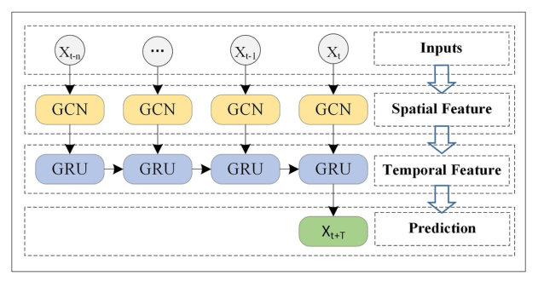
Framework Overview
Fig. 3. Overview. We take the historical traffic information as input
and obtain the finally prediction result through the Graph Convolution Network and the Gated Recurrent Units model.

Slide 13
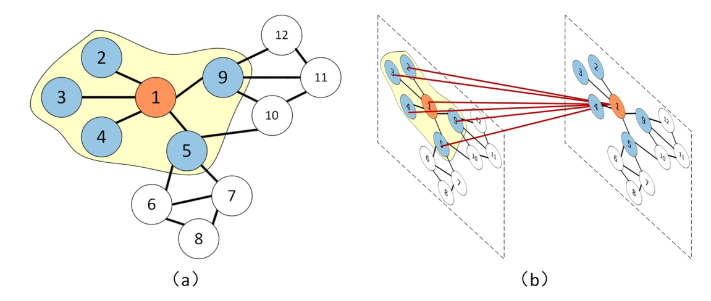
Spatial Dependence Modeling
Given adjacency matrix A and characteristic matrix X, GCN constructs a filter in Fourier domain. The filter acts on the nodes of the graph, captures the spatial features between the nodes through its first-order neighborhood, and then constructs GCN by stacking multiple convolution layers.
Fig. 4. Assuming that node 1 is a central road.
The blue nodes indicate the roads connected to the central road.
We obtain the spatial feature by obtaining the topological relationship between the road 1 and the surrounding roads.

Slide 14





Function Expression
Weight matrix of the input layer to output layer
Adjacency matrix
Activation function
Feature matrix
Weight matrix of the hidden layer to output layer
Preprocessing step
A matrix with self-connection structure
Degree matrix

Slide 15
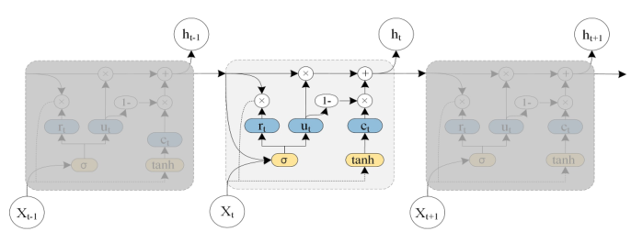
Temporal Dependence Modeling
The reason of choosing GRU:
LSTM training time is longer, GRU structure is relatively simple, parameters are less, training ability is faster.
Fig. 5. The architecture of the Gated Recurrent Unit model.

Slide 16
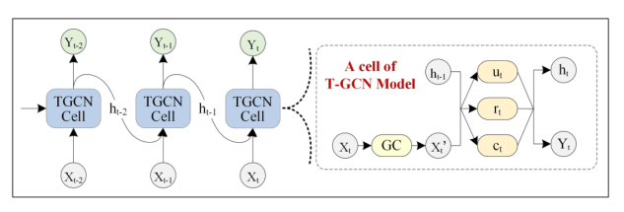
Temporal Graph Convolutional Network
Fig. 6. The overall process of spatio-temporal prediction. The right part represents the specific architecture of a T-GCN unit, GC represents graph convolution.

Slide 17
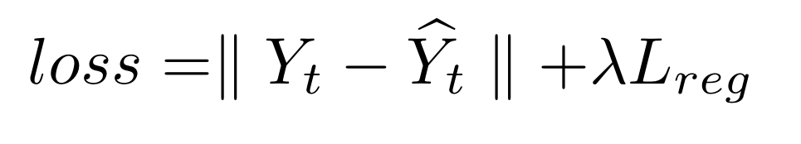
Loss Function Expression
Predicted traffic speed
A hyperparameter
Real traffic speed
L2 regularization term that helps
to avoid an over fitting problem

Slide 18
Datasets
SZ-taxi
156 roads (nodes), and summarize the flow rate every 15 minutes. Adjacency matrix a [156,156].
characteristic matrix X [156,15].
Los-loop
A[207,207],X [207,5]。
Data set partition: 80% for training, 20% for testing.
Prediction Goal: the flow rate after 15, 30, 45 and 60 minutes.

Slide 19
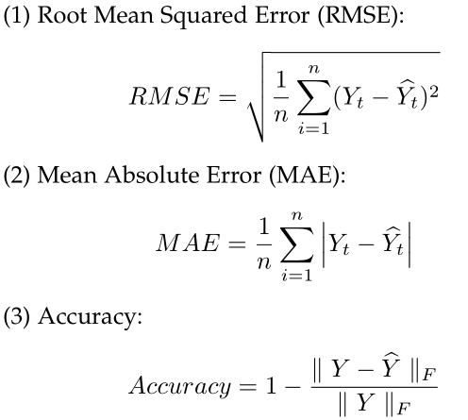
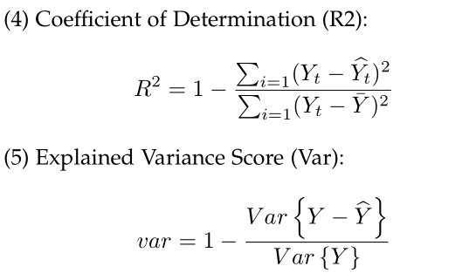
Evaluation Metrics

Slide 20
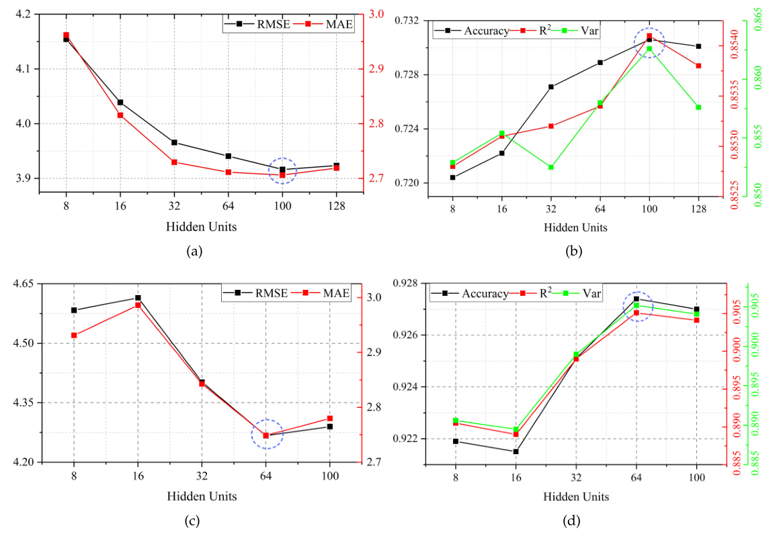
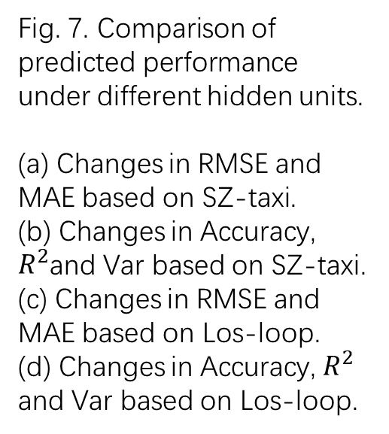
Result(hidden units)
Fig. 7. Comparison of predicted performance under different hidden units.
(a) Changes in RMSE and MAE based on SZ-taxi.
(b) Changes in Accuracy, $R^{2}$and Var based on SZ-taxi. (c) Changes in RMSE and MAE based on Los-loop.
(d) Changes in Accuracy, $R^{2}$ and Var based on Los-loop.

Slide 21
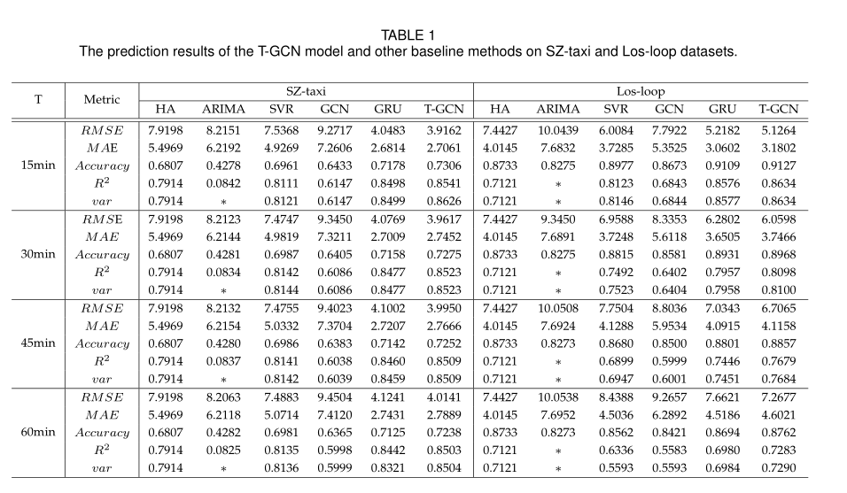
Result(High prediction precision.)

Slide 22
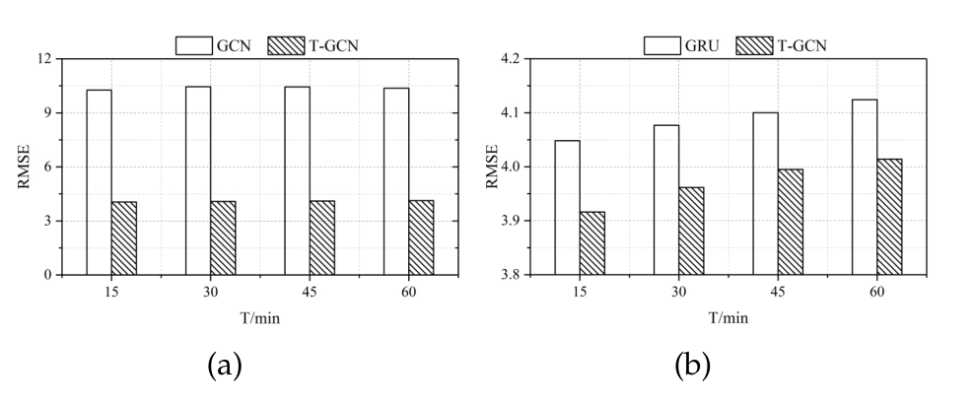
Result(Spatio-temporal prediction capability)
Fig. 8. (a) The RMSE of the T-GCN model lower than the GCN model, which considers spatial feature only, indicating the effectiveness of the T-GCN to capture spatial feature. (b) The RMSE of the T-GCN model lower than the GRU model, which considers temporal feature only, indicating the effectiveness of the T-GCN to capture temporal feature.

Slide 23
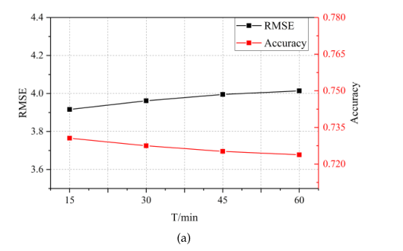
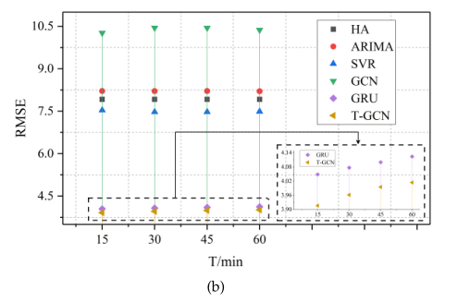
Result(Long-term prediction ability)
Fig. 9. (a) Under different prediction horizons, the change of RMSE and Accuracy are small, indicating that our approach is insensitive to prediction horizons. (b) Under different prediction horizons, the T-GCN model has lowest RMSE error compared to baseline methods.

Slide 24
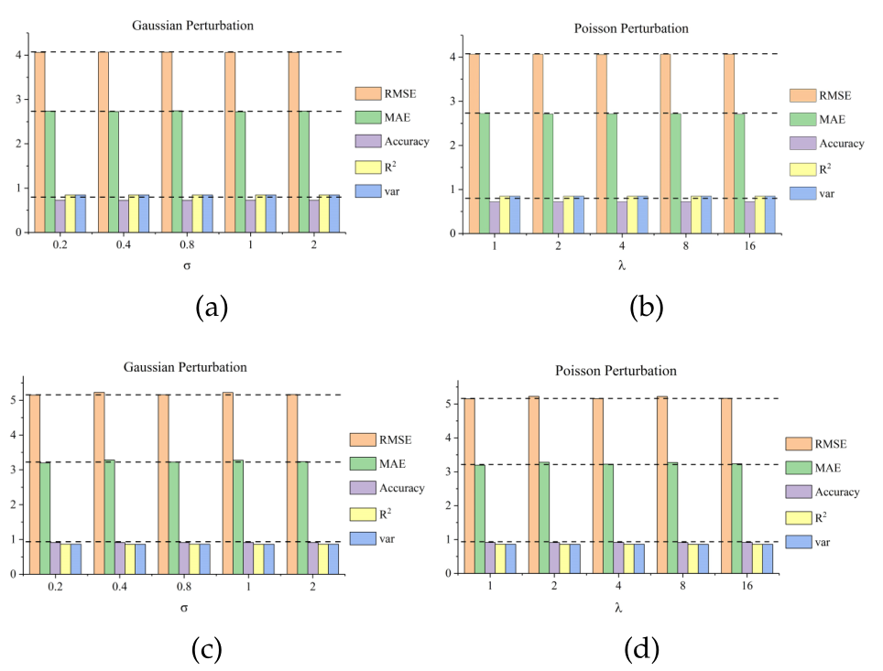
Result(Perturbation Analysis and Robustness)
Fig. 10. Perturbation analysis. The horizontal axis represents σ or λ, the vertical axis represents prediction results, and different colors mean different metrics.
(a) The results of adding Gaussian perturbation on SZ-taxi.
(b) The results of adding Poisson perturbation on SZ-taxi.
(c) The results of adding Gaussian perturbation on Los-loop.
(d) The results of adding Poisson perturbation on Los-loop.

Slide 25
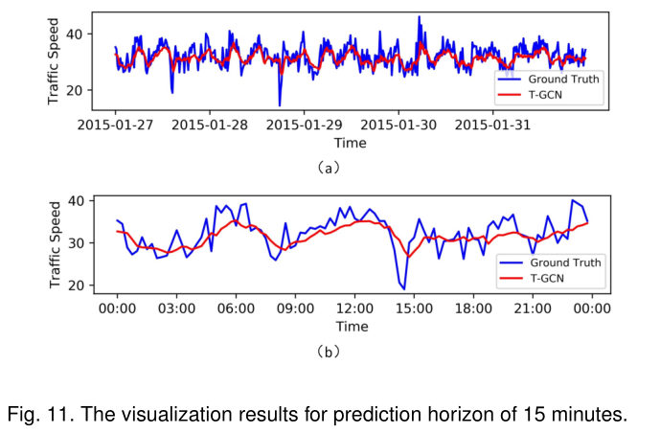
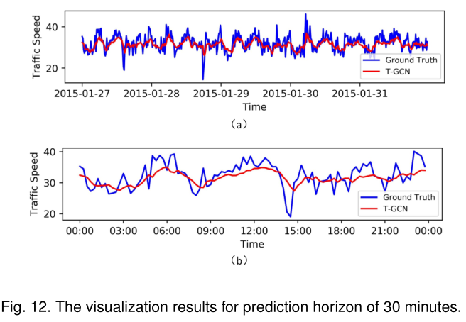
Model Interpretation
Figure 11, Figure 12 show the visualization results for prediction horizons of 15 minutes, 30 minutes

Slide 26
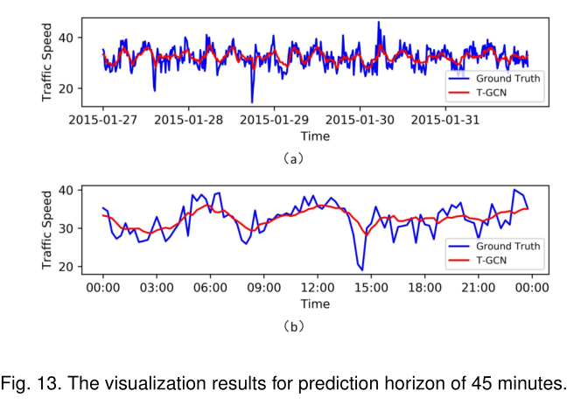
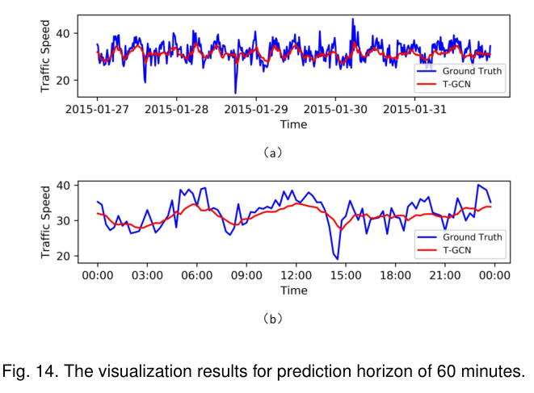
Model Interpretation
Figure 13, Figure 14 show the visualization results for prediction horizons of 45 minutes, 60 minutes

Slide 27
Model Interpretation
(1) T-GCN model has poor prediction at local minimum / maximum. Conjecture: GCN defines a smoothing filter in Fourier domain and captures spatial features by continuously moving the filter, which leads to smoother peaks.
(2) There is a certain error between the actual traffic information and the predicted results, which is caused by the "zero taxi value". The zero value of taxi is the phenomenon of setting the traffic characteristic matrix with non-zero real value to zero.
(3) T-GCN model can capture the temporal and spatial characteristics and learn the change trend. It can detect the beginning and end of peak hours, and get the prediction results in a mode similar to the actual traffic speed.

