Slide 1
A3T-GCN: Attention Temporal Graph Convolutional Network for Traffic Forecasting
Citation：
Zhu, Jiawei, Yujiao Song, Ling Zhao and Haifeng Li. “A3T-GCN: Attention Temporal Graph Convolutional Network for Traffic Forecasting.” ArXiv abs/2006.11583 (2020).

Slide 2
Background
Accurate real-time traffic forecasting has always been a great challenge because of complex SPATIAL and TEMPORAL dependencies.
Temporal dependence means that traffic state changes with time, which is manifested by periodicity and tendency.
Spatial dependence means that changes in traffic state are subject to the structural topology of road networks, which is manifested by the transmission of upstream traffic state to downstream sections and the retrospective effects of downstream traffic state on the upstream section.

Slide 3
Contribution
A new traffic forecasting model A3T-GCN which combines GCNs and GRUs and introduces an attention mechanism. It not only can capture spatiotemporal dependencies but also adjust and assemble global variation information.
The proposed A3T-GCN model is composed of GCN module, GRU module and Attention module.

Slide 4
Difference between A3T-GCN and T-GCN
On the basis of T-GCN, A3T-GCN introduces attention mechanism, adjusts the importance of different time points, and collects global time information, so as to improve the prediction accuracy, obtain the global change trend of traffic state, and obtain more accurate prediction accuracy.

Slide 5







Problem Definition
Definition 1:
V is a set of road nodes, N is the number of the nodes, and E is a set of edges.
The adjacency matrix A is used to represent the connection between roads.
Definition 2:
P represents the number of node attribute features (the length of the historical time series)
is used to represent the speed on each road at time i

Slide 6
Problem Definition
Definition 3:
Goal:
Predict the traffic information in a certain period of time based on the historical traffic information on the roads.
The problem of spatio-temporal traffic forecasting can be considered as learning the mapping function f on the premise of road network topology G and feature matrix X and then calculating the traffic information in the next T moments.

Slide 7
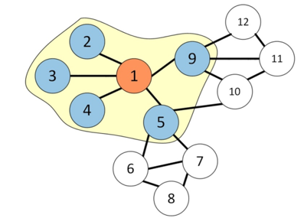
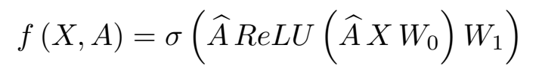
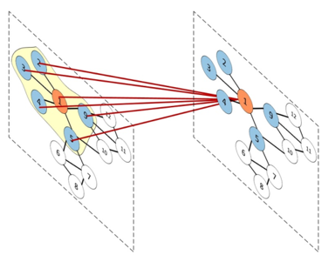
GCN Model
The topological characteristics of the road network were captured to obtain spatial dependencies.
Two-layer GCN convolution output works as follows:
By determining the topological relationship between the central section and the surrounding section, GCNs can simultaneously encode the topological structure of the road network and the attributes of the section.

Slide 8
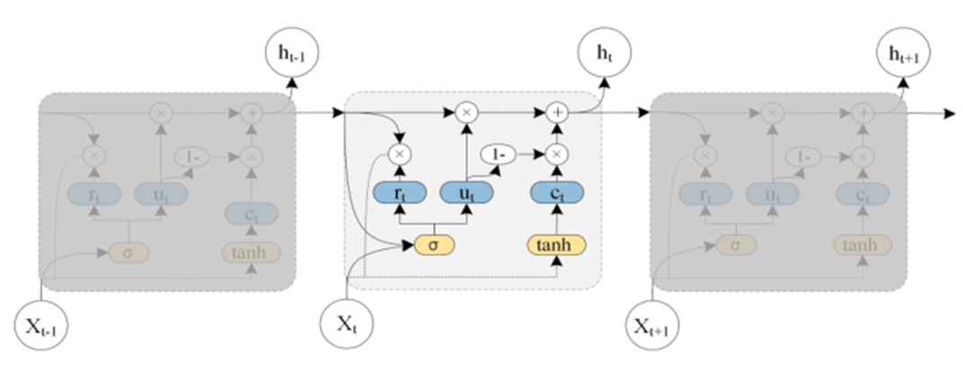
GRU Model
GRUs retain the variation trends of historical traffic information when capturing traffic information at current moment because of the gated mechanism. Hence, this model can capture dynamic temporal variation features from the traffic data, that is, this study has applied a GRU model to learn the temporal variation trends of the traffic state.
The architecture of the Gated Recurrent Unit model.

Slide 9
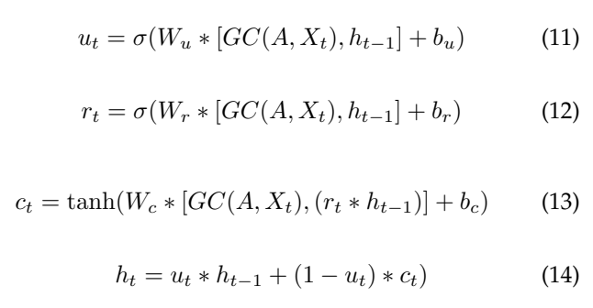
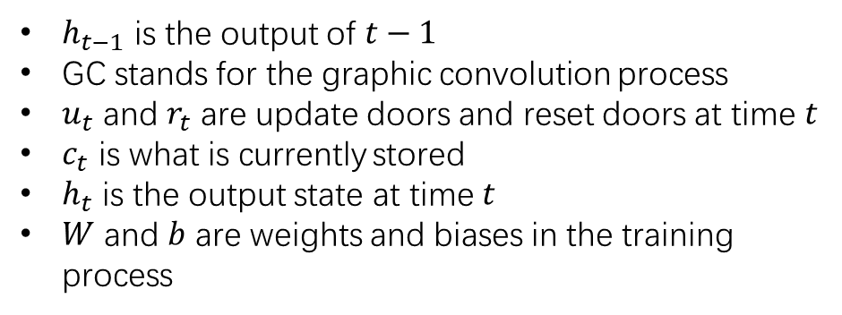
GRU Model
$h_{t−1}$ is the output of $t−1$
GC stands for the graphic convolution process
$u_{t}$ and $r_{t}$ are update doors and reset doors at time $t$
$c_{t}$ is what is currently stored
$h_{t}$ is the output state at time $t$
$W$ and $b$ are weights and biases in the training process

Slide 10
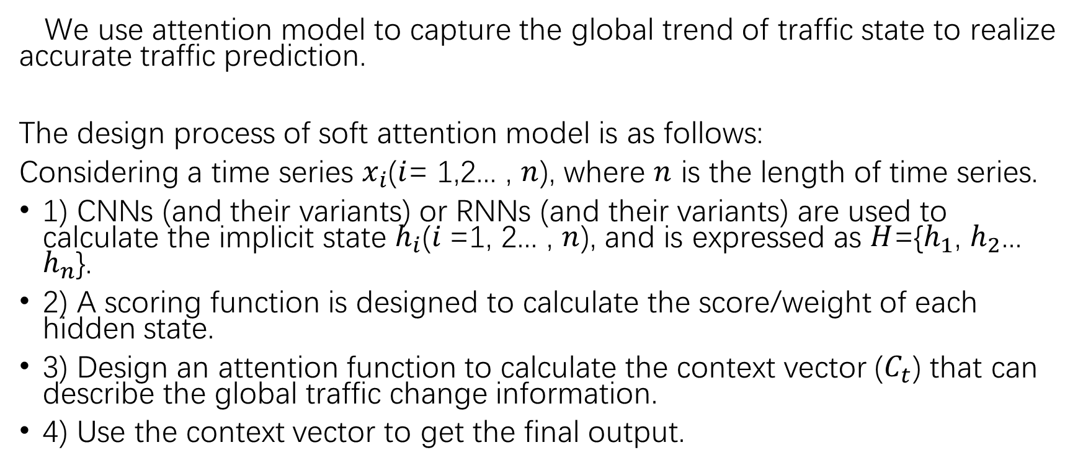
Attention Model
We use attention model to capture the global trend of traffic state to realize accurate traffic prediction.
The design process of soft attention model is as follows:
Considering a time series $x_{i}$($i$= 1,2... , $n$), where $n$ is the length of time series.
1) CNNs (and their variants) or RNNs (and their variants) are used to calculate the implicit state $h_{i}$($i$=1, 2... , $n$), and is expressed as $H$={$h_{1}$, $h_{2}$... $h_{n}$}.
2) A scoring function is designed to calculate the score/weight of each hidden state.
3) Design an attention function to calculate the context vector ($C_{t}$) that can describe the global traffic change information.
4) Use the context vector to get the final output.

Slide 11
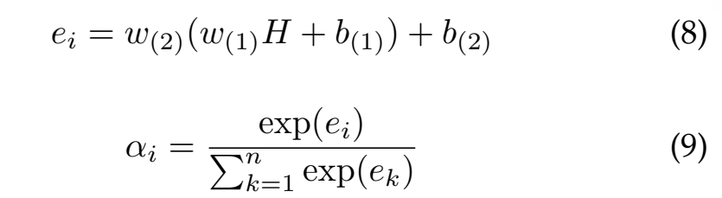
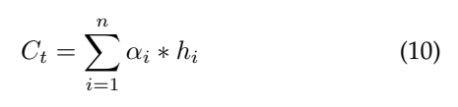
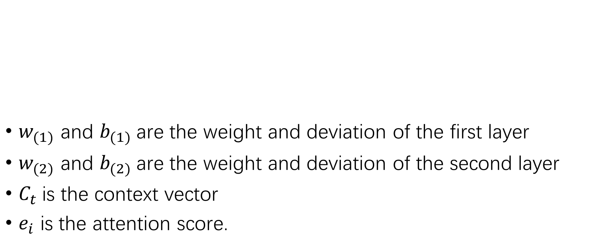
Attention Model
$w_{(1)}$ and $b_{(1)}$are the weight and deviation of the first layer
$w_{(2)}$ and $b_{(2)}$are the weight and deviation of the second layer
$C_{t}$is the context vector
$e_{i}$ is the attention score.

Slide 12
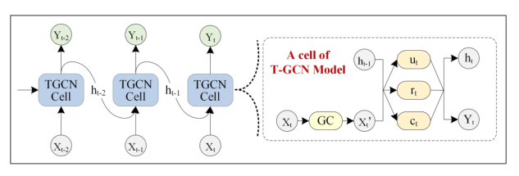
T-GCN Model
Fig. 6. The overall process of spatio-temporal prediction. The right part represents the specific architecture of a T-GCN unit, GC represents graph convolution.

Slide 13
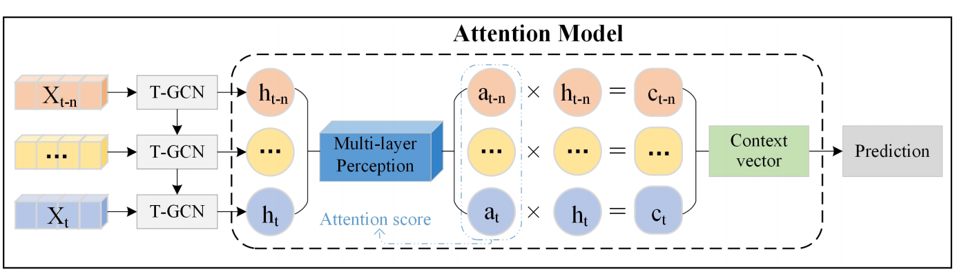

A3T-GCN Model
Step 1. T-GCN model was established by combining GCN and GRU. $n$hidden states ($h$) can be calculated from Equation (11), representing the spatio-temporal characteristics: {$h_{t−n}$,... , $h_{t−1}$, $h_{t}$}.
Step 2. Implicit input into the attention model, the context vector $C_{t}$ covering the global traffic change information is obtained.
Step 3. The prediction results are output by the full connection layer.

Slide 14
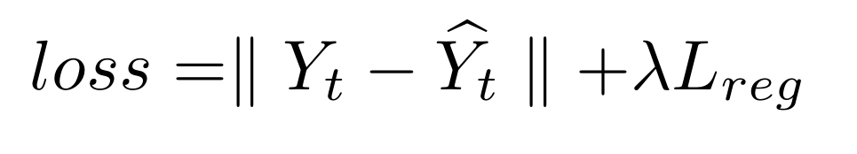
Loss Function
Predicted traffic speed
A hyperparameter
Real traffic speed
L2 regularization term that helps
to avoid an over fitting problem

Slide 15
Data Description
SZ-taxi
156 roads (nodes), and summarize the flow rate every 15 minutes. Adjacency matrix a [156,156].
characteristic matrix X [156,15].
Los-loop
A[207,207],X [207,5].
Data set partition: 80% for training, 20% for testing.
Prediction Goal: the flow rate after 15, 30, 45 and 60 minutes.

Slide 16
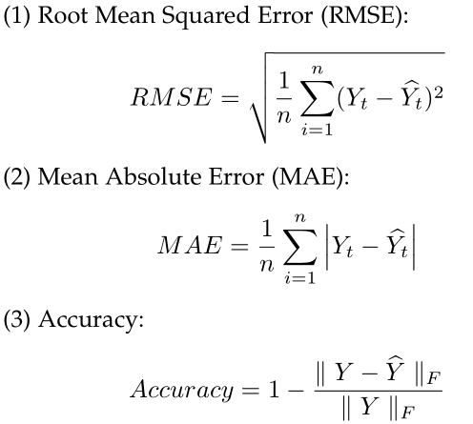
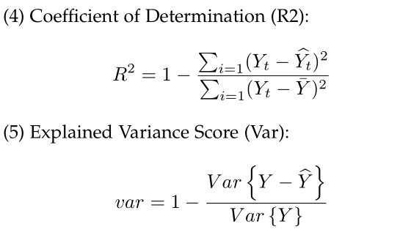
Evaluation Metrics

Slide 17
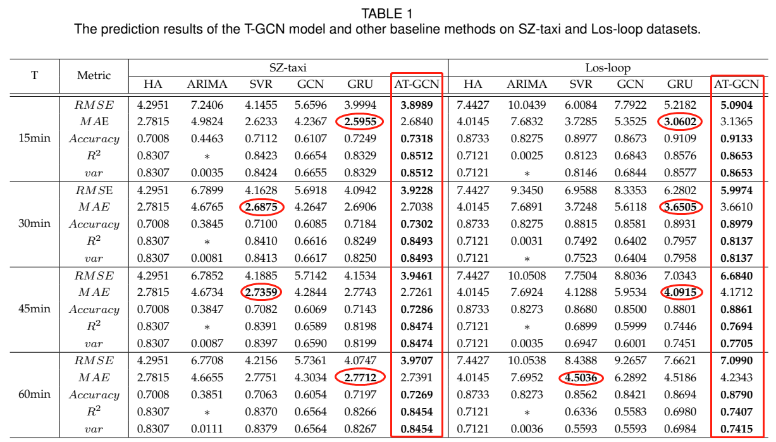
Experimental Result Analysis(Precision)

Slide 18
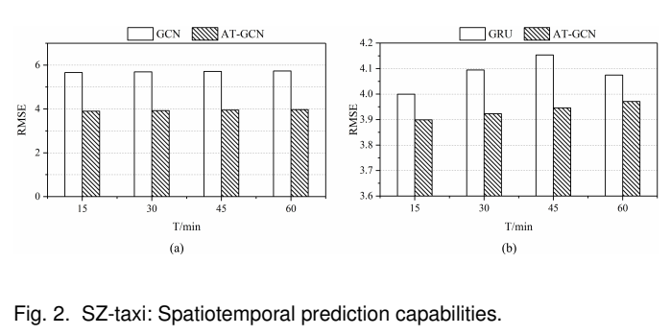
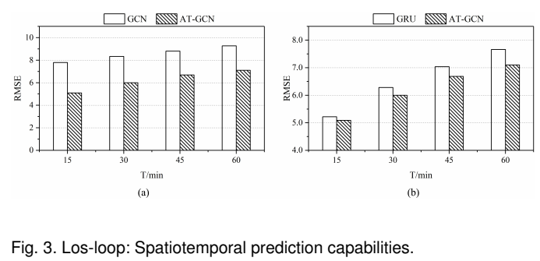
Experimental Result Analysis (Spatiotemporal prediction capabilities.)

Slide 19
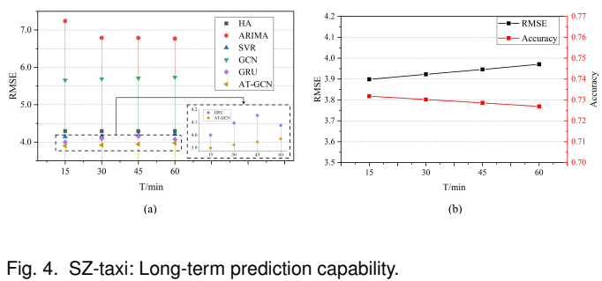
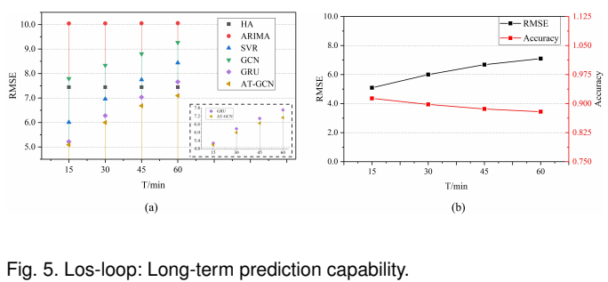
Experimental Result Analysis (Long-term prediction capability. )

Slide 20
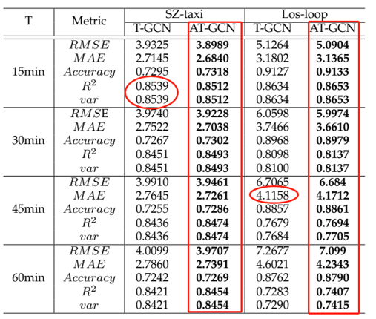

Experimental Result Analysis (Effectiveness of attention mechanism )

Slide 21
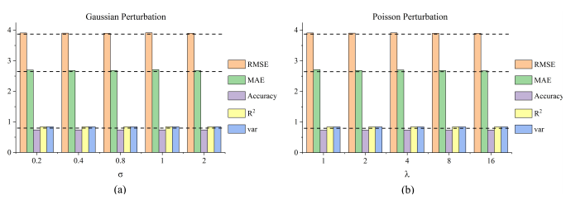
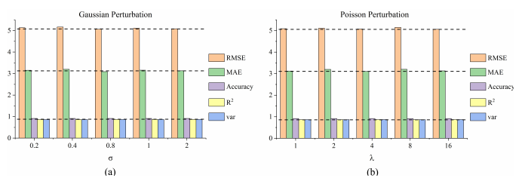


Perturbation Analysis

Slide 22
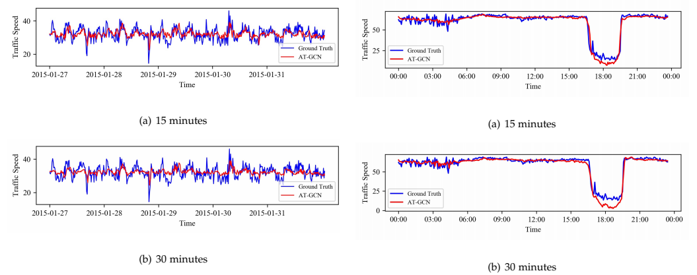

Visualized Analysis

Slide 23
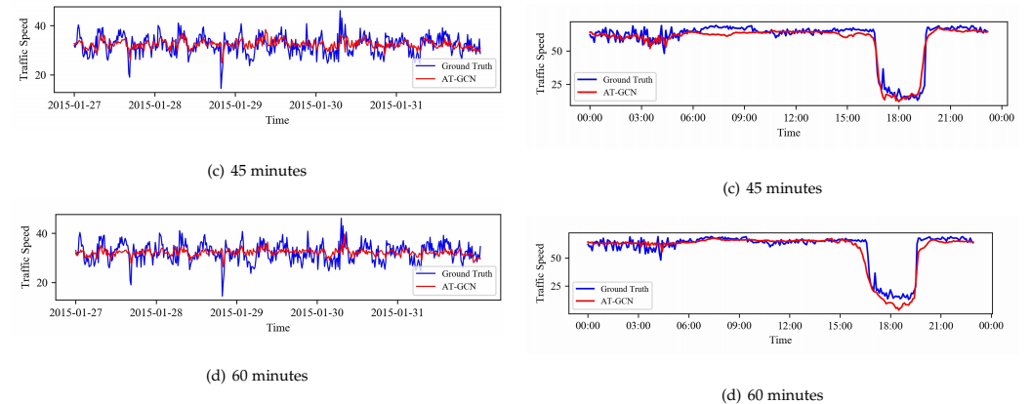
Visualized Analysis

Slide 24
Conclusion
In the proposed method, the spatial dependencies are captured by GCN based on the topological characteristics of the road network. Meanwhile, the dynamic variation of the sequential historical traffic speeds is captured by GRU. Moreover, the global temporal variation trend is captured and assembled by the attention mechanism.
Based on two real urban roads datasets, the A3T-GCN model proves its validity and highest precision in real-time traffic forecasting.

