Slide 1
AST-GCN: Attribute-Augmented Spatiotemporal Graph Convolutional Network for Traffic Forecasting
Citation:
J. Zhu, Q. Wang, C. Tao, H. Deng, L. Zhao and H. Li, "AST-GCN: Attribute-Augmented Spatiotemporal Graph Convolutional Network for Traffic Forecasting," in IEEE Access, vol. 9, pp. 35973-35983, 2021, doi: 10.1109/ACCESS.2021.3062114.

Slide 2
Background
Spatiotemporal models integrating GCNs and RNNs have become research hotspots and have made significant progress. However, few works integrate external factors.
Actually, it’s difficult to achieve accurate traffic forecasting because future traffic states not only depend on historical states but can also be affected by a variety of static and dynamic external factors.

Slide 3
Contributions
(1) Proposed a new model AST-GCN that can capture external information in combination with the spatiotemporal graph convolution model.
(2) The AST-GCN model integrates both dynamic and static external information related to the road, such as weather and surrounding POIs.
(3) Results of the AST-GCN model outperform the baselines, indicating the effectiveness of modeling external information.

Slide 4
Related Works
Statistical models
Historical Average Model (HAM)
Autoregressive Integrated Moving Average model(ARIMA)
Vector Autoregression(VAR)
Traditional Machine Learning Models
K-Nearest Neighbor Algorithm(KNN)
Support Vector Machine(SVM)、Support Vector Regression(SVR)
Deep Learning Models
DBNs, SAEs, RNNs, LSTMs, GRUs, ST-ResNet, DMVST-Net, GeoMAN, etc.

Slide 5
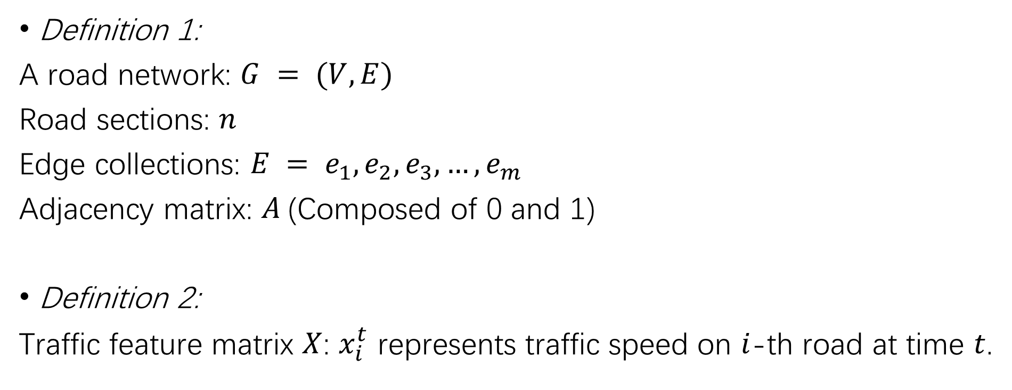
Problem Definitions
Definition 1:
A road network: $G = (V, E)$
Road sections: $n$
Edge collections: $E = e_{1},e_{2},e_{3},…,e_{m}$
Adjacency matrix: $A$(Composed of 0 and 1)
Definition 2:
Traffic feature matrix $X$: $x_{i}^{t}$ represents traffic speed on $i$-th road at time $t$.

Slide 6

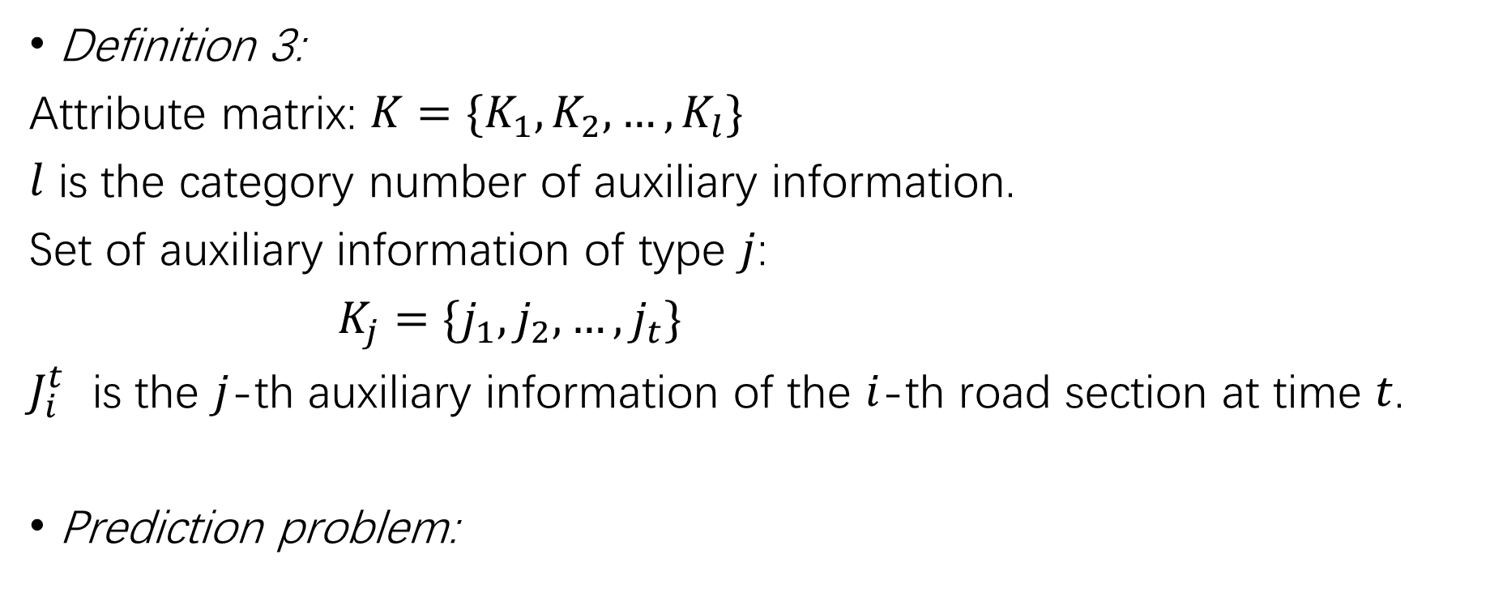
Problem Definitions
Definition 3:
Attribute matrix: $K=\{K_{1},K_{2},…,K_{l}\}$
$l$ is the category number of auxiliary information.
Set of auxiliary information of type $j$:
$K_{j}=\{j_{1},j_{2},…,j_{t}\}$
$J_{i}^{t}$ is the $j$-th auxiliary information of the $i$-th road section at time $t$.
Prediction problem:

Slide 7
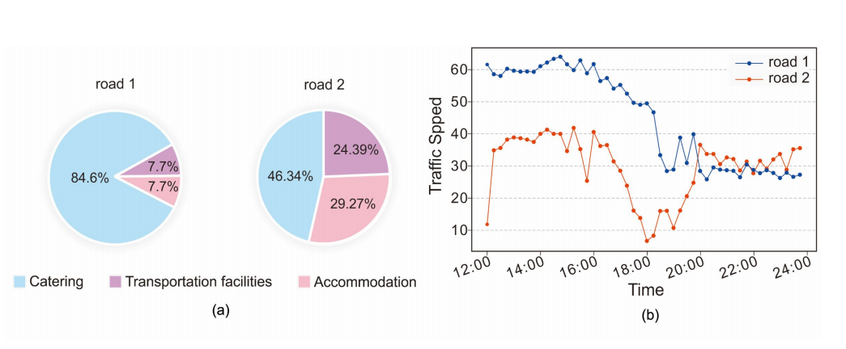
External Factors
Static factors
Fig. 1. Illustration of the influence of POIs on traffic states.

Slide 8
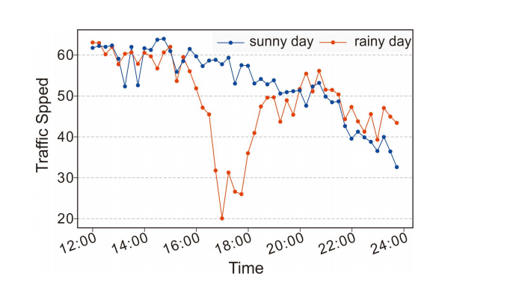
External Factors
Dynamic factors
Fig. 2. Illustration of the influence of weather conditions on traffic states.

Slide 9



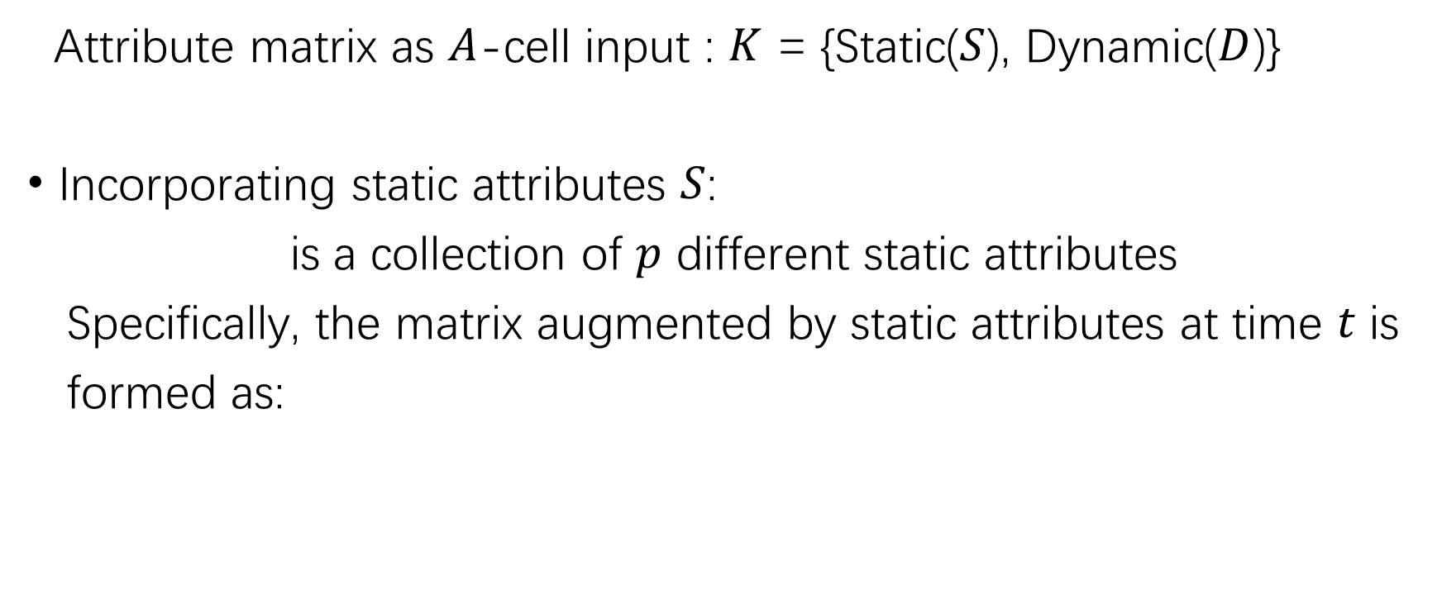
Attribute Augmentation Unit
Attribute matrix as $A$-cell input : $K$ = {Static($S$), Dynamic($D$)}
Incorporating static attributes $S$:
is a collection of $p$ different static attributes
Specifically, the matrix augmented by static attributes at time $t$ is
formed as:

Slide 10




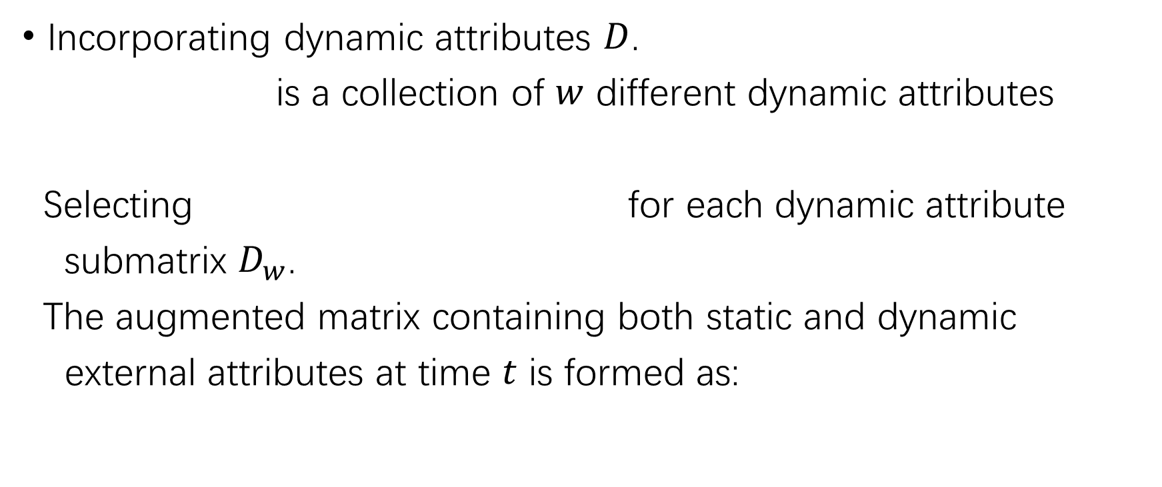
Attribute Augmentation Unit
Incorporating dynamic attributes $D$.
is a collection of $w$ different dynamic attributes
Selecting for each dynamic attribute
submatrix $D_{w}$.
The augmented matrix containing both static and dynamic
external attributes at time $t$ is formed as:

Slide 11
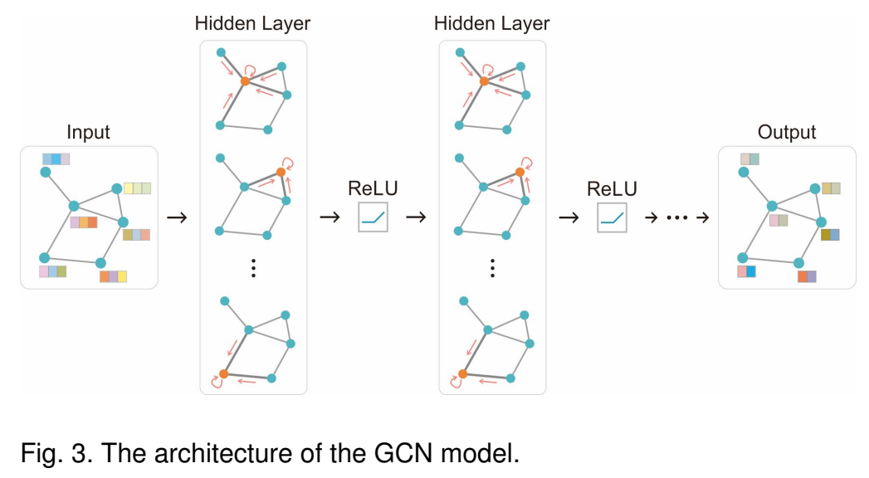
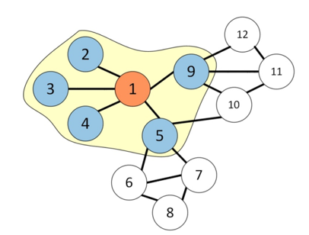



Spatiotemporal Dependencies : GCNs

Slide 12
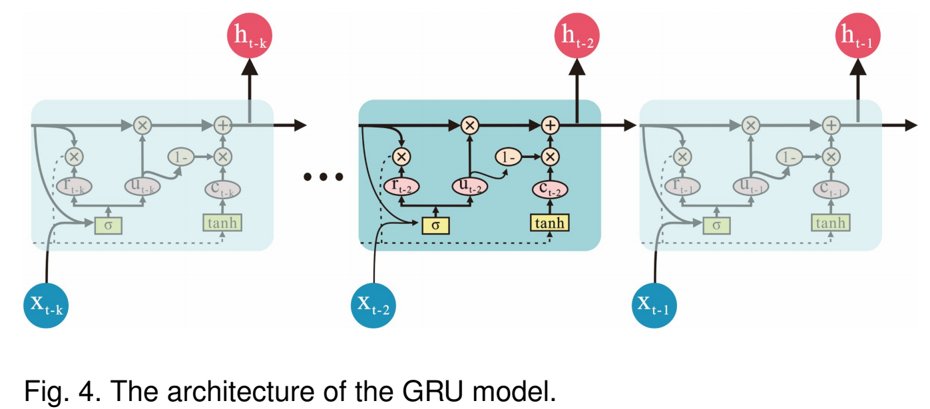
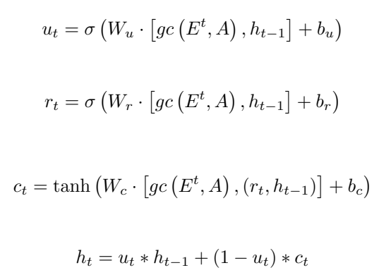
Spatiotemporal Dependencies : GRUs

Slide 13
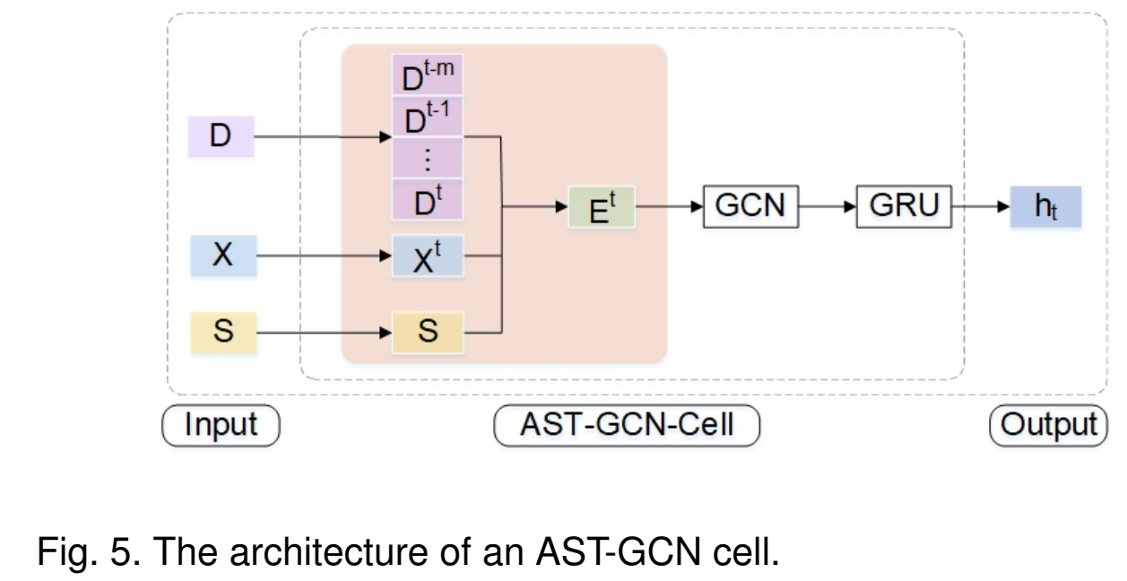
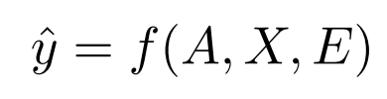
Attribute-enhanced Spatiotemporal Graph Convolution Model (AST-GCN)

Slide 14
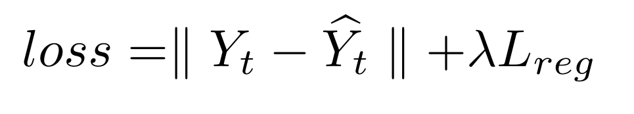
Loss Function
Prediction
A hyperparameter
Ground Truth
L2 regularization term that helps
to avoid an over fitting problem

Slide 15
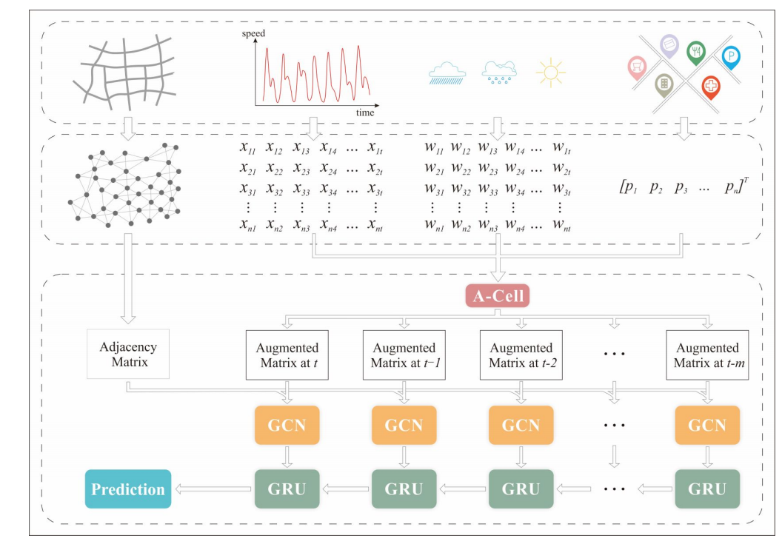
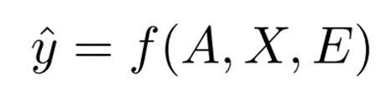
AST-GCN Framework
1.data preprocessing
2. attribute augmentation
4.prediction
3. spatial-temporal dependency modeling

Slide 16

Datasets
SZ-taxi:
Shenzhen taxi trajectory data from January 1 to January 31, 2015.
Including 156 major road sections in the Luohu District.
SZ_POI:
Information about POIs surrounding selected road sections which
is divided into 9 types.
SZ_Weather:
Auxiliary information contains the weather conditions about the study
area recorded every 15 minutes in January 2015, which is divided
into 5 categories.

Slide 17
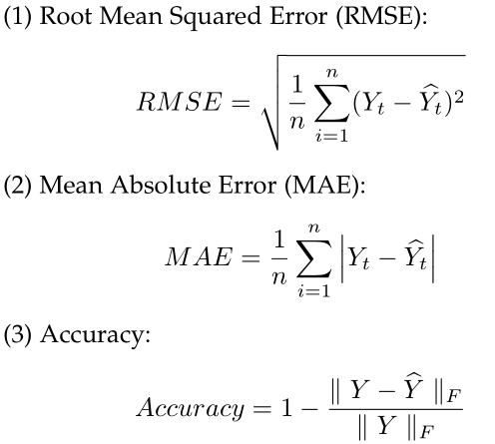
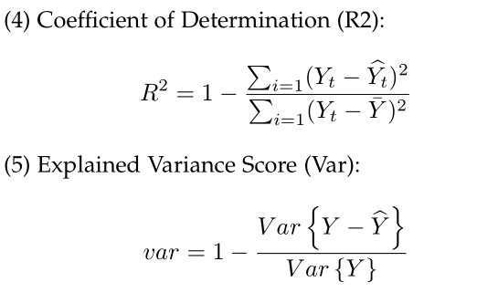
Evaluation Metrics

Slide 18
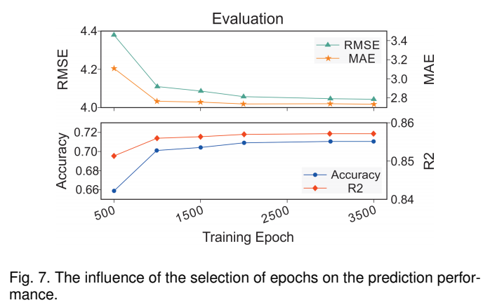
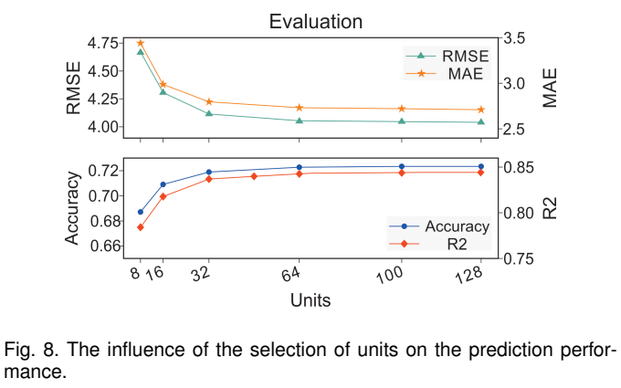
Parameter Settings
Learning rate: 0.001
Batch size: 64
Proportion of the training set: 0.8

Slide 19
Baselines
ARIMA: Auto-Regressive Integrated Moving Average model
SVR: Support Vector Regression model
GCN: Graph Convolution Network model
GRU: Gated Recurrent Unit model
TGCN: Spatiotemporal Graph Convolution Network model
DCRNN: Diffusion Convolutional Recurrent Neural Network model

Slide 20
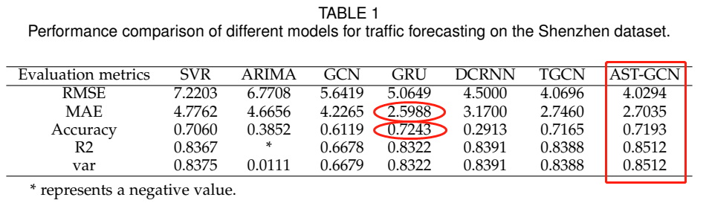
Experimental Results
Forecasting Comparison with Baselines

Slide 21
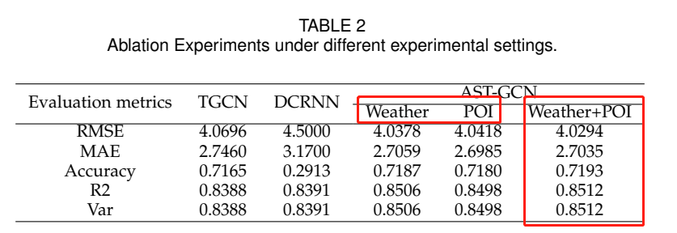
Ablation Experiments
Ablation Experiments

Slide 22
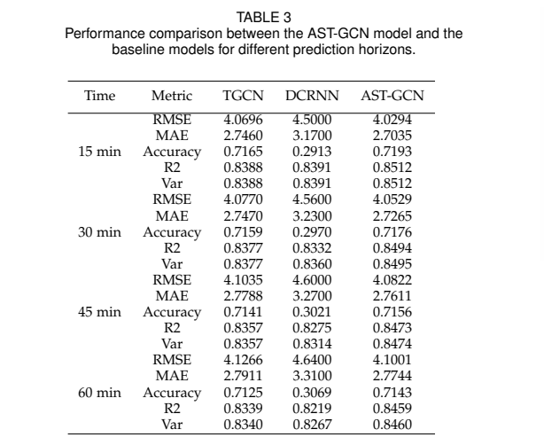
Experimental Results
Forecasting Performance of
AST-GCN for Different Horizons

Slide 23
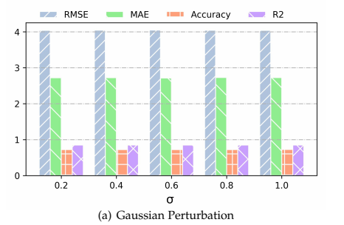
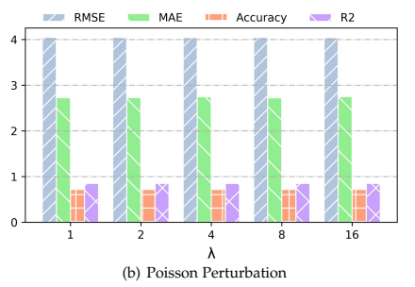
Perturbation Analysis
Gaussian distribution
Poisson distribution

Slide 24
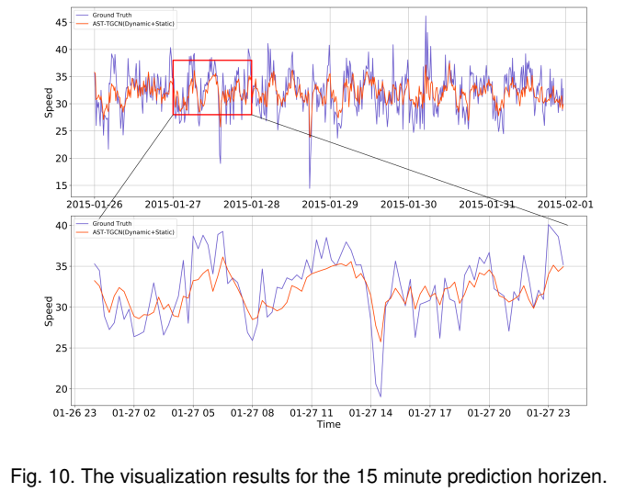
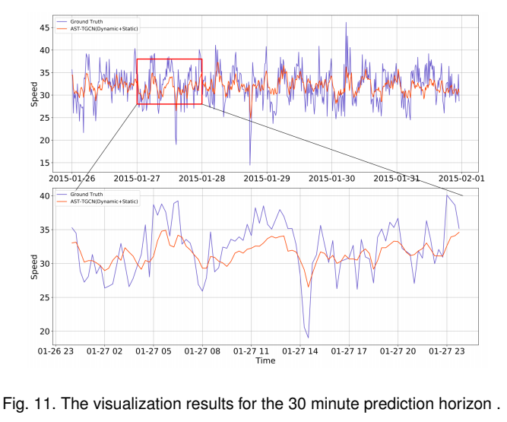
Interpretation of the AST-GCN
(1) Long-term forecasting

Slide 25
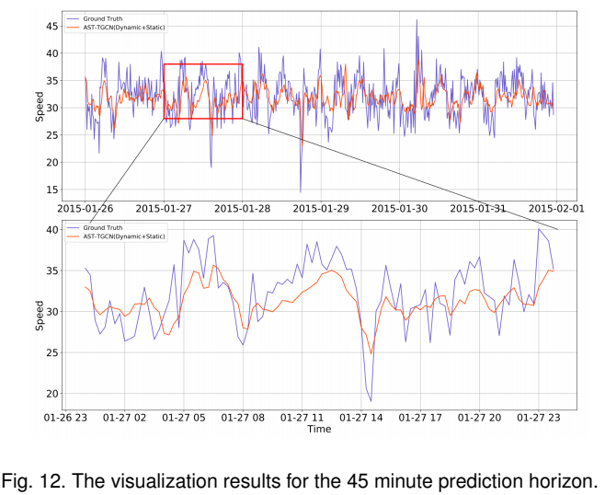
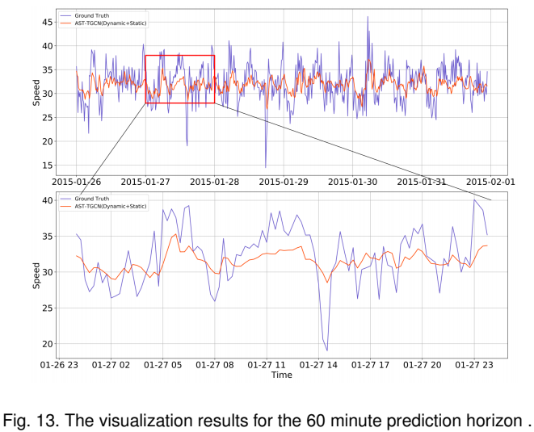
Interpretation of the AST-GCN
(1) Long-term forecasting

Slide 26
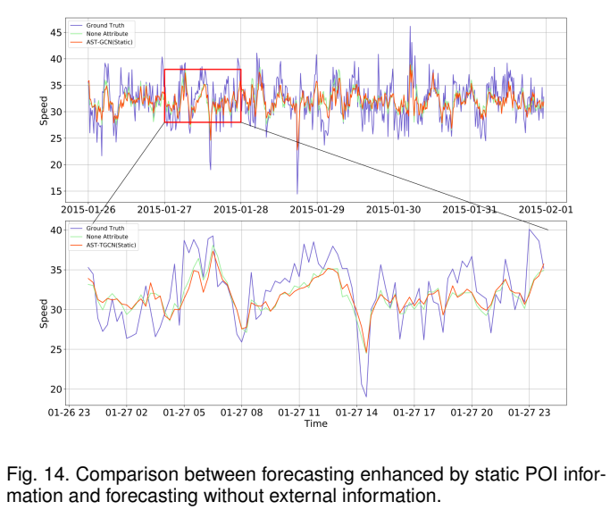
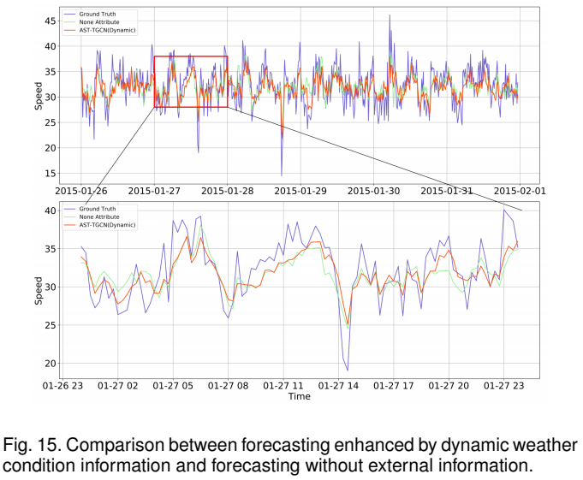
Interpretation of the AST-GCN
(2) Attribute importance

Slide 27
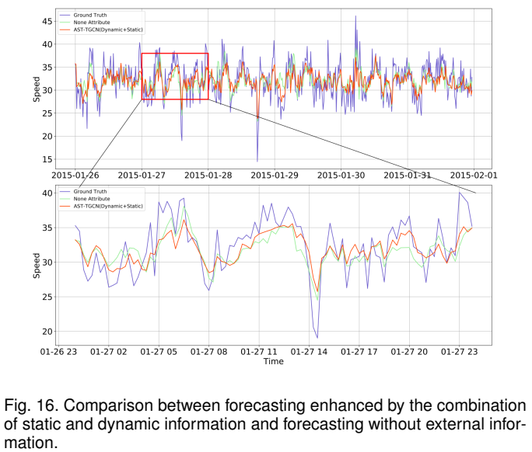
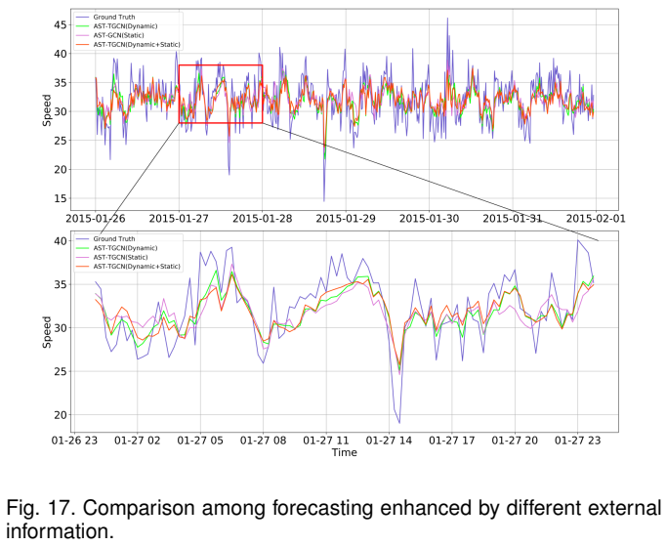
Interpretation of the AST-GCN
(2) Attribute importance

Slide 28
Conclusion
The proposed attribute-enhanced spatiotemporal graph convolution model AST-GCN can not only integrate static external information but also dynamic external data.
Through comparison with the baseline methods, the prediction results verify the importance of considering external information in traffic forecasting tasks.

