Slide 1
MEDIA STREAMING PLATFORM CAMPAIGN
Netflix

Slide 2
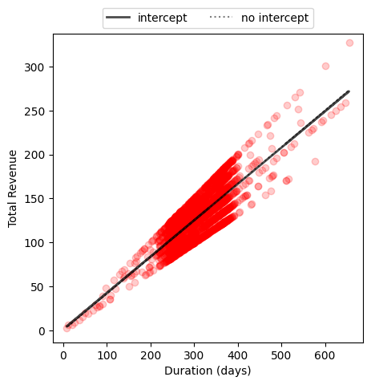
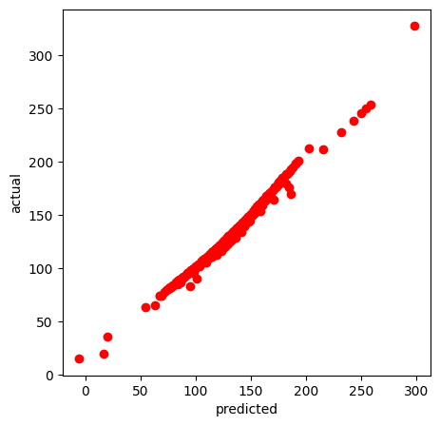
Linear Regression
The Linear Regression was generated in 2 different ways. The slope of the regression line suggests how much the total revenue is expected to increase for each additional day of duration

Slide 3
WHO ARE netflix’s user
01
Understand the demographics

Slide 4

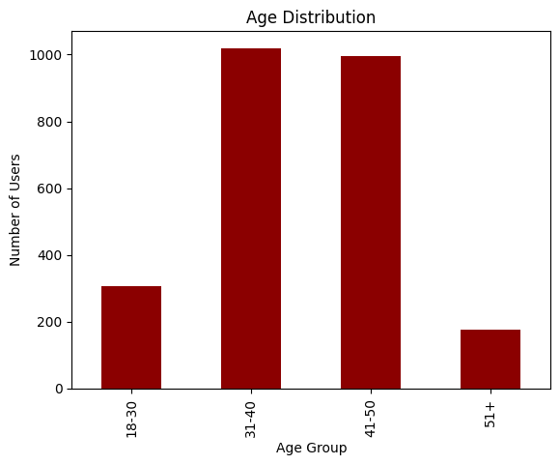

Slide 5
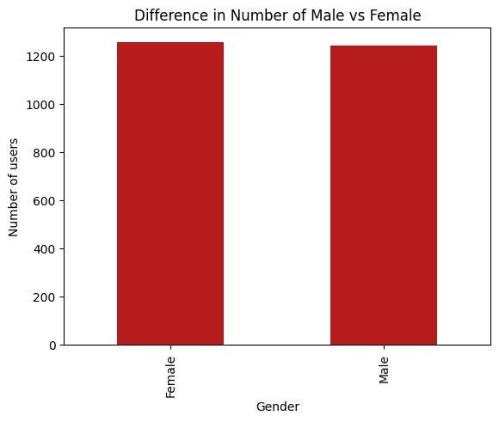
Gender Distribution
1243
1257
GENDER
MALE
FEMALE
There is not a big difference between number of genders.

Slide 6
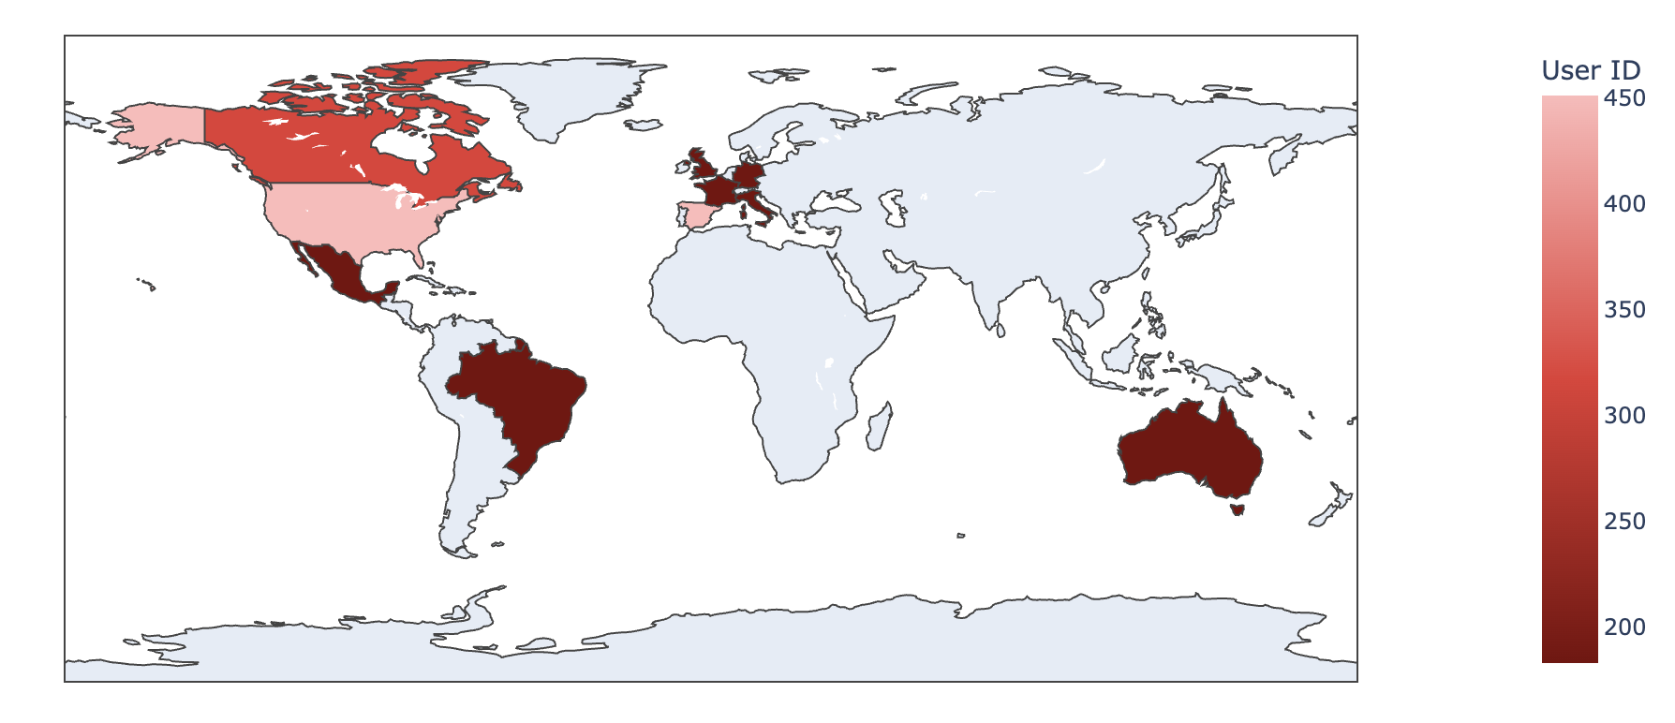
Country Distribution
451
317
Most Users
Second Highest

Slide 7
User Habits
02
How are Netflix's users consuming content?

Slide 8
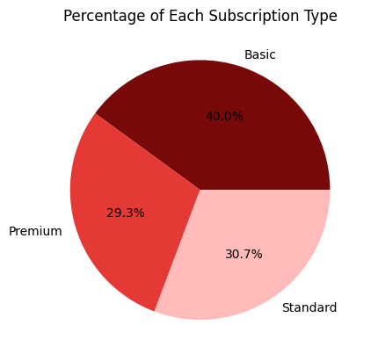
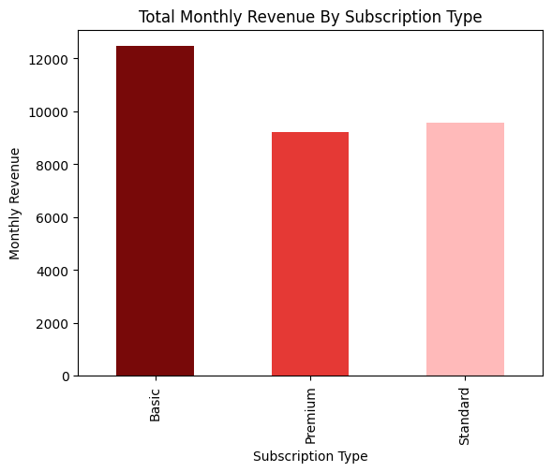

Slide 9
Why Cancel?
03
What make users cancel their subscriptions?

Slide 10
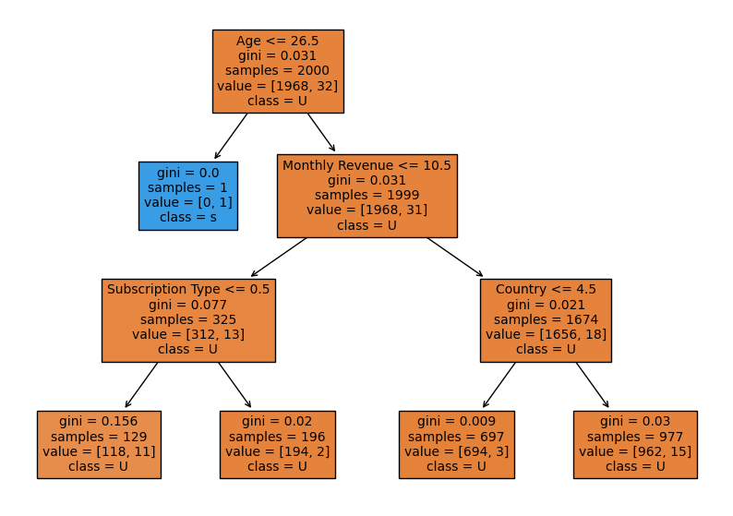
Based on the decision tree, the primary factors for predicting User Churn Rate are “Age” and “Monthly Revenue”

Slide 11
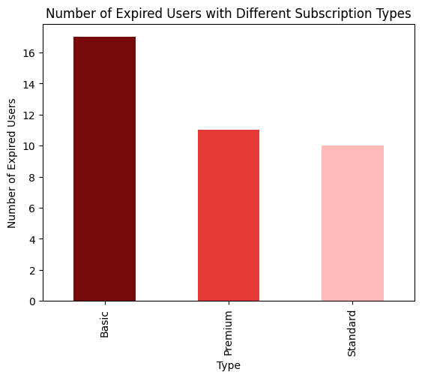

Slide 12
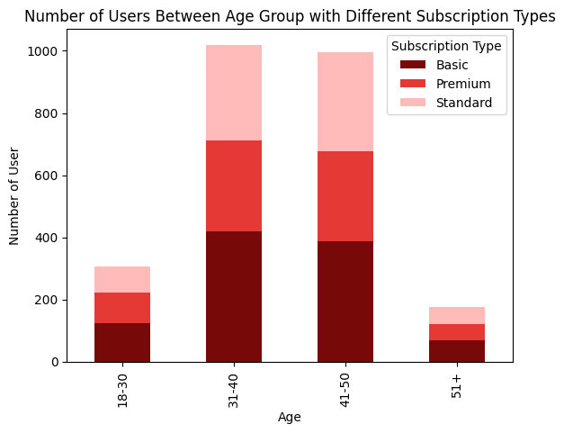
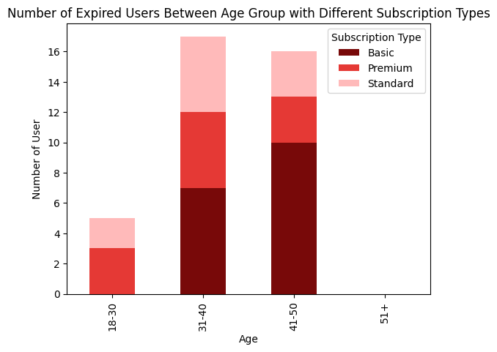

Slide 13
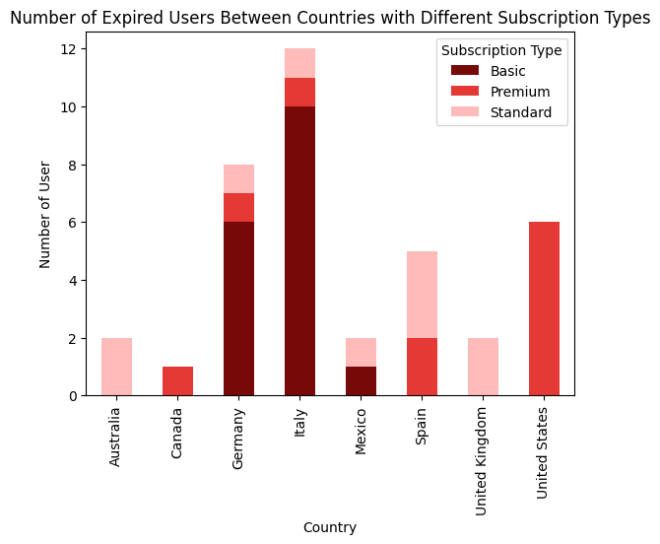

Slide 14
Recommendations
04
What can Product Manager do?

Slide 15
Strategies
Targeted Retention Strategies
Content Strategy Optimization
Pricing Strategy Evaluation
Enhanced Customer Retention Programs

Slide 16
Thank You!

