Slide 1
HIERARCHICAL MODELING SIMULATOR with WebGL
Computer Graphics
Team 14. Jinwon Jung & Geunho Lee

Slide 2
TABLE OF CONTENTS
01
02
WHAT TO IMPLEMENT
THE RESULT
03
04
HOW TO IMPLEMENT
MEMBER INTRODUCTION
Introduce Subject and Purpose
Show Capture images and Brief demonstration
Describe the Graphics and HTML techniques
Introduce Team members and Roles

Slide 3
01
WHAT TO IMPLEMENT
Introduce Subject and Purpose

Slide 4
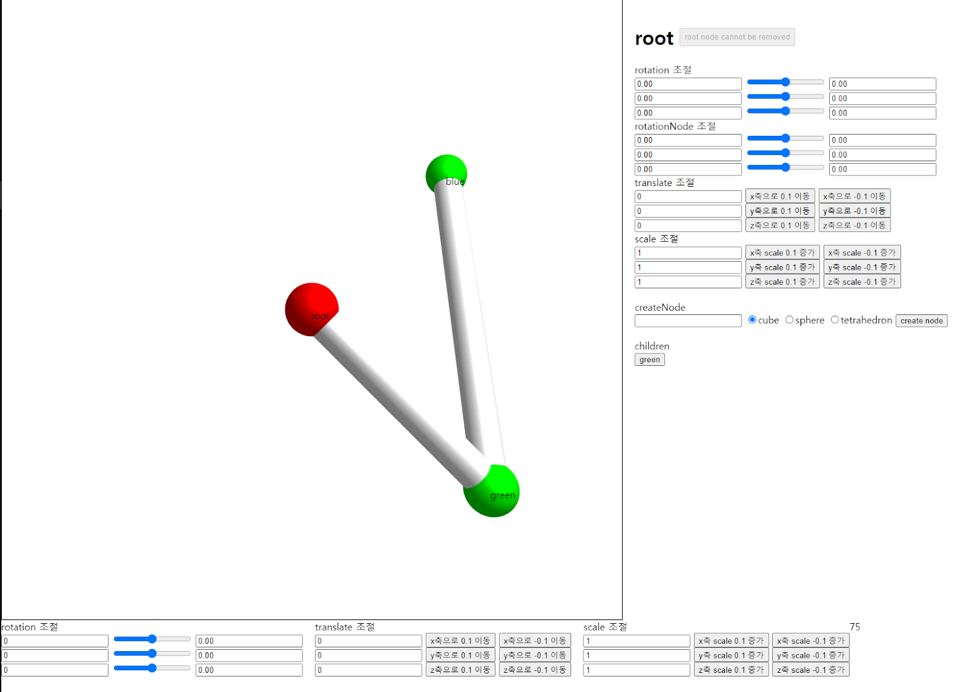
Subject and Purpose
We wanted to try something out of the ordinary.
However, there were no real objects that came to mind.
So, we came up with a virtual model!
In addition, we thought it would be good to learn the basic concept of hierarchical modeling through our virtual model.
Therefore, the final aim was to become a hierarchical modeling simulator for education!

Slide 5
02
THE RESULT
Show Capture images and Brief demonstration

Slide 6
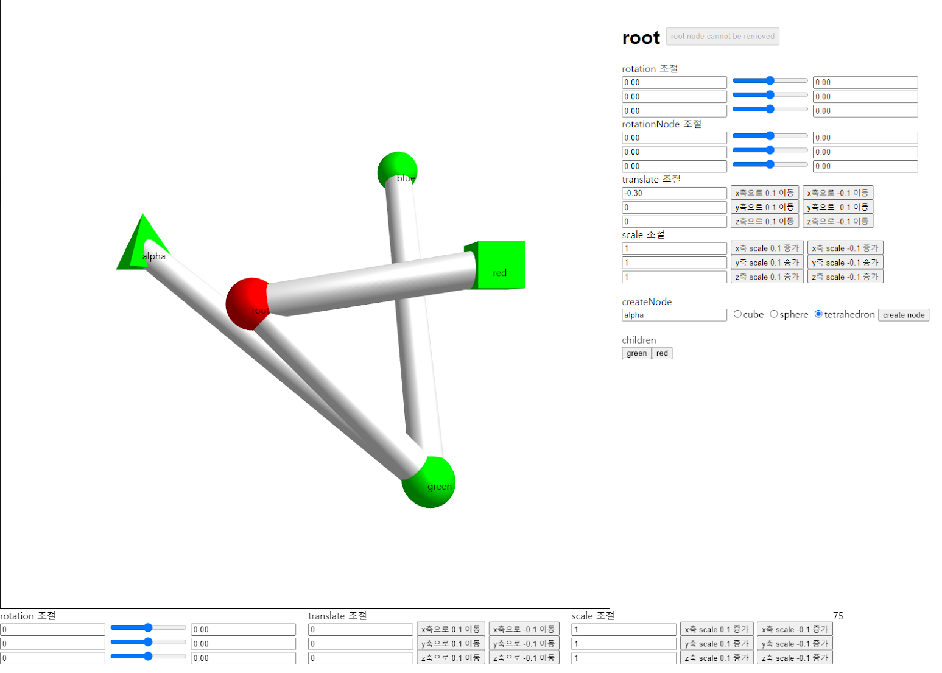
Simulator UI
New nodes can be created and deleted.
We can also select a specific node and use the side button to transform it.
They have a hierarchy!

Slide 7
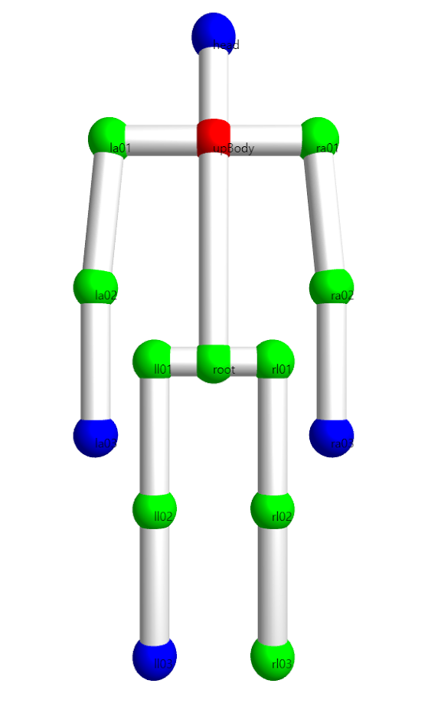
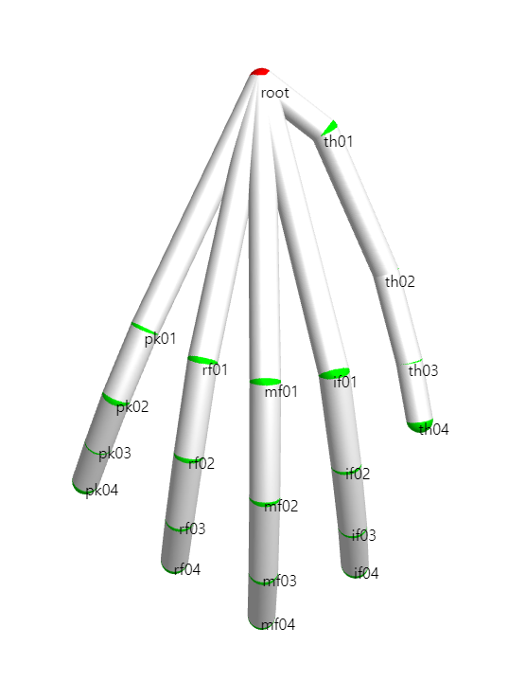
Hierarchical Modeling Example
It was not made with the addition of nodes and the transformation function of the simulator.
However, these are modeling examples made using the same sphere and cylinder.

Slide 8
03
HOW TO IMPLEMENT
Describe the Graphics and HTML techniques

Slide 9
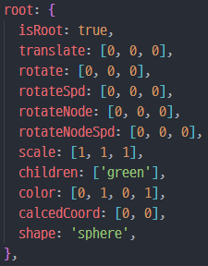
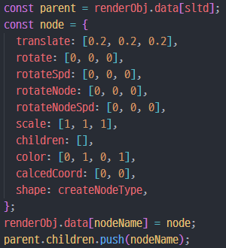
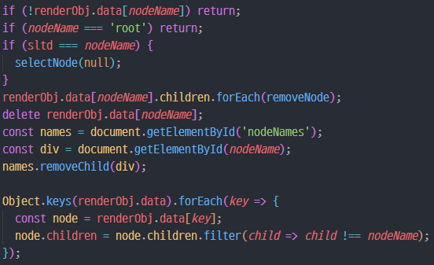
Events in the Simulator 1
Create
the structure of
node object
the part of
node creation
Add a new node
to the node object
with name, children, etc.
Delete
Remove the selected node
from the node dictionary

Slide 10
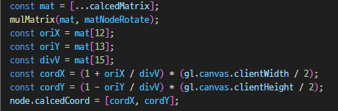
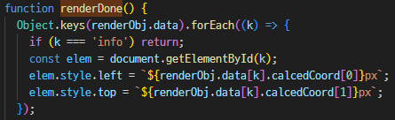
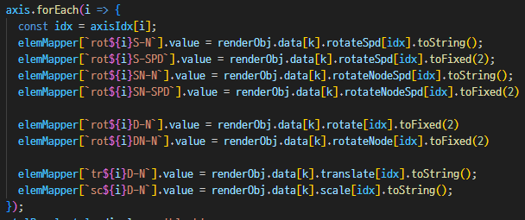
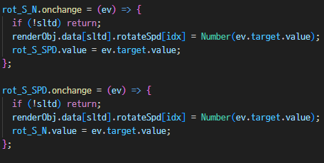
Events in the Simulator 2
Select
Select a node on the canvas
with a mouse click
Transformation
Transform the selected node
using the side buttons

Slide 11
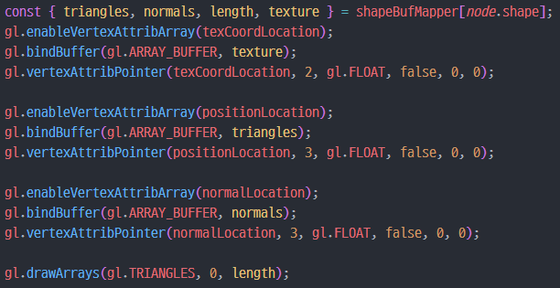
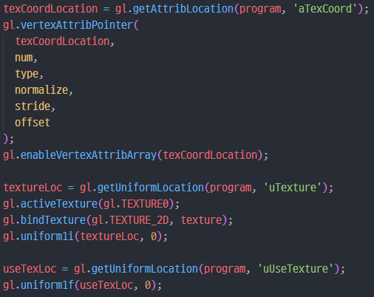
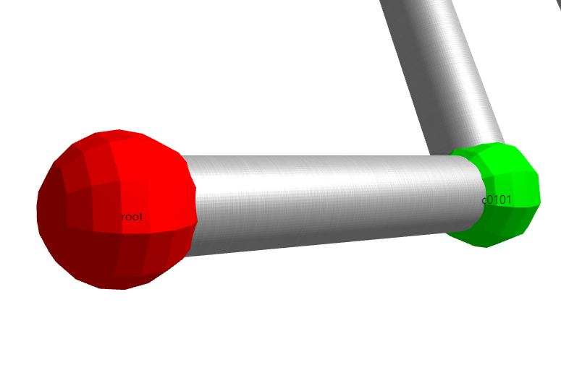

Modeling and Texture in Examples
Modeling
Steel Texture
It is called recursively from the root node of the model.
If it is not a root, a cylinder is drawn, and a sphere is drawn.
We get data from the vertex and texture coordinate,
and normal vector buffers.
It also sends its own color and computed transformation matrix using `uniform` function.
The steel image was loaded with the `texImage2D` function, and the coordinates in the image were designated for each vertex.
Since we only need textures on the crank model, whether to apply the textures is passed to the vertex and fragment shaders.

Slide 12
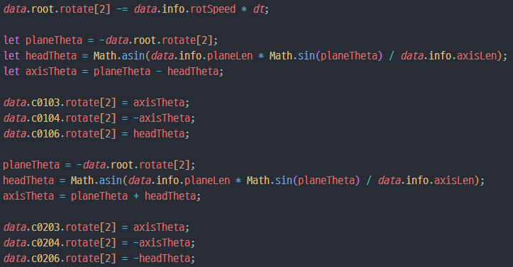
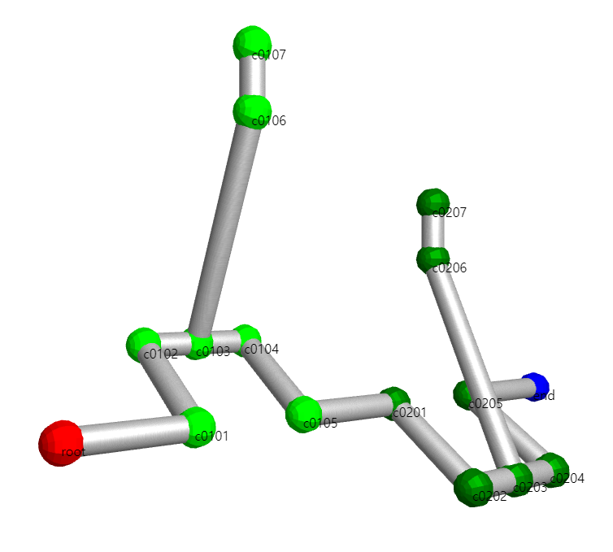
Animation in Examples
Crank :
We calculated the angles of other nodes that change according to the rotation angle of the root.
And the rotation angle is set to change to a value calculated for each frame.
Human Hand :
Angle change was applied to each finger joint of the initially set model.
In the form of a toggle, the finger moves when the button is pressed.
And it can be implemented by storing the toggle and the range of angles to rotate.

Slide 13
OUR TEAM
Jinwon Jung
Geunho Lee
Software / 201720706
Software / 202020767
- Node Create & Delete
- Node Select & Transformation
- Hierarchical Modeling
- Hierarchical Modeling
- Texture Mapping
- Animation

Slide 14
THANKS

