Slide 1
Coding with Python
MJ Ko

Slide 2
What is Coding?
What is Coding?
Coding (also called programming) is the process of writing instructions for a computer to follow. Think of it like writing a recipe for a computer!
Coding is writing instructions for computers
It's like writing a recipe, but for machines
Coding is used in almost everything around us

Slide 3

Real-World Example: Recipe vs Code
Making a Sandwich:
Recipe (Human Instructions):
Let’s make sandwich
Take two slices of bread
Spread mayonnaise on one slice
Add lettuce, and tomato
Put the other slice on top
Cut diagonally
Code (Computer Instructions):
def make_sandwich():
bread1 = get_bread_slice()
bread2 = get_bread_slice()
spread_mayonnaise(bread1)
add_lettuce(bread1)
add_tomato(bread1)
place_bread(bread2, bread1)
cut_sandwich_diagonally()

Slide 4
Coding in Everyday Life
You interact with code every day:
Smartphones: Every app is made with code
Websites: Everything online is created with code
Cars: Modern cars have computers running code
Appliances: Microwave, washing machine, coffee maker
What Can You Build with Code?
Games: Minecraft, Fortnite, mobile games
Apps: Instagram, TikTok, WhatsApp
Websites: Google, Facebook, Amazon
Tools: Calculators, calendars, weather apps
Art: Digital art, music, animations
Science: Data analysis, simulations, research tools

Slide 5
Do you want to learn more about Coding?

Slide 6
Programming Languages
What is a Programming Language?
A programming language is a set of rules and instructions that humans use to communicate with computers.
Why Do We Need Programming Languages?
The Problem: Computers Speak Binary
Computers only understand binary code - strings of 0s and 1s:
01001000 01100101 01101100 01101100 01101111
This binary code means "Hello" - but it's impossible for humans to write programs this way!
01110111 01101111 01110010 01101100 01100100 00001101 00001010 <—?
The Solution: Programming Languages
Programming languages let us write code in a way that's:
Readable for humans
Convertible to binary for computers
Logical and structured

Slide 7
Programming Language
Types of Programming Languages:
High-Level Languages: Python, JavaScript, Java
Low-Level Languages: Assembly, Machine Code
Specialized Languages: SQL, HTML, CSS
Why Python?
Easy to read and write
Great for beginners
Powerful and versatile
Large community and resources
Popular language for AI Training

Slide 8
When to Code
The Software Development Process:
Planning: What do you want to build?
Design: How will it work?
Coding: Write the actual code <— This is what we are talking about!
Testing: Make sure it works correctly
Debugging: Fix any problems
Deployment: Share your creation
Tips!
Start small and build up
Test frequently
Keep your code organized
Document your work
Learn from mistakes

Slide 9
Do you want to do coding now?

Slide 10
Your First Program
Computer wants to say “Hola!”.
What would be the right one?
1. 01001000 01100101 01101100 01101100 01101111
2. H—O—L—A—!
3. print(“Hola!”)
4.¡Ordenador, por favor di hola! ¿Puedes?
(Computer please say Hola! Can you?)

Slide 11
Your First Program
Computer wants to say “Hola!”.
Hello World Program:
print(‘¡Hola!')
Your First Steps:
Open a text editor or online editor
https://www.onlineide.pro/playground/python
Write your code
Save with .py extension
Run the program
See the output!
Try with Hola {Su nombre}!

Slide 12
Variables
What are Variables?
Variables are like containers that store information in your program.
Creating Variables:
name = 'Alice'
age = 25
height = 5.6
is_student = True
Data Types:
Strings: Text (like 'Hello')
Numbers: Whole numbers (like 42) and Decimal numbers (like 3.14)
Booleans: True or False
Variable Rules:
Start with letters or underscore
No spaces (use underscores)

Slide 13
Code Blocks
What are Code Blocks?
Code blocks are groups of related instructions that work together.
Indentation:
Python uses indentation (spaces) to show which code belongs together:
if temperature > 80:
print('It is hot!')
print('Wear sunscreen')
print('This is not in the if block')
Block Types:
Function blocks
Conditional blocks (if/else)
Loop blocks
Class blocks
Tips!
Use consistent indentation
Usually 4 spaces per level
Don't mix tabs and spaces

Slide 14
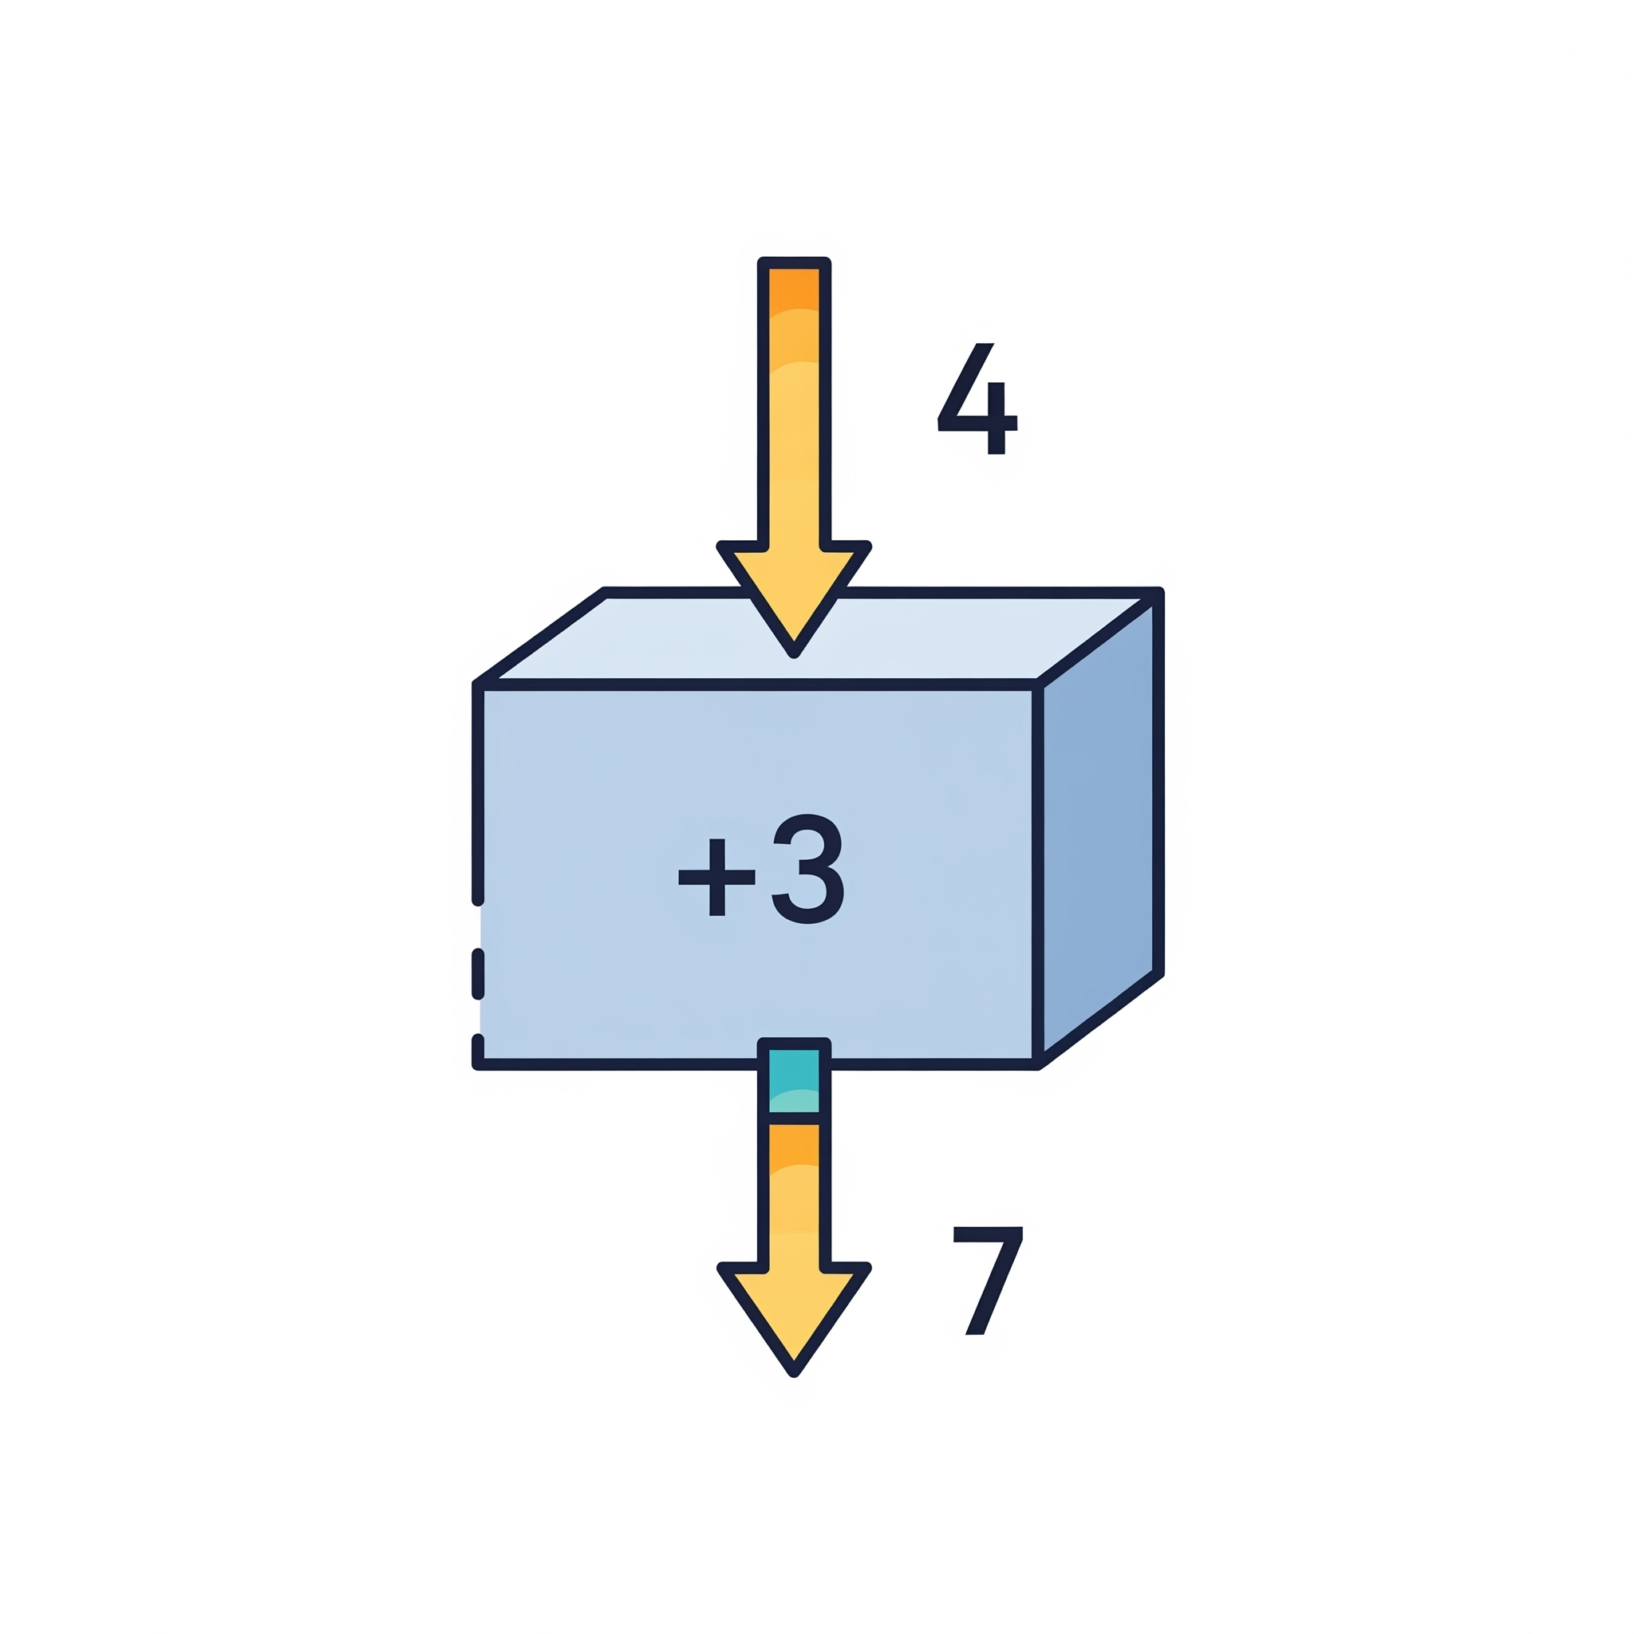
Functions
What are Functions?
Functions are reusable blocks of code that perform specific tasks.
Functions to add 3
def addThree(myNumber):
return myNumber + 3
firstOne = addThree(5)
secondOne = addThree(10)
What will we have in firstOne and secondOne?
firstOne : 5, secondOne 10
firstOne : 555, secondOne: 101010
firstOne : 8, secondOne : 13
firstOne : ‘Hola!’, secondOne : ‘Hola!’

Slide 15
Functions
Creating Functions:
def addThree(myNumber):
print(‘I am calculating…’)
return myNumber + 3
Function Parts:
def: Keyword to define a function
Function name: What you call it
Parameters: Information the function needs
Body: The code that runs
Return: What the function gives back
Why Use Functions?
Reuse code
Organize your program
Make code easier to understand

Slide 16
If/Else Statements
What are If/Else Statements?
If/else statements let your program make decisions based on conditions.
Basic Structure:
if condition:
elif another_condition:
else:
Comparison Operators:
== (equal to)
!= (not equal to)
> (greater than)
< (less than)
>= (greater than or equal)
<= (less than or equal)
Example
2 != 3
10 < 20
4 == 4

Slide 17
Chapter 9: If/Else Statements
Example:
name = “”
if name == “”:
print('Eres guapo')
else:
print('Eres gracioso')

Slide 18
Loops
What are Loops?
Loops let you repeat code multiple times without writing it over and over.
For Loops:
for item in [1, 2, 3, 4, 5]:
print(item)
for i in range(5):
print(f'Count: {i}')
While Loops:
count = 0
while count < 5:
print(count)
count += 1
Loop Control:
break: Stop the loop early
continue: Skip to next iteration
range(): Generate sequences of numbers
When to Use:
For loops: When you know how many times
While loops: When you don't know how many times

Slide 19



Rock Paper Scissors Game!
Game Rules:
Rock crushes Scissors
Scissors cuts Paper
Paper covers Rock
Same choice = Tie

Slide 20
Rock Paper Scissors Game!
Who wins?
?
?
?

Slide 21
Building the Rock Paper Scissors Game
Complete Game Code:
import random
def play_rps():
hands = ['rock', 'paper', 'scissors']
computer = random.choice(hands)
player = input('Rock, paper, or scissors? ').lower()
if player not in hands:
print('Invalid choice!')
return
print(f'Computer chose: {computer}')
if player == computer:
print('Tie!')
elif (player == 'rock' and computer == 'scissors') or \
(player == 'paper' and computer == 'rock') or \
(player == 'scissors' and computer == 'paper'):
print('You win!')
else:
print('Computer wins!')
while True:
play_rps()
if input('Play again? (y/n): ').lower() != 'y':
break

Slide 22
Congratulations! 🎉
You've Completed the Python Course!
What You've Learned:
✅ What coding is and why it matters
✅ How to write Python programs
✅ Variables, functions, loops, and conditions
✅ How to build a complete game
Next Steps:
Practice with the exercises
Try building your own projects
Explore more Python libraries
Learn about web development
Study data science and AI
Remember:
Coding is a skill that improves with practice
Don't be afraid to make mistakes
The Python community is here to help
Keep building and creating!
Enjoy coding! 🌟

Slide 23
Resources
Online Python Playground
https://www.onlineide.pro/playground/python
Rock Paper Scissors Game
https://rps.coolbassmusic.com

