Slide 1


Truck Platooning
Team 5
Ashwin Balaji Arun Kumar - 7224514
Harshavarthan T 7224216
Ulas Arslan 7223322
Adesh More 7224845

Slide 2
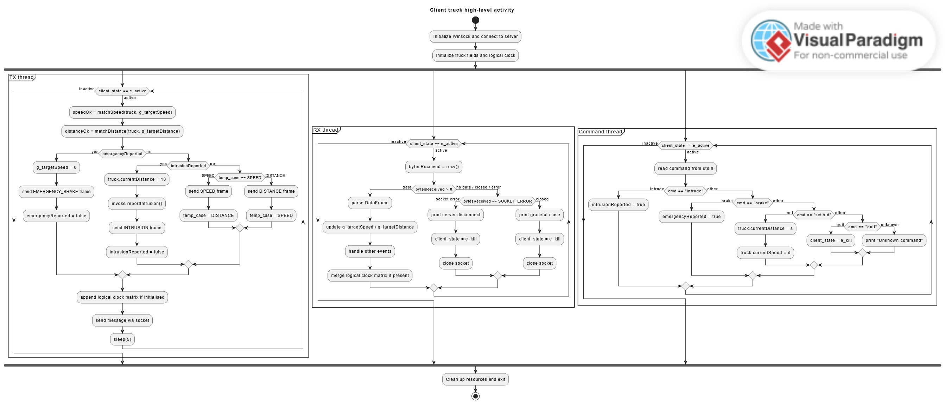
Notes:
Ashwin

Slide 3
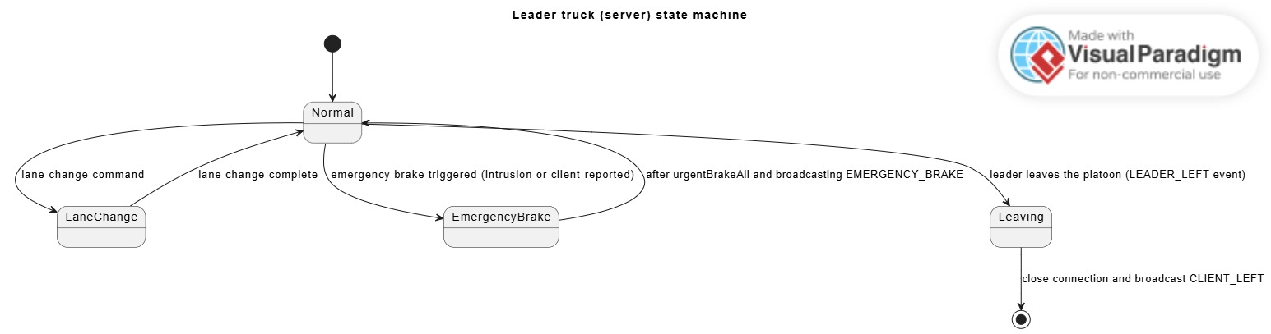
Notes:
Ulas

Slide 4
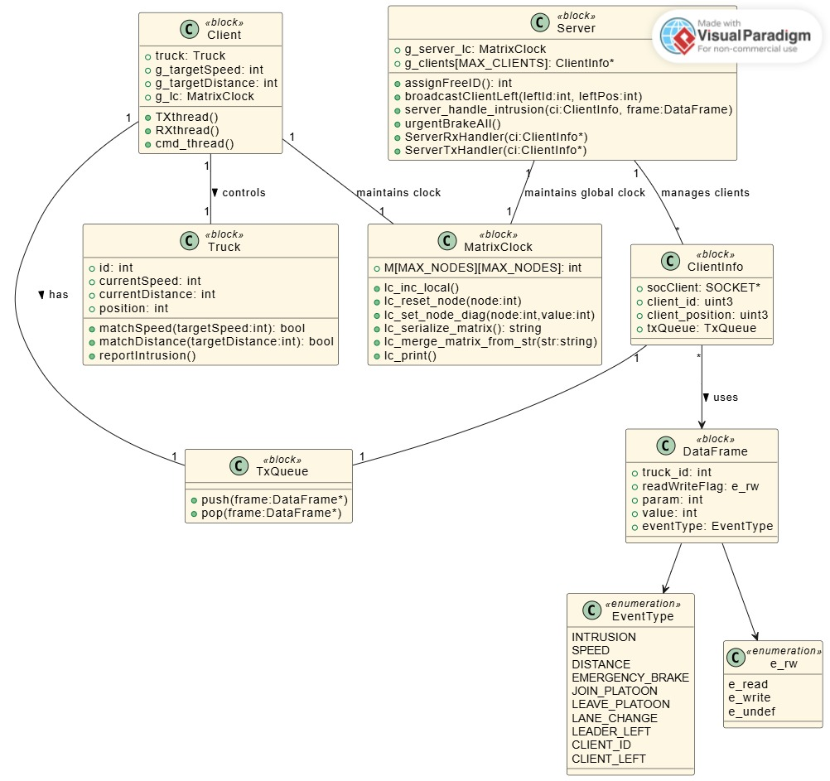
Notes:
ulas

Slide 5
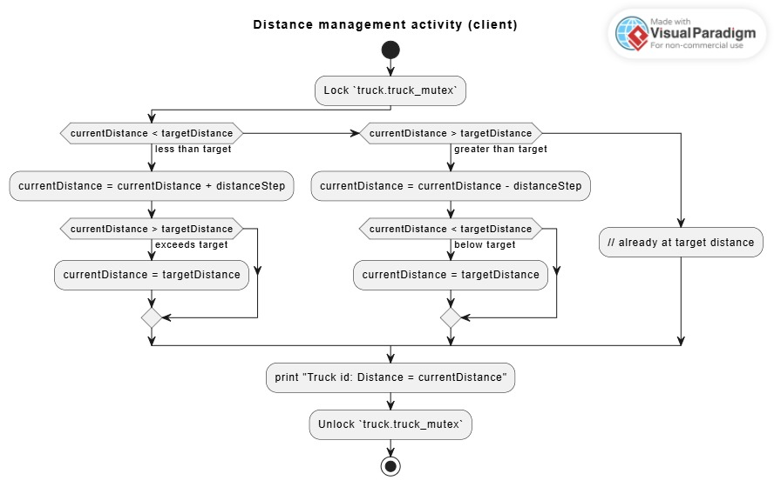
Notes:
Harsha

Slide 6
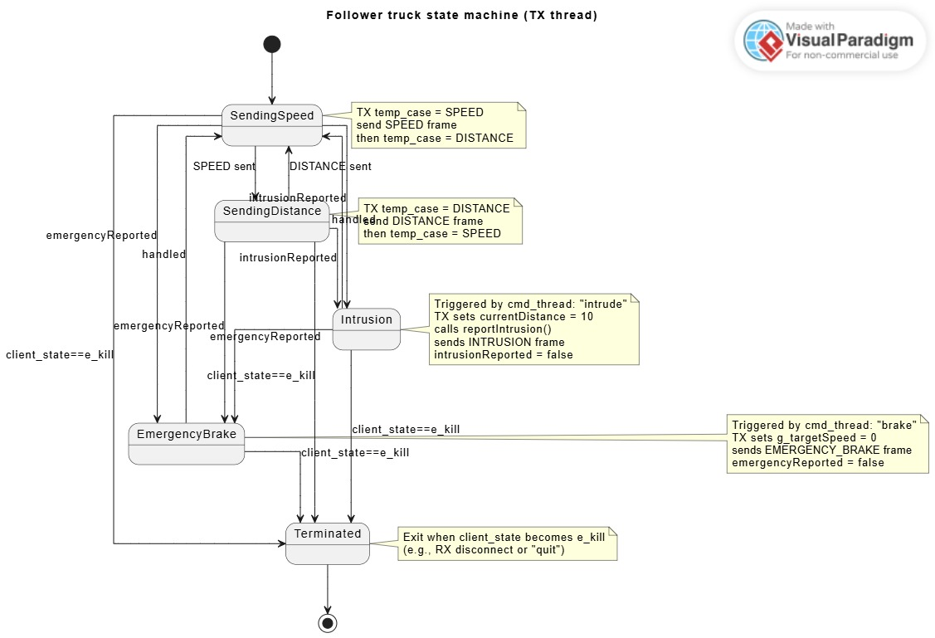
Notes:
Harsha

Slide 7
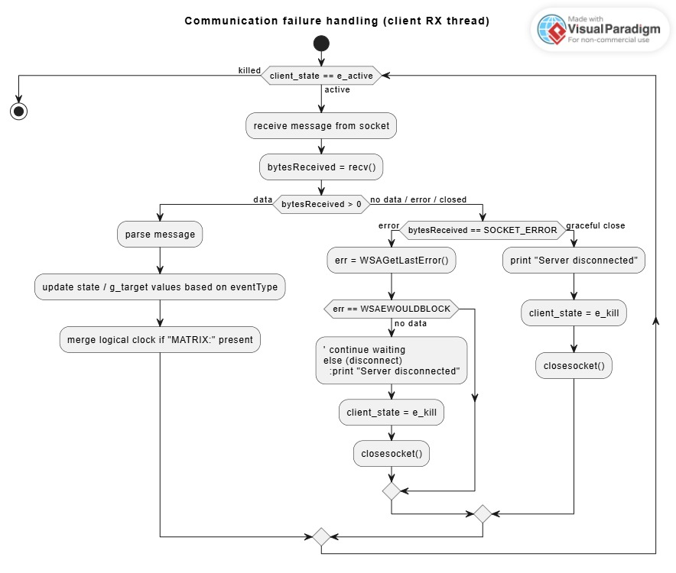
Notes:
Ashwin

Slide 8
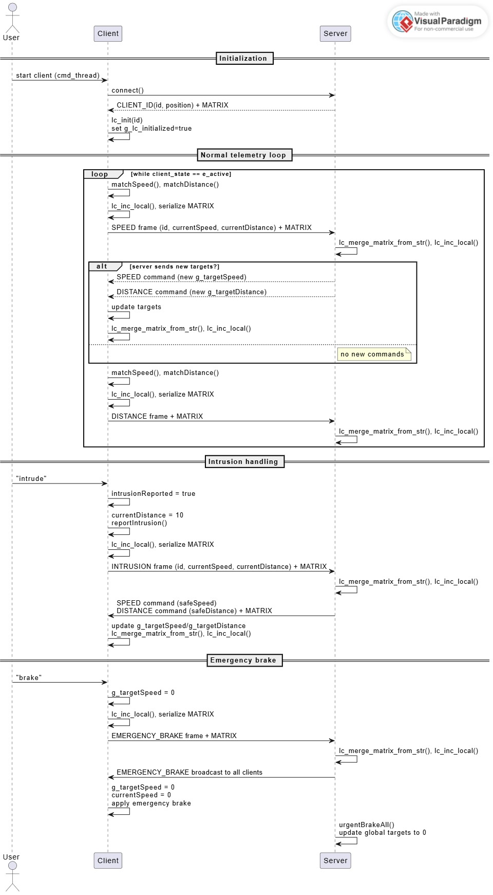

Slide 9
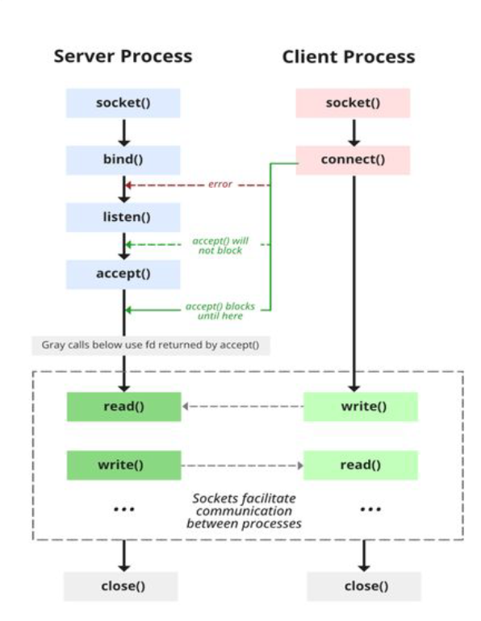
Communication Protocol
TCP/IP Socket Programming
Notes:
Harsha

Slide 10
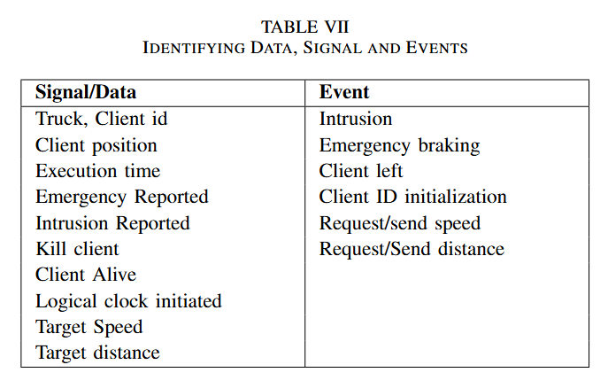
Data/ Signal & Events
Revision History: DPS-TEAM5.docx

Slide 11
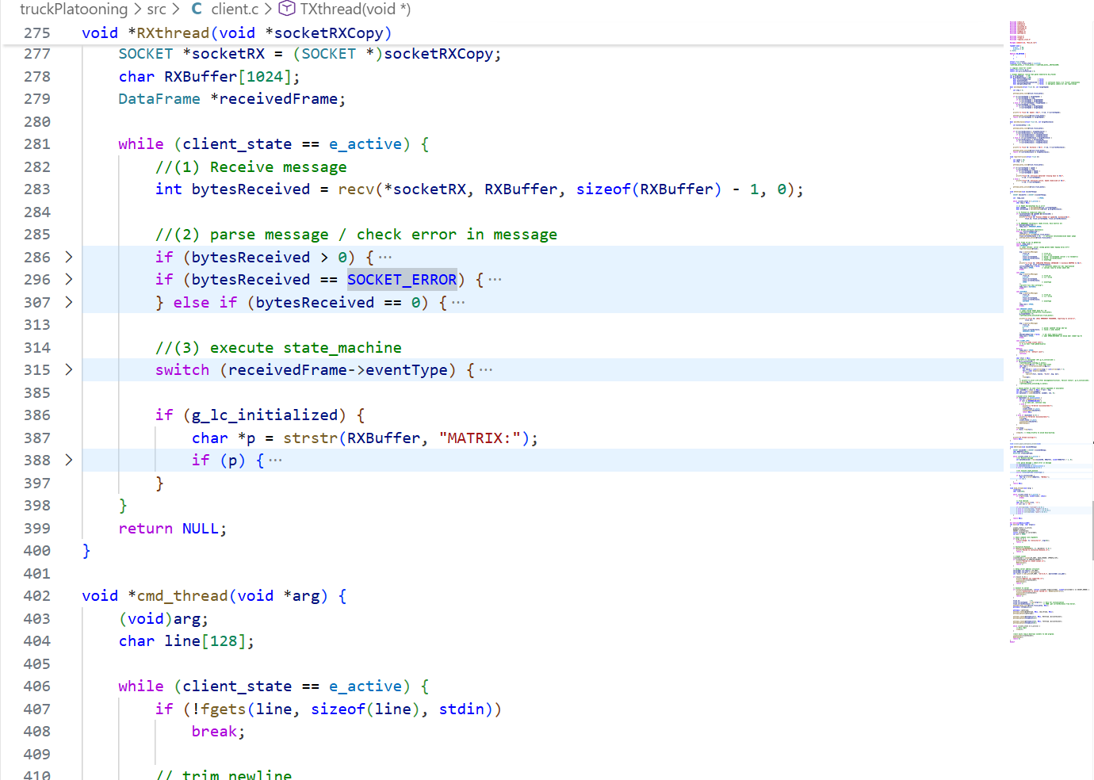
Client‑Side Thread
Main Thread
  Manages client lifecycle (startup, shutdown).
Command Thread (cmd_thread)
  Processes user inputs from the terminal.
Transmitter Thread (TX)
  Sends data requests to the server.
Receiver Thread (RX)
  Continuously listens for incoming data (speed, distance, control messages).
Outcome
All tasks run concurrently without blocking each other.

Slide 12
Server‑Side Thread
Posix thread – P thread
Supports up to 7 simultaneous clients.
For each connected client:
  TX Thread → sends data to that client.
  RX Thread → receives data from that client.
Main Server Thread
Waits for new client connections.
Creates TX/RX thread pairs as clients join.

Slide 13
Logical clock matrix
Why Logical Clocks Are Needed
Nodes generate events concurrently (state updates, control messages, emergencies).
Uses an n\times n matrix, where n is the maximum number of active devices.
Each node is assigned a unique index (server = 1, clients assigned dynamically).
Every node maintains its own matrix, storing: its local event history, and its knowledge of other node events.

Slide 14
Logical clock matrix
Event Generation
When a node performs an action (message creation, speed update, control response):
It increments the diagonal entry of its own index.
This marks the occurrence of a new local event.
Message Transmission
Before sending a message:
The entire logical clock matrix is serialized.
The matrix is appended to the outgoing payload.
Message Reception & Merge
Receiver deserializes the matrix.
Performs an element‑wise merge with its own matrix.
Ensures the receiver holds the most recent and causally consistent event history.

Slide 15
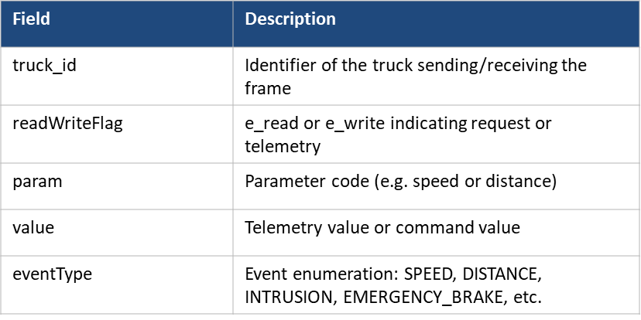
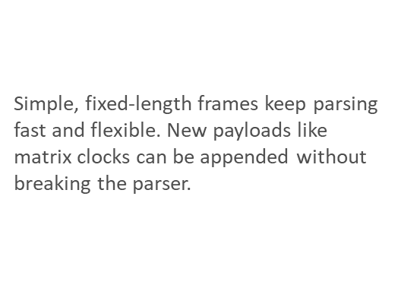
Data Frame Structure & Event Types
Notes:
Harsha

Slide 16
Parsing in TX and RX Threads
TX thread:
• Adjust speed and distance with matchSpeed(), matchDistance()
• Construct message with constructMessage()
• Append MATRIX string and send over socket
RX thread:
• Receive raw string and parse with parseMessage()
• Update g_targetSpeed or g_targetDistance on SPEED/DISTANCE
• Handle INTRUSION or EMERGENCY_BRAKE and merge matrix
• Reset matrix row/column when a client leaves

Slide 17
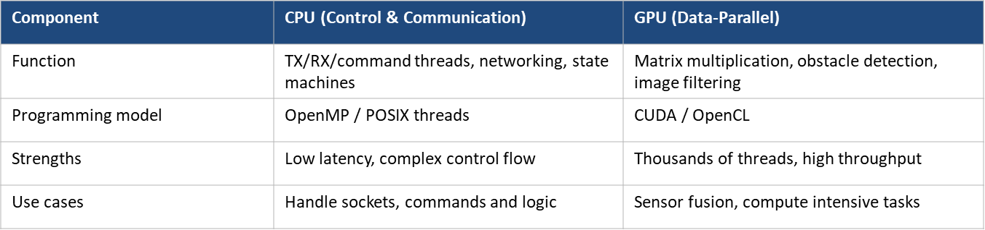
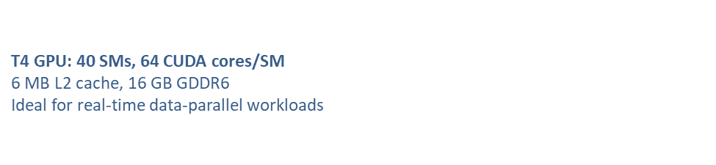

CPU vs GPU Tasks

Slide 18
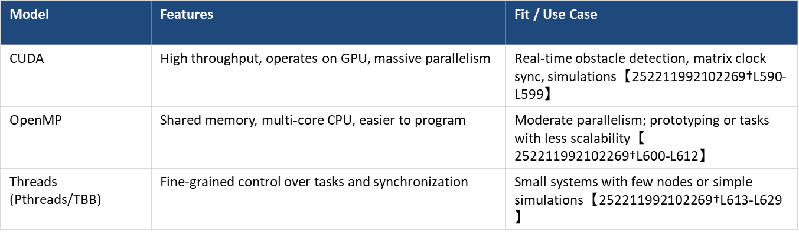
Parallel Programming Models

Slide 19
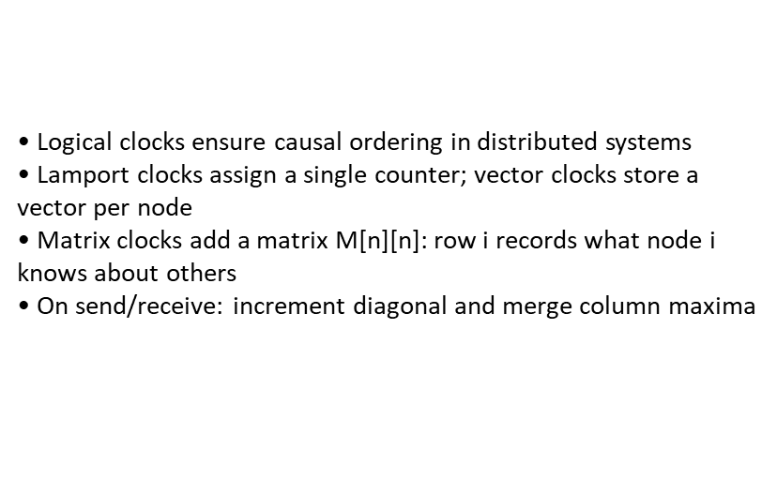
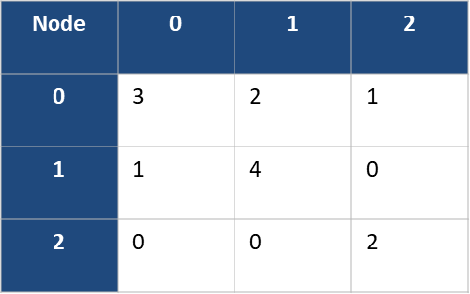
Matrix Clock Concept

Slide 20
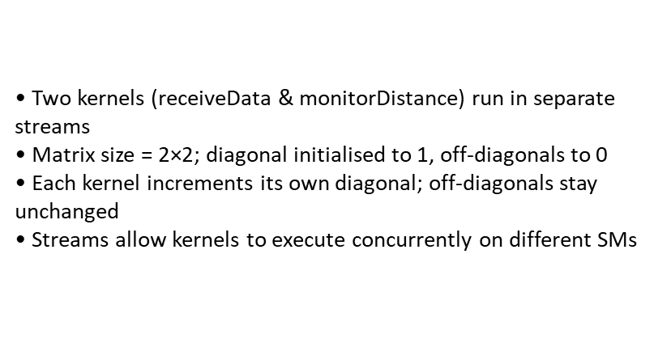
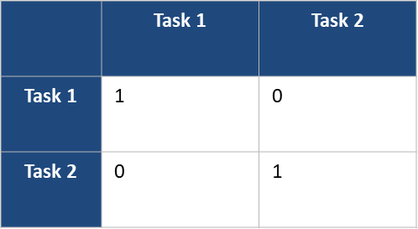
GPU Matrix Clock Implementation
On the GPU, multiple kernels can execute in parallel.
These kernels act like independent logical entities.

Slide 21
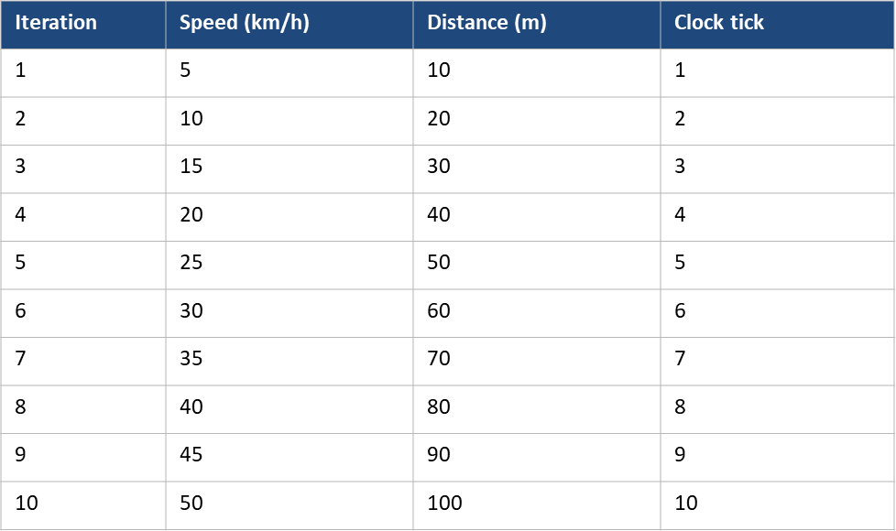
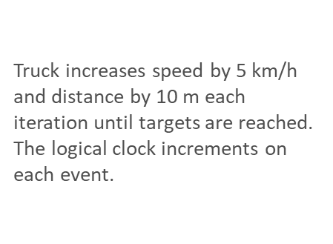
Simulation: Speed, Distance & Clock

Slide 22
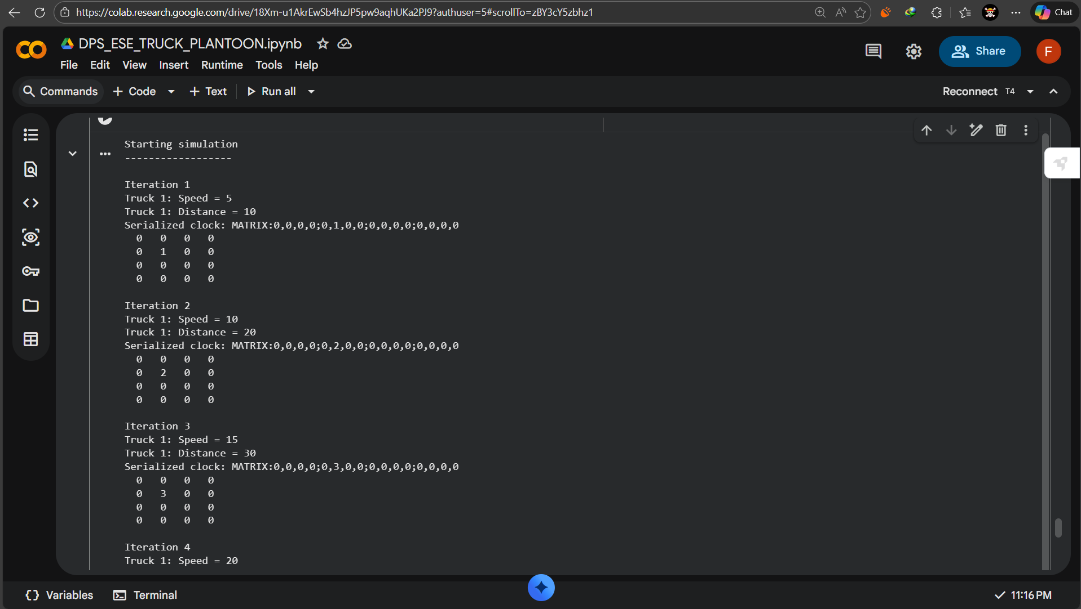
GPU Implementation

Slide 23
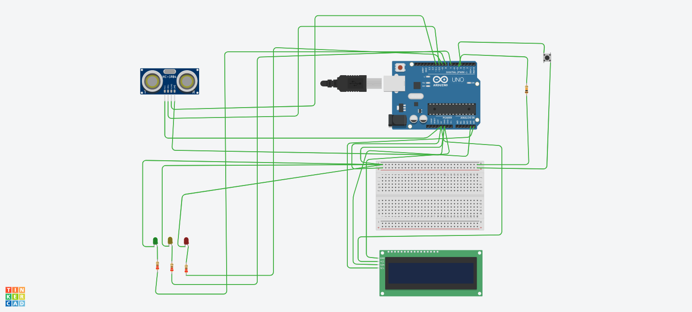
System Simulation and Safety Validation Using HC-SR04 and Embedded Control Logic

Slide 24
The simulation demonstrates:
Correct interpretation of distance sensor data
Proper state transitions (SAFE → ALERT → DANGER → COLLISION)
Accurate Time-To-Collision (TTC) computation
Reliable visual feedback using LEDs and LCD
System robustness against sensor noise and short-range limitations

Slide 25
Safety Analysis Using Fault Tree Analysis (FTA) for a Truck Platooning System
System Components:
HC-SR04 Ultrasonic Sensor – Measures distance to leading vehicle/obstacle
Embedded Controller (Arduino UNO) – Executes control and safety logic
Hazard Push Button – Manual emergency override
LED Indicators – Visual status (SAFE / ALERT / DANGER / COLLISION)
I2C LCD (16×2) – Displays speed, distance, TTC, and system state

Slide 26
Objective of Fault Tree Analysis
Identify hazards that can lead to unsafe operation
Decompose hazards into basic failure events
Assign probabilities to failure events
Evaluate overall risk
Define mitigation strategies

Slide 27
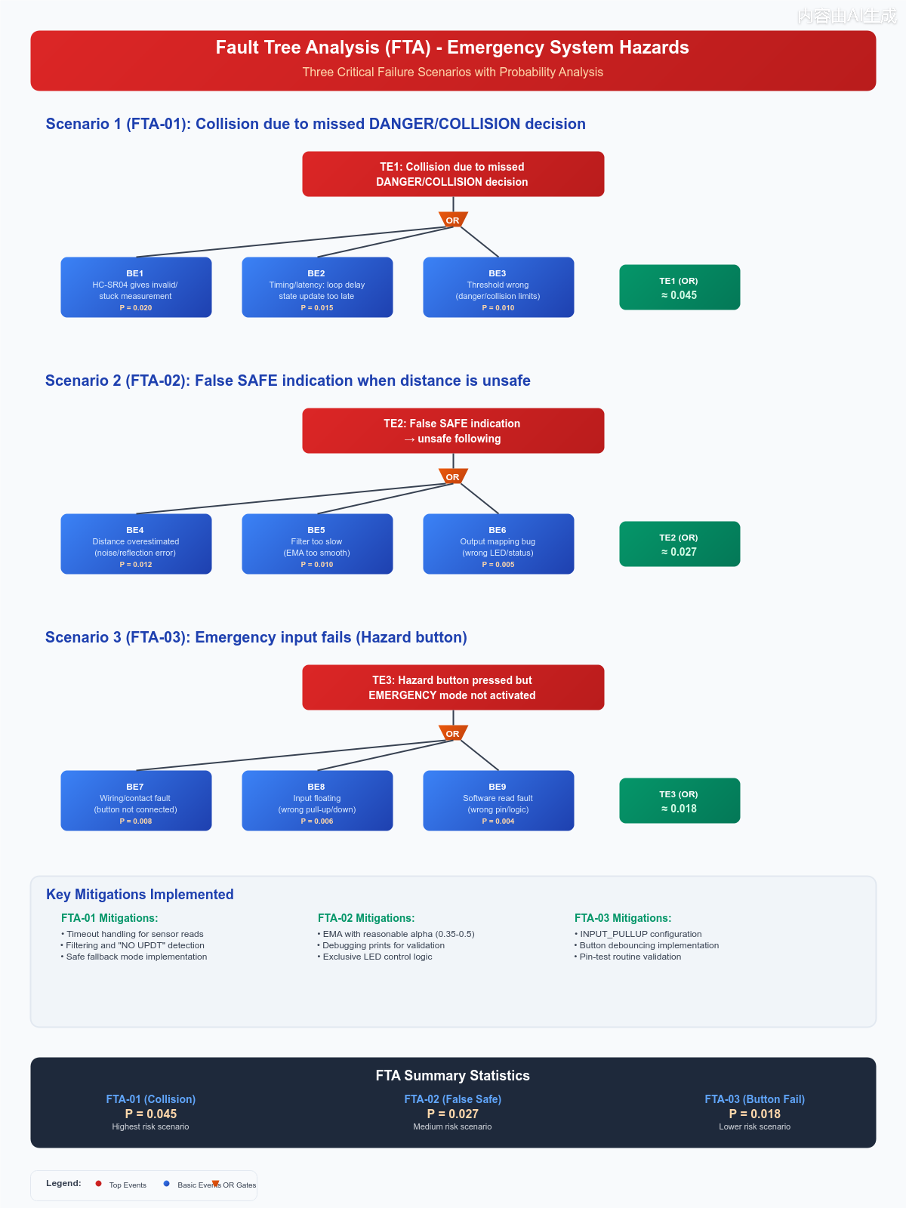

Slide 28
Hazard Identification
Hazard 1 : Collision due to missed or late danger detection
Hazard 2 : False SAFE indication when distance is unsafe

Slide 29
Hazard 1 : Collision due to missed or late danger detection : Events
Basic Event | Description | Probability
1 | HC-SR04 sensor malfunction | 0.020
2 | Software timing / loop delay | 0.015
3 | Threshold logic misconfiguration | 0.010

Slide 30
Hazard 1 : Collision due to missed or late danger detection : Handling
Design-Level Mitigations
Fail-safe design: Invalid or stale sensor data forces ALERT/DANGER
Thresholds chosen according to sensor physical range
Safety priority: collision > danger > alert > safe
Implementation-Level Mitigations
Echo timeout to prevent blocking
Distance update freshness monitoring (NO UPDT)
Exponential Moving Average (EMA) filtering

Slide 31
Hazard 2 : False SAFE indication when distance is unsafe​: Events
Basic Event | Description | Probability
1 | Sensor noise / reflection | 0.012
2 | Filter response too slow | 0.010
3 | Output mapping/software bug | 0.005

Slide 32
Hazard 2 : False SAFE indication when distance is unsafe: Handling
Design-Level Mitigations
SAFE state only allowed after stable distance for multiple cycles
Conservative logic: uncertainty → ALERT/DANGER
Clear operator feedback (NO SENSOR / NO UPDATE)
Implementation-Level Mitigations
Validation of raw and filtered distance
Exclusive LED activation (only one LED on at a time)
Debug logging for verification
Plausibility checks between speed and distance

Slide 33
SCHEDULING
Why Scheduling Is Important
  Safety-critical real-time system
  Multiple periodic tasks running concurrently
  Deadlines must always be met
  Late execution may cause unsafe behavior

Slide 34
RMS (Rate Monotonic Scheduling)
  Fixed priority scheduling algorithm
  Short-term has high priority
  U < U_bound, (derived from formula)
EDF (Earliest Deadline First)
  Dynamic priority scheduling algorithm
  The nearest deadline has the highest priority.
  Flexible but more complex
  U < 1

Slide 35
Task | Method | Type | T(ms) | D(ms) | WCET(ms)
T1 | ServerTXHandler | Periodic | 2 | 2 | 0.5
T2 | ServerRXHandler | Periodic | 2 | 2 | 0.1
T3 | urgentBrakeAll | Periodic | 2 | 2 | 0.2
Total CPU Utilization = 0.4
Bound for RMS = 0.78
For EDF: Condition satisfies
For RMS: Condition satisfies

Slide 36
UNIT TESTING
Early verification of system behavior
Tests individual functions in isolation
Implemented using CUnit framework
Goal:
  Detect errors before integration
  Understanding the reliability of the system

Slide 37
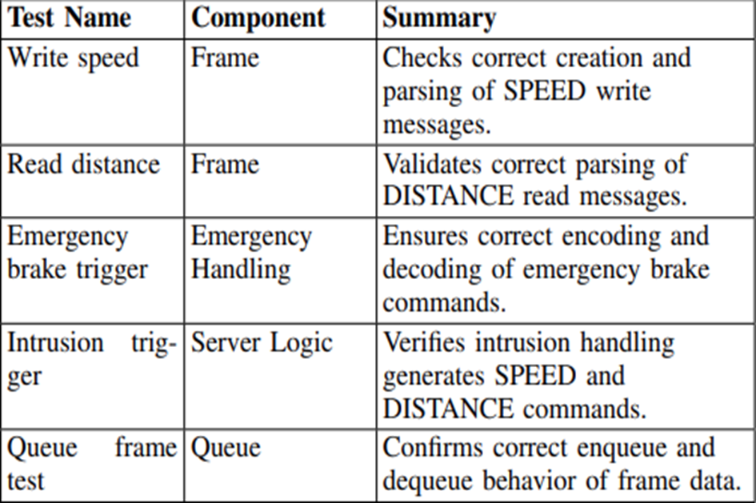
VALIDATION TEST

Slide 38
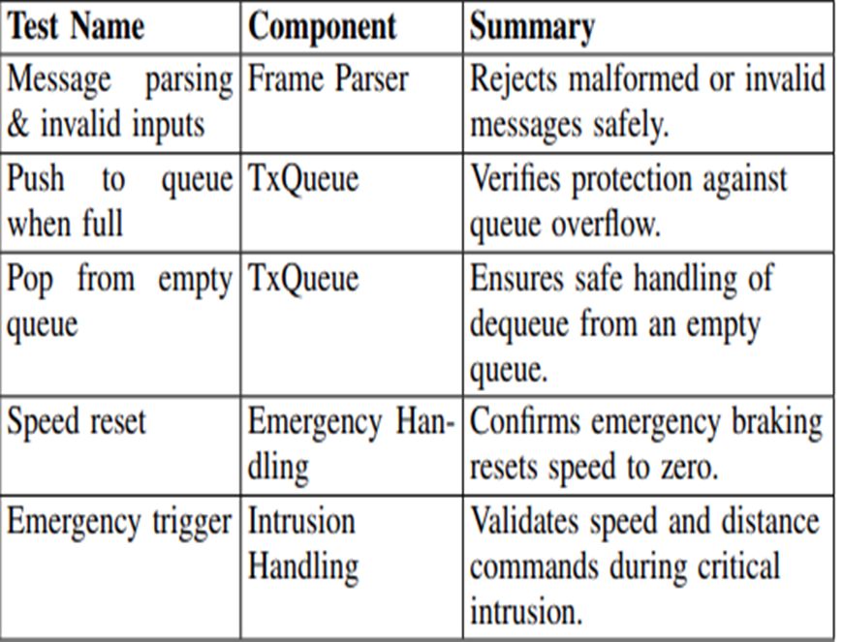
DEFECT TEST

Slide 39
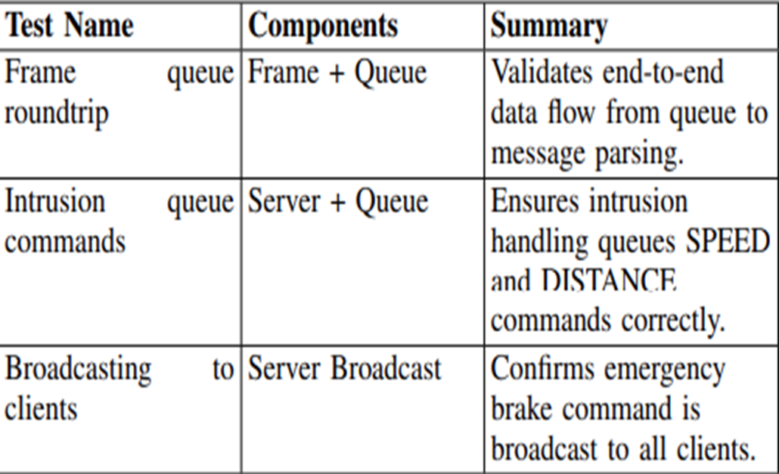
COMPONENT TEST

Slide 40
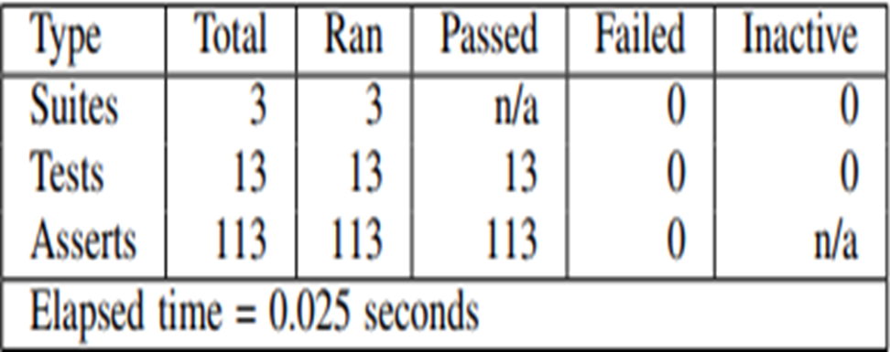
TEST SUMMARY

Slide 41
Thank You

