Slide 1
Chapter 13:
A Simple 3D Application

Slide 2
This Chapter: we will learn about
Basic elements in 3D composition
  Model
  Camera
  Scene (lighting and material)
Left vs. Right Handed Coordinate System
Compose a 3D Scene in a Computer Graphics Program

Slide 3
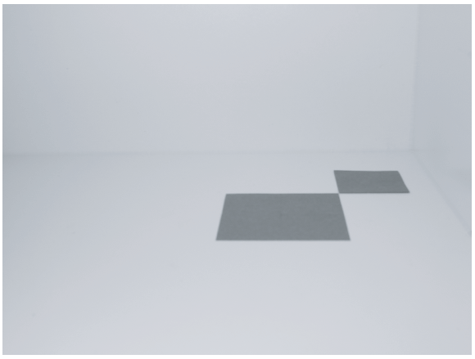
A Photograph of two papers
The Model: 2 papers
  8cm x 8cm and 5cm x 5cm
The Camera
  Simple pinhole
  No focusing capability
The Scene
  Arrangements model
  and camera
  Light sources (later)

Slide 4
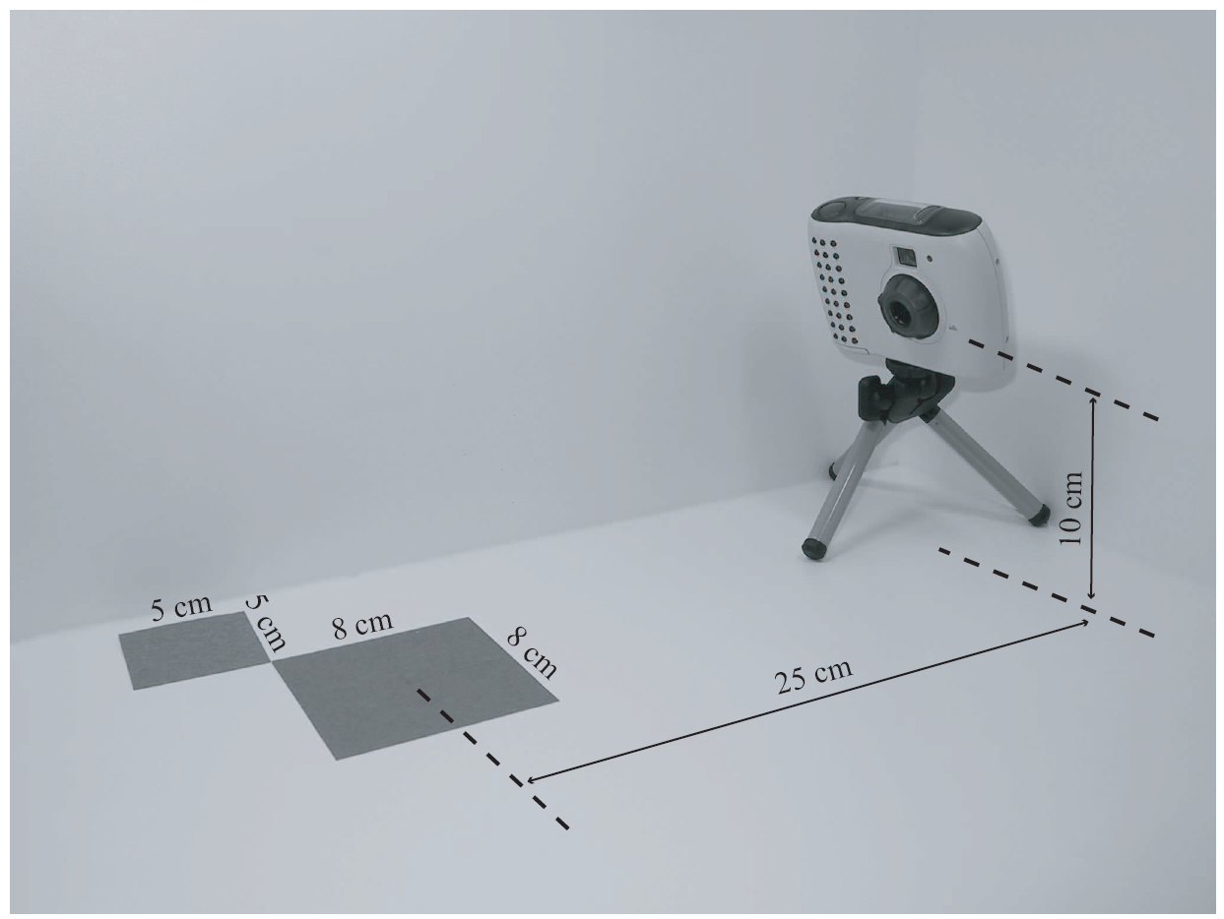
The Arrangements

Slide 5
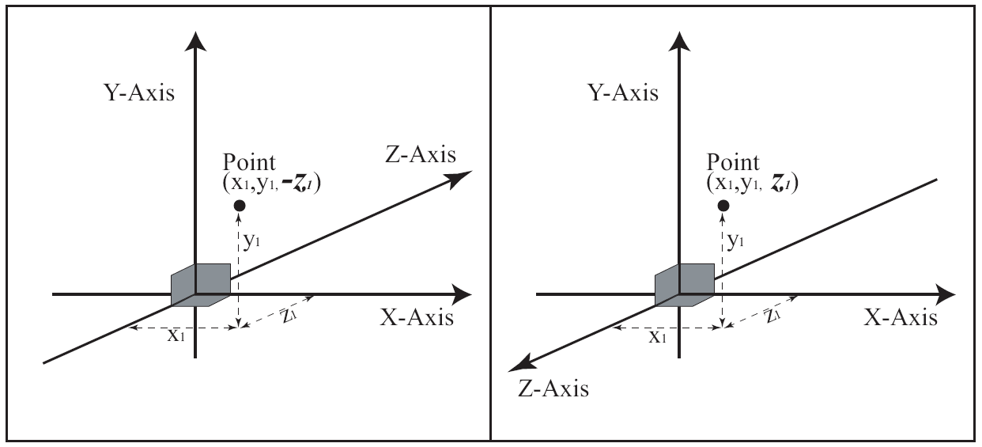
3D Coordinate Systems
Two options for Z-axis direction!
  Same position, different sign for z-value!!

Slide 6
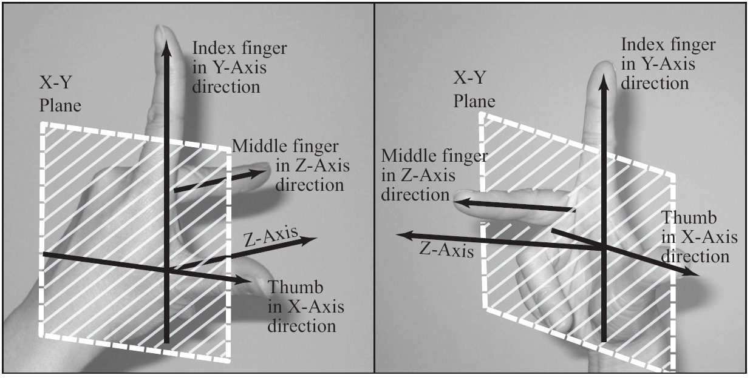
Left vs. Right Handed Systems
Right-Handed System EXCLUSIVELY!!

Slide 7
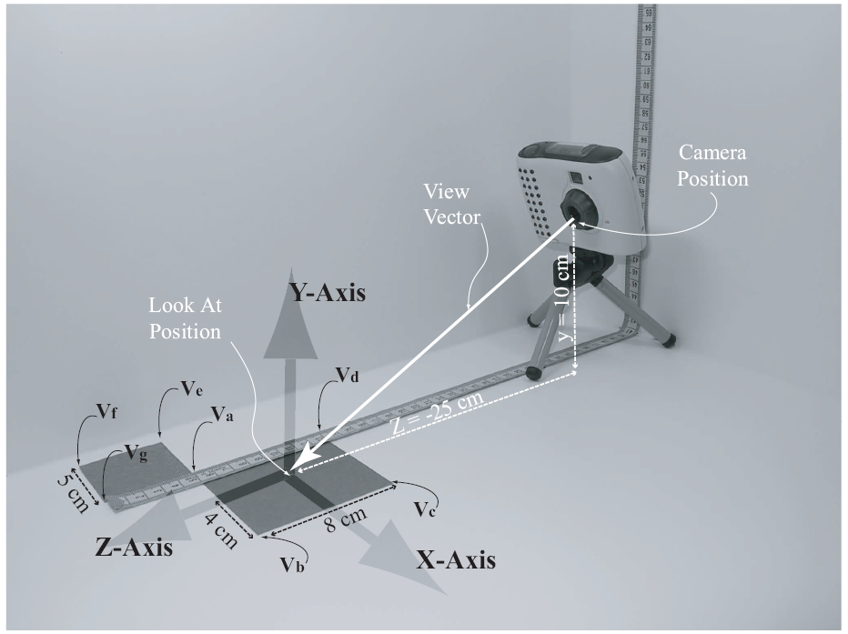
The Model and the Scene
Right-Handed Coordinate System
Convenience
  Origin
  Center of 8x8
  Units
  in cm

Slide 8
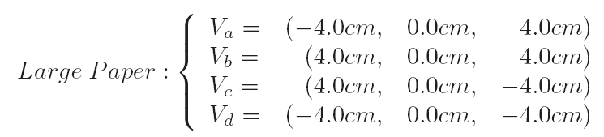

Details …

Slide 9
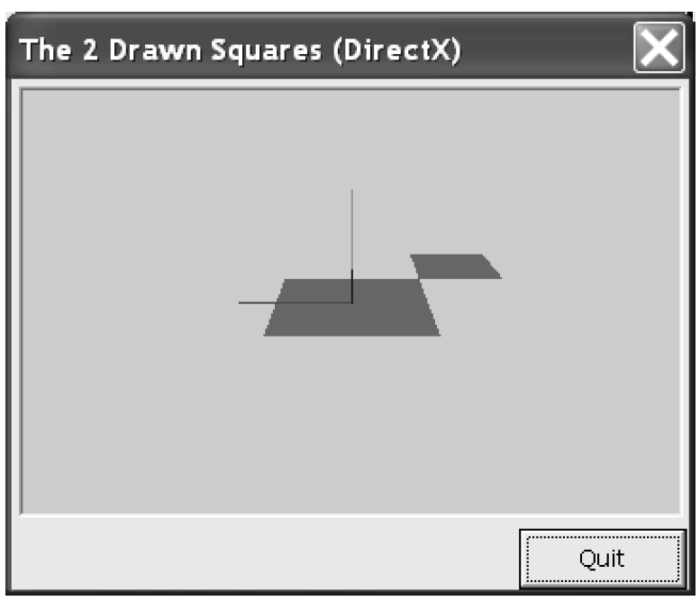
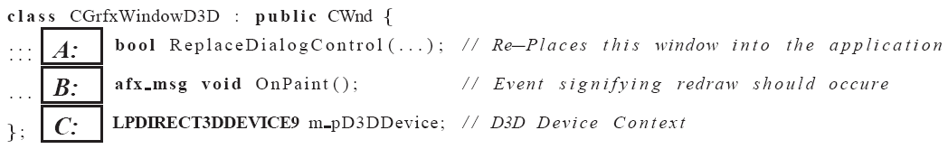
Tut 13.1: Drawing the papers
For now:
  Simplest application
  no library
GrfxWindow class

Slide 10
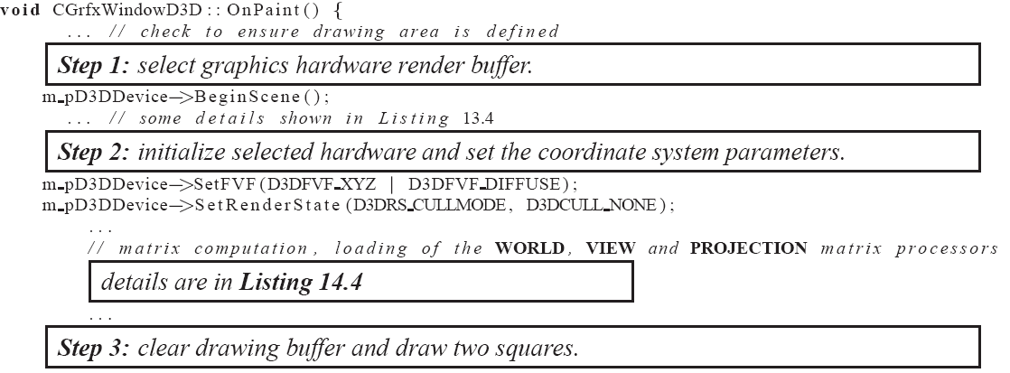
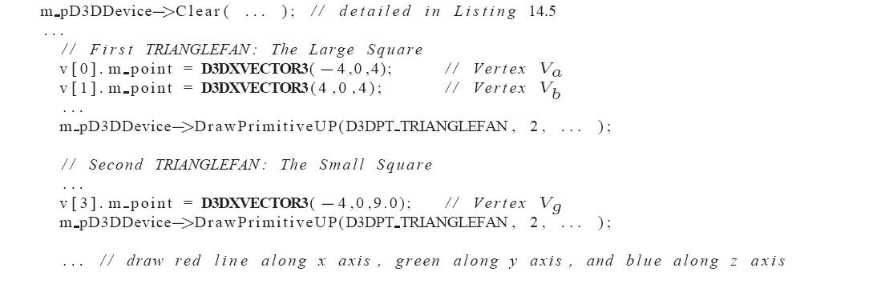
Tut 13.1: The drawing code …

Slide 11
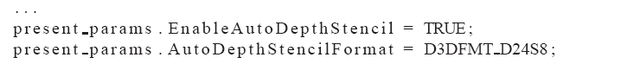
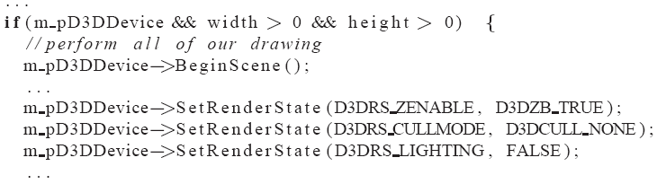
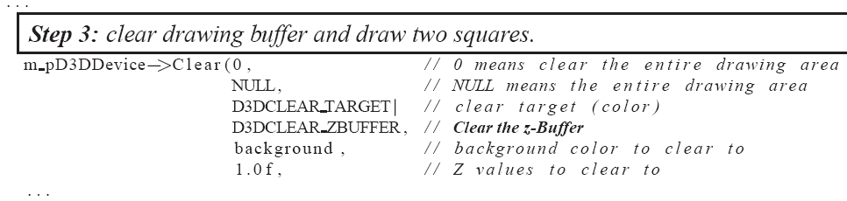
Tut 13.1: Z-Buffer for 3D Drawing
  GrfxWindow::OnCreate(): create z-buffer
  GrfxWindow::OnPaint():
    Enable z-buffer
    Clear z-buffer

