Slide 1
Chapter 11:
Hierarchical Modeling
Chapter 11

Slide 2
This Chapter: we will learn about
Building Hierarchical Models
Controlling components in a Hierarchical Model
Object Coordinate System
Scene Graphs/Trees/Nodes
Chapter 11

Slide 3

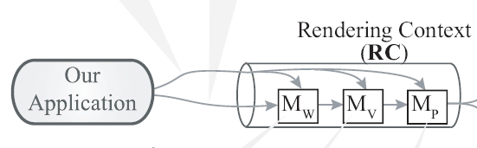
Review of D3D …
We wish to draw a vertex V_{i}
What is being drawn is V_{o}, where
For D3D
We have see:
  M_{V} = M_{w2n}
  This chapter, we examine what to do with M_{W}
  M_{P} = I₄ will not change until 3D
Chapter 11

Slide 4
Motivation …
A circle at V_{i} = (x_{i}, y_{i}) with radius r
Define a triangle fan
  Either: centered at V_{i} with radius r
  Or: at origin (0,0), with radius 1.0 AND
    Load: M_{W} = S(r,, r) T(x_{i,}, y_{i})
XformInfo class: to compute/load
  M_{W} = T(-p_{x}, -p_{y})S(s_{y}, s_{y})R(θ)T(p_{x,}, p_{y})T(t_{x,}, t_{y})
  A general operator to transform primitives
Chapter 11

Slide 5
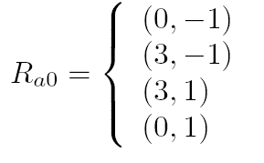
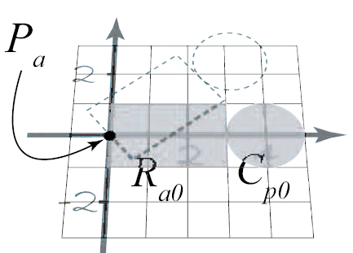
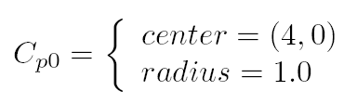

Now, a simple Arm …
  Rectangle:
  Circle:
Want to: Rotate the entire Arm about
  Pivot:
EASY to accomplish with xformInfo!
Chapter 11

Slide 6
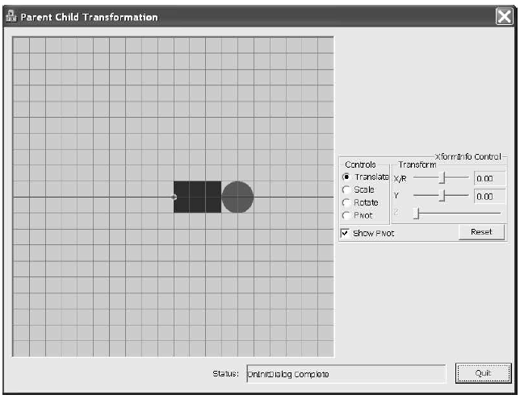
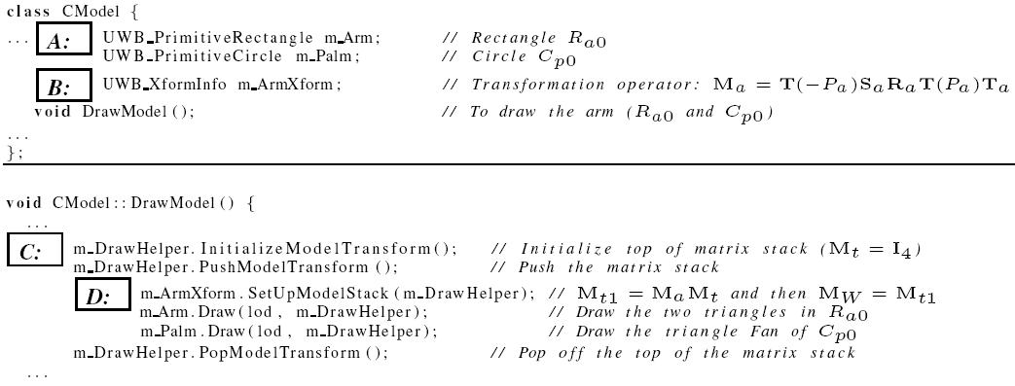
Tut 11.1: Controlling Simple Arm
Controls
Chapter 11

Slide 7
Tut 11.1: some details …
Label C: Sets top of Stack to Identity: I₄
Label D:
  On the stack computes
    M_{a} = T(-p_{x}, -p_{y})S(s_{y}, s_{y})R(θ)T(p_{x,}, p_{y})T(t_{x,}, t_{y}) AND
  Loads top of stack to:
    WORLD matrix (M_{W} = M_{a})
Chapter 11

Slide 8
Tut 11.1: more detilas
M_{W} = M_{a} where …
  M_{a} = T(-p_{x}, -p_{y})S(s_{y}, s_{y})R(θ)T(p_{x,}, p_{y})T(t_{x,}, t_{y})
Arm movement is accomplished …
  With no changes to any of the vertices
    R_{a0} and C_{p0} vertices are not altered!
  With xformInfo class
    Load M_{a} from top of stack to M_{W}
    Then draw
Chapter 11

Slide 9
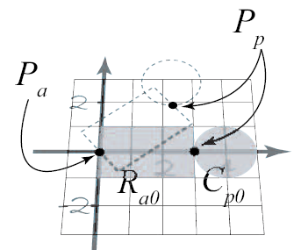
Generalize the idea …
Control the
  Palm on the arm
  Palm is the circle (C_{p0}) pivoted at (P_{p})
Observe (intuition)
  Palm follows the arm xform
    i.e., when rotate arm, palm must follow
  Palm has additional xform …
    i.e., palm can be rotated independent from arm
Chapter 11

Slide 10
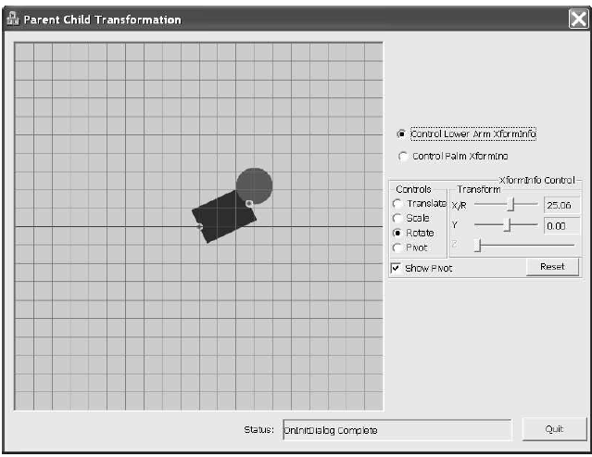
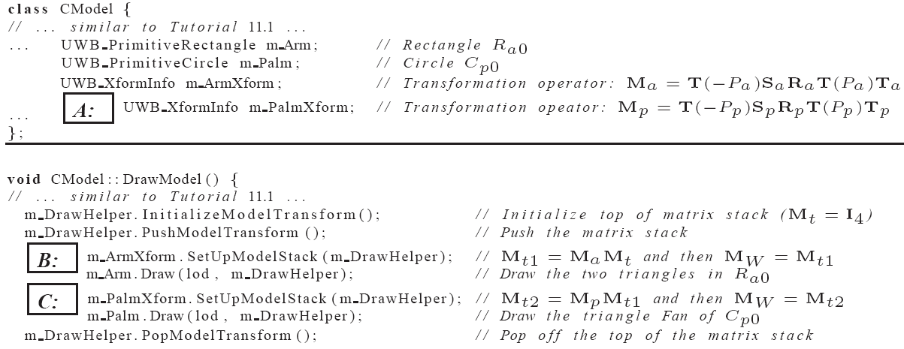
Tut 11.2: Parent/Child Xform
Note:
  Label A: one more
  XformInfo object
Chapter 11

Slide 11
Tut 11.2: Some details …
Label B:
  Computes M_{a} from m_ArmXform
  Draws R_{a0} rectangle with M_{W}= M_{a}
Label C:
  Computes M_{p} from m_PalmXform and
  concatenates with M_{a} to compute: M_{p}M_{a}
  Draws C_{p0} rectangle with M_{W}= M_{p}M_{a}
Chapter 11

Slide 12
Observations:
Graphical Objects
  Geometric Primitives
  Once defined, do not alter
Interactive control
  Accomplished via computing/setting transformations
Components
  By strategically defining/concatenating separate transforms
  Accomplish intuitive group/component control
Chapter 11

Slide 13
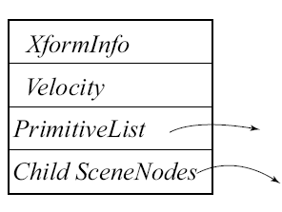
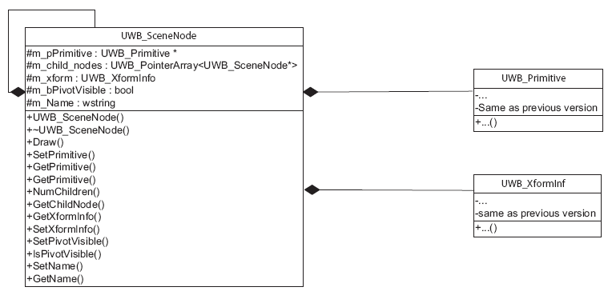
Lib 11: SceneNode class
Design to support convenient concatenation of XformInfo
Chapter 11

Slide 14
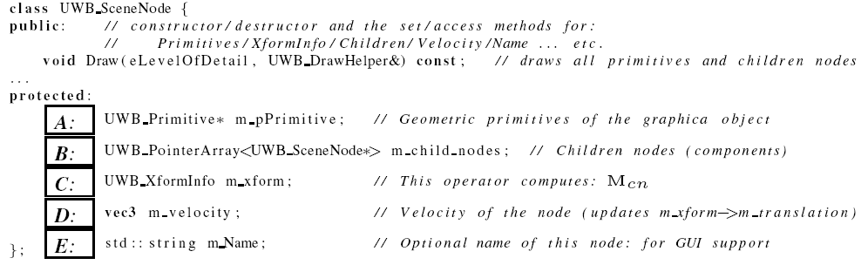
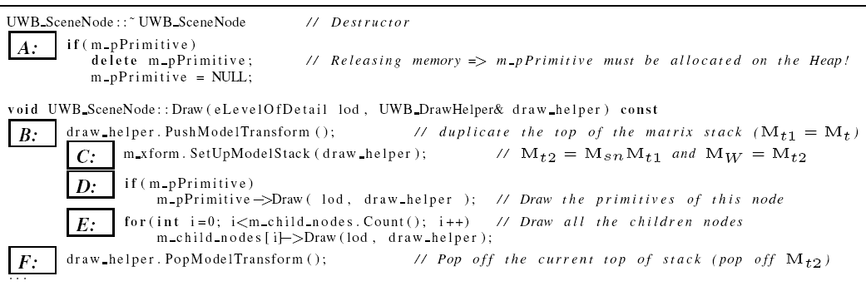
SceneNode Details
Chapter 11

Slide 15
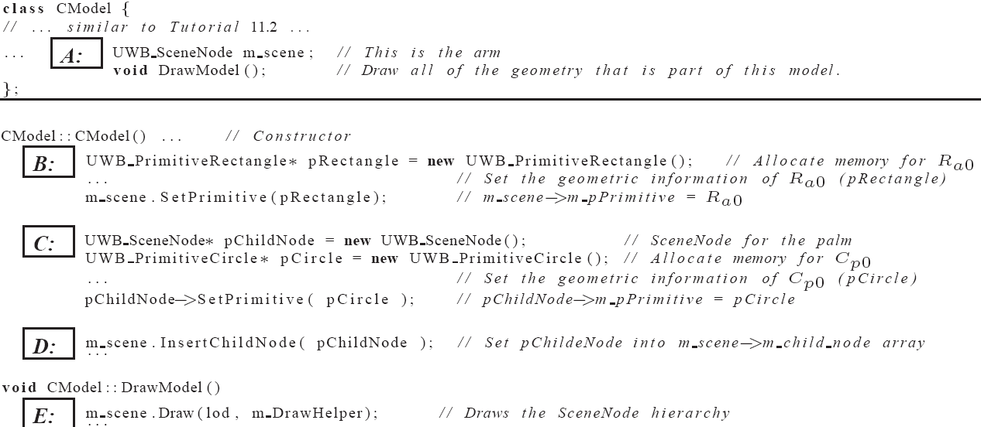
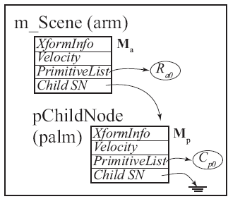
Tut 11.3: SceneNode
Look/Feel: identical to Tut 11.2
Chapter 11

Slide 16
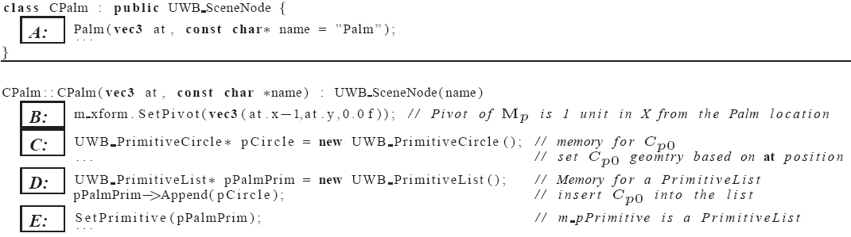
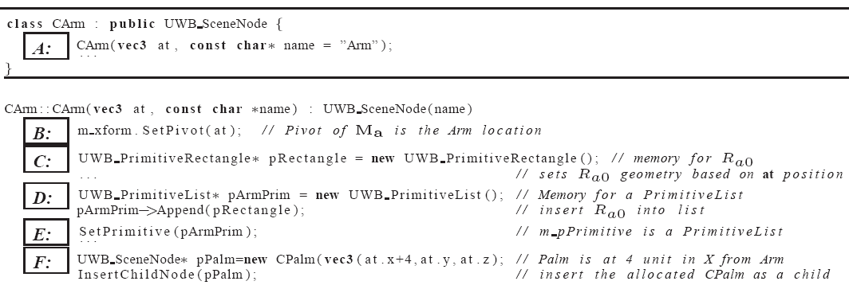
Tut 11.4: Subclass from SceneNode
Look/Feel: identical to Tut 11.2/11.3
Chapter 11

Slide 17
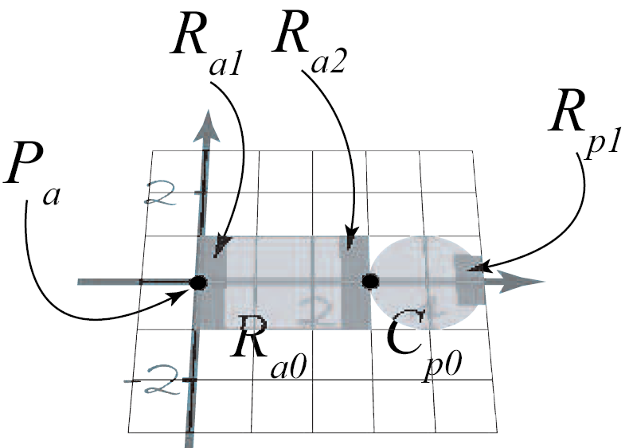
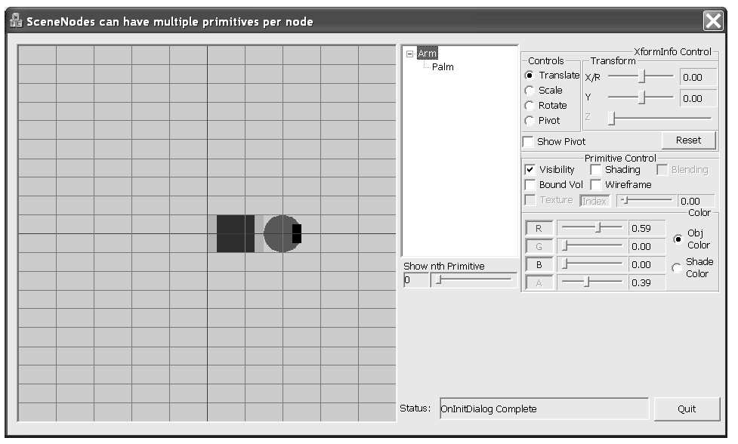
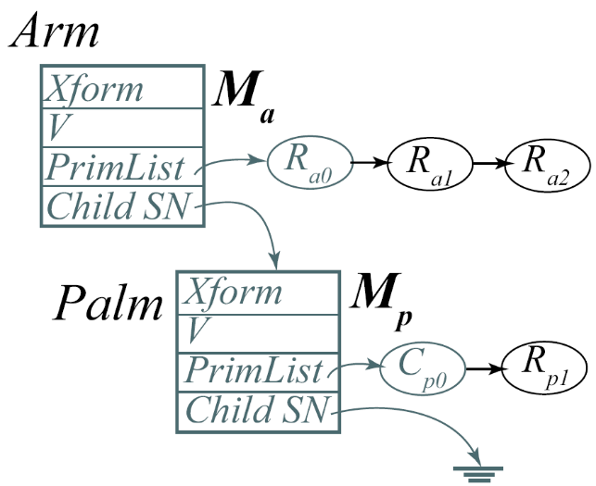
Tut 11.5: SceneTreeControl (GUI support)
SceneTreeControl
Chapter 11

Slide 18
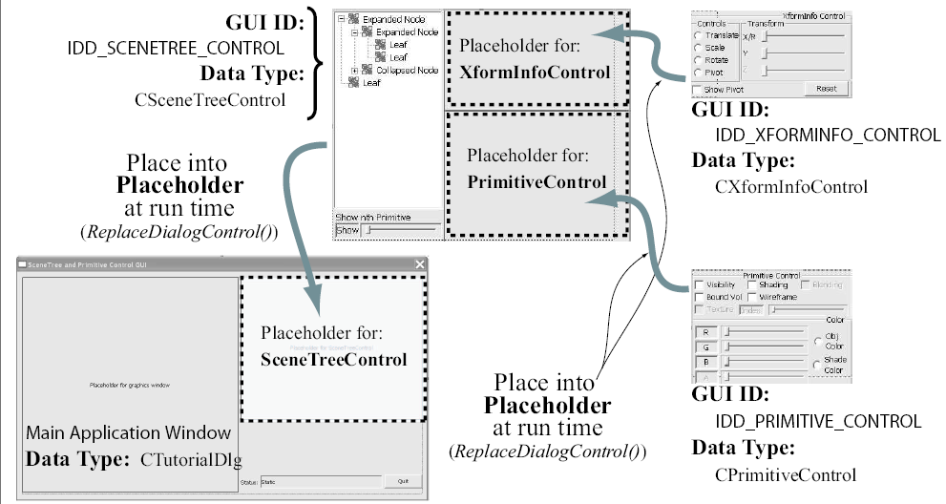
SceneTreeControl: some details
Chapter 11

Slide 19
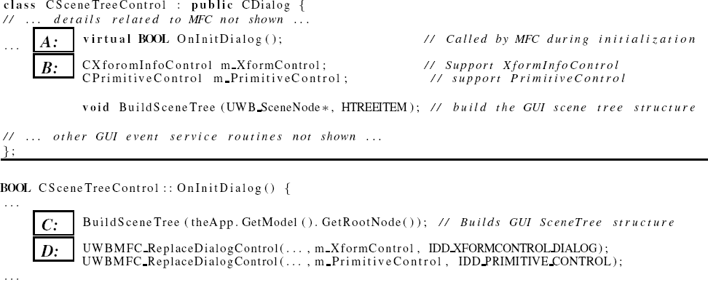
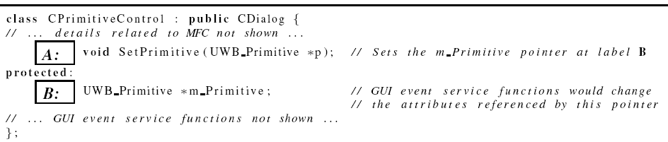
SceneTreeControl: Implementation
Chapter 11

Slide 20
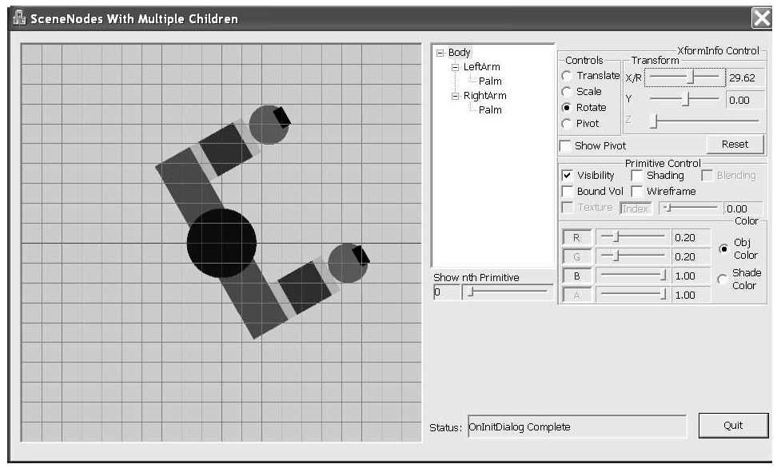
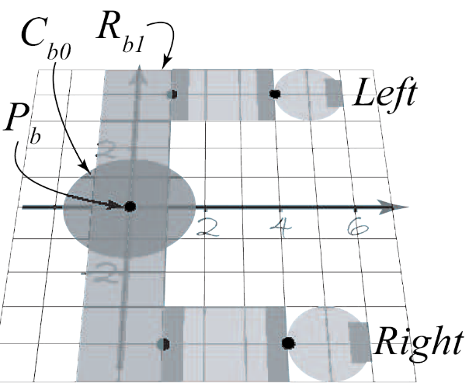
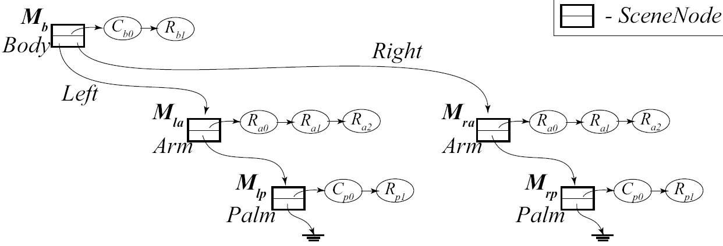
Tut 11.6: Hierarchy of SceneNodes
Chapter 11

Slide 21
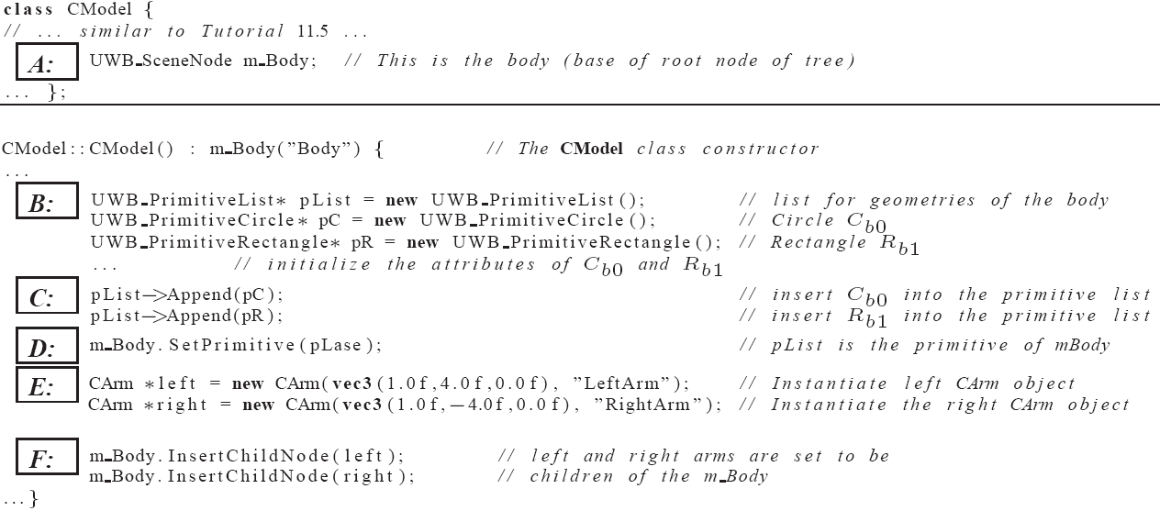
Tut 11.6: Implementation
Chapter 11

Slide 22


Tut 12.6: Details …
Body xformed by:
Left Arm by:
Left Palm by:
Chapter 11

Slide 23
Instancing: sharing …
Notice …
  left and right arm/palm
  are identical!
  How can we re-use?!
Chapter 11

Slide 24
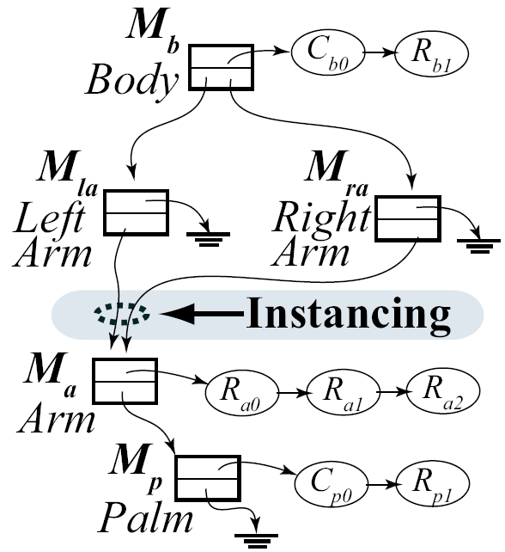
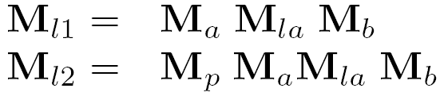
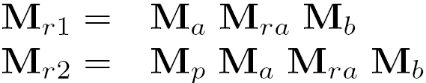
Instancing: Sharing of hierarchy
Arm hierarchy shared by
separate left/right
transforms
See: two separate arms:
  left
    Arm
    palm
  Right
    Arm
    palm
Chapter 11

Slide 25
Sharing Hierarchy: Problem
Transforms:
  Left Arm/Palm
  Right Arm/Palm
Notice: M_{a} and M_{p} in both left and right
When change these two transforms
  Left/right arm/palm will change in identical manner!
In this case:
  no way to control left/right separately!
Chapter 11

Slide 26

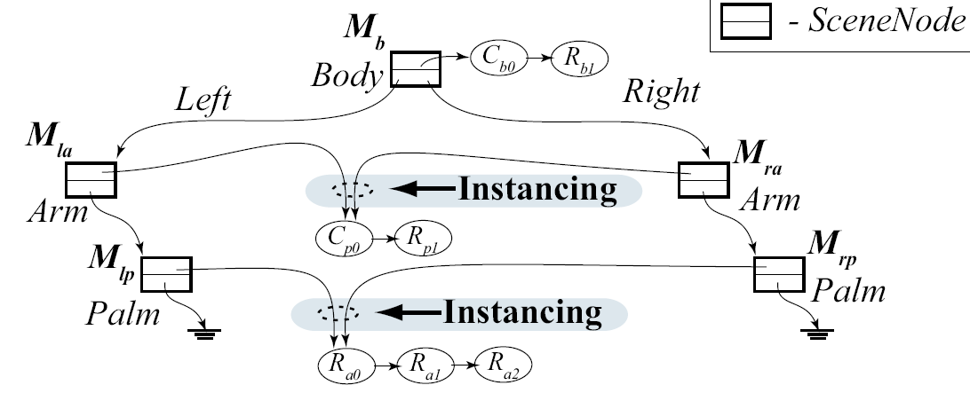
Instancing: Sharing Geometry
Problem: complexity!
Chapter 11

Slide 27
Instancing: Discussion …
Commercial System:
  Sharing of geometry
    Memory management is tricky!
      reference count
  Sharing of hierarchy
    Typically not used because of restricted control
UWBGL_LIB:
  DO NOT support any form of instancing
Chapter 11

Slide 28
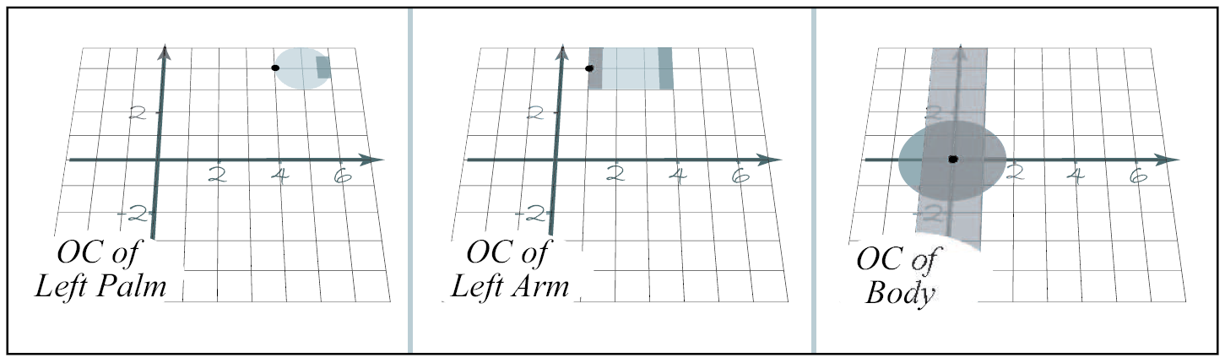
Object Coordinate (OC) System
Chapter 11

Slide 29
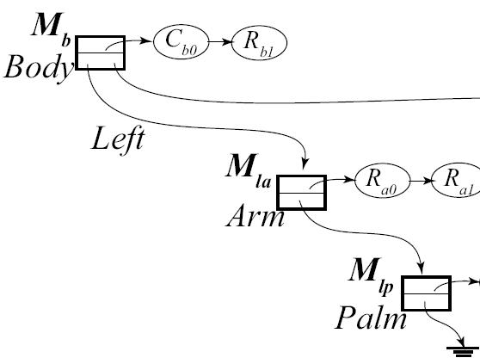
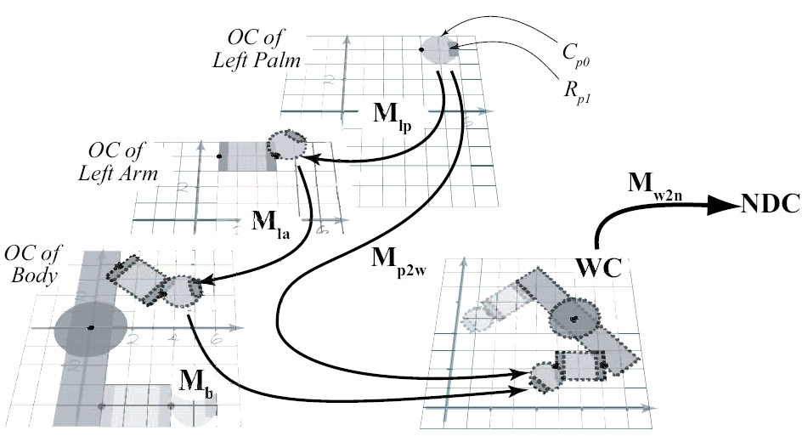
Left Arm/Palm to WC Transform
Chapter 11

Slide 30
Object Coordinate and Transforms
Drawing: XformInfo in SceneNode
    Computes/loads M_{W} to transform node OC to WC
    WindowHandler (DrawOnlyHandler::DrawGraphics()):
      Computes load M_{w2n} to M_{V} to transform form WC to NDC
Mouse click selection
    Positions are given to us in HC space!
    Our program represent graphical objects in OC!
Collision: we must decide!
    Perform computation in WC? Or
    Perform computation in OC?
Chapter 11

Slide 31
Mouse Click Selection
Two Tasks:
  Coordinate Space: From DC to OC
  Proximity Test:
    when in OC
    determine if mouse click is close to object
Chapter 11

Slide 32
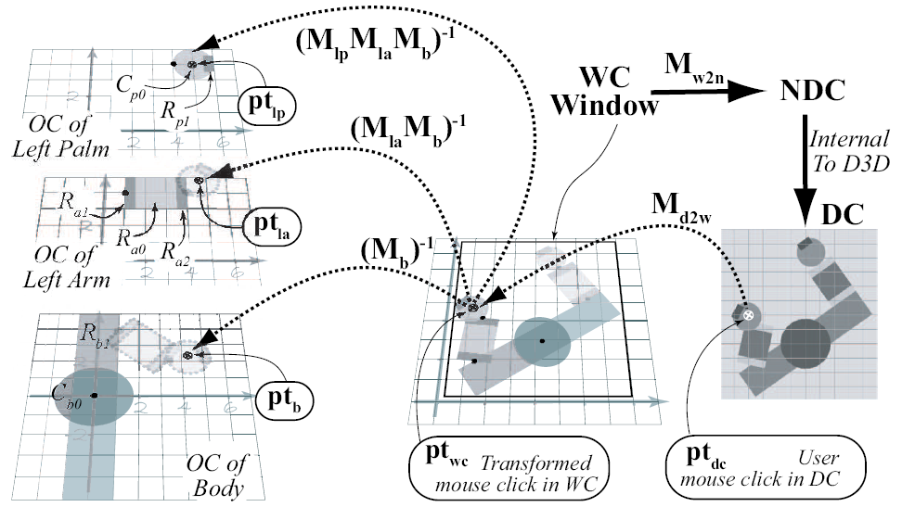
Mouse click position in OCs
Chapter 11

Slide 33




DC to OC Transforms …
Mouse click:
In Body OC:
In Left Arm OC:
In Left Palm OC:
Chapter 11

Slide 34
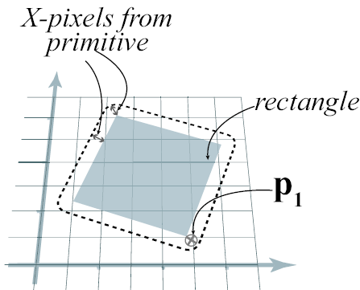
Proximity Test:
Close-enough test
  In general: expensive!
In our case:
  Use point in
  bounding volume
Chapter 11

Slide 35
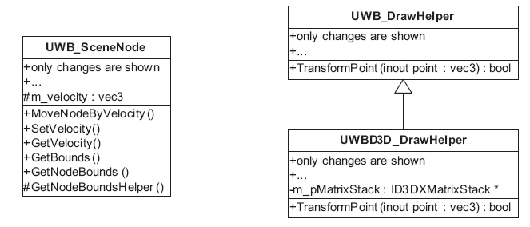
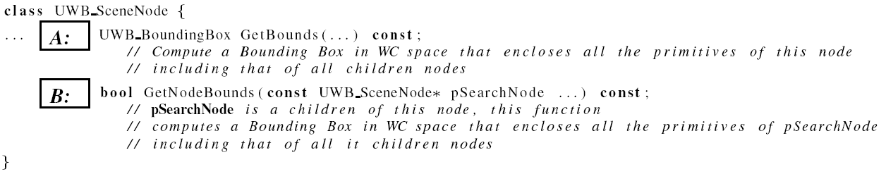
Lib12: SceneNode bound support
Bound: in WC
Velocity: for moving the entire node (by changing XformInfo)
Chapter 11

Slide 36
Lib12: Transformation support
DrawHelper::TransformPoint()
  Transforms a point based
  Using the top of matrix stack
Usage:
  Push matrix stack
  Compute transform
  on the matrix stack
  Transform points
  Pop matrix stack
Chapter 11

Slide 37
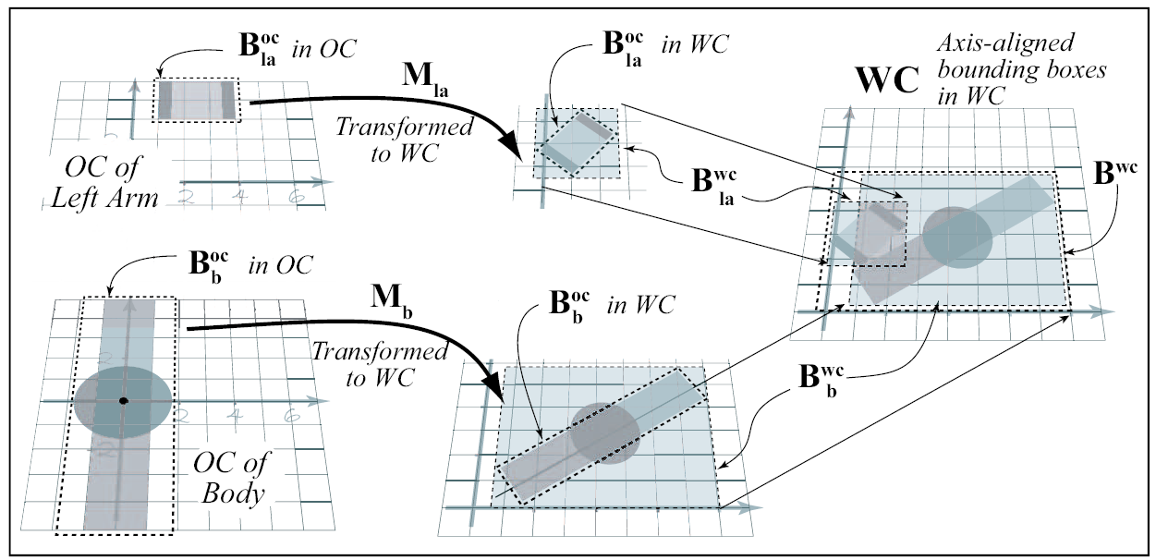
Compute SceneNode BBox
Chapter 11

Slide 38
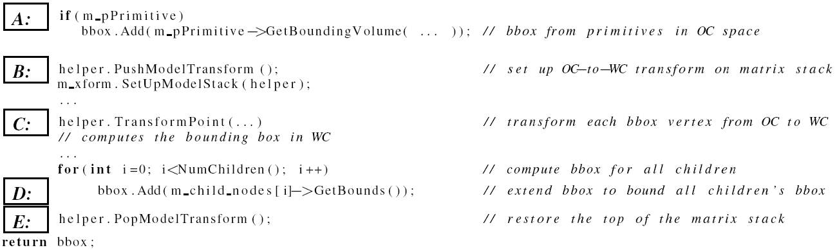
SceneNode: Bound implementation
  A: BBox of all primitives for this node
  B: OC to WC matrix
  C: Transform BBOX to WC
  D: Compute/Merge with Children BBOX
Chapter 11

Slide 39
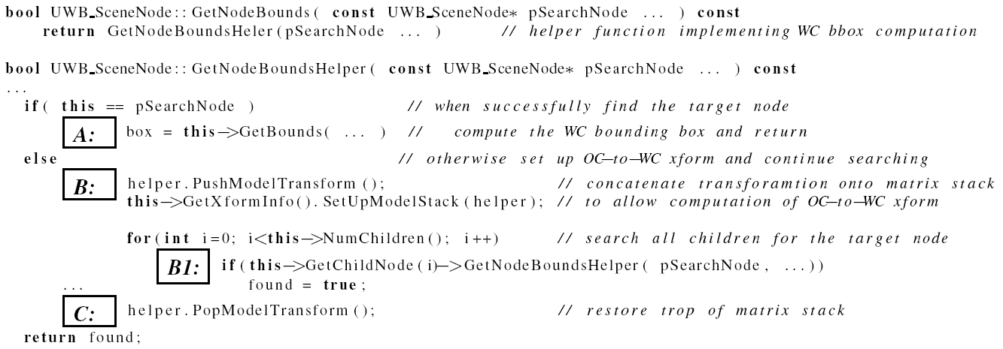
SceneNode::GetNodeBound()
  A: If specific scene node found:
    compute bound starting from this node
  B: if not found, Set OC to WC xform and
    B1: continue traversing down the hierarchy (looking for given node)
  C: Restore Xfrom Stack
Chapter 11

Slide 40
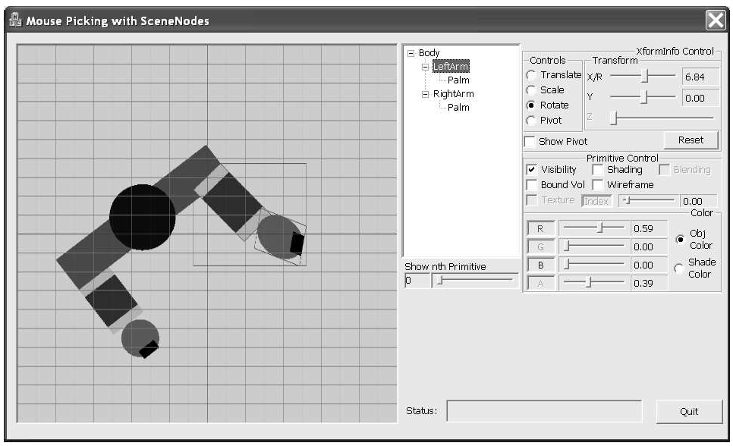
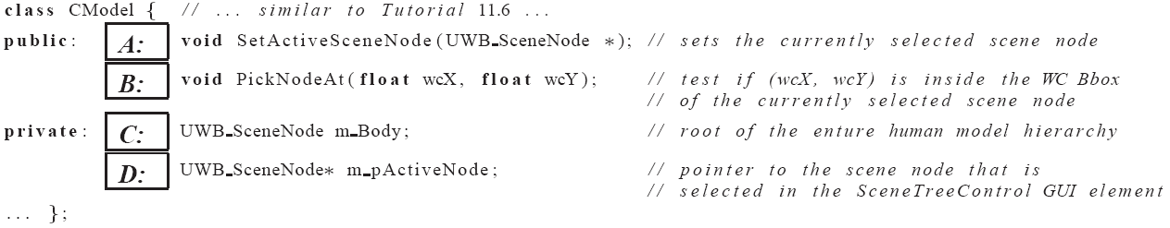
Tut 11.7: Mouse Hit Detection
  LMB click in bound to
  see component selected
Chapter 11

Slide 41
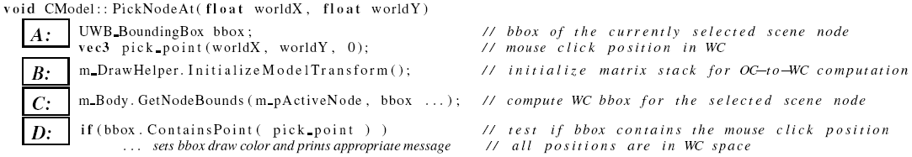
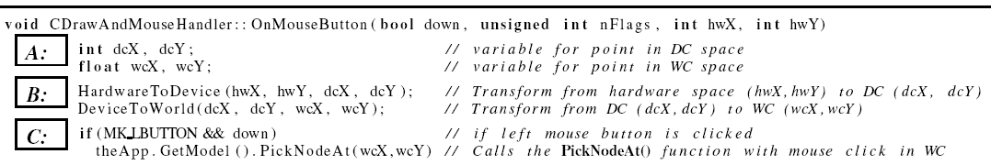
Tut: 11.7: some details
Chapter 11

Slide 42
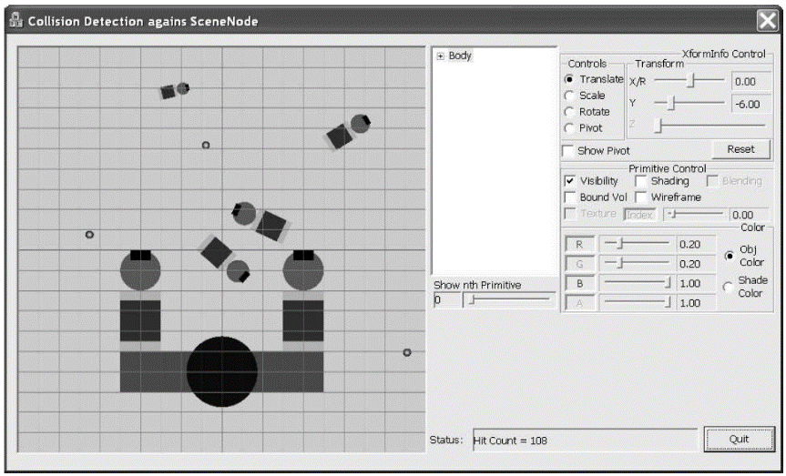
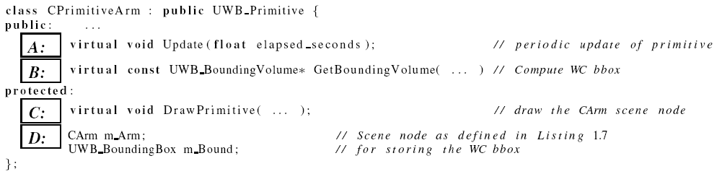
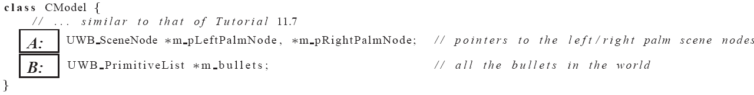
Tut 11.8: Collision
CPrimitiveArm: is a primitive
  Can be used as bullets
  In the CModel m_bullets array
Chapter 11

Slide 43
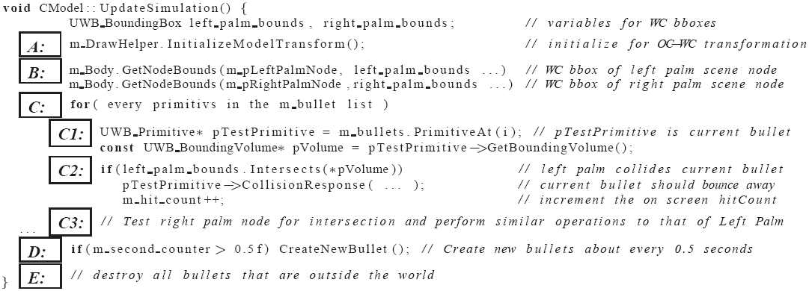
Tut 11.8: UpdateSimulation()
B: Keeps references to colliding parts (Palms)
C: Collide all bullets (balls and PrimitiveArm)
  With Left/Right Palms
D: Randomly create new bullets
Chapter 11

Slide 44
Tut 11.8: Lesson …
Rough Approximation:
  Proximity tests are simple Bbox
  Many false positives!
Multiple collisions:
  A bullet can intersect with a palm multiple times!
  Resulting in multiple hitCount for the same palm/bullet collisions
Chapter 11

Slide 45
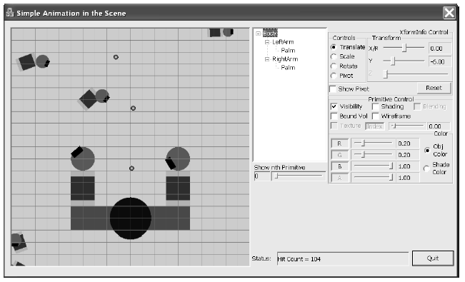

Tut 11.9: Simple Animation …
Continuously change
the xform of a
SceneNode (palm)
Chapter 11

