Slide 1
Chapter 8:
Transformation Operators
Chapter 8

Slide 2
This Chapter: we will learn
Vectors
  Representing vertices
Matrix
  Representing transformation operators
Review
  Translation/Scale/Rotation
Examine D3D Implementation
Chapter 8

Slide 3

Vertex position and Row Vector
Vertex, V, at (x,y)
  V = (x, y)
Represent as a row vector
Chapter 8

Slide 4
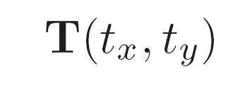
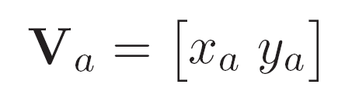
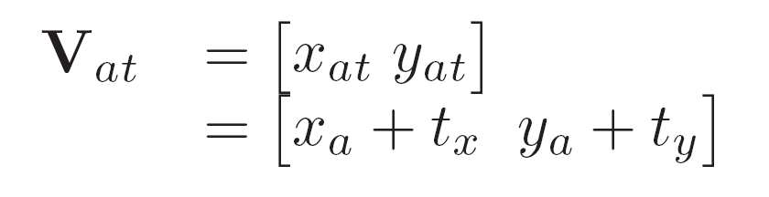

Translation Operator:
Translation means moving
Operator:
Moves vertex:
To:
We represent:
Chapter 8

Slide 5
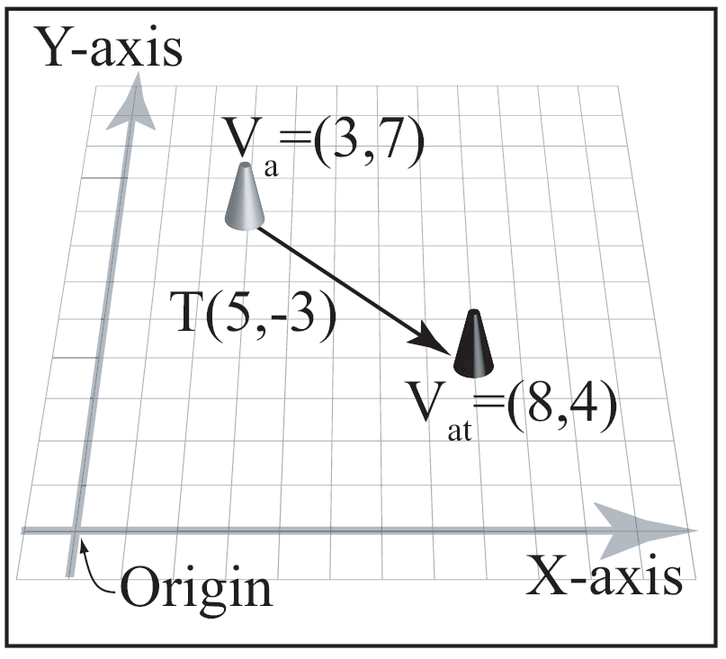


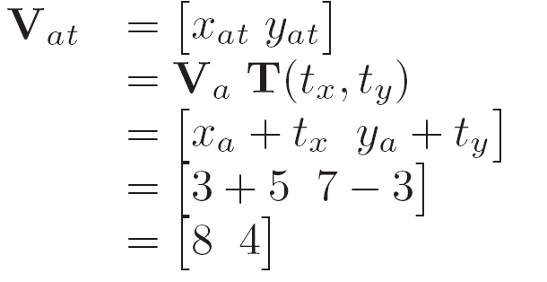
Translation Example:
Operator:
Vertex:
Result:
Chapter 8

Slide 6
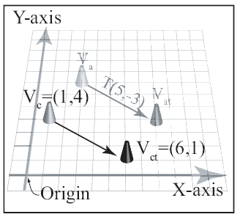
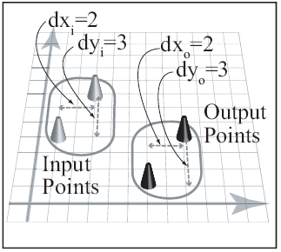
Translation: Properties
Moves relative
Relation of input/output
points maintains
Chapter 8

Slide 7
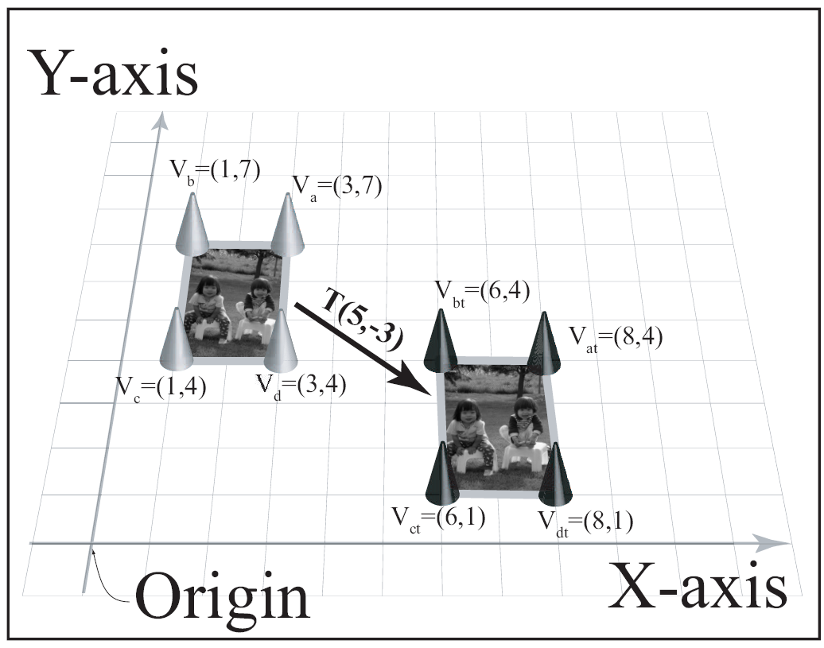
Translating entire object:
Chapter 8

Slide 8


Translation Properties
Geometric: does not change shape:
    Size, edges, and angles between angles
Reversibility
Identity: T(0,0)
Extension to 3D: simple
Chapter 8

Slide 9


Note on order of operation
True for ALL operators: T, S, R
is different from
In fact: with row vector representation
    is undefined!
Chapter 8

Slide 10

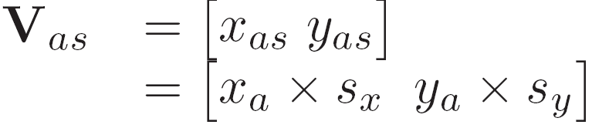
Scaling Operator:
scaling means change size
Operator:
scales vertex:
To:
We represent:
Chapter 8

Slide 11
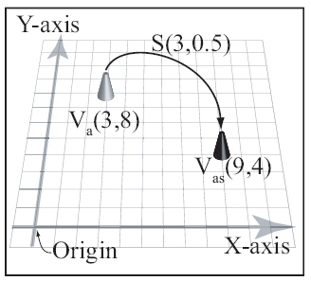


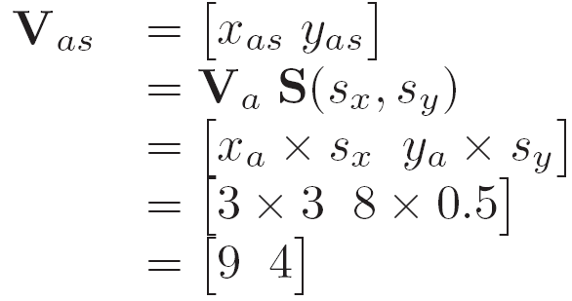
Scaling Example:
Operator:
Vertex:
Result:
Chapter 8

Slide 12

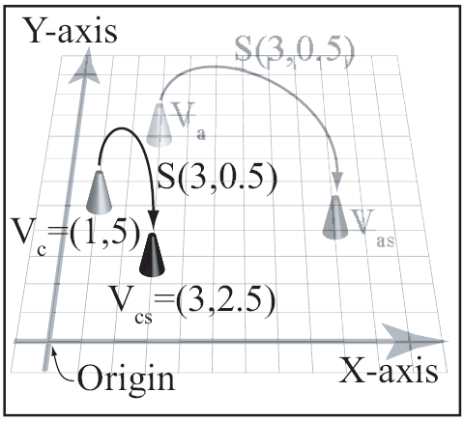
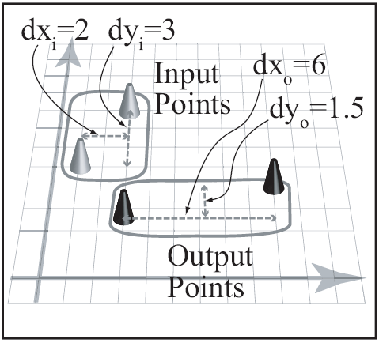
Scaling stretches distance (from axes)
Operator:
  Individual points
  Groups of points
Chapter 8

Slide 13
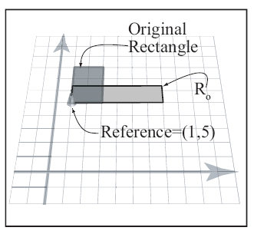
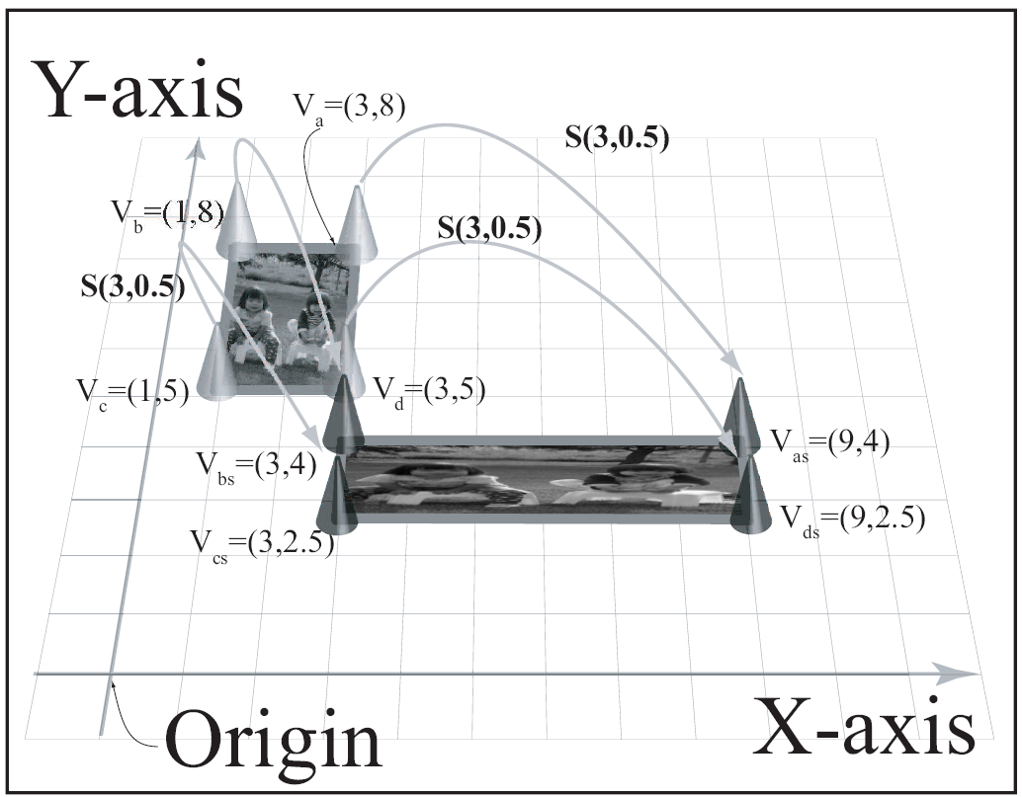
Scaling entire object
Chapter 8

Slide 14
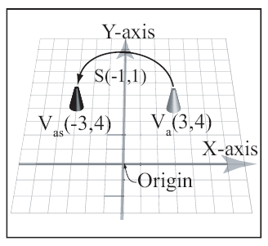
Reflection: Negative scaling factors
Negative factor in x:
  Reflect across y
Negative factor in y:
  Reflect across x
Chapter 8

Slide 15
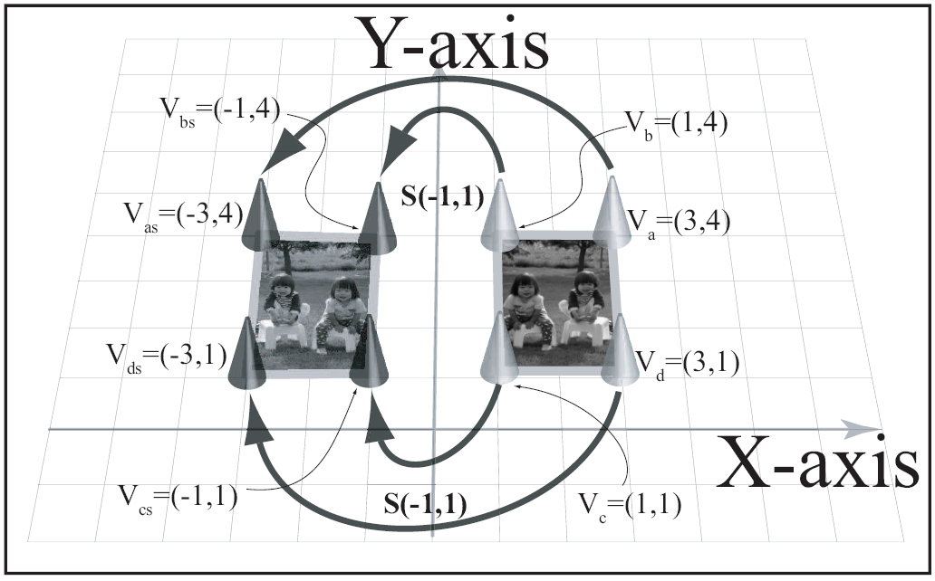
Reflection: entire object
Chapter 8

Slide 16
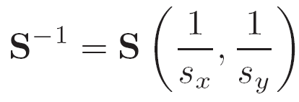

Scaling Properties
Geometric: scale factors
  scale distances to the axes.
Reversibility
Identity: S(1,1)
Extension to 3D: simple
Chapter 8

Slide 17

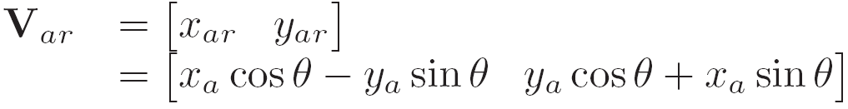

Rotation Operator:
Rotation means turning
Operator:
Moves vertex:
To:
We represent:
Chapter 8

Slide 18
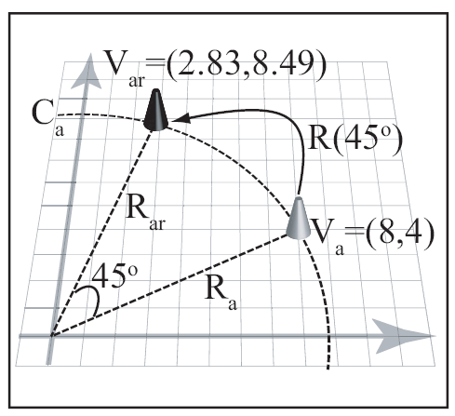


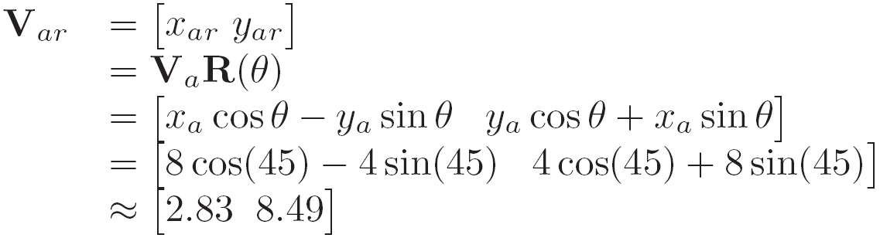
Rotation Example:
Operator:
Vertex:
Result:
Chapter 8

Slide 19
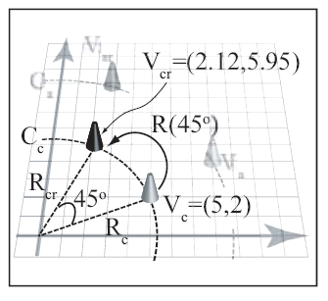
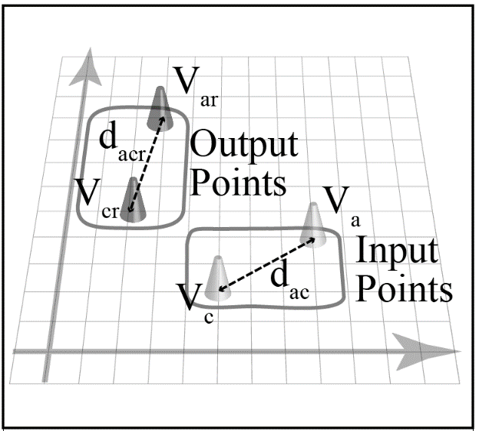
Rotation: Fixed distance from Origin
Move along
circumference
Distance between
points do not change
Chapter 8

Slide 20
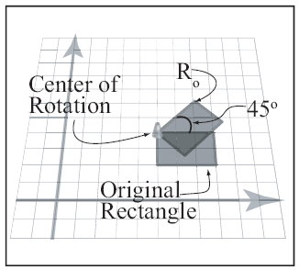
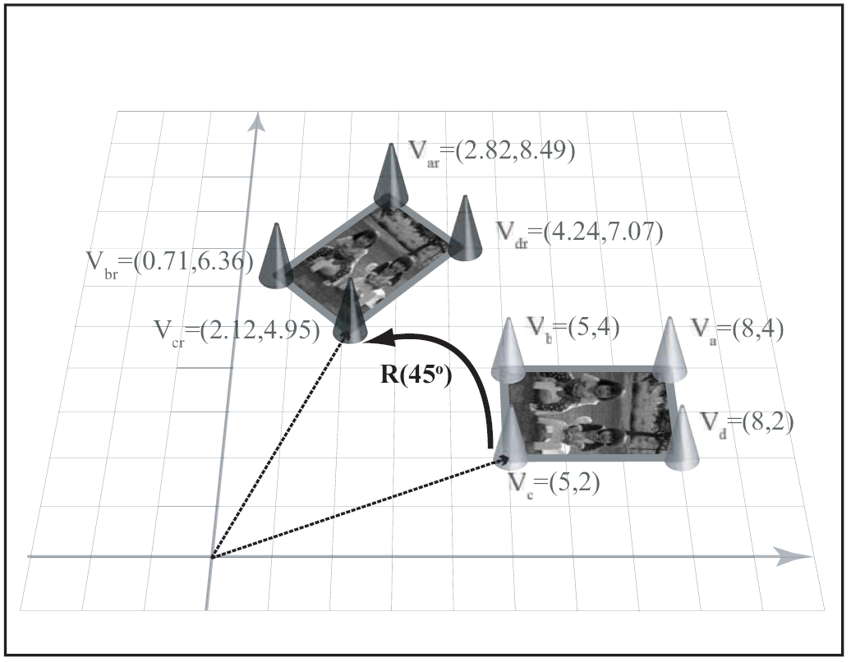
Rotating entire object:
Chapter 8

Slide 21

Rotation Properties
Geometric:
    Shape and area does not change
Reversibility
Identity: R(0)
Extension to 3D: tricky!
    Will study in detailed in later chapter
Chapter 8

Slide 22
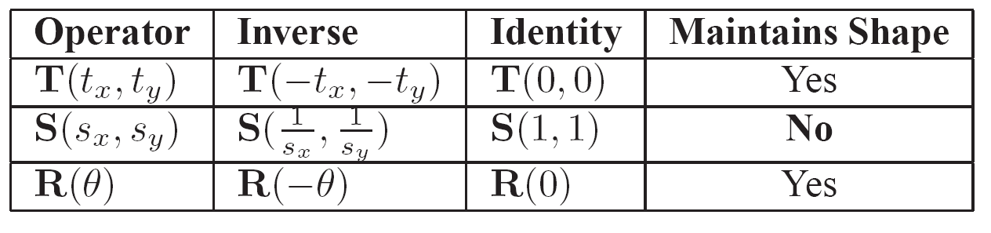
Summary: operators
Chapter 8

Slide 23



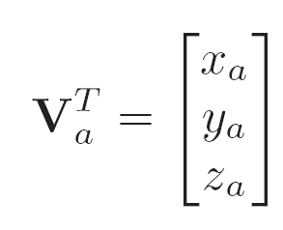
A Word about vectors …
Vertex position:
Row Vector
Column Vector
(Transpose)
Chapter 8

Slide 24
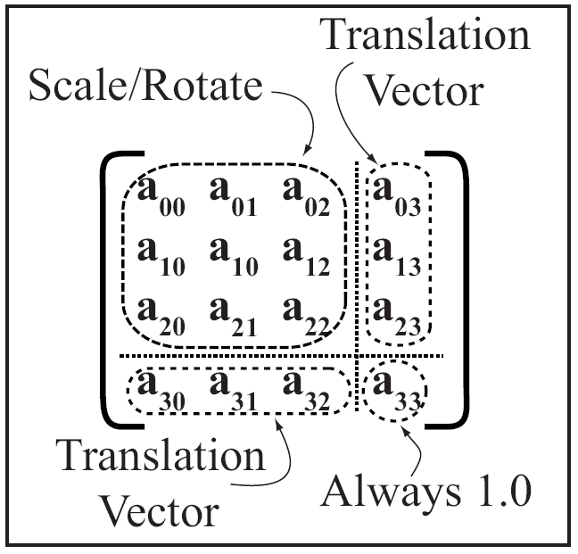
A Word about Matrices
4x4 array of floats
Chapter 8

Slide 25
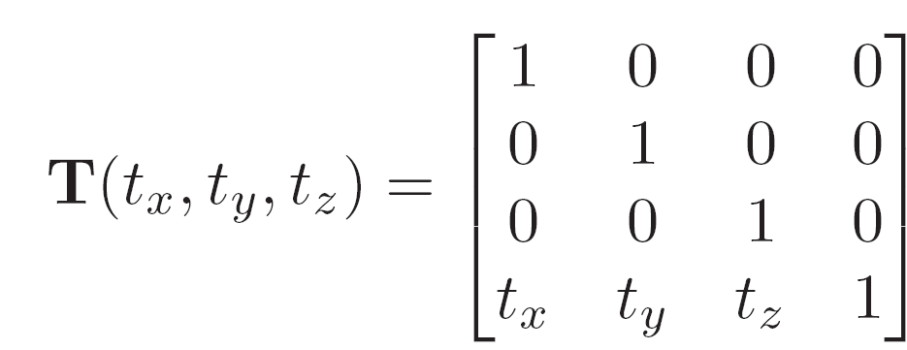
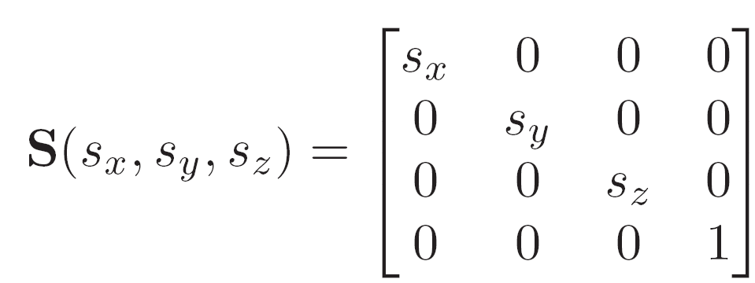
Operators: Translate and Scale
Chapter 8

Slide 26
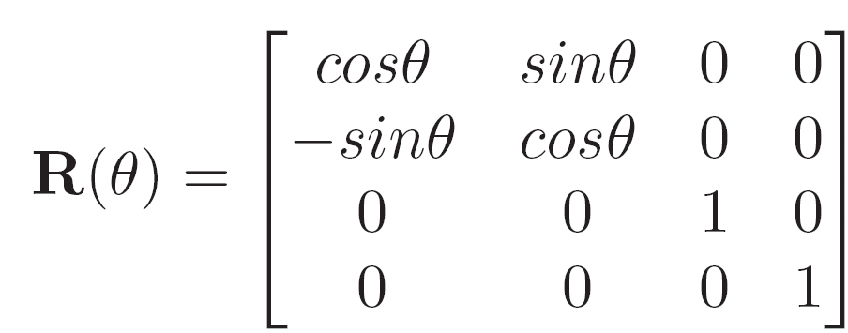
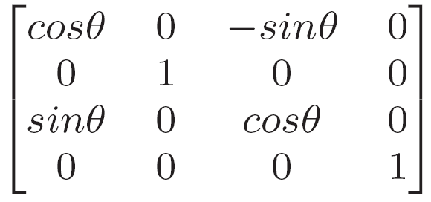
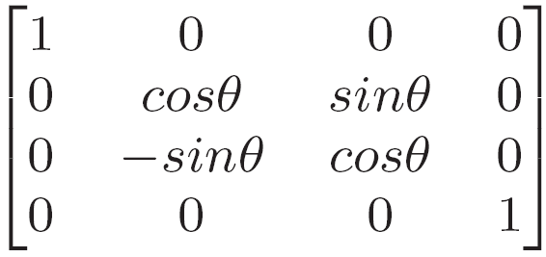
Rotation Operators:
About Z-axis
About Y-axis
About X-axis
Chapter 8

Slide 27
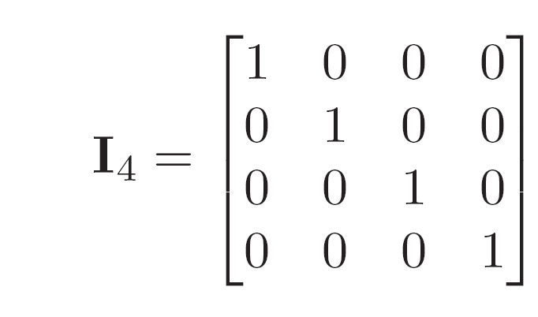
Identify Matrix
Does not do any thing!
M is a matrix
  MI = M and IM = M
Important matrix for initialization!
Chapter 8

Slide 28
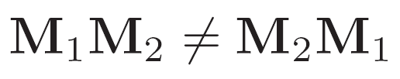
Some properties of Matrices
Order of operation is important!
Precedence of operation is not important!
Chapter 8

Slide 29


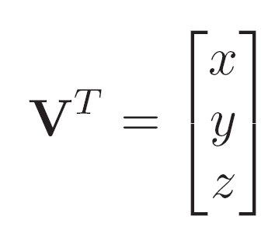
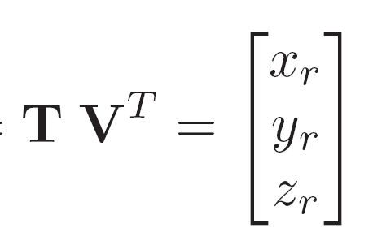
Matrices and Vectors
Row vector:
  To translate by T:
Column vector:
  To translate by T:
Chapter 8

Slide 30
Row vs. Column Vectors
One should never mix row and column vector representation
We use Row representation exclusively!
Operator always appear on the right side of the vector!
Referred to as:
  Post multiplying a vector
Chapter 8

