Slide 1
Chapter 9:
Combining Transformation Operators
Chapter 9

Slide 2
This Chapter: we will learn
How and Costs of combine operators
Inverse Operators
Pivoted Scale/Rotate
Programming Support
  UWBGL
Chapter 9

Slide 3



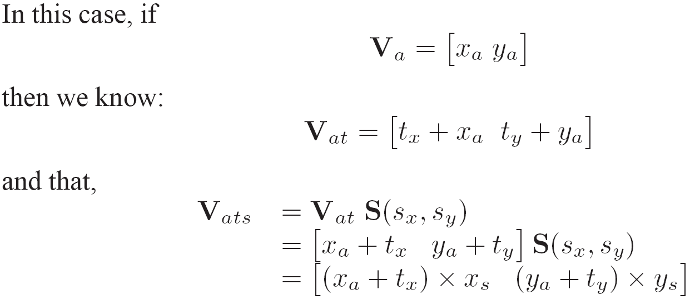
Translate Then Scale
Given vertex:
Translate then Scale:
If
Then
And
Chapter 9

Slide 4

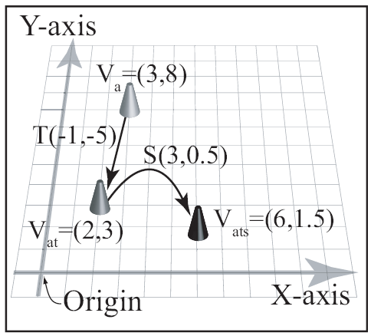

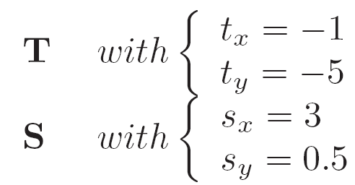
Example:
Chapter 9

Slide 5

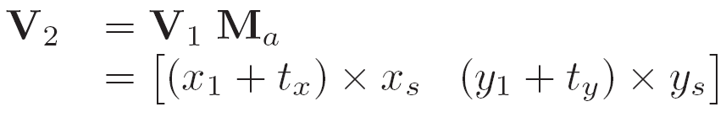
Concatenate:
Compact Representation
Computation Efficiency
  Cost to concatenate
  Worthwhile if uses operator many times
Chapter 9

Slide 6




!Warning! Order of operation
Recall …
So, if
Then, in general
Chapter 9

Slide 7


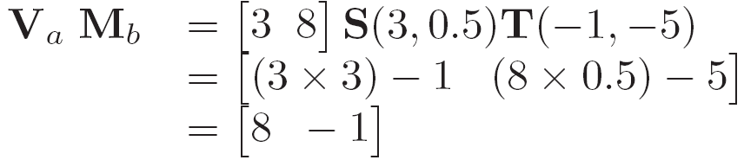
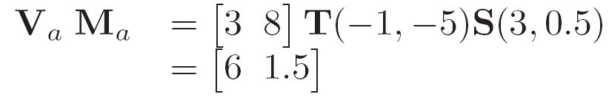
Example: Order of operation
For:
If and
Chapter 9

Slide 8
Reminder …
Transforms V_{a}
  Translation (T) followed by
  Scale (S)
Vertex is to the left of the operators!!
In our case (row vectors): the following is undefined!!
Chapter 9

Slide 9
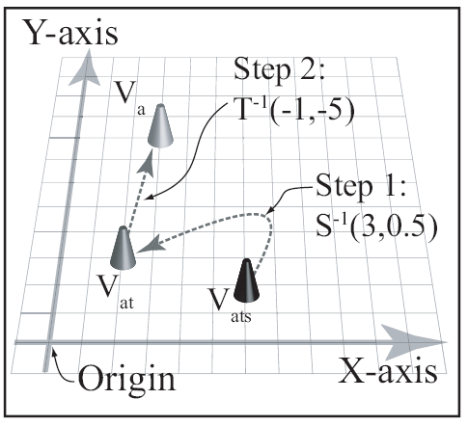



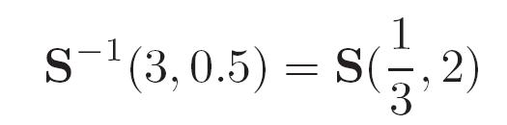

Inverse Transform: Undo
Chapter 9

Slide 10

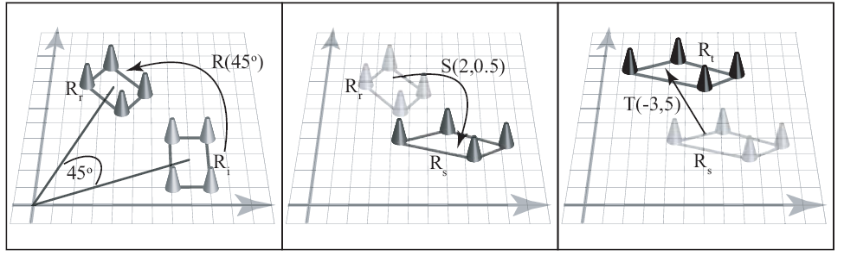
For example:
Chapter 9

Slide 11

Inverse of:
  To undo (inverse):
  If:
  Then
  Or:
Chapter 9

Slide 12
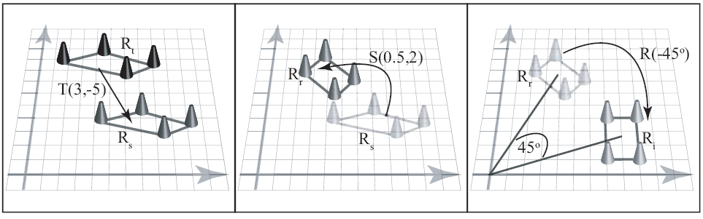
Inverse of:
Chapter 9

Slide 13
Inverse of concatenated operator
Apply the inverse in reverse order!
In general: Inverse is not unique
  E.g., R(θ), inverse can be
    R(-θ) or
    R(-θ+360), or R(- θ+270) …
Chapter 9

Slide 14
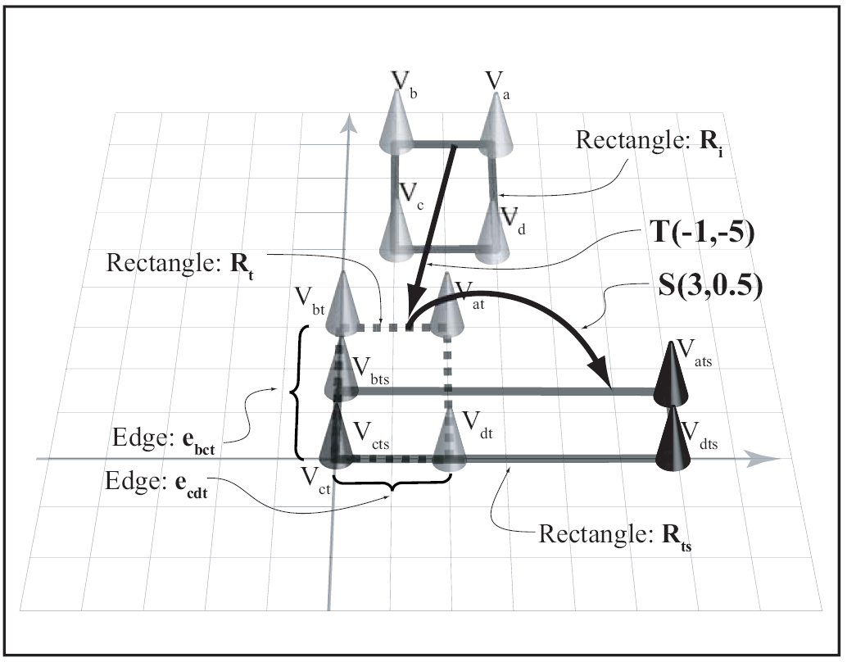
Combining Translation and Scaling
  Translate before scale to
    align vertex with origin
    “anchor” the vertex
  E.g., scale rectangle
  by S(3,0.5) with
  a fixed anchor (V_{c})
Chapter 9

Slide 15


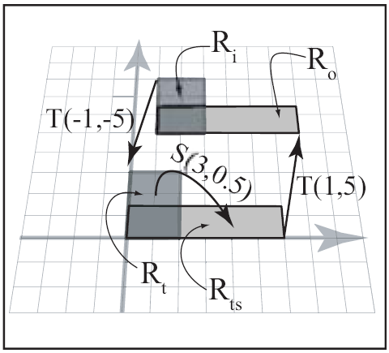
Pivoted Scaling:
Scaling with respect to
    Pivot position:
  E.g., scale rectangle
  with respect to
  pt=(1,5)
Chapter 9

Slide 16

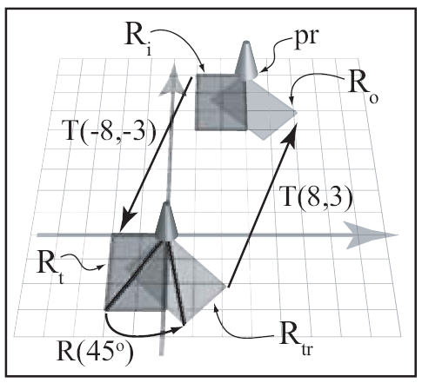
Rotation with Arbitrary Pivot
Pivot position:
  E.g., rotate rectangle
  with respect to
  top-right corner (pr)
  pt=(3,8)
Chapter 9

