Slide 1
Chapter 12:
Making the Applications Interesting
Chapter 12

Slide 2
This Chapter: we will learn about
File Texture Mapping
Alpha Blending
  Simulate transparency
Chapter 12

Slide 3
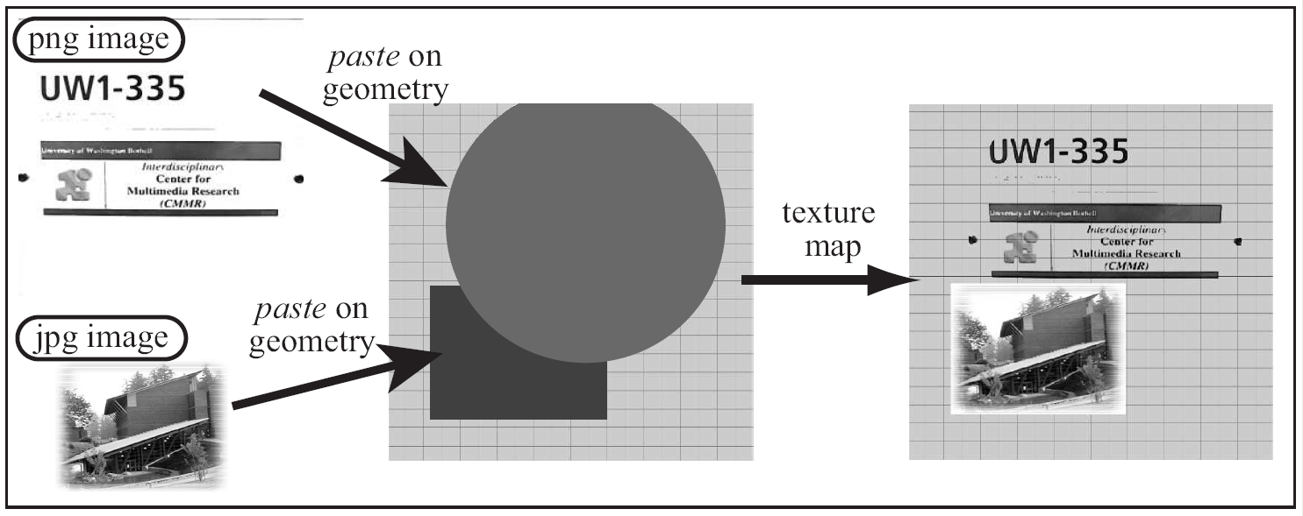
File Texture Mapping
Pasting images on primitives
Chapter 12

Slide 4
File Texture and Mapping
File Texture: an image file
  A 2D array of color stored in a file
    Texel: each color element in the file
  Any image or digital photograph
  Images are stored in formatted files:
    E.g.: gif, jpg, tiff, png.
Mapping: “pasting on”
  Paste the image (file texture) on a given primitive
Chapter 12

Slide 5
Texture Coordinates
Mapping: matching of coordinates
  A coordinate system on image file
    (st) - coordinate
  A coordinate system on primitive
    (uv) - coordinate
Mapping:
  Match the two coordinate systems!
Chapter 12

Slide 6
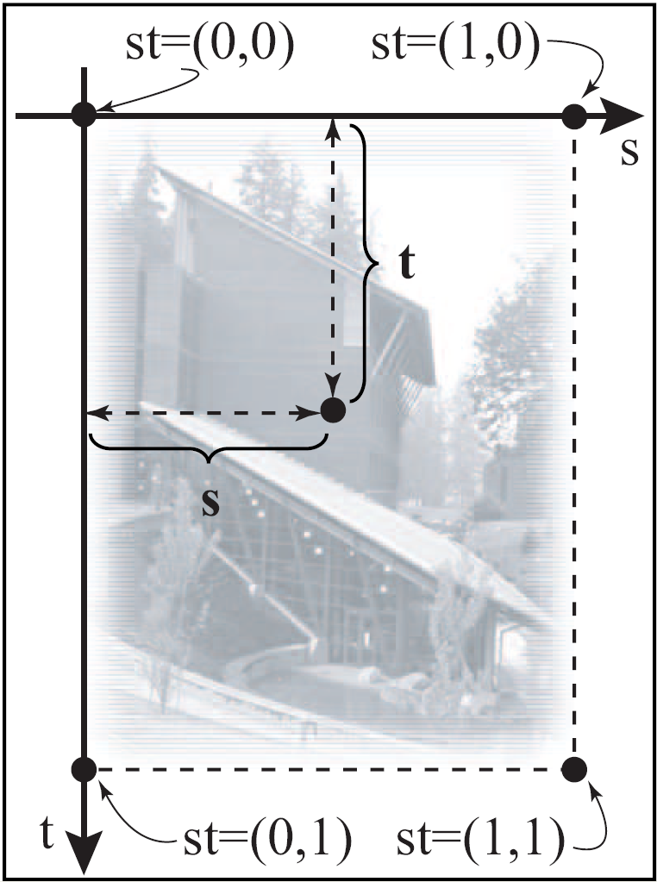
Implicit st – Coordinate System
implicitly defined on
all file textures
  Origin: upper-left corner
  s-Axis: Right-wards
  t-axis: down-wards
  Range: 0.0 to 1.0
  Coverage: always the
  entire image!
Chapter 12

Slide 7
Explicit uv – Coordinate System
uv are
  Defined on the Primitives
  Defined by, us, the programmers!
Each vertex of a primitive:
  A Position: (x, y, z)
  A Color: (r, g, b)
  NOW: Texture Coordinate (u, v)
Chapter 12

Slide 8
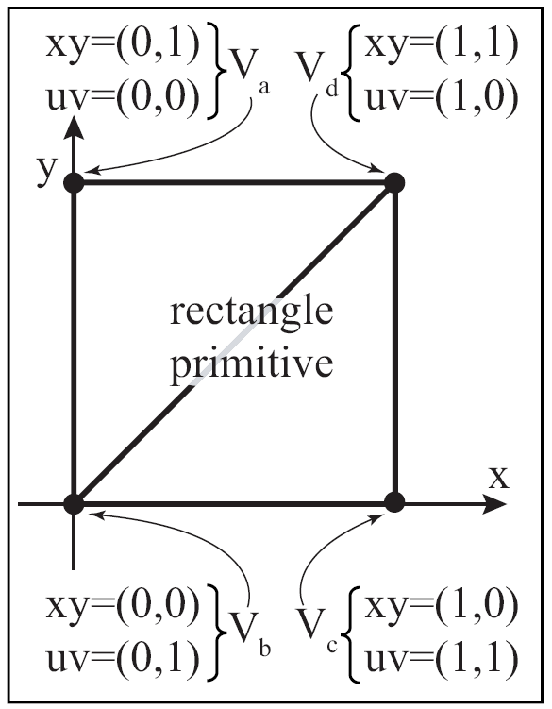
Example of defining uv: rectangle
Chapter 12

Slide 9
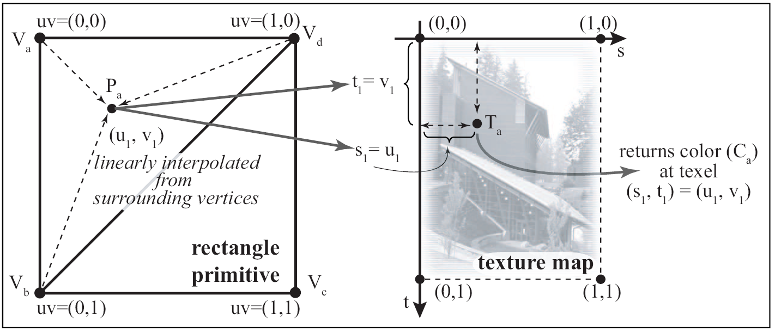
Mapping: Texel lookup
Texel color (C_{a}) used as color of primitive
Chapter 12

Slide 10
Programming File Texture
We must define uv-coordinate on primitives
Select/Load an image file into the graphics API
Define how texel will be used
Enable texture mapping before drawing the primitive
Chapter 12

Slide 11


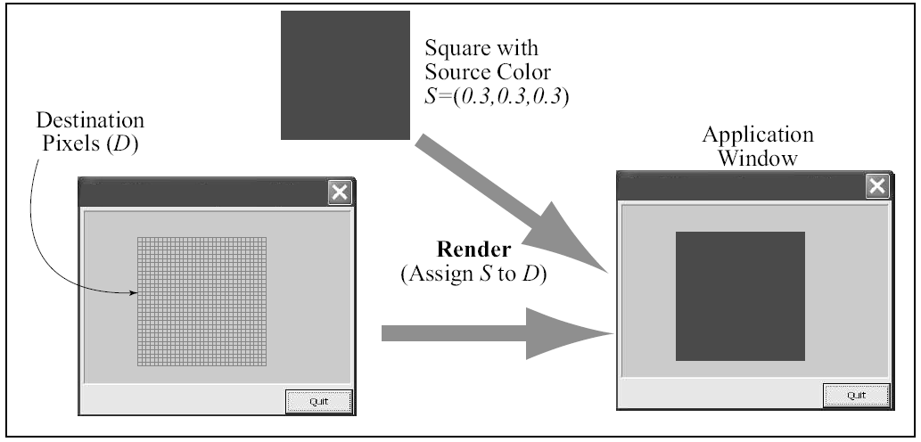
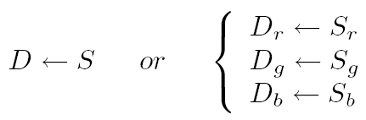
Transparency (Alpha Blending)
Drawing a rectangle:
  Source: color of rectangle
  Destination: pixels in frame buffer
Source written into Destination
  Source
  overwrites
  Destination
Chapter 12

Slide 12
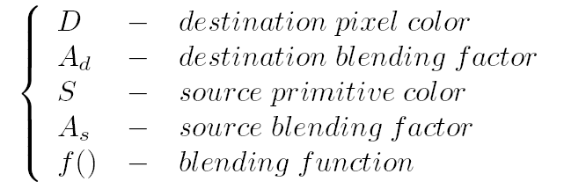
Blending vs. Over writing
Instead of over writing
  D ← S
Compute a new value for D
  based on current D and S
  D ← f(D x A_{d}, S x A_{s})
Chapter 12

Slide 13


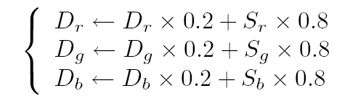
Example: Simple blending
Draw a blue rectangle (no blending)
Now set
  Source blend factor:
  Destination blend factor:
  Blending function: Add
Draw a red rectangle:
Chapter 12

Slide 14
Blending and Alpha Channel
Store blending factor as part of color
  Instead of Color = (r, g, b)
  Include a 4th channel: (r, g, b, α)
α cannot affect pixel color directly
  (r, g, b) changes pixel directly
  α used as either
    source blend factor (A_{s}) or
    destination blend factor (A_{d})
Chapter 12

Slide 15
Example: Working with α Channel
Draw a normal blue rectangle
  Pixel color (Destination)
    D_{r} D_{g} D_{b} = (0.8, 0.8, 0.8)
Now, A red rectangle with
  Source Color:
    S_{r} S_{g} S_{b} S_{α} = (0.2, 0.2, 0.2, 0.8)
Blending setting:
  Source blend: A_{s} = S_{α}
  Destination blend: A_{d} = (1 - S_{α})
  Blending Function: Add
α Controls blending:
  Alpha Blending
Chapter 12

Slide 16


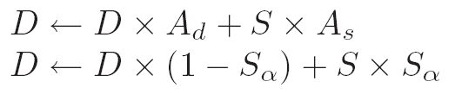
Alpha as: Opacity
When:
    Source Blend Factor
    Destination Blend Factor
    Blend Function: Add
Alpha is opacity
  Alpha = 1
    Destination is over-written
  Alpha = 0
    Source is completely invisible!
Chapter 12

