Slide 1
Chapter 15:
Working with the Camera
Chapter 15

Slide 2
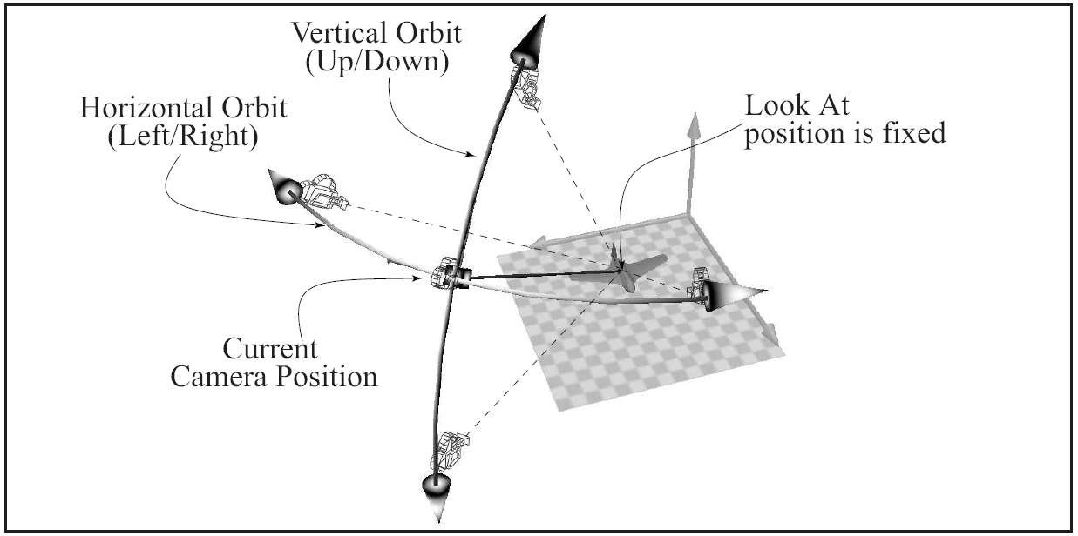
LMB: Tumble or Orbit the Camera
Chapter 15

Slide 3
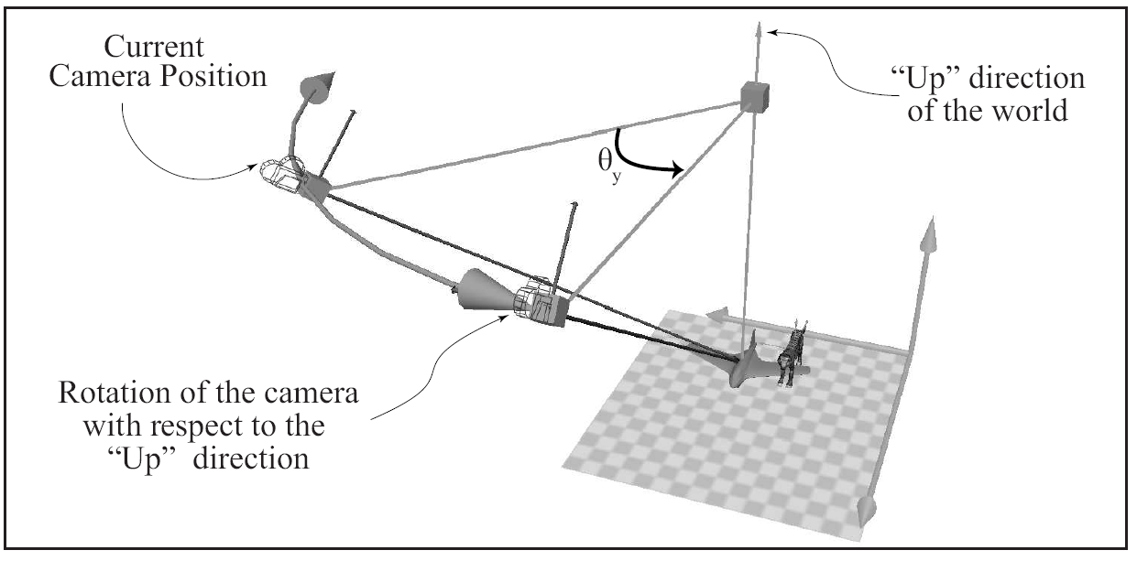
Left/Right Orbiting
Axis of rotation: The “Up” Direction
Chapter 15

Slide 4
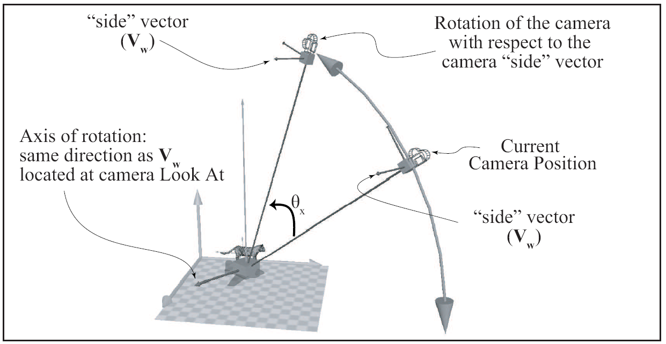
Up/Down Orbiting
Axis or rotation: Side Vector
Chapter 15

Slide 5
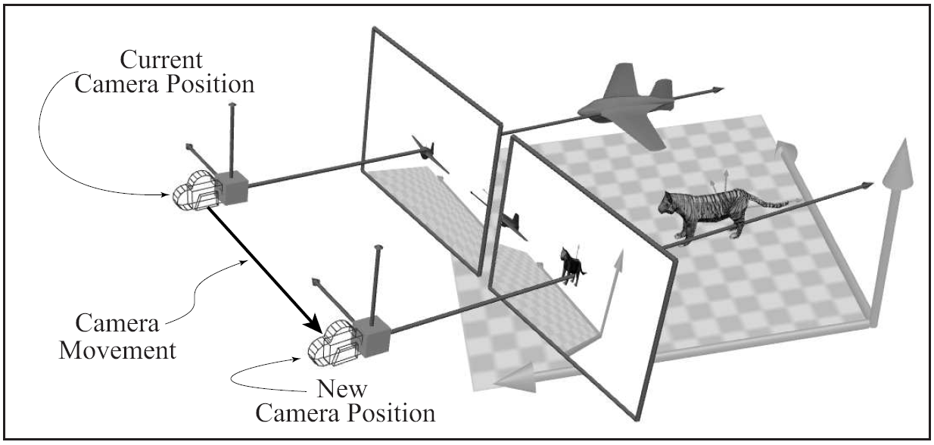
MMB: Pan or Track the camera
Chapter 15

Slide 6
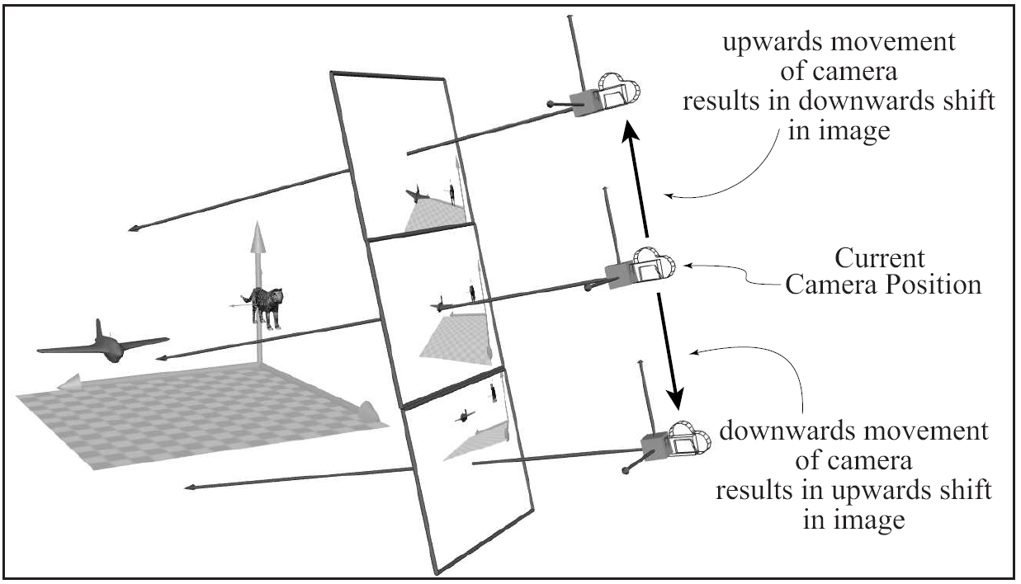
Vertical Tracking: (Along UpVector)
Chapter 15

Slide 7
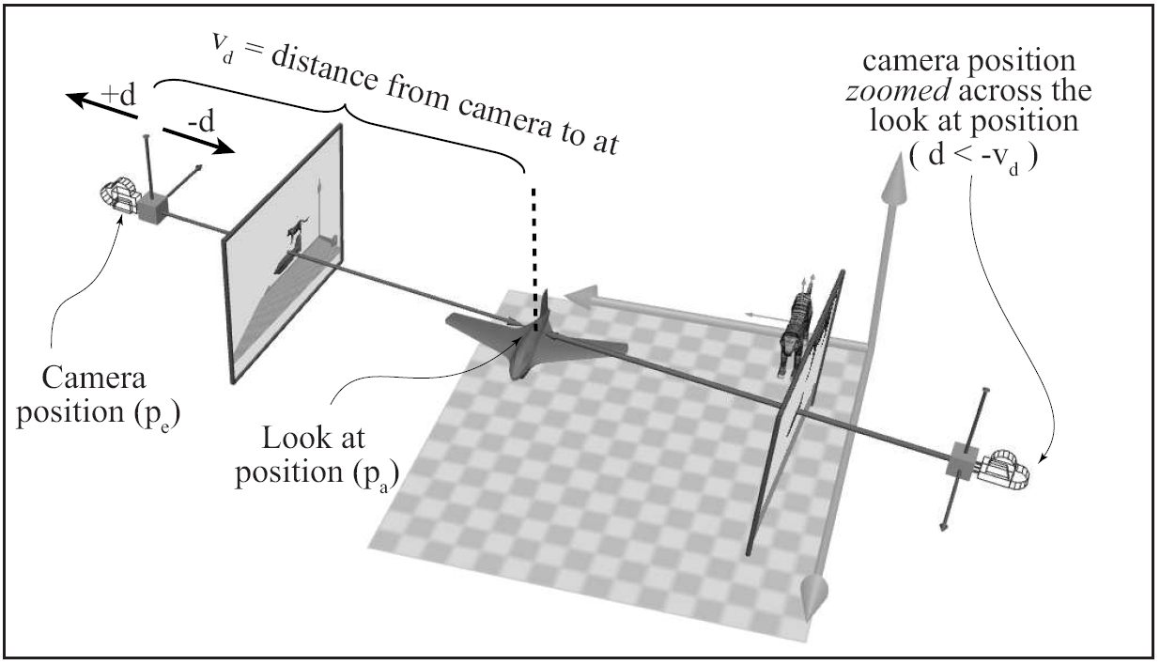
RMB: Dolly or Zoom the Camera
Chapter 15

