Slide 1
Barycentric Coordinates
Credit: Based on a bad draft version from ChatGPT

Slide 2
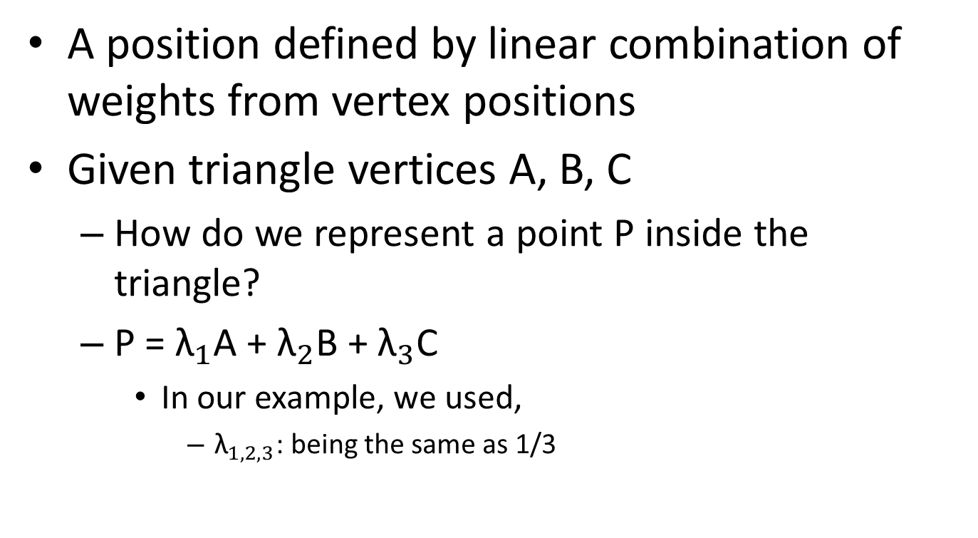
Motivation
A position defined by linear combination of weights from vertex positions
Given triangle vertices A, B, C
How do we represent a point P inside the triangle?
P = ${\text{λ}}_{1}$A + ${\text{λ}}_{2}$B + ${\text{λ}}_{3}$C
In our example, we used,
${\text{λ}}_{1, 2,3}$: being the same as 1/3

Slide 3
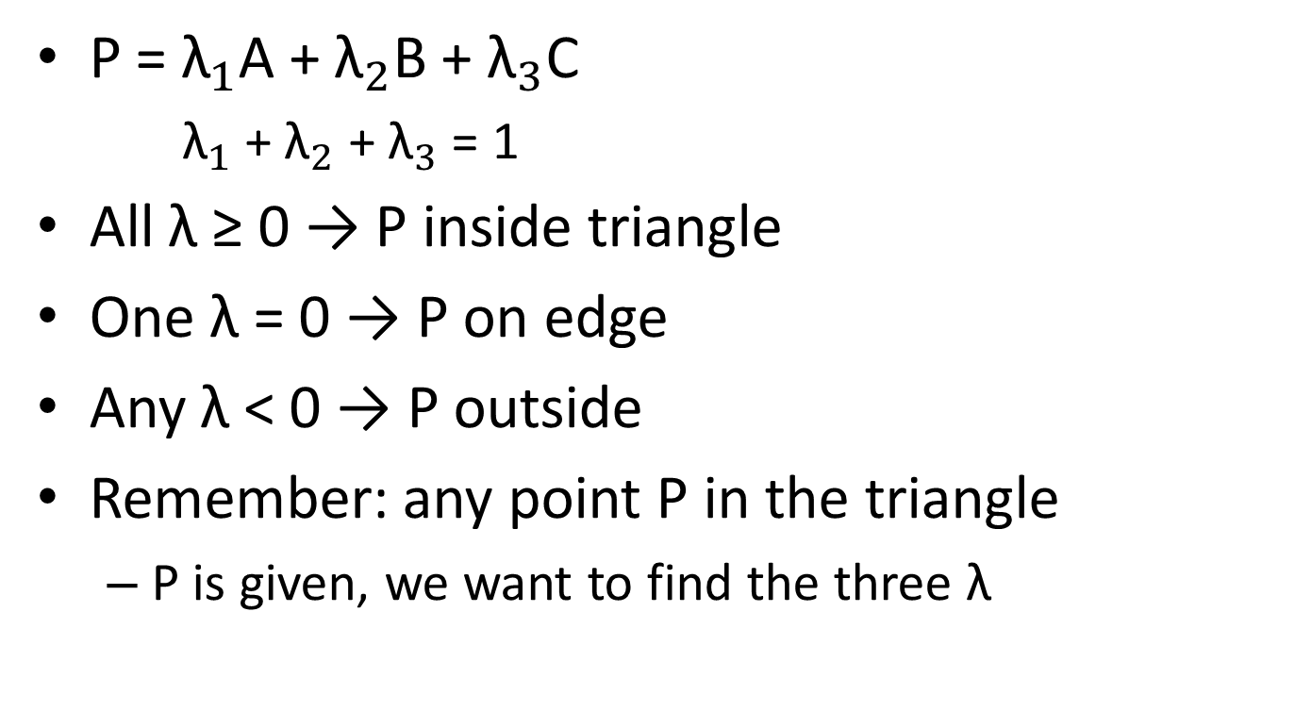
Interesting Point
A
P = ${\text{λ}}_{1}$A + ${\text{λ}}_{2}$B + ${\text{λ}}_{3}$C
${\text{λ}}_{1}$ + ${\text{λ}}_{2}$ + ${\text{λ}}_{3}$= 1
All λ ≥ 0 → P inside triangle
One λ = 0 → P on edge
Any λ < 0 → P outside
Remember: any point P in the triangle
P is given, we want to find the three λ
P
B
C

Slide 4
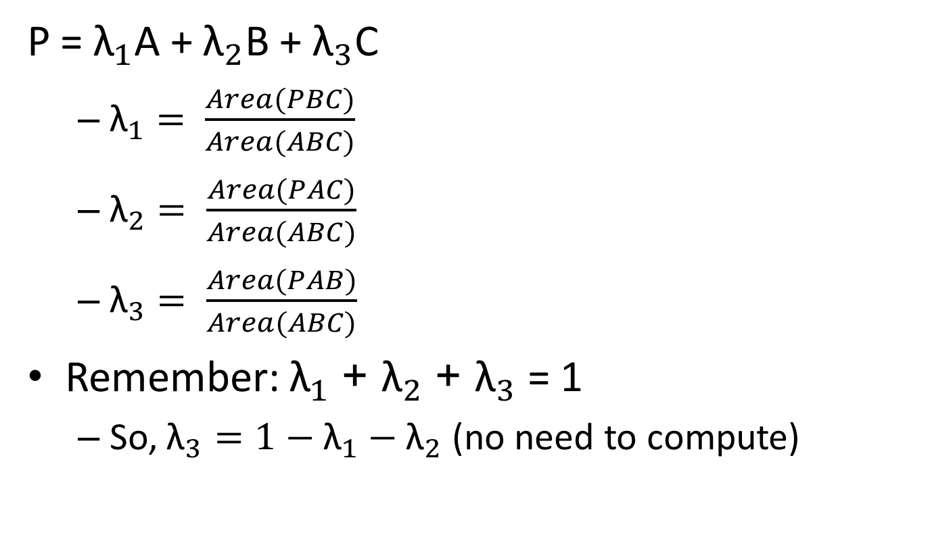
Definition
P = ${\text{λ}}_{1}$A + ${\text{λ}}_{2}$B + ${\text{λ}}_{3}$C
${\text{λ}}_{1}= \frac{Area(PBC)}{Area(ABC)}$
${\text{λ}}_{2}= \frac{Area(PAC)}{Area(ABC)}$
${\text{λ}}_{3}= \frac{Area(PAB)}{Area(ABC)}$
Remember: ${\text{λ}}_{1}$ + ${\text{λ}}_{2}$ + ${\text{λ}}_{3}$ = 1
So, ${\text{λ}}_{3}=1−{\text{λ}}_{1}−{\text{λ}}_{2}$ (no need to compute)
A
P
B
C

Slide 5
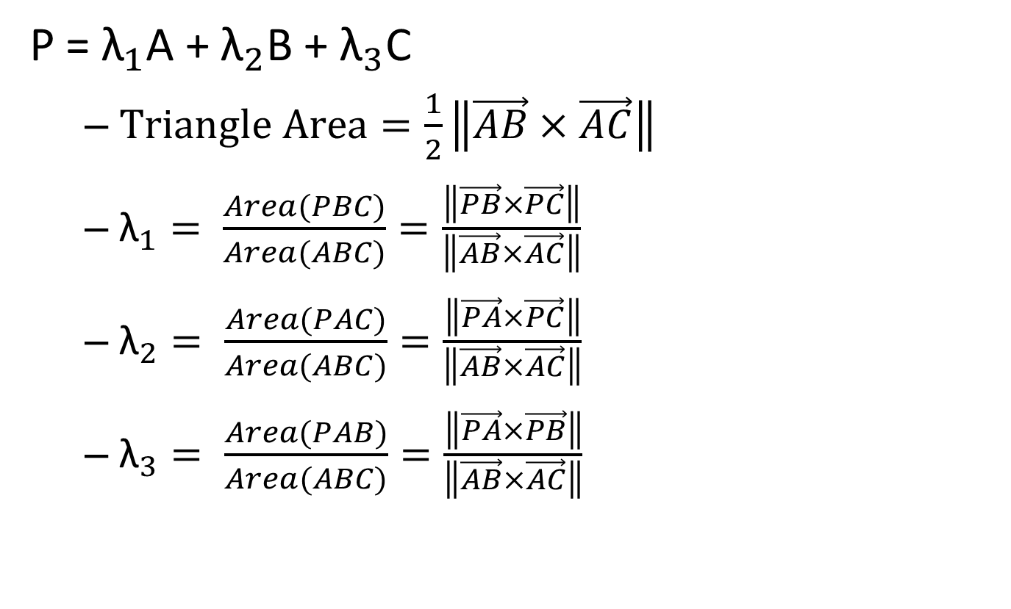
Area of Triangle?!
P = ${\text{λ}}_{1}$A + ${\text{λ}}_{2}$B + ${\text{λ}}_{3}$C
$Triangle Area=\frac{1}{2}\left\|\vec{AB}×\vec{AC}\right\|$
${\text{λ}}_{1}= \frac{Area(PBC)}{Area(ABC)}=\frac{\left\|\vec{PB}×\vec{PC}\right\|}{\left\|\vec{AB}×\vec{AC}\right\|}$
${\text{λ}}_{2}= \frac{Area(PAC)}{Area(ABC)}=\frac{\left\|\vec{PA}×\vec{PC}\right\|}{\left\|\vec{AB}×\vec{AC}\right\|}$
${\text{λ}}_{3}= \frac{Area(PAB)}{Area(ABC)}=\frac{\left\|\vec{PA}×\vec{PB}\right\|}{\left\|\vec{AB}×\vec{AC}\right\|}$
A
P
B
C

Slide 6
Applications
Point-in-triangle test
Color interpolation in graphics
Texture mapping
Finite element methods

