Slide 1
CSSSKL 342: Programming Issues With Object-Oriented Languages
Kelvin Sung
Email: ksung@uw.edu

Slide 2
You are …
First quarter at UWB?
First quarter as CSS student?
Programming Language?
Operating Systems?
What does it mean to “know” or “have worked with” an OS?
As Users: Config, Find/Run Program, Install/Remove new programs
As CS Professions: Files navigation, System Calls (or APIs)
All taking CSS342?
Do well in 342 and … good things will come >$100K job!

Slide 3
I am Kelvin Sung :
The old dude that never leaves
My background
Graphics + Videogames
Find out more about me:
My faculty home page
Other classes I teach
CSS385: https://myuwbclasses.github.io/CSS385/
CSS451: https://myuwbclasses.github.io/CSS451/
CSS452: https://myuwbclasses.github.io/CSS452/
CSS552: https://myuwbclasses.github.io/CSS552/
My current research page. (Need: CSS342 to participate)

Slide 4
Learning Goals of this class [prioritizes]
Learn how to learn programming languages
Learn a [new] OS
Learn C++

Slide 5
Approach to learning a Programming Language
How to learn programming languages: Syllabus of this class
Tools ➔ Format ➔ I/O + Arrays (Nuances: memory management)
Classes: how to: subclass, override,
Templates, iterator [advanced features in the language]
APIs (e.g., Vectors, Lists, Maps)
Stuff you learn in CSS342
Learn OS
Work in the environment
Constant compare to Windows or MACs ➔THEY ARE THE SAME!

Slide 6
Learn C++
Smallest goal, but most important for now
Do the Labs
Ask Questions, ASK QUESTIONS
After done with labs
Try variations, invent new problems to try out
Repeat in C++ Java exercise you have done in CSS142/143
Create the positive feedback loop
More you do ➔ better you become ➔becomes fun ➔want to do more

Slide 7
About the course
Canvas
Syllabus
Class meets once a week: Friday 1:15pm to 5:15pm
Recommended System setup
Video tutorials are very cool! (thanks to Professor Michael Stiber)
C++
www.cplusplus.com
Books listed in the syllabus
Goals – The mechanics of and not the application of C++
Pick up an existing project written in C++
Start a new project using C++
Transform a project from other programming languages to C++
NOT: how to use a specific language feature (e.g., private subclass)

Slide 8
Grades
Pass/Fail: do not count towards GPA, do not affect your graduation
So, how about it? Let’s learn without worries!
You MUST participate!
You must SUBMIT every assignment
You must show an honest effort has been made with tangible results
“An honest effort” some/most things work.
We will download, compile, run, examine

Slide 9
Our remote machines
csslab.uwb.edu
In our lab, ALWAYS compile with:
g++ filename.cpp // g++ all small case!
Your system should have been set up, at this point you should be able to enter HelloWorld.cpp, compile, and run.

Slide 10
Linux Basic
File system: Absolute vs Relative
Shell and Commands
Folder/Directory: mkdir, rmdir, ls
Navigation: cd
Remove file: rm
Editor: vim [KEY: modes + save and exit]
Compile
g++ -std=c++11 <-E -S -c -o>
-E: include
-S: include + compile
-c: include + compile + assemble
-o: include + compile + assemble + link

Slide 11
C++ 101

Slide 12
Development Environment
Windows
IDEs: Visual studio, Eclipse CDT, etc. We will use Visual Studio Code (VSC)
Create a solution
Create/Add projects
Add items: .cpp, .h, .txt, etc.
Mac
IDE: Xcode
GNU toolchains
Linux (this class)
IDEs: Eclipse CDT, NetBeans, etc.
GNU toolchains (What to do when there is no IDE)
g++: e.g., g++ -o CompiledFileName SourceFileName.cpp
gdb: e.g., gdb CompiledFileName

Slide 13
Main program – The entry point
void main() ⬅NOT TRUE in general.
when you don’t care about arguments and exit code
int main()
when you care about the exit code
return 0 by default
int main(int argc, char* argv[])
when you care about arguments and the exit code
argc: number of arguments
argv: actual arguments
The program name is actually the first argument
int main()
{
}

Slide 14
iostream
C++
#include <iostream>
Using namespace std;
cin, cout, cerr, clog
cin vs. std::cin
cout vs. std::cout
cout vs. cerr: different output streams, cout is buffered
cout << “string xxxx” << variable << “string xxxxx” <<endl;
cerr << “string xxxx” << variable << “string xxxxx” <<endl;
cin >> variable1 >> variable2;
JAVA
System.out.print(“hello ”);
System.out.println(“world”);
BufferedReader in = new BufferedReader(new
InputStreamReader(System.in));
String text = in.readLine();

Slide 15
Type Conversion

Slide 16
Explicit Conversions
C++ is a strong-typed language
C-like casting
Functional
Casting Operators
new_type variable = static_cast <new_type> (old_type_expression)
new_type variable = dynamic_cast <new_type> (old_type_expression)
new_type variable = const_cast <new_type> (old_type_expression)
new_type variable = reinterpret_cast <new_type> (old_type_expression)
double x = 1.1;
int y = (int) x
int y = int (x)
More about const_cast:
https://www.geeksforgeeks.org/casting-operators-in-c-set-1-const_cast/

Slide 17
Pass by Reference

Slide 18
“Pass by reference” vs. “Pass by value”
Reference
Aliases only
No storage need be allocated
Can only be initialized
Can never be changed later
Cannot be null
No need to dereference
C++: “pass by value” is the default behavior
Advantages? Easy coding, easy management, protection, etc.
Disadvantages? A copy in stack will be created

Slide 19
File Operation

Slide 20
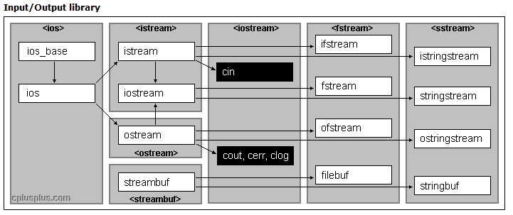
File I/O
#include <fstream>
outFileStream << variable
inFileSteam >> variable

Slide 21
What to submit in your .zip file
Primitive3.cpp – write by yourself
FileOperationPractice.cpp – write by yourself
AnswersToReferenceDemo.txt – answer all questions
AnswersToFileDemo.txt – answer all questions
Zip All!

