Slide 1
Course Evaluation - check your emails

Slide 2
C++ learning materials
C++ Reference: http://www.cplusplus.com
C++ FAQ: http://www.parashift.com/c++-faq
From Java to C++: http://courses.washington.edu/css342/zander/css332/

Slide 3
CSSSKL 342 Lab 5
C++ Standard Template Library (STL)

Slide 4
Summary of Labs 1 - 4
Visual Studio and toolchains
Primitive type data, file I/O, conversion, lifespan
Class, inheritance, constructor, destructor, operator overloading
Copy constructor, assignment operator, deep vs. shallow copy
Memory management, array, new vs. delete, new [] vs. delete []
Pointer vs. reference

Slide 5
Public, Private, and Protected
Public Members
Can be accessed from anywhere
Parent or child
Class or object
Private Members
Only the owner class and friend functions can access private members
Child classes cannot access
Objects cannot access
Protected Members
The class that originally declared these members can access
Friends of the class that originally declared these members can access
Classes derived with public or protected access from the class that originally declared these members
Objects of the owner class cannot access
Child objects of the owner class cannot access

Slide 6
Public, Private, and Protected
Public inheritance
Public in parent → Public in child
Protected in parent → Protected in child
Private in parent: cannot be accessed in child
Private Inheritance
Public in parent → Private in child
Protected in parent → Private in child
Private in parent : cannot be accessed in child
Protected Inheritance
Public in parent → Protected in child
Protected in parent → Protected in child
Private in parent: cannot be accessed in child

Slide 7
Summary
Public → straightforward to use, but insecure
Private → straightforward to use, secure, but may need more coding
Protected → not straightforward to use, secure
When you are thinking about pass money to your children only, you want to protect it

Slide 8
C++ Standard Template Library (STL)
Containers
vector, list, map, stack, queue, deque, set, bitset,
unordered_set, unordered_map, array, forward_list
Input/Output Stream
istream, iostream, fstream, sstream
Miscellaneous
algorithm, limits, random, string, utility, numeric, etc.
Atomics and threading
atomic, condition_variable, mutex, thread, future
C Library

Slide 9
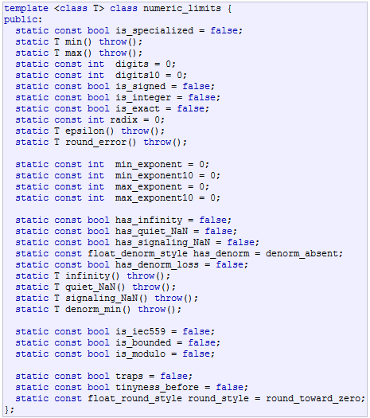
Limits
std::numeric_limits
template <class T> numeric_limits;
e.g.
std::numeric_limits<int>::min()
std::numeric_limits<int>::max()
std::numeric_limits<int>::has_infinity

Slide 10
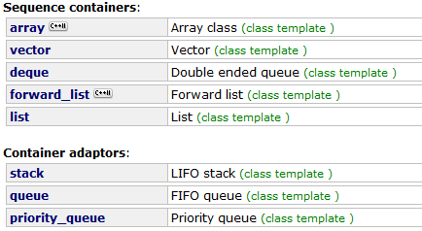
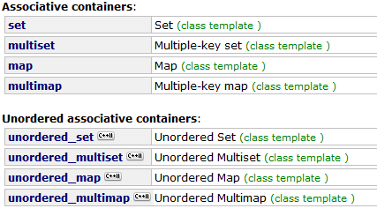
Containers

Slide 11
Vector
The first container you should consider in most cases!
Properties
Sequence: elements are stored in a strict linear sequence, and in continuous memory space
Pointer arithmetic – direct access to any element
Example methods
size, max_size, empty, capacity
operator[], at, front, back
push_back, pop_back, insert, erase, swap, clear

Slide 12
List
Properties
Elements are ordered in a linear sequence, but may not in continuous memory
Doubly-linked list
NO direct random access
Each element keeps information on how to locate the next and the previous elements
Example methods
size, max_size, empty
front, back
push_front, pop_front, push_back, pop_back, insert, erase, swap, clear
Unique, merge, sort, reverse

Slide 13
Map
The first associative container you should consider in most cases!
Properties
Associative
Ordered
Unique keys
Example methods
size, max_size, empty
operator[], at
Insert, erase, swap, clear
Find, count, lower_bound, upper_bound, equal_range

Slide 14
Algorithm
All are template functions
Non-modifying, sequential operation
for_each, count, count_if, find, find_if, etc.
Modifying, sequential operation
copy, swap, replace, replace_if, remove, reverse, unique, etc.
Sorting
sort, stable_sort, partial_sort, is_sorted, etc.
Binary search (operating on partitioned/sorted ranges)
binary_search, lower_bound, upper_bound, etc.
Min/max
min, max, min_element, max_element
Heap, Merge, Partitions, Other

Slide 15
Looking forward
Survive in CSS 342
Useful C++ topics to be learned by yourself
Virtual functions, pure virtual functions, abstract class, multi-inheritance
Polymorphism, dynamic type checking
Exceptions
Smart pointers
Design patterns
Hardcore C++ programmer

