Slide 1
COMP561405—游戏设计与开发 Introduction to 2D Game Development
Kelvin Sung, 宋賢清
Computing and Software Systems
University of Washington Bothell
March 2024
Notes:
Poll

Slide 2
Most Importantly: You?
Where are we from and what language we speak?
中国 →中文 (普通话)
Do you know people around you?
在班上有朋友吗？
You need to form teams (of 5 or 6) ASAP
Me: University of Washington Bothell: 华盛顿大学 (华大) Bothell分校
Do not confuse with the UW Seattle Campus
Countries: China (Taiwan), Singapore, Canada, US [中国(台灣), 新加坡, 加拿大, 美国]
Languages:
A little Chinese [一点儿普通话，一点儿广东话]
A little English [一点儿英语]

Slide 3
Second Most Important: WHY?
Why are you here?
For fun? … FUN? 11 days with 32-contact hours!
To learn?
WHAT do you want to learn?
English?
Videogames development and something about game engine?
Software development?
How other cultures teach and learn?
Notes:
Why poll

Slide 4
A Word about Culture:
HELP ME: Take charge of your learning Actively!
Single most important responsibility as a student: Ask me questions!!
YES I mean during class, interrupt me and ask any questions you may have!
!!PLEASE!!
Please answer my questions in class, yelling out the answer is welcome
Stop me:
When I go too fast!
When I teach things you already know!
Guide me!
You and I: we are here to have fun!
Let’s learn together!

Slide 5
Third Most Important: your background
Programming Languages
C++? C#? Java? PHP? Ruby?
Foundational computer science background?
Object Oriented Programming? Data structures? Operating Systems?
Graphical User Interface (GUI) Programming?
Swing? WPF?
Computer Graphics?
D3D? OpenGL? WebGL?
Game development experience?
Build and sell your own games?
Know Unity? UnReal?

Slide 6
your background: my expectations/Hope
Programming Languages … one of
C++ C# Java Python
Foundational computer science background?
YES: Object Oriented Programming and Data structures
A little or not much: Operating Systems?
GUI and Computer Graphics?
A little or not much
Experience with Videogame development?
Do not need any!
LET ME KNOW if you have very different background for the above

Slide 7
A Word about me …
Kelvin Sung, Shandong-ese from Taiwan province 宋賢清, 台灣省山東青島人，
Born in Taiwan, been back to Shandong … 台灣出生，到過山東，沒去過青島
Grew up in Singapore (since I was 6) 在新加坡长大
Education: in US since 16
BS in EE: University of Wisconsin-Madison
MS, PHD in CS: University of Illinois at Urbana-Champaign
Experience and Areas of Research
Computer graphics: image synthesis
Maya Renderer: one of the chief designers
More recently: Video games for non-entertainment purposes, remote AR/VR collaboration

Slide 8
Summary of you and I
Your motivations match the goals of this class
Learn/apply knowledge
Teaching and Learning from a different culture
Fun
You have proper backgrounds
Programming languages, technical background (OO + data structures)
You know a little about who I am
We are well-positioned to begin!

Slide 9
Now this class:
2D Videogame Development
Why limit to 2D?
What is the difference between building a game and other software systems?
We will learn …
The fundamental tool for building a videogame: the game engine
Conceptual and programming model of a game engine and game objects
Essentials of videogames
Fun, the world, UI, behavior, interaction (rigid bodies), effects (illumination, particle systems)
Fundamentals of building a game
Presentation of idea, prototypes to demo feasibility, vertical slice to sell the idea, and, PLAY TESTS
Build a game!
Notes:
2D only: because of time limit. Learning in steps, learn the tools, know how to build, understand the challenges, then, increase the tool complexities to 3D, so, next class.
Games: subjectivity, an Art for others, TESTs + Feedback (Engaging your players in activities)

Slide 10
THIS CLASS
This week: yes, literally from Monday to Friday!
I want to: … teach …elementary topics
You want to: … learn … about yourself, your interests, From Teams of 5 or 6 members
Weekend: Saturday and Sunday
Brainstorm for game design, playtest to evaluate and provide feedback
Start designing your game!
Next week: Monday to Thursday: Build the best game ever
Present idea, show demo, we play your alpha, and we play your final game

Slide 11
THIS CLASS
My style
Fast pace
Passionate
Work hard with everyone in class
You want to decide, if
You want to learn with me, or
You are able to learn from me

Slide 12
Week 1: Game Engine and Game Components
Learn:
Intro + Environment + Game Engine + a little about Programming Model
Learn: Game Objects, Camera, UI, Game Manager, Effects, Autonomous Behaviors (AI)
3 Programming Assignments: due before class Submit: EXE build + Source Code
Ex1: Small Coding Exercise (individual) due on Wednesday before class
Ex2 : a simple interactive application (individual) due on Friday before class
Ex3: a simple (not fun) game (team) due on next Monday before class
Quiz on Tuesday, Thursday, and Friday beginning of class
Would take 10-20 minutes to about 30 minutes
open book, open everything, individual effort
Very fast turnaround! No time to stop and wander

Slide 13
WeekEnd: How to and Begin to Design
Saturday: Design process and how to receive feedback
Brainstorm + Playtest
Sunday: Game design
Come to class to complete your game design
I will meet with each team individually

Slide 14
Week 2: Build an Awesome Game (in 3 days!)
Schedule
Monday: Presentation: Your final game proposal
Tuesday: Presentation: Game prototype demo
Wednesday: Presentation + Everyone plays everyone else’s games: Alpha game playtest
Thursday: Presentation + Whole class plays!
Whole class will rank the teams after the presentations. Top ranked teams:
First: +5%
Second: +4%
Third: +3%
Forth: +2%
Fifth: +1%

Slide 15
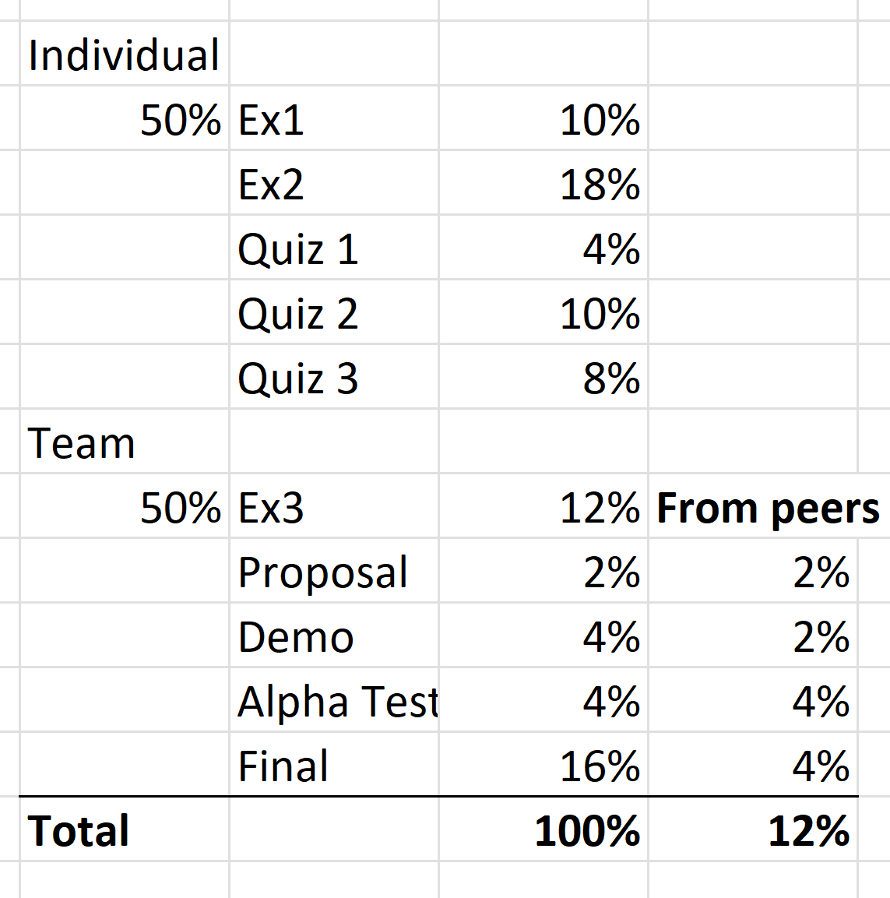
How you Will be Evaluated
Grade will be curved
My plan …
Average: About 85-90%
My hope:
No one score less than 70%

Slide 16
While Taking this class …
Learning:
Fun: design, program, debug, play videogames, compete(?)
Less fun: no time to sleep, deadlines, compete(?)
Not much time to:
Do anything else for these two weeks!
Team work:
about yourself, and
who you want to work with
Game development is about team work (50% of grade from teamwork)

Slide 17
Teaching and Learning
I teach based on:
Showing and demonstrating examples (ppts when appropriate)
Referring to lecture notes explaining the examples
Receiving questions/comments from you!!
You are responsible to learn by:
Following the examples in class [ASK questions]
Understanding the concepts behind the examples
Practicing and reviewing the concepts/skills by hands-on exercises
Remember to ask questions:

Slide 18
Questions?
My questions for you: … so far in our class …
What have you learned?
What is the single most important thing you have learned?

Slide 19
… Let us begin …

Slide 20
First thing: Team forming …
Teams of 5 or 6 members: To Dos …
First: final your friends and people you wantr to work with, form a team (with everyone’s agreement)
Second: Follow this link: https://docs.qq.com/sheet/DRFFYYndTcXVzRG1v?tab=09pftn.
On 工作表2：Enter your names besides an available team
On 工作表1：Find names of each team member and enter the appropriate team-number under Column-C
Deadline for forming teams: Wednesday before class

Slide 21
https://myuwbclasses.github.io/XJTU-IntroGameDev/

