Slide 1
COMP561405—游戏设计与开发 Introduction to 2D Game Development
Kelvin Sung, 宋賢清
Computing and Software Systems
University of Washington Bothell
March 2024
Notes:
Poll

Slide 2
Most Importantly: You?
Where are we from what language do we speak?
中国 →中文 (普通话)
Do you know people around you?
在班上有朋友吗？
Me: University of Washington Bothell: 华盛顿大学 (华大) Bothell分校
Do not confuse with the UW Seattle Campus
Countries: China (Taiwan), Singapore, Canada, US [中国(台灣), 新加坡, 加拿大, 美国]
Languages:
A little Chinese [一点儿普通话，一点儿广东话]
A little English [一点儿英语]

Slide 3
Second Most Important: WHY?
Why are you here?
For fun? … FUN? 14 days with 32-contact hours!
To learn?
WHAT do you want to learn?
English?
Videogames development and something about game engine?
Software development?
How other cultures teach and learn?
Notes:
Why poll

Slide 4
A Word about Culture:
HELP ME: Take charge of your learning Actively!
Single most important responsibility as a student: Ask me questions!!
YES I mean during class, interrupt me and ask any questions you may have!
!!PLEASE!!
Answer my questions in class, unmute and answer, or type in Chat
Stop me:
When I go too fast!
When I teach things you already know!
Guide me!
You and I: we are here to have fun!
Let’s learn together!

Slide 5
Third Most Important: your background
Programming Languages
C++? C#? Java? PHP? Ruby?
Foundational computer science background?
Object Oriented Programming? Data structures? Operating Systems?
Graphics User Interface (GUI) Programming?
Swing? WPF?
Computer Graphics?
D3D? OpenGL? WebGL?
Game development experience?
Build and sell your own games?
Know Unity? UnReal?
Notes:
Programming Languages poll
Background poll

Slide 6
your background: my expectations/Hope
Programming Languages … one of
C++ C# Java Python
Foundational computer science background?
YES: Object Oriented Programming and Data structures
A little or not much: Operating Systems?
GUI and Computer Graphics?
A little or not much
Experience with Videogame development?
Do not need any!
LET ME KNOW if you have very different background for the above

Slide 7
A Word about me …
Kelvin Sung, Shandong-ese from Taiwan province 宋賢清, 台灣省山東青島人，
Born in Taiwan, been back to Shandong … 台灣出生，到過山東，沒去過青島
Grew up in Singapore (since I was 6) 在新加坡长大
Education: in US since 16
BS in EE: University of Wisconsin-Madison
MS, PHD in CS: University of Illinois at Urbana-Champaign
Experience and Areas of Research
Computer graphics: image synthesis
Maya Renderer: one of the chief designers
More recently: Video games for non-entertainment purposes, remote AR/VR collaboration

Slide 8
Summary of you and I
Your motivations match the goals of this class
Learn/apply knowledge
Teaching and Learning from a different culture
Fun
You have proper backgrounds
Programming languages, technical background (OO + data structures)
You know a little about who I am
We are well-positioned to begin!

Slide 9
Now this class:
2D Videogame Development
Why limit to 2D?
What is the difference between building a game and other software systems?
We will learn …
The fundamental tool for building a videogame: the game engine
Conceptual and programming model of a game engine and game objects
Essentials of videogames
Fun, the world, UI, behavior, interaction (rigid bodies), effects (illumination, particle systems)
Fundamentals of building a game
Presentation of idea, prototypes to demo feasibility, vertical slice to sell the idea, and, PLAY TESTS
Build a game!
Notes:
2D only: because of time limit. Learning in steps, learn the tools, know how to build, understand the challenges, then, increase the tool complexities to 3D, so, next class.
Games: subjectivity, an Art for others, TESTs + Feedback (Engaging your players in activities)

Slide 10
THIS CLASS
This week: yes, literally from Monday to Friday!
I want to: … teach …elementary topics
You want to: … learn … about yourself, your interests, From Teams of 5 or 6 members
Weekend: Saturday and Sunday
Brainstorm for game design, playtest to evaluate and provide feedback
Start designing your game!
Next week: Monday to Thursday: Build the best game ever
Present idea, show demo, we play your alpha, and we play your final game

Slide 11
THIS CLASS
My style
Fast pace
Passionate
Work hard with everyone in class
You want to decide, if
you want to learn with me, or
You are able to learn from me

Slide 13
Part I (28th May): Game Engine and Game Components
Learn: Intro + Environment + Game Engine + a little about Programming Model
Assignment: due 11pm on Tuesday 30th May
Short Quiz: on the Game Engine (should take 10-20 minutes)
Quiz on Canvas to be open after today’s class.
Small Coding Exercise: Exercise 1 (should take about an hour)
Submit to Canvas
Submit: EXE build + Source Code
If you don’t practice, you won’t learn, really!
Very short turnaround! Gives you some sense of the pace for Part II

Slide 14
Part II (July 2023): Build an Awesome Game
Meetings: Every day at 9:00am, until we are done.
Exception: 14 July (Friday): 8-11am class time
Top priorities in the first 3 to 4 days:
Mastery of game engine + Familiarity with real-time interactive applications + Form Teams!!
Intro to yourself and your interests for forming groups e.g., Student-1 (good coverage), Student-2 (simplicity), Student-3 (the art!)
Learn:
Learn: Game Objects, Camera, UI, Game Manager, Effects, Autonomous Behaviors (AI)
Practice: a simple interactive application (individual), a simple game (group project)
Last 10 days: Final Project Development and Progress Demo
How to brainstorm + what is a fun game
Presentation: Your final game proposal
Presentation: Game prototype demo
Presentation + Everyone plays everyone else’s games: Alpha game playtest
Presentation + Everyone plays everyone else’s games: Beta game playtest
Presentation + Whole class plays!

Slide 15
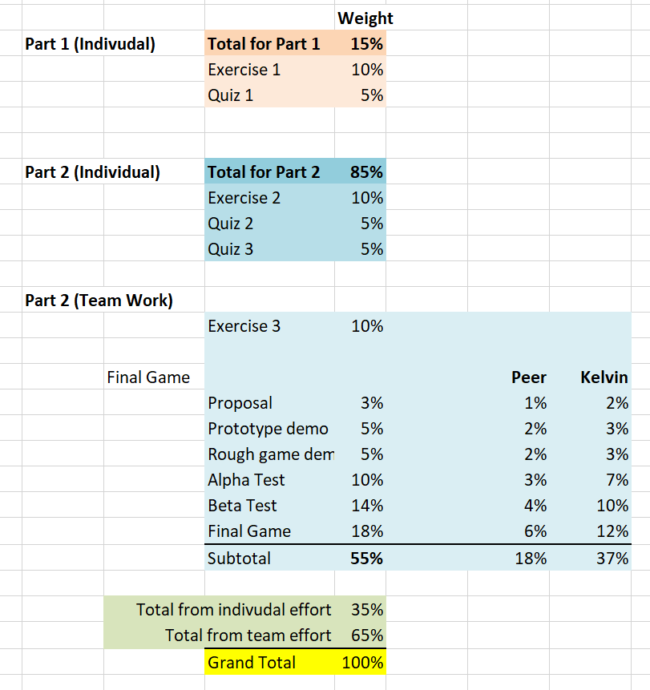
How you Will be Evaluated

Slide 16
While Taking this class …
Learning:
Fun: design, program, debug, play videogames, compete(?)
Less fun: no time to sleep, deadlines, compete(?)
Not much time to:
Shop, hike, explore, swim, chat
Team work:
about yourself, and
who you want to work with

Slide 17
Teaching and Learning
I teach based on:
Showing and demonstrating examples (ppts when appropriate)
Referring to lecture notes explaining the examples
Receiving questions/comments from you!!
You are responsible to learn by:
Following the examples in class [ASK questions]
Understanding the concepts behind the examples
Practicing and reviewing the concepts/skills by hands-on exercises
Remember to ask questions:
Unmute and speak!
Type in Chat and annotate “Q” (anywhere)

Slide 18
Questions?
My questions for you: … so far in our class …
What have you learned?
What is the single most important thing you have learned?

Slide 19
… Let us begin …

Slide 20
https://myuwbclasses.github.io/IntroGameDevelopment/

