Slide 1
Module 4
Summary
INTRO GAME DEVELOPMENT · UNITY
All About the Camera, Familiar Functions and Views: the key ideas, and a quick self-check
Notes:
Use this at the end of the lecture, after teaching from the Module 4 notes page. About 10 to 15 minutes: the takeaways, six self-check questions, then what to do before next class. There's no quiz for Module 4; the questions practice the notes' review questions with different numbers.

Slide 2
Module 4 in six lines
KEY TAKEAWAYS
1
Move the camera with its position; zoom with its orthographicSize.
2
To zoom toward a point, move and resize together so the point stays put.
3
Lerp eases a value to its target over time: smooth, respectful camera moves.
4
A shake is an oscillation that dies out over its duration.
5
Each camera draws into its own Viewport Rect; a second camera can follow the hero.
6
A new scene erases every GameObject; only static data carries over.
Module 4 · Summary · 2
Notes:
Read through the six lines; each has a slide after this with the detail students need. Ask which one they're least sure about and spend the time there.

Slide 3
Move, zoom, and keep the hero in view
4.1 · BASIC CAMERA CONTROLS
Zoom toward a point
Push the camera
World bounds
delta = (p − camera) × (factor − 1)
camera −= delta
size ×= factor
PushCameraByPos(pos, 0.8f)
GetWorldBound()
ClampToWorldBound()
The inner box is 80% of the view, a 10% margin on every side. When the hero leaves it, the camera moves just enough to bring it back.
Compute what the camera sees, and keep objects inside it.
The point stays at the same spot on screen while everything else grows or shrinks around it.
Depth matters too: the Background sits at z = 1, behind the hero and the egg.
Module 4 · Summary · 3
Notes:
Keys in 4.1: N moves by the slider amounts, M moves to Dye, H zooms about the center, J zooms toward Dye. Camera manipulation is just two values: the camera's position and its orthographicSize. CameraSupport is a partial class split into logical files. Zooming in toward Dye at x = 10 by 0.5 moves the camera to x = 5 and halves its size, so Dye stays at the same screen spot.

Slide 4
Get there gradually, not in one jump
4.2 AND 4.3 · LERP
TimedLerp
Respectful camera (4.3)
A new lerp starts from now
Each frame, cover Rate × Time.smoothDeltaTime of the remaining distance; after Duration seconds, snap to the target. A plain C# class, not a MonoBehaviour.
MoveBy() and ZoomTowards() lerp instead of jumping. Zooming lerps position and size with the same Rate and Duration, so they stay in step.
Start another before the first finishes and it begins from the current value: repeated presses add up differently than you'd expect.
On testing: build a separate, trivial test scene (like 4.2) and try every case before using a utility in a game.
Module 4 · Summary · 4
Notes:
In 4.2, Z grows the hero by 8 and lerps it back; pressing Z again before it settles reads the enlarged size as the new end value, so the hero grows for good (fix: ignore Z while the lerp is active). In 4.3, pressing N twice quickly ends a little short of twice the distance, for the same reason. TimedLerp moves with Time.smoothDeltaTime but times itself with real time.

Slide 5
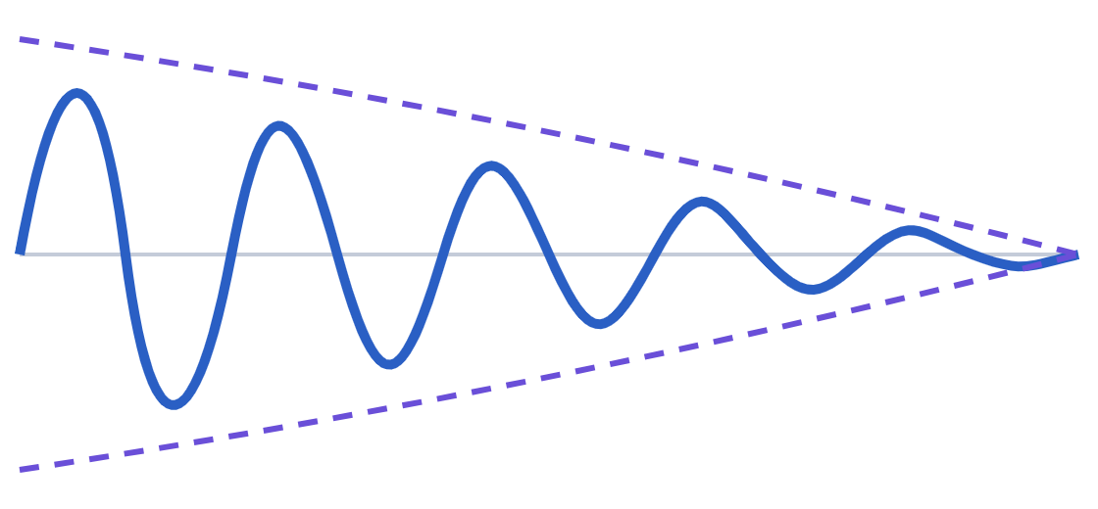
A shake is a wobble that dies out
4.4 · SHAKING
offset = frac² × cos(t × ω)
frac runs from 1 down to 0 over the Duration, so the swings shrink. Random sign flips make it look like a real shake.
Frequency is cycles per shake, not per second: the same Frequency with a shorter Duration shakes faster.
Shake beats a move in progress: the shake overwrites the position each frame; when it ends, the camera jumps to wherever the move has reached.
Module 4 · Summary · 5
Notes:
X shakes the camera ("the boss is coming!"); the sliders set Frequency, Duration and the shake size. The dashed lines are the shrinking envelope. For more advanced camera behaviors (parallax, following), look for existing solutions before writing your own.

Slide 6
Circle the hero, and watch it with a second camera
4.5 AND 4.6 · ORBITING AND VIEWPORTS
Orbit (4.5)
Viewport (4.6)
Each frame, rotate the egg by OrbitSpeed × Time.smoothDeltaTime, then place it at host + OrbitRadius × transform.right.
A camera's Viewport Rect (X, Y, W, H) is in fractions of the window, from (0, 0) at the bottom-left to (1, 1) at the top-right.
Only the host's position is used, so rotating the hero changes nothing; the egg turns once per orbit.
HeroCam follows the hero in a small view; each camera only draws what lies between its Near and Far planes.
Module 4 · Summary · 6
Notes:
In 4.5 there's no UI: move the Hero, or change the Egg's Orbit Radius and Orbit Speed in the editor. The default speed of 360 / 10 degrees per second makes one orbit every 10 seconds. In 4.6, the four sliders set HeroCam's Viewport Rect. Both cameras see the same Background at z = 30; HeroCam's Far plane is set so it doesn't draw it.

Slide 7
Loading a scene wipes the slate
4.7 · NEW SCENE + PERSISTENCE
Erased
Kept
Required
Every GameObject, with all its components and their fields.
static data: 4.7's GameState is a plain C# class held in a static field. (DontDestroyOnLoad() is another way.)
SceneManager.LoadScene() only loads scenes in the Scene List (File › Build Profiles).
Anything that must survive a new level needs special care: a singleton or other static storage.
Module 4 · Summary · 7
Notes:
In 4.7, do some hero lerps (Z) and shakes (X), watch the counts, then press L to load NewLevel: the counts carry over because they live in static data, not in a GameObject. A scene missing from the Scene List doesn't load, even in the editor; Unity logs an error instead.

Slide 8
Moving and zooming the camera
CHECK YOUR UNDERSTANDING · 1 OF 2
1
2
3
The camera is at x = 0. You zoom in toward a point at x = 20 with factor 0.5. Where does the camera end up?
The hero calls PushCameraByPos(pos, 0.6f). How close to the edge of the view can it get before the camera moves?
In 4.3 you press N to move by (10, 0), then press it again before the first move finishes. Where does the camera end up?
a. x = 0
b. x = 10
a. Within 6% of the edge
a. Exactly 20 to the right
c. x = 20
b. Within 20% of the edge
b. A bit less than 20 to the right
d. x = −10
c. Within 40% of the edge
c. Exactly 10 to the right
d. Right to the edge
d. More than 20 to the right
Module 4 · Summary · 8
Notes:
Answers on slide 10: 1 b, 2 b, 3 b. There's no quiz for Module 4; these follow the notes' review questions with different numbers.

Slide 9
Shakes, viewports and scenes
CHECK YOUR UNDERSTANDING · 2 OF 2
4
5
6
A shake is created with new ShakePosition(8, 2f). How many back-and-forth swings per second is that?
A camera's Viewport Rect is X = 0, Y = 0, W = 0.5, H = 0.5. Where is its view?
The score is a public field of the GameManager component. What happens to it after SceneManager.LoadScene()?
a. Top-left corner, a quarter of the width
a. 8
b. Bottom-left corner, half the width and half the height
a. It carries over: public fields persist
b. 4
b. It's lost with the GameObject; keep it in static data instead
c. 16
c. Centered in the window
d. 2
d. The whole window
c. Unity asks whether to keep it
d. It doubles
Module 4 · Summary · 9
Notes:
Answers on the next slide: 4 b, 5 b, 6 b.

Slide 10
Answers and why
CHECK YOUR UNDERSTANDING · ANSWERS
# | Answer | Why
1 | b | delta = (20 − 0) × (0.5 − 1) = −10, and the camera moves by −delta: to x = 10.
2 | b | 0.6 keeps an inner box of 60% of the view, leaving a 20% margin on each side.
3 | b | The second lerp starts from where the first one had reached, short of +10.
4 | b | Frequency counts cycles per shake: 8 cycles in 2 seconds is 4 per second.
5 | b | Viewport values are fractions measured from the bottom-left corner (0, 0).
6 | b | Loading a scene erases every GameObject and its components; static data survives.
Module 4 · Summary · 10
Notes:
For question 1, the zoom point stays at the same screen spot: it was 20 right of center in the old view and is 10 right of center in a view half as wide.

Slide 11
Practice, then on to Module 5
BEFORE NEXT CLASS
Try it yourself
For your game
In 4.4, press X with a short Duration, then a long one, and compare
In 4.6, drag the Viewport sliders to put HeroCam in each corner
In 4.7, count some shakes, press L, and check the count
Reuse CameraSupport, TimedLerp and ShakePosition: they're written to be reused
Look for existing solutions for parallax and following before writing your own
Next: Module 5, Unity-specific tools.
Module 4 · Summary · 11
Notes:
The full Module 4 notes, with every step and the lerp and shake plots, stay on the course site.

