Slide 1
CATS
Results Module – Map UI Options
Go >>

Slide 2
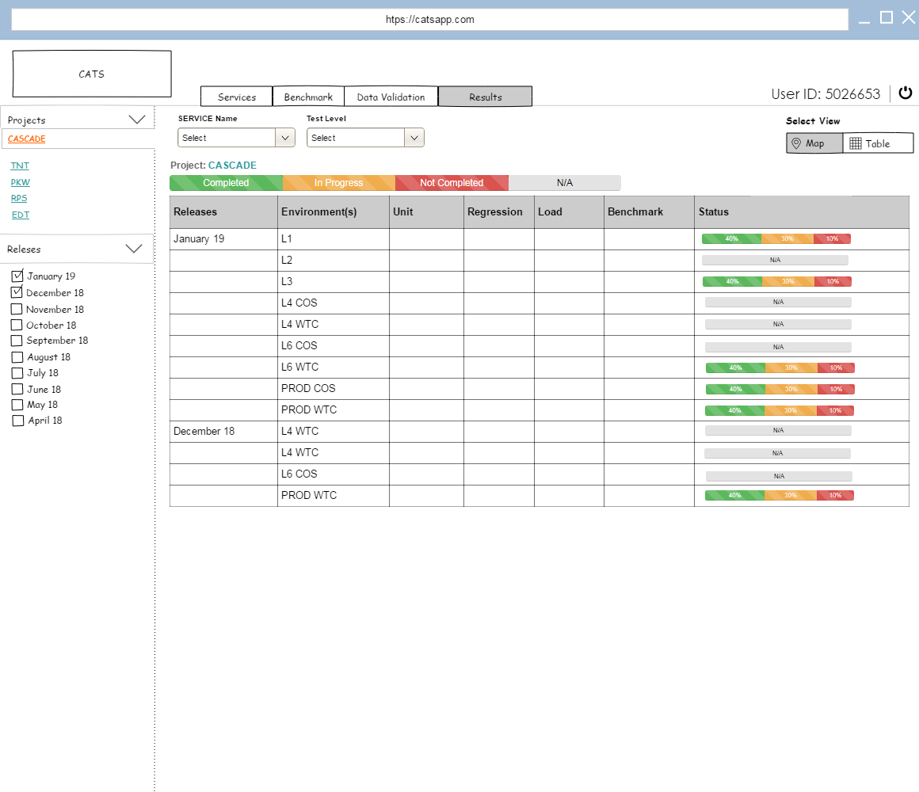
v
Option 2

Slide 3
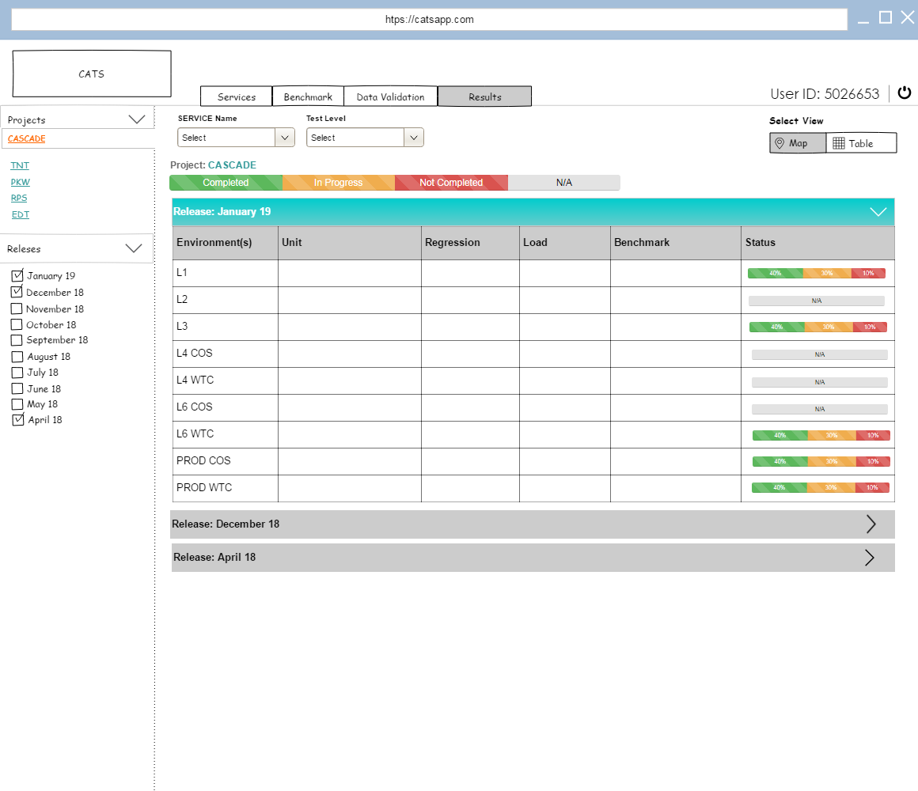
v
CLICK HERE

Slide 4
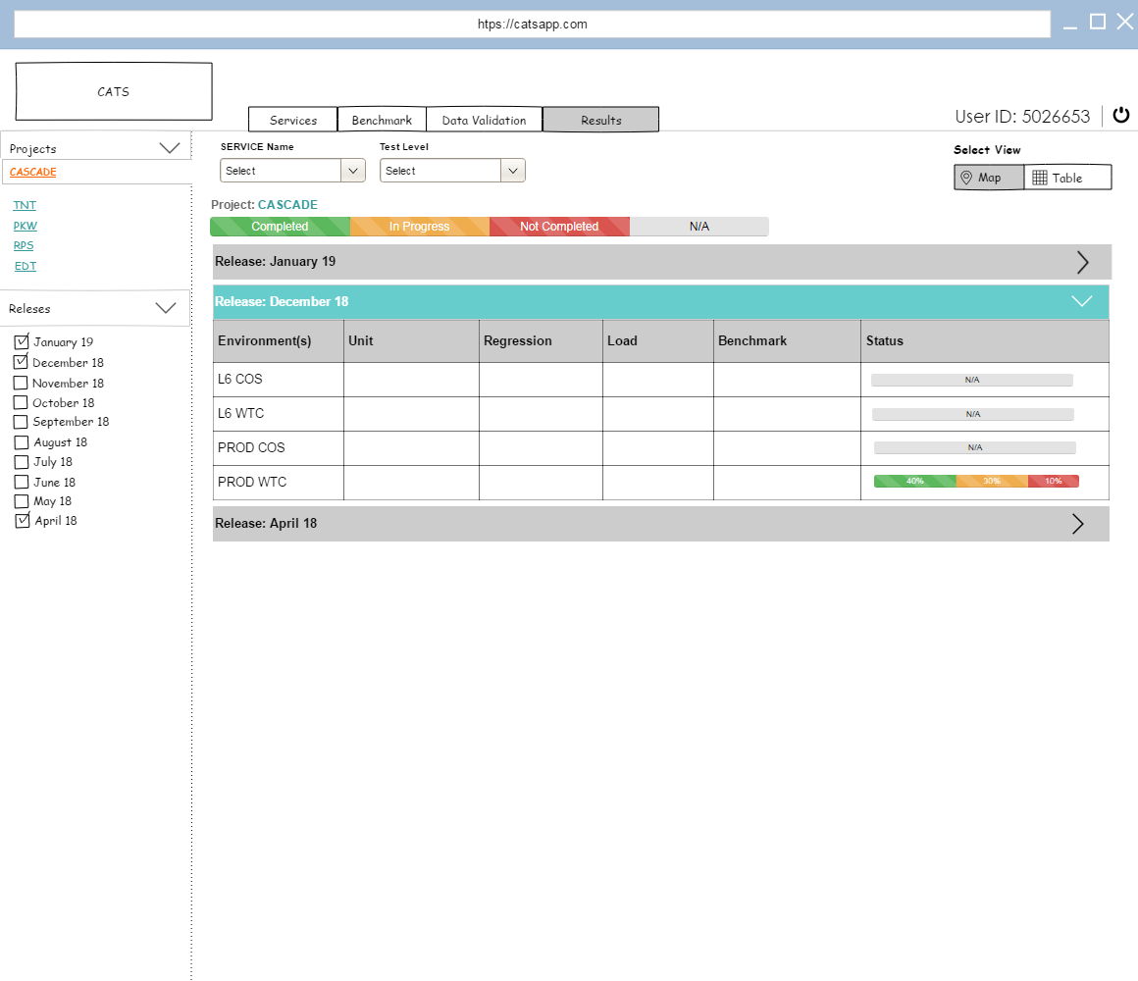
v
CLICK HERE
Option 1
Option 3

Slide 5
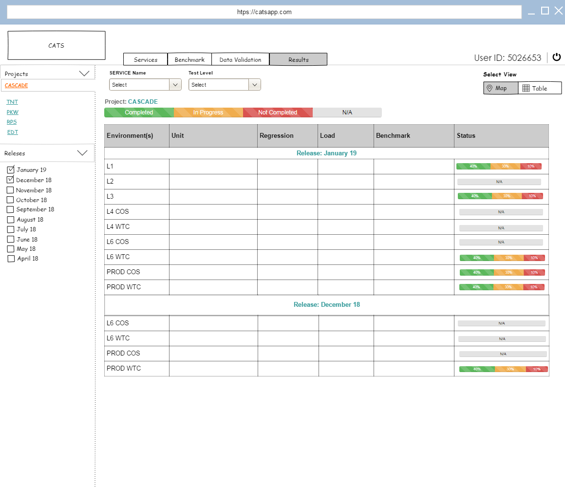
v
Option 1
Option 2

