Slide 1
CATS
Results - Module

Slide 2
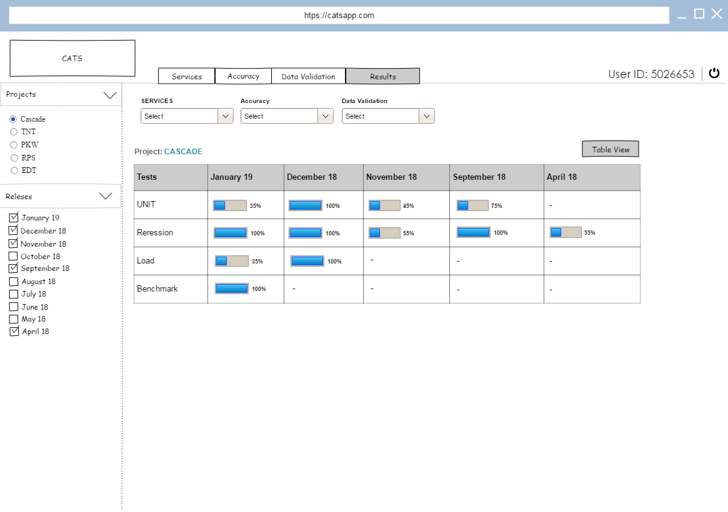
v

Slide 3
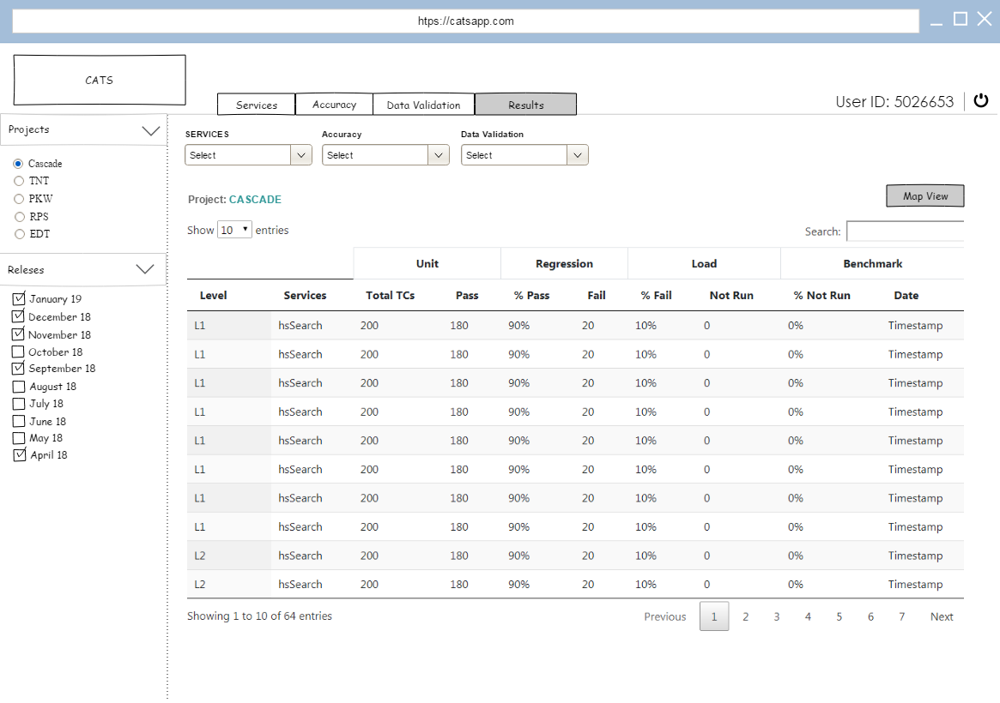
v

