Slide 1
How I learned to stop visualizing and love statistics

Slide 2
You have a hunch

Slide 3
Visualizations → sanity check
Statistics → quantify the hunch
(Visualizations → storytelling)
Notes:
----- Meeting Notes (1/9/12 16:15) -----

Slide 4
Someone says: “Obama got more small campaign contributions than McCain”

Slide 5
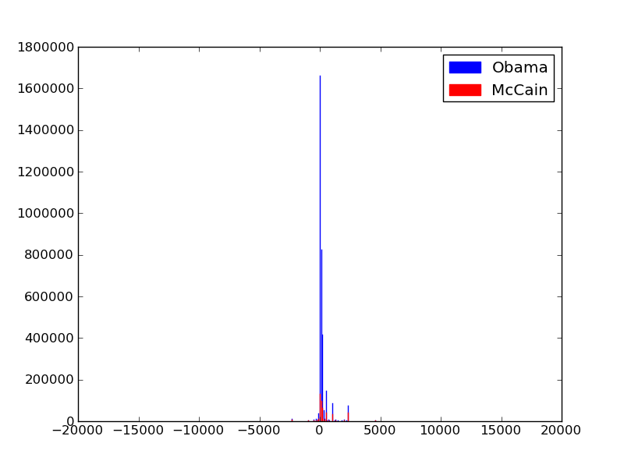

Slide 6
???

Slide 7
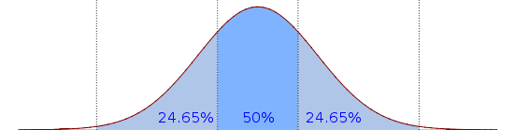
Notes:
https://en.wikipedia.org/wiki/File:Boxplot_vs_PDF.svg

Slide 8
Median
Notes:
https://en.wikipedia.org/wiki/File:Boxplot_vs_PDF.svg

Slide 9
25%
75%
Notes:
https://en.wikipedia.org/wiki/File:Boxplot_vs_PDF.svg

Slide 10
Inner Quartile Range
Notes:
https://en.wikipedia.org/wiki/File:Boxplot_vs_PDF.svg

Slide 11
Whiskers / Extremes
Notes:
https://en.wikipedia.org/wiki/File:Boxplot_vs_PDF.svg

Slide 12
Outliers
Notes:
https://en.wikipedia.org/wiki/File:Boxplot_vs_PDF.svg
----- Meeting Notes (1/9/12 16:23) -----
make arrows shorter

Slide 13
Box-and-Whiskers Plot

Slide 14
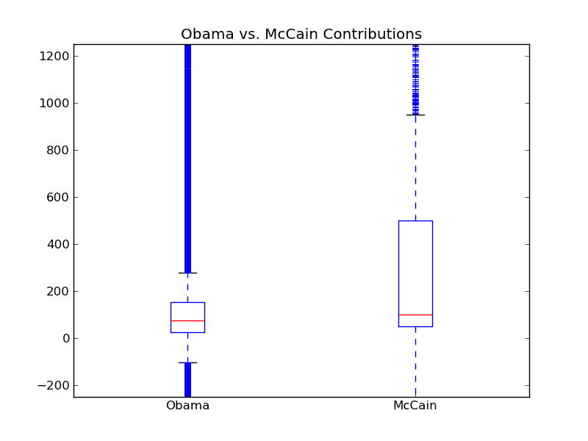

Slide 15
???

Slide 16
Are they actually different?
T-Test

Slide 17
Assume
Reality
Obama
McCain
Obama
McCain

Slide 18
How likely is given ?
Obama
McCain
Obama
McCain

Slide 19
avg2
avg1
Obama
McCain

Slide 20
avg2
Effect Size
avg1
Obama
McCain

Slide 21
avg2
variance 2
avg1
variance 1
Obama
McCain

Slide 22
How likely is given ?
avg2
variance 2
avg1
variance 1

Slide 23
How likely are they equal
given avg/variance differences?
Probablility p
p is low
Obama, McCain
are different
p is high
Don’t trust
the difference
(significant)
(not significant)

Slide 24
Significance is binary
Pick a threshold: .01? .05?
Is p > threshold, or < threshold?
p < .05? significant
p > .05? don’t trust the difference

Slide 25
T-Test Signifiance
# Samples
Obama: >1M
McCain: >1M
avg2
variance 2
+
avg1
variance 1

Slide 26
No such thing as “Extremely Significant”
Difference in averages can be extreme or not
Significance is binary: trust result, or not?

Slide 27
Correlation, Linear Regression

Slide 28
County Health Rankings
Every county in USA
Years of Potential Life Lost (YPLL): early morbidity
less is good
more is bad
Median income, % population w/ diabetes,
% population under 18, …

Slide 29
What is correlated with early death in a community?
Burgers
Sleep
Education
Exercise
# Rappers
Your theory here

Slide 30
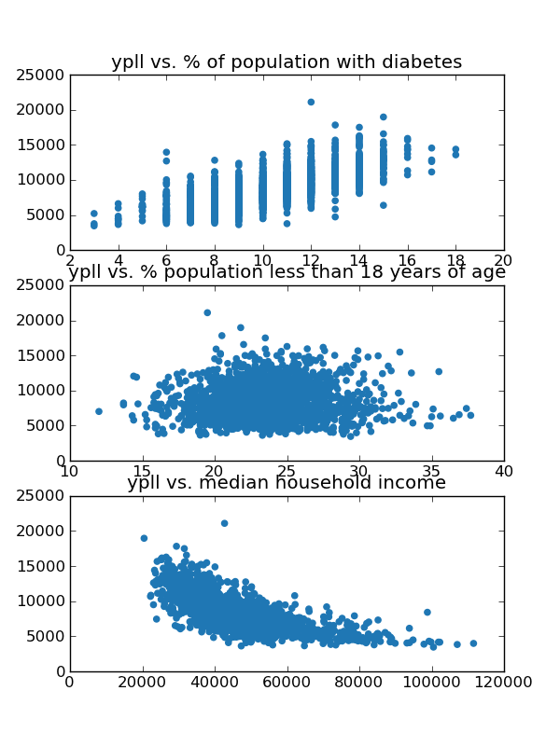
Notes:
We have scatterplots of the data
We can look at them and tell if they are correlated somehow. This is positive this is negative this is a blob
But how do we quantify it?
Correlation scores. There are lots of them. They each make assumption about the relationship between x and y. Linear? Parabolic? Arbitrary function?
Good---so we’re going to expect linear regression to give us three things: a line, a correlation amount, and significance.
The one we will use today is called linear regression, assumes the relationship is linear, and tries to fit a line. <animate line>
You end up with a ‘best-fit’ line that you can use to predict y from x in the future, and a correlation score: how well does the line fit.

Slide 31
Line coefficients:
y = mx + b
Correlation amount:
R² (0 to 1)
Significance:
p < .05?

Slide 32
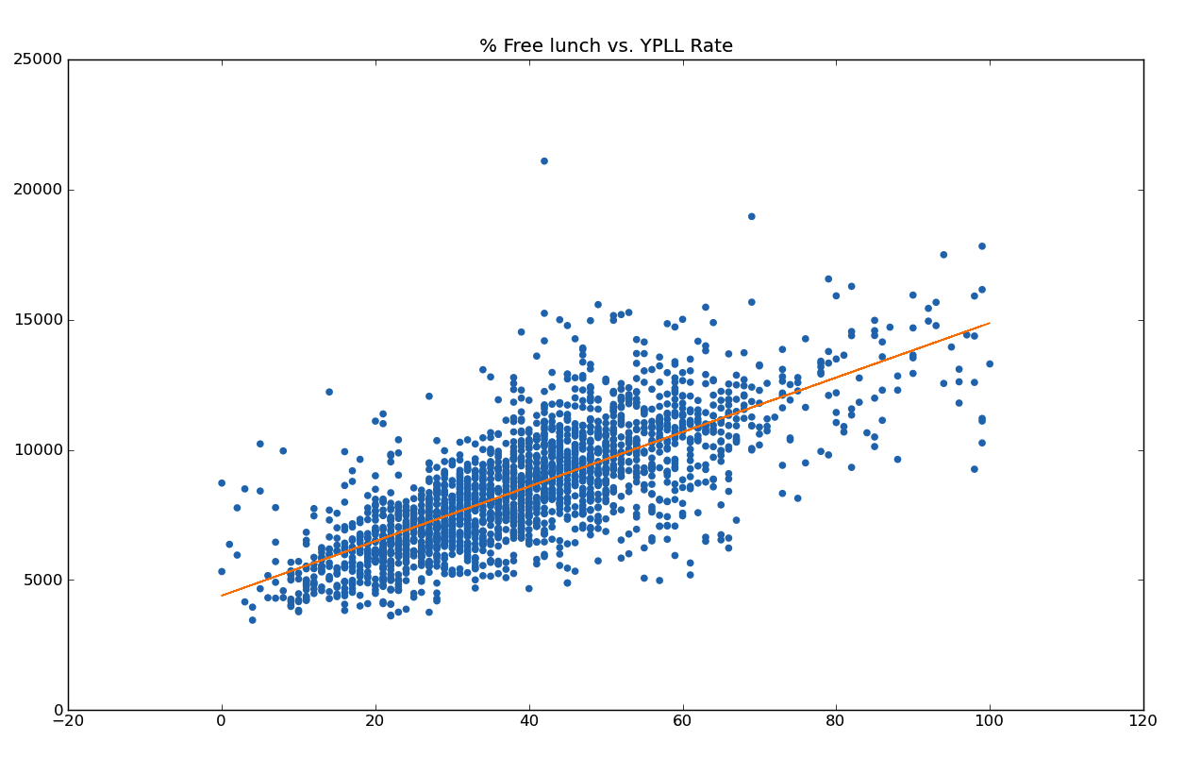

Slide 33

Notes:
https://eu.art.com/products/p10018489953-sa-i5785795/warning-zombies-ahead.htm

Slide 34

Decrease amount of free lunch
→
Reduce early morbidity!
Notes:
http://2.bp.blogspot.com/_V5gBGYc5EYM/TLJHJCSkcxI/AAAAAAAAB1w/NdJxNoIEELU/s1600/unhappy-boy.jpg

Slide 35
Correlation != Causation
Correlation
Causal Hunch
Randomized Trial
T-Test!

Slide 36
Remember to git pull
http://dataiap.github.com/dataiap/day3/

