Slide 1
Day 4: Text Analysis

Slide 2

Notes:
----- Meeting Notes (1/12/12 10:49) -----
working with a dataset kindly donated to the world by Enron

Slide 3

Notes:
----- Meeting Notes (1/12/12 10:49) -----
specifically all of the emails in kenneth lay's inbox

Slide 4
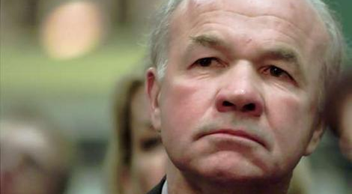
Kenneth Lay

Slide 5
lay-k/
_sent/
all_documents/
business/
deleted_items/
family/
inbox/
sec_panel/
sent/
Notes:
----- Meeting Notes (1/12/12 10:49) -----
we included the dataset in the datasets directory under email. if you unzip, the dir structure looks like this

Slide 6
lay-k/
_sent/
all_documents/
business/
deleted_items/
family/
inbox/
sec_panel/
sent/
Email1
Email2
….
Notes:
----- Meeting Notes (1/12/12 10:49) -----
Each folder contains a list of files. and each file is a single email
in today's lab, we want to do two things

Slide 7
2

Slide 8
Relevant terms
Summaries
Searching
“Conference”
“Call”
“Saturday”
“Noon”
Notes:
----- Meeting Notes (1/12/12 10:49) -----
First, we'd like to find the relevant terms in a given email.
For example, for one email we want to extract the relevant terms ….

Slide 9
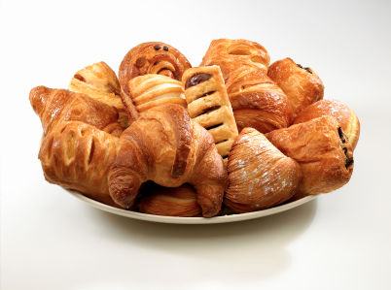
Relevant terms
Summaries
Searching
Similarity
Notes:
----- Meeting Notes (1/12/12 10:49) -----
Second, we'd like to compute a score to tell us how similar the emails are to one another.
For example, reading email about brunch.

Slide 10
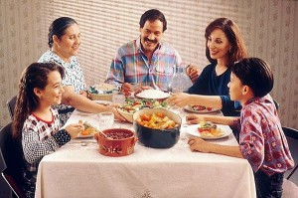
Relevant terms
Summaries
Searching
Similarity
Notes:
----- Meeting Notes (1/12/12 10:49) -----
what other emails are talking about food, or brunch?
Similarity should weigh those emails higher than

Slide 11
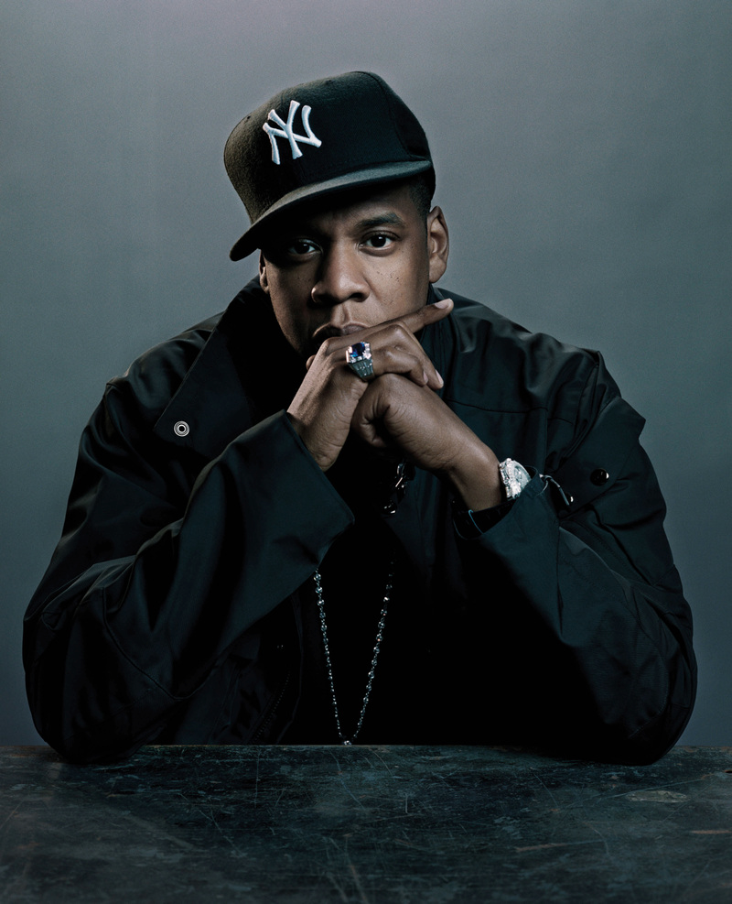
Relevant terms
Summaries
Searching
Similarity
NO
Notes:
----- Meeting Notes (1/12/12 10:49) -----
ones about prominent rap stars.
alright.

Slide 12
Relevant Terms
using TF-IDF

Slide 13
Intuition
Count # times each word is used
We are in the process of trying to arrange a conference call with you on either Tuesday or Wednesday of next week to discuss the paper which is attached
We will be doing this by conference call and once we set a time to talk with you, will give you the number to call.
TF
Notes:
Either define Term frequency or never use it.
----- Meeting Notes (1/12/12 10:49) -----
what if we counted the number of times each word is used? The assumption is that the more relevant a word is, the more times it'll be mentioned.
This count is also called Term-Frequency

Slide 14
Intuition
Count # times each word is used
We are in the process of trying to arrange a conference call with you on either Tuesday or Wednesday of next week to discuss the paper which is attached.
We will be doing this by conference call and once we set a time to talk with you, will give you the number to call.
conference: 2
TF
Notes:
----- Meeting Notes (1/12/12 10:49) -----
For example, in one of kenneth's emails, he uses the word conference twice. and if we scan the email, it seems like it's about conference calls.
But there's a problem

Slide 15
Intuition
Count # times each word is used
We are in the process of trying to arrange a conference call with you on either Tuesday or Wednesday of next week to discuss the paper which is attached.
We will be doing this by conference call and once we set a time to talk with you, will give you the number to call.
to: 4
TF
Notes:
----- Meeting Notes (1/12/12 10:49) -----
reason because to is in almost all emails! so it doesn't help us hone in.

Slide 16
Intuition
Count # times each word is used
Penalize if most documents use word
We are in the process of trying to arrange a conference call with you on either Tuesday or Wednesday of next week to discuss the paper which is attached.
We will be doing this by conference call and once we set a time to talk with you, will give you the number to call.
to: 4
TF
IDF
Want to penalize

Slide 17
IDF. How do they work?
log( total # emails / # emails with word)

Slide 18
IDF. How do they work?
log( total # emails / # emails with word)
1000 Total Emails
3
IDF
2
1
1000
# emails with term

Slide 19
IDF. How do they work?
log( total # emails / # emails with word)
1000 Total Emails
3
IDF
2
“to”
1
1000
# emails with term

Slide 20
IDF. How do they work?
log( total # emails / # emails with word)
1000 Total Emails
3
“Conference”
IDF
2
“to”
1
1000
# emails with term

Slide 21
IDF. How do they work?
log( total # emails / # emails with word)
1000 Total Emails
3
“Conference”
IDF
2
“Bankrupt”
“to”
1
1000
# emails with term

Slide 22
Relevant Terms
Frequent
Words in email
But not in all
emails
Notes:
----- Meeting Notes (1/12/12 10:52) -----
To recap, we want relevant terms where
word pops up a lot in the email
but not found in all emails

Slide 23
Relevant Terms
Frequent
Words in email
But not in all
emails
TF
IDF
*

Slide 24
Relevant Terms
Frequent
Words in email
But not in all
emails
TF
IDF
*
Per-Email
Corpus Wide

Slide 25
Relevant Terms
We are in the process of trying to arrange a conference call with you on either Tuesday or Wednesday of next week to discuss the paper which is attached.
We will be doing this by conference call and once we set a time to talk with you, will give you the number to call.
Notes:
Great. We got a list of important words for each email.

Slide 26
Relevant Terms
TFIDF
conference 4.1
call 3
…
to 0.03
a 0.0012
We are in the process of trying to arrange a conference call with you on either Tuesday or Wednesday of next week to discuss the paper which is attached.
We will be doing this by conference call and once we set a time to talk with you, will give you the number to call.
Notes:
Great. We got a list of important words for each email.
----- Meeting Notes (1/12/12 10:52) -----
If we sort them from high to low tfidf

Slide 27
How similar is email 1 to email 2?
Cosine Similarity
Notes:
It turns out these tfidf scores can help us solve the second problem.

Slide 28
Email1 = conference, enron, donuts,…
Email2 = enron, call, appointment,…
Notes:
Let’s say we already calculated the tfidfs, and took the top 100

Slide 29
Email1 = conference, enron, donuts,…
Email2 = enron, call, appointment,…
Email1 ∩ Email2
Notes:
Then two emails that have the same top terms are probably nearly identical. And if they don’t share any terms, then probably not.
So we could just define a similarity score based on the size of the intersection!
Ask a question here. Can I design an email similar to all emails

Slide 30
Email1 = conference, enron, donuts,…
Email2 = enron, call, appointment,…
Email1 ∩ Email2
# words in both emails

Slide 31
Email1 • Email2
||Email1|| * ||Email2||
Notes:
In reality, people model an email’s top terms and their tfidfs as a vector. Each term is a dimension.
Explain dot product and norm with example.

Slide 32
E1 = {‘conference’:4, ‘enron’:3}
E2 = {‘enron’: 1, ‘call’:2}
Notes:
You’ll be working with this, so let me walk you through how to calculate it in python

Slide 33
E1 = {‘conference’:4, ‘enron’:3}
E2 = {‘enron’: 1, ‘call’:2}
E1[‘enron’] * E2[‘enron’] + …
Notes:
If they overlapped on other terms, we would just add them.

Slide 34
E1 = {‘conference’:4, ‘enron’:3}
E2 = {‘enron’: 1, ‘call’:2}
E1[‘enron’] * E2[‘enron’] + …
sqrt( 4²+3² ) * sqrt( 1²+2² )
E1
E2

Slide 35
Data Cleaning

Slide 36
ok. 10:40 to be safe:P
On Fri, Jan 6, 2012 at 5:15 PM, Eugene Wu <sirrice@gmail.com> wrote:
> i have a feeling that breakfast foods stop at 11 at clover because thats
> how it works at the truck.
> so maybe 1045 or something is better.
>
>
> On Fri, Jan 6, 2012 at 5:09 PM, Adam Marcus <marcua@csail.mit.edu> wrote:
>
>> see you there at 11!
>>
>>
>> On Fri, Jan 6, 2012 at 5:05 PM, Eugene Wu <sirrice@gmail.com> wrote:
>>
>>> lets have brunch at 11. That way we skip the rush as well.
>>>

Slide 37
<html><body><img src="http://Link.p0.com/1x1.dyn?0VkG5BnoiRicmh9RA0Vs1eiXF=0" width=1 height=1 width="1" height="1" border="0"><table width="100%" cellpadding="0" cellspacing="0" border="0"><tr><td bgcolor="#f3f7fe"><table cellpadding="10" bgcolor="f3f7fe" border="0" cellspacing="0"><tr><td align="left"><p style="margin-left: 20px;"><font face="arial" size="1" color="#666666"><a href="http://Link.p0.com/t.d?T4Go9L_LLgypcb=/@HTML_2PREVIEW_2LINK_0a=5CRic-uFlRqyK5Ptqj2VYenr&msgVersion=mobile"><font color="#0038a5">View mobile version</font></a></font></p><table border="0" cellspacing="0" cellpadding="0" width="580"><tr><td width="1" height="

Slide 38
Regular Expressions “Enron’s”
“sirrice@gmail.com”
Normalization “Word” == “word”
Stop Words Ignore “a”, “to”, …

Slide 39
So we implemented all of that…
Notes:
On my gmail

Slide 40
Sucked

Slide 41
Email Body vs Subject
Garbage in garbage out

Slide 42
Forwarded message
Unsubscribe
Love
Sincerely

Slide 43
Subject Line
Fwd: 11/5 Dinner @ Jewel Bako. 7:45PM
Dinner
What time for dinner tomorrow?

Slide 44
Pretty Long
(optional)

Slide 45

Download your IMAP Email!
dataiap/resources/download_emails.py

Slide 46
Presentations Wednesday!
1 minute
2 slides by Tuesday night
Google presentations
Interesting dataset
Interesting analysis
Topic Extensions
Notes:
To give context, it’s informal. For example, I would talk about rappers.

Slide 47
http://dataiap.github.com/dataiap/day4
git pull

Slide 48
Remind them about
Downloading their own email
Last day presentations.
Proton pump inhibitor

