Slide 1
Day 4: Text Analysis

Slide 2


Slide 3


Slide 4
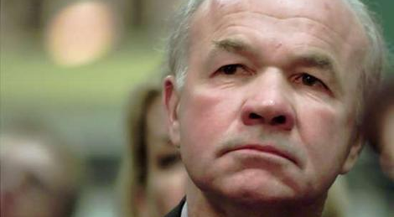
Kenneth Lay

Slide 5
lay-k/
_sent/
all_documents/
business/
deleted_items/
family/
inbox/
sec_panel/
sent/

Slide 6
lay-k/
_sent/
all_documents/
business/
deleted_items/
family/
inbox/
sec_panel/
sent/
Email1
Email2
….

Slide 7
2

Slide 8
Relevant terms
Summaries
Searching
“Conference”
“Call”
“Saturday”
“Noon”

Slide 9
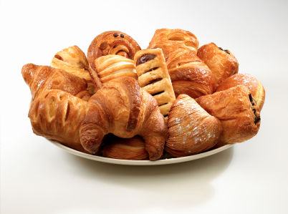
Relevant terms
Summaries
Searching
Similarity

Slide 10
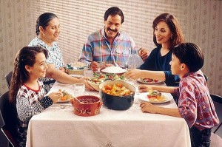
Relevant terms
Summaries
Searching
Similarity

Slide 11
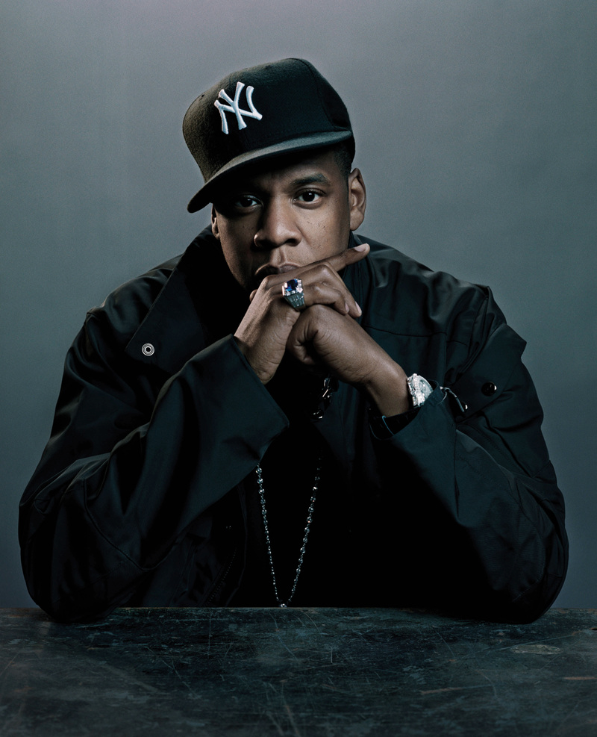
Relevant terms
Summaries
Searching
Similarity
NO

Slide 12
Relevant Terms
using TF-IDF

Slide 13
Intuition
Count # times each word is used
We are in the process of trying to arrange a conference call with you on either Tuesday or Wednesday of next week to discuss the paper which is attached
We will be doing this by conference call and once we set a time to talk with you, will give you the number to call.
TF
Notes:
Either define Term frequency or never use it.

Slide 14
Intuition
Count # times each word is used
We are in the process of trying to arrange a conference call with you on either Tuesday or Wednesday of next week to discuss the paper which is attached.
We will be doing this by conference call and once we set a time to talk with you, will give you the number to call.
conference: 2
TF

Slide 15
Intuition
Count # times each word is used
We are in the process of trying to arrange a conference call with you on either Tuesday or Wednesday of next week to discuss the paper which is attached.
We will be doing this by conference call and once we set a time to talk with you, will give you the number to call.
to: 4
TF

Slide 16
Intuition
Count # times each word is used
Penalize if most documents use term
We are in the process of trying to arrange a conference call with you on either Tuesday or Wednesday of next week to discuss the paper which is attached.
We will be doing this by conference call and once we set a time to talk with you, will give you the number to call.
to: 4
TF
IDF
Want to penalize

Slide 17
IDF. How do they work?
log( total # emails / # emails with word)

Slide 18
IDF. How do they work?
log( total # emails / # emails with word)
1000 Total Emails
3
IDF
2
1
1000
# emails with term

Slide 19
IDF. How do they work?
log( total # emails / # emails with word)
1000 Total Emails
3
IDF
2
“to”
1
1000
# emails with term

Slide 20
IDF. How do they work?
log( total # emails / # emails with word)
1000 Total Emails
3
“Conference”
IDF
2
“to”
1
1000
# emails with term

Slide 21
IDF. How do they work?
log( total # emails / # emails with word)
1000 Total Emails
3
“Conference”
IDF
2
“Bankrupt”
“to”
1
1000
# emails with term

Slide 22
Relevant Terms
Frequent
Words in email
But not in all
emails

Slide 23
Relevant Terms
Frequent
Words in email
But not in all
emails
TF
IDF
*

Slide 24
Relevant Terms
Frequent
Words in email
But not in all
emails
TF
IDF
*
Per-Email
Corpus Wide

Slide 25
Relevant Terms
We are in the process of trying to arrange a conference call with you on either Tuesday or Wednesday of next week to discuss the paper which is attached.
We will be doing this by conference call and once we set a time to talk with you, will give you the number to call.
Notes:
Great. We got a list of important words for each email.

Slide 26
Relevant Terms
TFIDF
conference 4.1
call 3
…
to 0.03
a 0.0012
We are in the process of trying to arrange a conference call with you on either Tuesday or Wednesday of next week to discuss the paper which is attached.
We will be doing this by conference call and once we set a time to talk with you, will give you the number to call.
Notes:
Great. We got a list of important words for each email.

Slide 27
How similar is email 1 to email 2?
Cosine Similarity
Notes:
It turns out these tfidf scores can help us solve the second problem.

Slide 28
Email1 = conference, enron, donuts,…
Email2 = enron, call, appointment,…
Notes:
Let’s say we already calculated the tfidfs, and took the top tfidfs

Slide 29
Email1 = conference, enron, donuts,…
Email2 = enron, call, appointment,…
Email1 ∩ Email2
Notes:
Ask a question here. Can I design an email similar to all emails

Slide 30
Email1 = conference, enron, donuts,…
Email2 = enron, call, appointment,…
Email1 ∩ Email2
# words in both emails

Slide 31
Email1 • Email2
||Email1|| * ||Email2||
Notes:
Explain dot product and norm with example.

Slide 32
E1 = {‘conference’:4, ‘enron’:3}
E2 = {‘enron’: 1, ‘call’:2}

Slide 33
E1 = {‘conference’:4, ‘enron’:3}
E2 = {‘enron’: 1, ‘call’:2}
E1[‘enron’] * E2[‘enron’]

Slide 34
E1 = {‘conference’:4, ‘enron’:3}
E2 = {‘enron’: 1, ‘call’:2}
E1[‘enron’] * E2[‘enron’]
sqrt( 4²*3² ) + sqrt( 1²*2² )

Slide 35
Data Cleaning

Slide 36
ok. 10:40 to be safe:P
On Fri, Jan 6, 2012 at 5:15 PM, Eugene Wu <sirrice@gmail.com> wrote:
> i have a feeling that breakfast foods stop at 11 at clover because thats
> how it works at the truck.
> so maybe 1045 or something is better.
>
>
> On Fri, Jan 6, 2012 at 5:09 PM, Adam Marcus <marcua@csail.mit.edu> wrote:
>
>> see you there at 11!
>>
>>
>> On Fri, Jan 6, 2012 at 5:05 PM, Eugene Wu <sirrice@gmail.com> wrote:
>>
>>> lets have brunch at 11. That way we skip the rush as well.
>>>

Slide 37
<html><body><img src="http://Link.p0.com/1x1.dyn?0VkG5BnoiRicmh9RA0Vs1eiXF=0" width=1 height=1 width="1" height="1" border="0"><table width="100%" cellpadding="0" cellspacing="0" border="0"><tr><td bgcolor="#f3f7fe"><table cellpadding="10" bgcolor="f3f7fe" border="0" cellspacing="0"><tr><td align="left"><p style="margin-left: 20px;"><font face="arial" size="1" color="#666666"><a href="http://Link.p0.com/t.d?T4Go9L_LLgypcb=/@HTML_2PREVIEW_2LINK_0a=5CRic-uFlRqyK5Ptqj2VYenr&msgVersion=mobile"><font color="#0038a5">View mobile version</font></a></font></p><table border="0" cellspacing="0" cellpadding="0" width="580"><tr><td width="1" height="

Slide 38
Regular Expressions “Enron’s”
“sirrice@gmail.com”
Normalization “Word” == “word”
Stop Words Ignore “a”, “to”, …

Slide 39
So we implemented all of that…
Notes:
On my gmail

Slide 40
Sucked

Slide 41
Email Body vs Subject
Garbage in garbage out

Slide 42
Forwarded message
Unsubscribe
Love
Sincerely

Slide 43
Subject Line
Fwd: 11/5 Dinner @ Jewel Bako. 7:45PM
Dinner
What time for dinner tomorrow?

Slide 44

Download your IMAP Email!
dataiap/resources/download_emails.py

Slide 45
Presentations Wednesday!
1 minute
2 slides by Tuesday night
Google presentations
Interesting dataset
Interesting analysis
Topic Extensions
Notes:
To give context, it’s informal. For example, I would talk about rappers.

Slide 46
http://dataiap.github.com/dataiap/day4
git pull

Slide 47
Remind them about
Downloading their own email
Last day presentations.
Proton pump inhibitor

