Slide 1


Just Relax
22
Nov.

Slide 2
In the textbook, we learned a love letter to long-distance running. They writer showed her sadness when she was diagnosed unable to run. But at that time, I couldn't understand her love.
And we also have long-distance running in zhejiang university, we respectfully call him ‘daka’ on the surface, and we can sometimes use the question ‘Did you clock in today?’ to start a new conversation with strangers. But, we also can use the question ‘How many times have you clocked in so far?’ to ruin someone else's Day.
clock in :打卡
Just Relax

Slide 3
For the first period of time, we ran 3.5 kilometer every day firmly.
We ran around the playground without any fun.
Just step by step, we can’t realize the happiness the author gets from the long-distance running.
However, it is not a lack of beauty of long-distance running.It is our lack of discovery. Running clock in can be really fun.
Just Relax

Slide 4
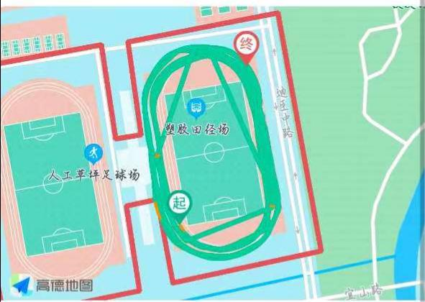
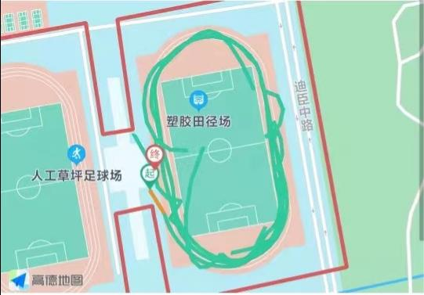
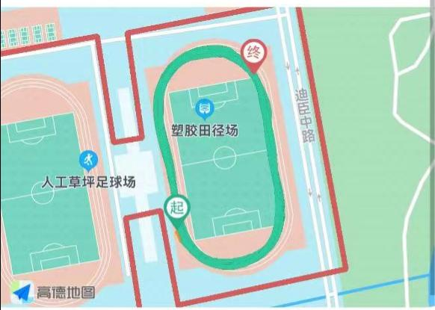
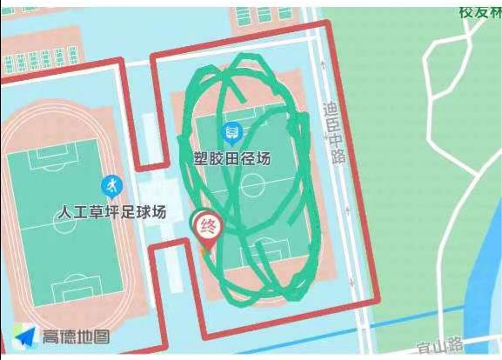
You might think this is your lap track.
But actually
lap track: 跑圈轨迹
Just Relax

Slide 5
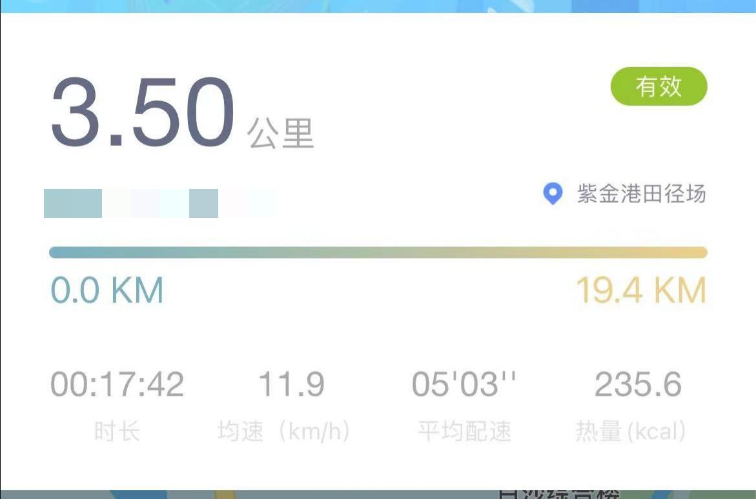
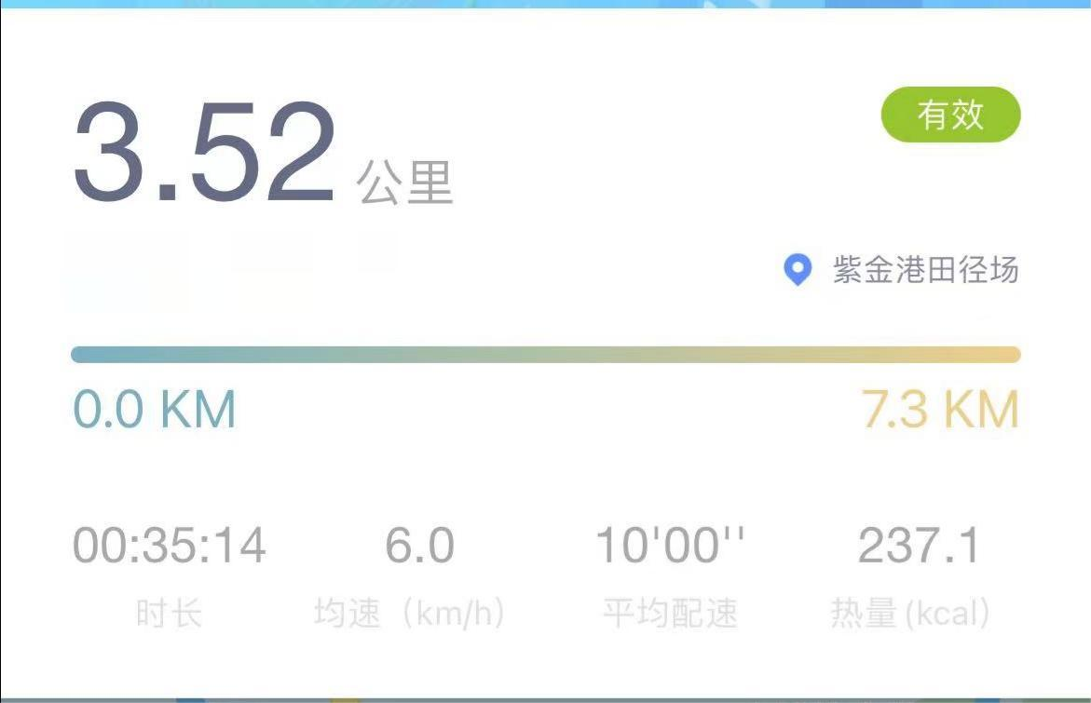
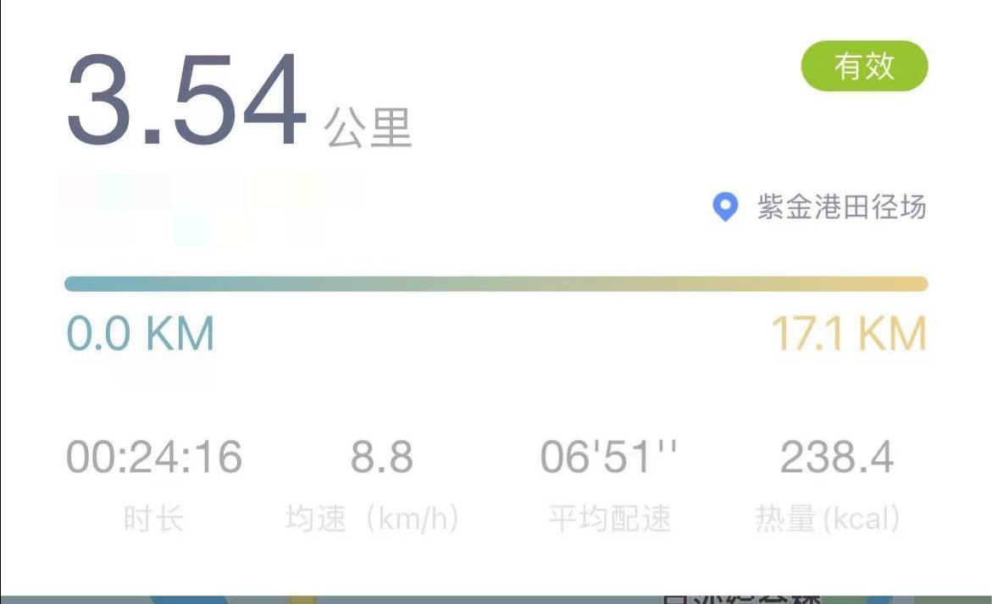
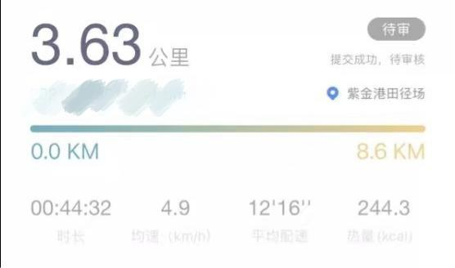
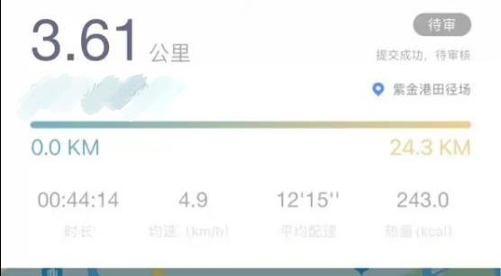
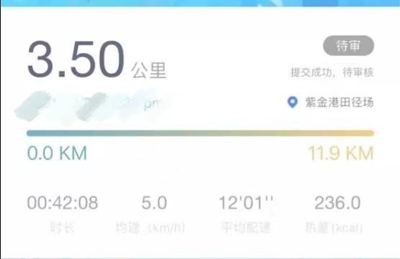
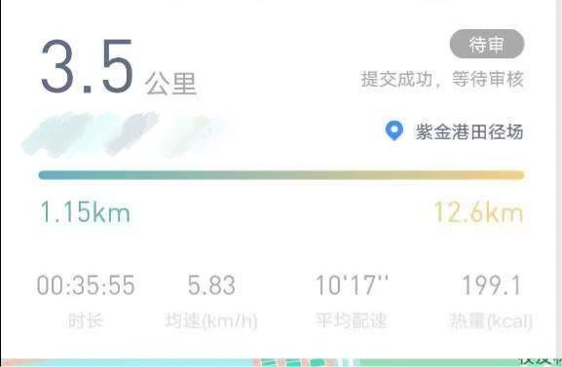
We firmly believe that after exercise, we can do this.
Reality gives us another blow
Just Relax

Slide 6
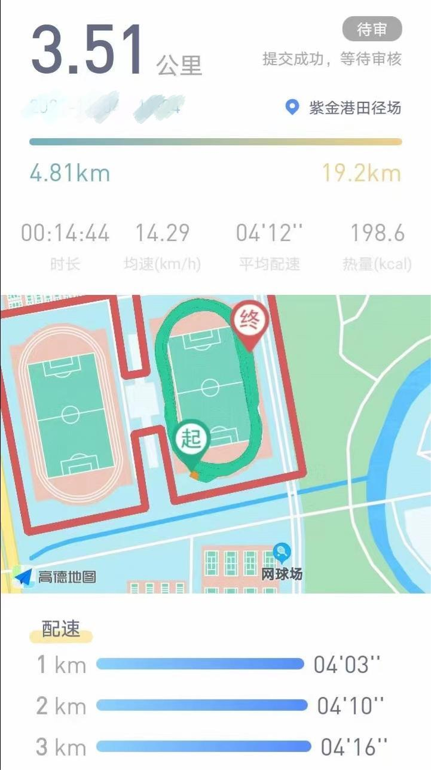
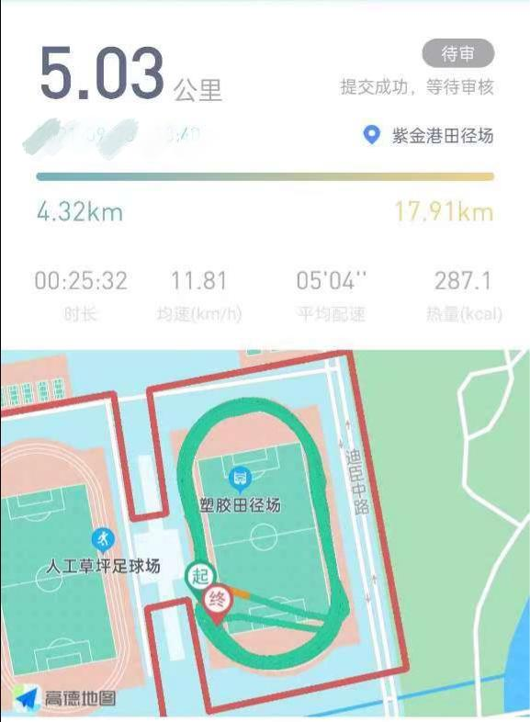
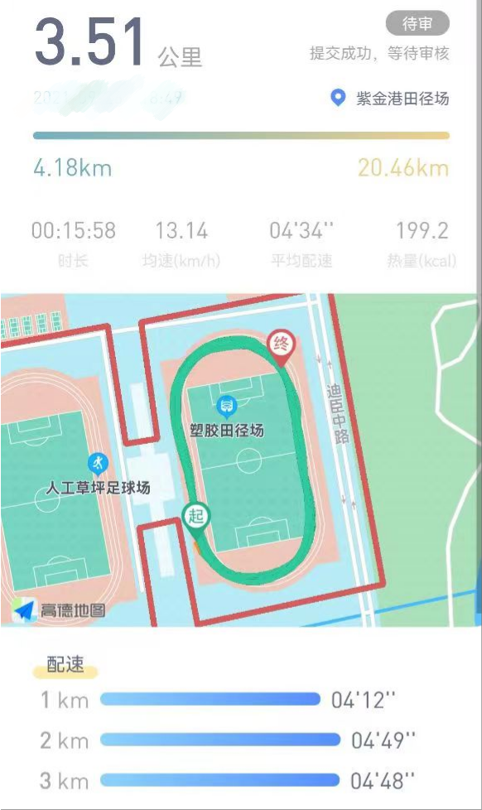
And there's always a group of people unable to extricate
oneself from Involution.
Involution:内卷
mileage : 里程数
Just Relax

Slide 7
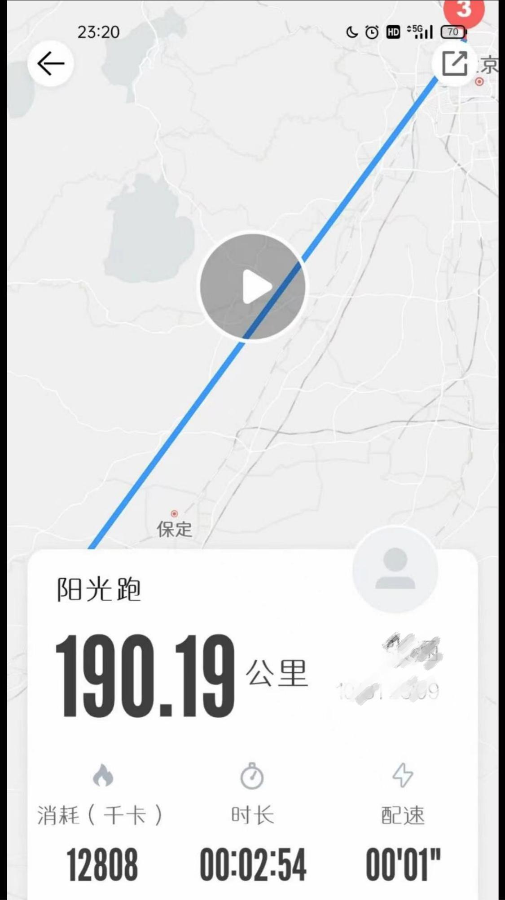
There are also some immortals.
immortal: 不朽的人物; 名垂千古的人物;
神; 永生不灭者;
Just Relax

Slide 8
It can be seen that long-distance running really brings us a lot of fun. Also, it will bring us a lot of help.
Regular exercise can not only enhance our physical immunity, but also achieve the effect of strengthening the body. If you keep exercising for a long time, you will also achieve the effect of weight loss.
At the same time, exercise can accelerate the rate of metabolism in the body, accelerate our heart rate and blood flow, and promote the body to continuously release heat. A large number of metabolic waste in the body will be discharged in the form of sweat, and the body will become cleaner and easier.
metabolism: 新陈代谢
Just Relax

Slide 9
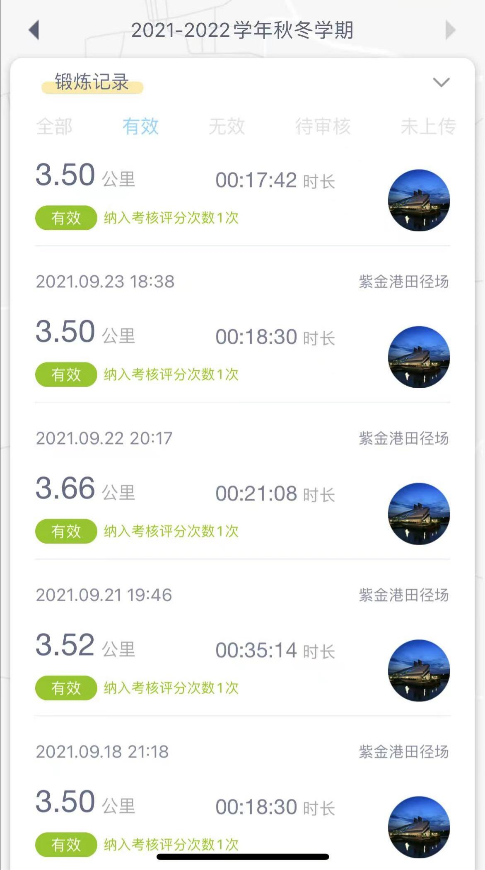
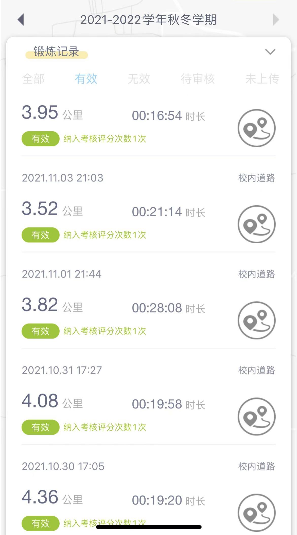
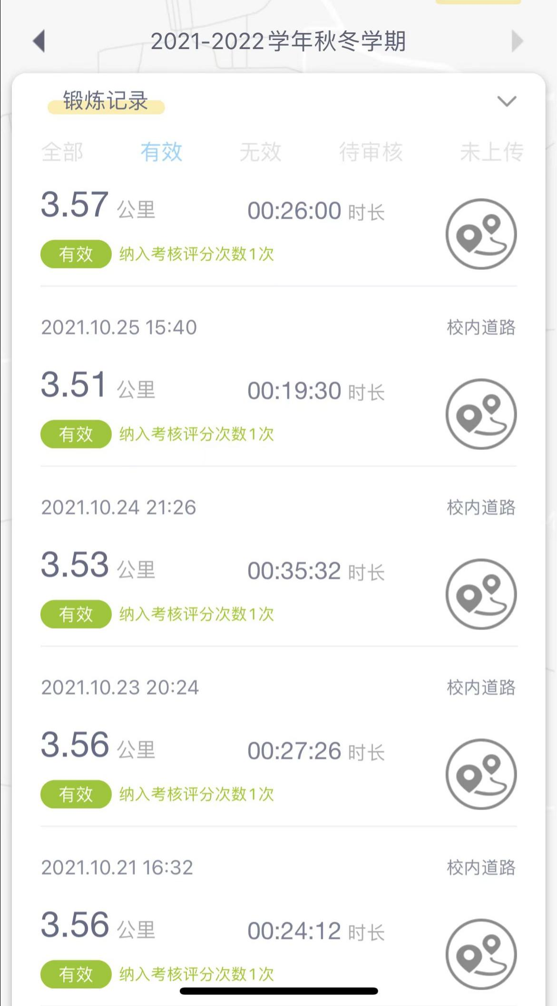
Long distance running also gives us change. It ensures that we can have a stronger body to study. Also, it teach us to improve our efficiency.
Just Relax

Slide 10
Thank You
Just Relax

