Slide 1
BUAD 5072
Machine Learning I
Shrinkage Methods: Ridge Regression
(ISLR, Chapter 6)
Notes:
1
1

Slide 2
Shrinkage Methods
The subset selection methods described above involve using least squares to fit a linear model that contains a subset of the predictors.
As an alternative, we can fit a model containing all p predictors using a technique that constrains or regularizes the coefficient estimates, or equivalently, that shrinks the coefficient estimates towards zero.
It may not be immediately obvious why such a constraint should improve the fit, but it turns out that shrinking the coefficient estimates can significantly reduce their variance.
The two best-known techniques for shrinking the regression coefficients towards zero are ridge regression and the lasso.

Slide 3
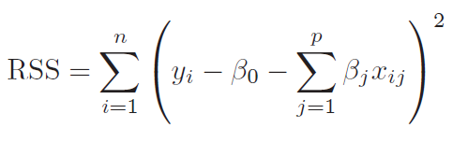
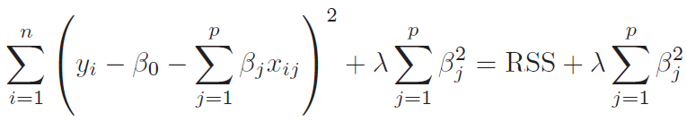
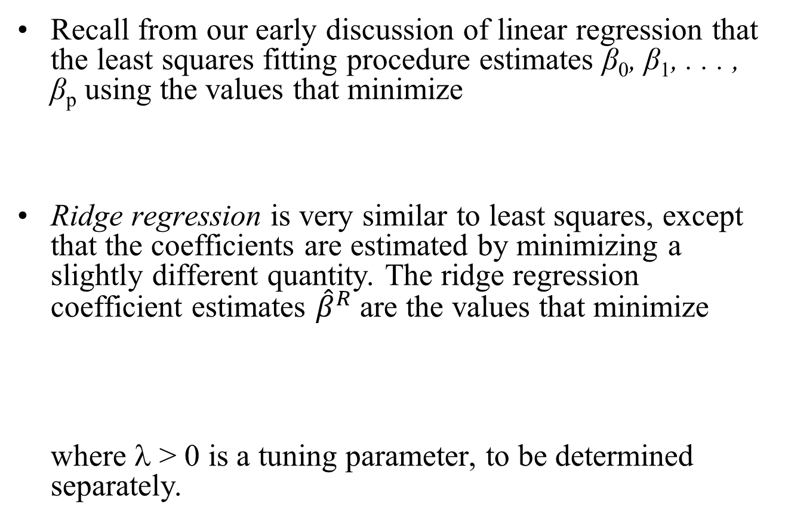
Ridge Regression
Recall from our early discussion of linear regression that the least squares fitting procedure estimates β₀, β₁, . . . , β_{p} using the values that minimize
Ridge regression is very similar to least squares, except that the coefficients are estimated by minimizing a slightly different quantity. The ridge regression coefficient estimates ${\hat{β}}^{R}$ are the values that minimize where λ > 0 is a tuning parameter, to be determined separately.

Slide 4
Ridge Regression
This expression trades off two different criteria:
As with least squares, ridge regression seeks coefficient estimates that fit the data well, by making the RSS small.
However, the second term, called a shrinkage penalty, is small when β₁, . . . , β_{p} are close to zero, and so it has the effect of shrinking the estimates of β_{j} towards zero.
The tuning parameter λ serves to control the relative impact of these two terms on the regression coefficient estimates:
When λ = 0, the penalty term has no effect, and ridge regression will produce the least squares estimates.
However, as λ→∞, the impact of the shrinkage penalty grows, and the ridge regression coefficient estimates will approach zero.

Slide 5
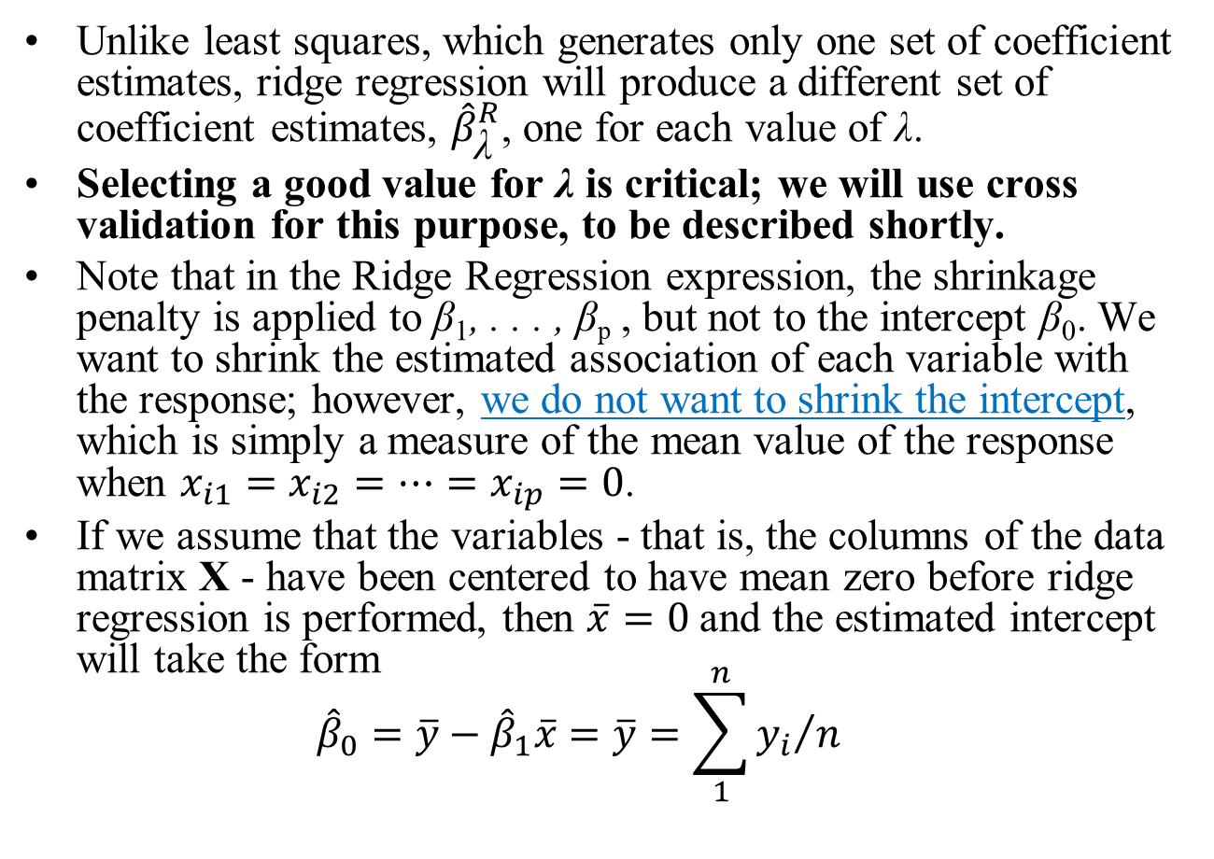
Ridge Regression
Unlike least squares, which generates only one set of coefficient estimates, ridge regression will produce a different set of coefficient estimates, ${\hat{β}}_{\text{λ}}^{R}$, one for each value of λ.
Selecting a good value for λ is critical; we will use cross validation for this purpose, to be described shortly.
Note that in the Ridge Regression expression, the shrinkage penalty is applied to β₁, . . . , β_{p} , but not to the intercept β₀. We want to shrink the estimated association of each variable with the response; however, we do not want to shrink the intercept, which is simply a measure of the mean value of the response when $x_{i1}=x_{i2}=…=x_{ip}=0$.
If we assume that the variables - that is, the columns of the data matrix X - have been centered to have mean zero before ridge regression is performed, then $\overline{x}=0$and the estimated intercept will take the form ${\hat{β}}_{0}=\overline{y}−{\hat{β}}_{1}\overline{x}=\overline{y}=\sum_{1}^{n}{{y_{i}}/n}$

Slide 6
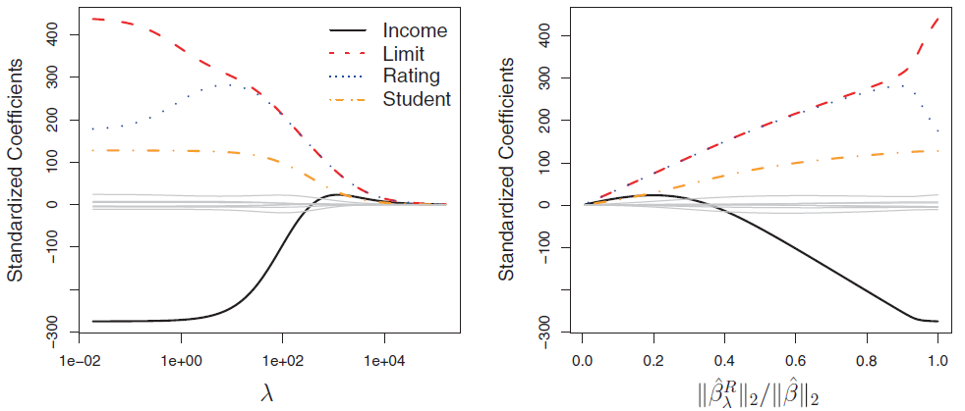
Ridge Regression: Example
In the left-hand figure above, the standardized ridge regression coefficient estimates for the Credit data set are displayed.
Each curve corresponds to the standardized ridge regression coefficient estimate for one of the ten variables, plotted as a function of λ.
At the extreme left-hand side of the plot, λ is essentially zero, and so the corresponding ridge coefficient estimates are the same as the usual least squares estimates.
But as λ increases, the ridge coefficient estimates shrink towards zero. When λ is extremely large, then all of the ridge coefficient estimates are basically zero; this corresponds to the null model that contains no predictors.

Slide 7
Ridge Regression: Example
In this plot, the income, limit, rating, and student variables are displayed in distinct colors, since these variables tend to have by far the largest coefficient estimates.
While the ridge coefficient estimates tend to decrease in aggregate as λ increases, individual coefficients, such as rating and income, may occasionally increase as λ increases.

Slide 8
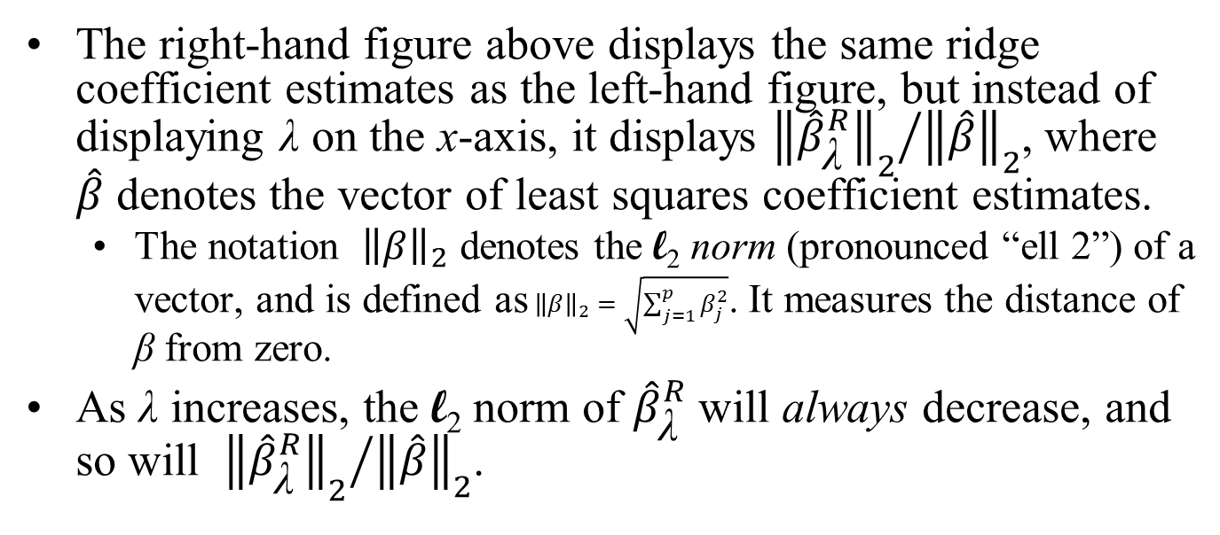
Ridge Regression: Example
The right-hand figure above displays the same ridge coefficient estimates as the left-hand figure, but instead of displaying λ on the x-axis, it displays ${{\left\|{\hat{β}}_{\text{λ}}^{R}\right\|}_{2}}/{{\left\|\hat{β}\right\|}_{2}}$, where $\hat{β}$ denotes the vector of least squares coefficient estimates.
The notation ${\left\|β\right\|}_{2}$ denotes the l₂ norm (pronounced “ell 2”) of a vector, and is defined as${\left\|β\right\|}_{2}=\sqrt{\sum_{j=1}^{p}{β_{j}^{2}}}$. It measures the distance of β from zero.
As λ increases, the l₂ norm of ${\hat{β}}_{\text{λ}}^{R}$ will always decrease, and so will ${{\left\|{\hat{β}}_{\text{λ}}^{R}\right\|}_{2}}/{{\left\|\hat{β}\right\|}_{2}}$.

Slide 9
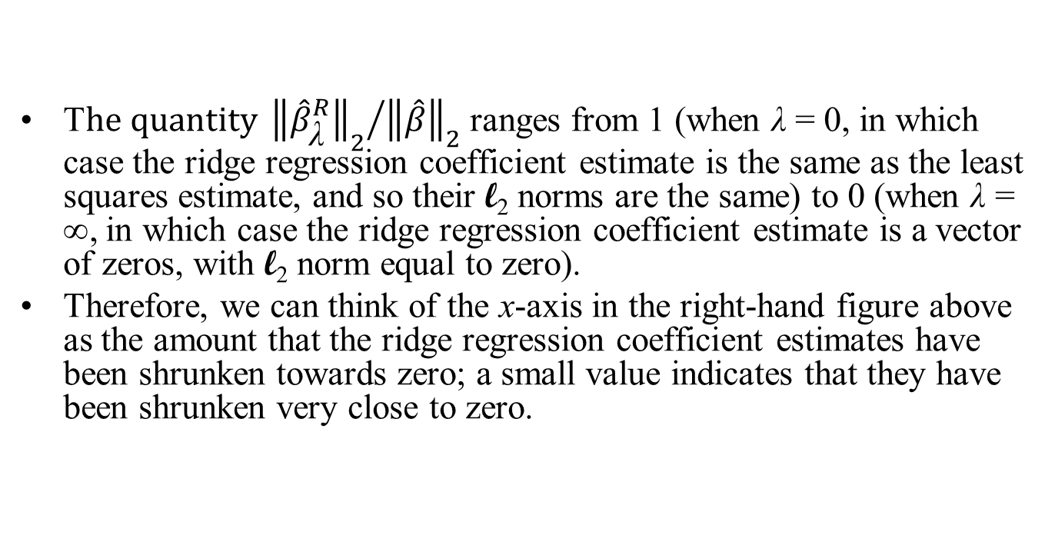
Ridge Regression: Example
T$he quantity {{\left\|{\hat{β}}_{\text{λ}}^{R}\right\|}_{2}}/{{\left\|\hat{β}\right\|}_{2}}$ ranges from 1 (when λ = 0, in which case the ridge regression coefficient estimate is the same as the least squares estimate, and so their l₂ norms are the same) to 0 (when λ = ∞, in which case the ridge regression coefficient estimate is a vector of zeros, with l₂ norm equal to zero).
Therefore, we can think of the x-axis in the right-hand figure above as the amount that the ridge regression coefficient estimates have been shrunken towards zero; a small value indicates that they have been shrunken very close to zero.

Slide 10
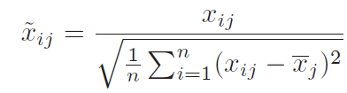
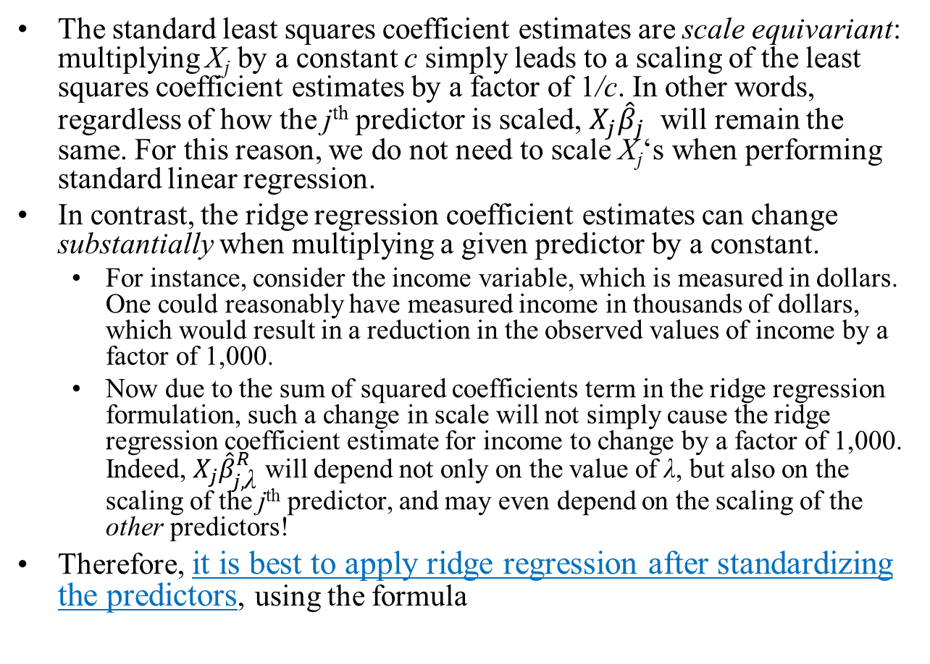
Ridge Regression: Example
The standard least squares coefficient estimates are scale equivariant: multiplying X_{j} by a constant c simply leads to a scaling of the least squares coefficient estimates by a factor of 1/c. In other words, regardless of how the j^{th} predictor is scaled, $X_{j}{\hat{β}}_{j}$ will remain the same. For this reason, we do not need to scale X_{j}‘s when performing standard linear regression.
In contrast, the ridge regression coefficient estimates can change substantially when multiplying a given predictor by a constant.
For instance, consider the income variable, which is measured in dollars. One could reasonably have measured income in thousands of dollars, which would result in a reduction in the observed values of income by a factor of 1,000.
Now due to the sum of squared coefficients term in the ridge regression formulation, such a change in scale will not simply cause the ridge regression coefficient estimate for income to change by a factor of 1,000. Indeed, $X_{j}{\hat{β}}_{j,\text{λ}}^{R}$ will depend not only on the value of λ, but also on the scaling of the j^{th} predictor, and may even depend on the scaling of the other predictors!
Therefore, it is best to apply ridge regression after standardizing the predictors, using the formula

Slide 11
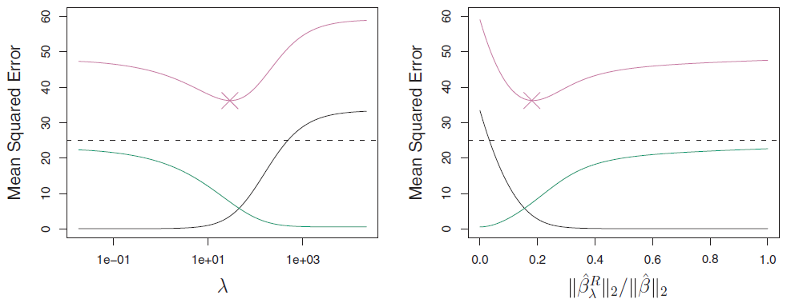
Why Does Ridge Regression Improve Over Least Squares?
Ridge regression’s advantage over least squares is rooted in the bias-variance trade-off. As λ increases, the flexibility of the ridge regression fit decreases, leading to decreased variance (plotted in green, as a function of λ) but increased bias (plotted in black).
This is illustrated in the left-hand panel of the figure above using a simulated data set containing p = 45 predictors and n = 50 observations.
At the least squares coefficient estimates, which correspond to ridge regression with λ = 0, the variance is high but there is low bias.
But as λ increases, the shrinkage of the ridge coefficient estimates leads to a substantial reduction in the variance of the predictions, at the expense of a slight increase in bias.
Recall that the test mean squared error (MSE), plotted in purple, is a function of the variance plus the squared bias.
For values of λ up to about 10, the variance decreases rapidly, with very little increase in bias. Consequently, the MSE drops considerably as λ increases from 0 to 10.
Beyond this point, the decrease in variance due to increasing λ slows, and the shrinkage on the coefficients causes them to be significantly underestimated, resulting in a large increase in the bias. The minimum MSE is achieved at approximately λ = 30.

Slide 12
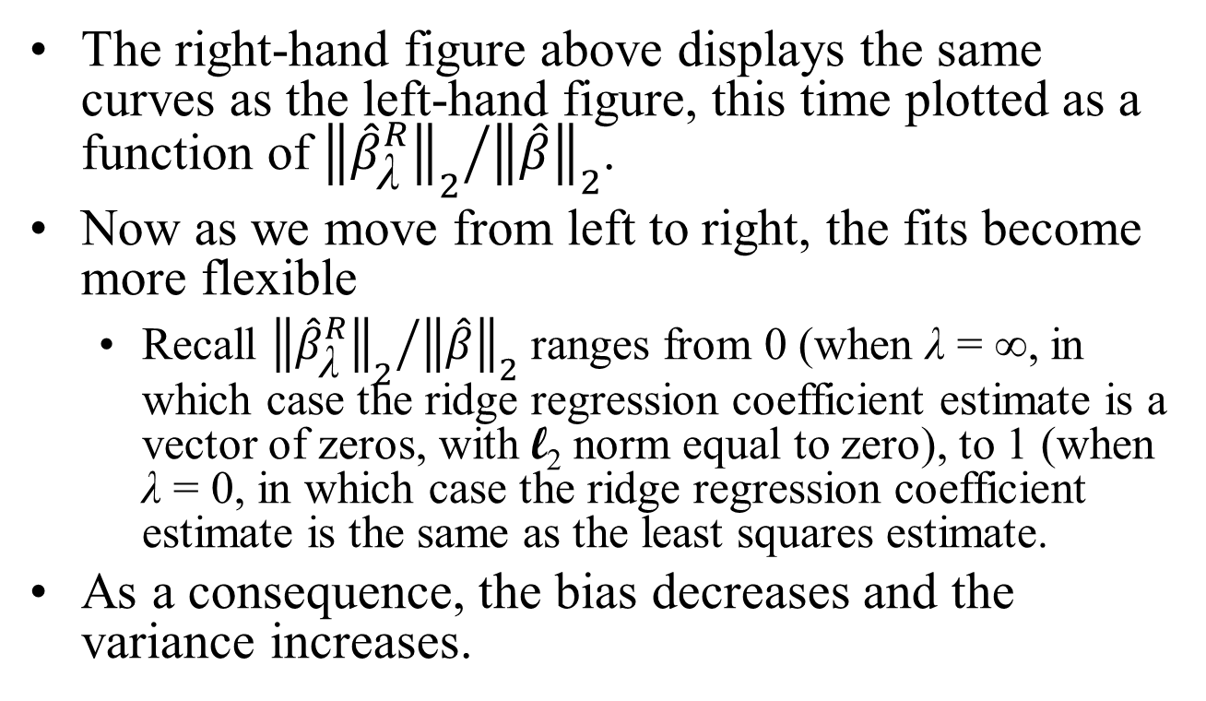
Why Does Ridge Regression Improve Over Least Squares?
The right-hand figure above displays the same curves as the left-hand figure, this time plotted as a function of ${{\left\|{\hat{β}}_{\text{λ}}^{R}\right\|}_{2}}/{{\left\|\hat{β}\right\|}_{2}}$.
Now as we move from left to right, the fits become more flexible
Recall ${{\left\|{\hat{β}}_{\text{λ}}^{R}\right\|}_{2}}/{{\left\|\hat{β}\right\|}_{2}}$ ranges from 0 (when λ = ∞, in which case the ridge regression coefficient estimate is a vector of zeros, with l₂ norm equal to zero), to 1 (when λ = 0, in which case the ridge regression coefficient estimate is the same as the least squares estimate.
As a consequence, the bias decreases and the variance increases.

Slide 13
Ridge Regression
In general, in situations where the relationship between the response and the predictors is close to linear, the least squares estimates will have low bias but may have high variance.
This means that a small change in the training data can cause a large change in the least squares coefficient estimates.
In particular, when the number of variables p is almost as large as the number of observations n, as in the example above (n = 50, p = 45), the least squares estimates will be extremely variable.
And if p > n, then the least squares estimates do not even have a unique solution, whereas ridge regression can still perform well by trading off a small increase in bias for a large decrease in variance.
Hence, ridge regression works best in situations where the least squares estimates have high variance.

Slide 14
Ridge Regression
Ridge regression also has substantial computational advantages over best subset selection, which requires searching through 2^{p} models.
As we discussed previously, even for moderate values of p, such a search can be computationally infeasible.
In contrast, for any fixed value of λ, ridge regression only fits a single model, and the model-fitting procedure can be performed quite quickly.
In fact, one can show that the computations required to solve the ridge regression formula, simultaneously for all values of λ, are almost identical to those for fitting a model using least squares.
A final point: ridge regression never eliminates predictors entirely, and is therefore not a subset selection method. The process of shrinking the coefficient estimates is instead called Regularization.

