Slide 1
Fantasy Football Analytics Using R and Python
Author: Mike Zhong
Course: Foundations of Analytics, Professor Suresh Kalathur

Slide 2
Motivation
To put together an analytical work-flow using R and Python from data collection, cleaning, and augmentation, through various analyses
To become more familiar manipulating data using R
To practice concepts learned in CS544 and apply them to real-world data
To gain insights into a very popular and relevant real-world game that is enjoyed by millions
With a widespread gain in popularity, daily fantasy football has become recognized in some states as a form of gambling, however, there is plenty of room to apply analytical techniques for individual profit

Slide 3

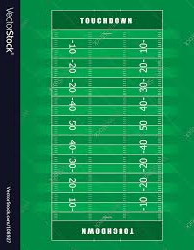
What is (American) Football?
American football is roughly based on rugby and is a game played by two teams, where each team fields a roster of players.
At any given time, each team will have 11 players on the field; one team will be on offense and the other team on defense.
Teams either run or pass the ball down the field in an attempt to get the ball into the ‘endzone’. If a player has possession of the ball in the ‘endzone’, they score a touchdown (TD) which is worth 6 points.
Each player typically has a specific role and plays a specific position.

Slide 4

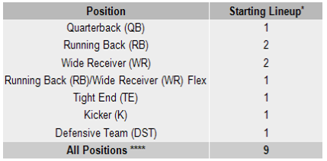
What is Fantasy Football?
Fantasy football is virtual game played on a weekly basis, whose outcomes depend on the events of real football games (also played on a weekly basis).
Fantasy leagues (collection of fantasy players) host a draft, where fantasy players draft real football players onto their roster. Players who are not drafted remain in a free agent pool and can be picked up later. However, there are usual a fixed number of spots on each roster and each ‘starting lineup’ must have a certain number of players of each position.
Players earn points for yards, receptions, and touchdowns, each week, two fantasy players will face off and the team with more points wins that week.
Scoring Schema:
Passing Yards: 1 point per 25 yards.
Passing Touchdowns: 6 points.
Passing Interceptions: -2 points.
Rushing Yards: 1 point per 10 yards.
Rushing Touchdowns: 6 points.
Receptions: 1 points (only if using PPR scoring)
Receiving Yards: 1 point per 10 yards.
Receiving Touchdowns: 6 points.

Slide 5
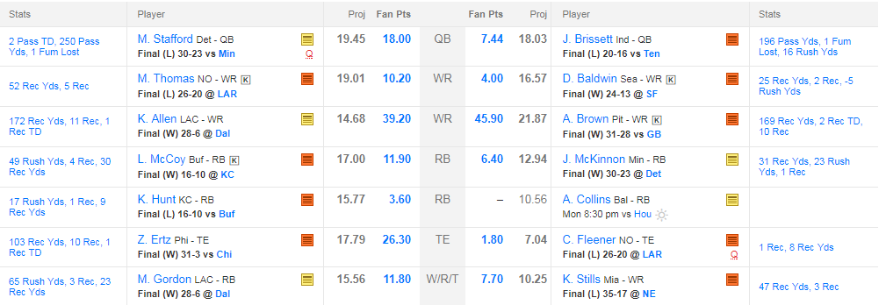
Example Matchup
In the scenario above, all the players on the left have already played but one player on the right has yet to play. Only when all players have finished (Monday night) are the final scores assessed and a winner declared

Slide 6
Data Sources
The internet is a rich source of fantasy football data, but most of the data is provided in the form of HTML tables mixed in with some javascript to provide users with a nice interface to view player stats and filter based on position, week, year, etc…
The following websites were scraped and all data used in this project originated from these sources:
Scraped for player positions: https://www.pro-football-reference.com/years/2016/fantasy.htm
Scraped for weekly scoring data: http://www.footballdb.com/fantasy-football/index.html

Slide 7
Data Scraping
Used Python’s Requests module to retrieve html pages containing the tables, then used the BeautifulSoup module to parse the tables into Data Frames.
The data had to be cleaned and formatted, columns were added to provide additional information used in downstream analysis.
Using query strings, I looped over all 16 weeks of the 2016 NFL season and produced 16 data frames corresponding to fantasy outputs of the top 100 players each week.
The 16 data frames were augmented with an additional column indicating the week, these data frames were then stacked vertically to produce a large data frame containing fantasy results for all 16 weeks.
This data frame lacked player position information, so a separate table containing just player names and positions was made. This table was then left-joined with the existing data frame using the player name as key. The resulting data frame was tested for missing entries and any missing entries were filled in.

Slide 8
Snapshot of Our Final Data Frame
Player | Team | Opponent | Location | Pts* | Att | Cmp | Yds | TD | Int | 2Pt | Rush Att | Rush Yds | Rush TD | Rush 2Pt | Rec | Rec Yds | Rec TD | Rec 2Pt | FL | Misc TD | Week | Position
Andrew Luck | IND | @DET | away | 43 | 47 | 31 | 385 | 4 | 0 | 1 | 3 | 21 | 0 | 0 | 0 | 0 | 0 | 0 | 0 | 0 | 1 | QB
Drew Brees | NO | @OAK | away | 39 | 42 | 28 | 423 | 4 | 0 | 0 | 2 | 5 | 0 | 0 | 0 | 0 | 0 | 0 | 1 | 0 | 1 | QB
AJ Green | CIN | NYJ | home | 36 | 0 | 0 | 0 | 0 | 0 | 0 | 0 | 0 | 0 | 0 | 12 | 180 | 1 | 0 | 0 | 0 | 1 | WR
DeAngelo Williams | PIT | WAS | home | 34 | 0 | 0 | 0 | 0 | 0 | 0 | 26 | 143 | 2 | 0 | 6 | 28 | 0 | 0 | 0 | 0 | 1 | RB
Jameis Winston | TB | ATL | home | 33 | 32 | 23 | 281 | 4 | 1 | 0 | 4 | 3 | 0 | 0 | 0 | 0 | 0 | 0 | 0 | 0 | 1 | QB
Brandin Cooks | NO | @OAK | away | 33 | 0 | 0 | 0 | 0 | 0 | 0 | 1 | 11 | 0 | 0 | 6 | 143 | 2 | 0 | 0 | 0 | 1 | WR
Spencer Ware | KC | @SD | away | 32 | 0 | 0 | 0 | 0 | 0 | 0 | 11 | 70 | 1 | 0 | 7 | 129 | 0 | 0 | 0 | 0 | 1 | RB
Willie Snead | NO | @OAK | away | 32 | 0 | 0 | 0 | 0 | 0 | 0 | 0 | 0 | 0 | 0 | 9 | 172 | 1 | 0 | 0 | 0 | 1 | WR
Antonio Brown | PIT | WAS | home | 32 | 0 | 0 | 0 | 0 | 0 | 0 | 0 | 0 | 0 | 0 | 8 | 126 | 2 | 0 | 0 | 0 | 1 | WR

Slide 9
Required Downstream Analysis
OOP approach.

Slide 10
Required Downstream Analysis (cont’d.)
Start Game:
Initialize()
Create all models (players, edges, vertices, tiles)
Assign edges/vertices to tiles (many-to-many)
Create adjacency matrix
Assign starting locations and resources
Save()
Start_turn()
Roll dice
Distribute resources
Player build options
End turn
Save()

Slide 11
Required Downstream Analysis (cont’d)

Slide 12
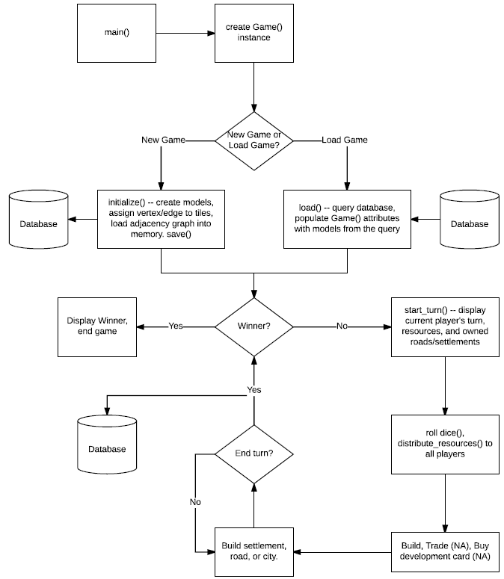
Game Flow Diagram

Slide 13
DEMO
This demo is purely a demonstration of the backend and game API, it is meant to simulate a game and update the database accordingly. It is possible to load a saved game but that will not be part of the simulation
No frontend was built
Time permitting, a small demonstration of Django’s database API will illustrate the changes to the database
Want to contribute? https://github.com/myz540/thezhongfamily
git clone https://github.com/myz540/thezhongfamily.git

