Slide 1
Nov 16th, 2024
Tutoring with
Mr. Rexx

Slide 2
生词表
planet 行星 temperature 温度 plant 植物 support 支持
surface 表面 cover 表面，覆盖 desert 沙漠, 甜品
spin 旋转, 自转 travel 旅行 atmosphere 大气层
ray 光线 exist 存在 breathe 呼吸

Slide 3
Earth is the __ planet from the Sun in the solar system.
2nd
5th
3rd
How long does it take for Earth to go around the Sun?
a week / a day / a year
What makes Earth support life ? Water, the land, and the __
Sun / air / mountain

Slide 4
Earth is our amazing home in space! It’s the 3rd planet from the Sun, and it’s just the right temperature for plants, animals, and people to live on. Earth has land, water, and air, which all work together to support life. About 70 percent of Earth’s surface is covered in water--oceans, lakes, and rivers--while the rest is land with forests, mountains, deserts, and more.
Earth spins like a top, which gives us day and night, and it takes a whole year for Earth to travel around the Sun. Earth also has a layer called the atmosphere that keeps us safe from the Sun’s strongest rays and helps us breathe.
Because of the water, the land, and the air, Earth is the only known planet where life exists. It’s our job to take care of our beautiful planet to keep it healthy for all living things!

Slide 5
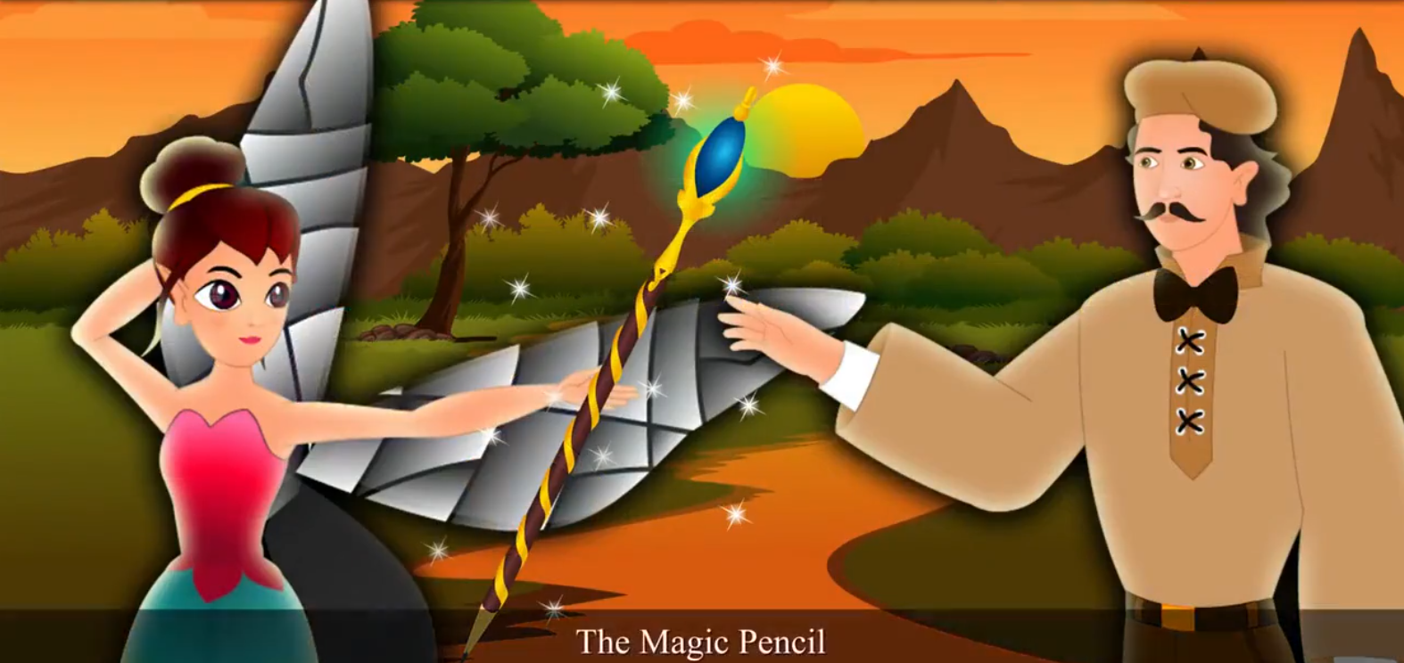
Movie Time
Watch a movie and tell me about your thoughts

Slide 6
Questions for The Movie
What is the reason that the pixie wants to help Albert?
Do you think it’s right for Alber to get the pencil?
Why Albert decided to give up the pencil?

Slide 7
Please move the chair, it is _____ the way.
A. on
B. in
C. among
D. upon
I don’t have any gift for my friend. What if _____ else brings a present?
A. anybody
B. nobody
C. everyone
D. none

Slide 8
I found a way of to prevent him from ___ me.
A. follow
B. followed
C. follows
D. following
Either you or she __ wrong. Either she or you __ wrong.
A. are
B. be
C. is
D. am

Slide 9
Smith went ___ the forest. Mary went __ the street.
A. across
B. out
C. through
D. cross
I don’t like milk, but mom make me __ it.
A. to drink
B. drunk
C. drinks
D. drink

Slide 10
被动语态
突出动作或结果，而非执行者 The meal was cooked.
避免明确提及责任人 A mistake was made.
强调客观性和正式感 The test was conducted in perfect environment.
处理未知或不重要的主体 The book was published in 1995.
使句子结构多样化

Slide 11
将句子改为被动语态：
The teacher explains the rules clearly.
答案：_____________________________________
将句子改为主动语态：
The homework was finished by Tom yesterday.
答案：_____________________________________
改写句子保持被动语态：
We are planting trees in the park.
答案：_____________________________________

Slide 12
填 空
The book ________ (write) by J.K. Rowling in 1997.
A new school ________ (build) in our town last year.
This letter ________ (not send) yet.
判断以下句子是否是正确的被动语态，并说明理由：
The car was repair yesterday.
Dinner is being prepared by my mom.
The check has been picked up.

Slide 13
被动语态
被动语态与普通系表结构的区别
The shop is closed at 6PM in the afternoon.
The shop is closed today.
主动语态表示被动含义
Moon cakes taste delicious.
This book is worth reading.

Slide 14
The number of boys in our class ___ twenty-nine.
A. are
B. am
C. be
D. is
A number of ___ from our class ___ English.
girls / girl
likes / liked / like / liking

Slide 15
The sports ___ take place in our school.
A. game
B. event
C. meeting
D. activity
The ring is made ___ gold.
A. with
B. of
C. from
D. up

Slide 16
I expect he will ____ walk again soon.
A. can
B. do
C. be able to
D. able to
Ken: What’s up?!
You: ____?
A. What’s up?
B. What?
C. Not much.
D. Why?

Slide 17
One Thing in the Past Week
What are the challenges you are facing while learning English
Can you tell which challenges you can overcome by yourself?
If yes, how would you overcome these challenges?

Slide 18
Any Question ?

