Slide 1
UNIVERSITY OF MANCHESTER
Performance Analysis & Russell Group Comparison

Slide 2
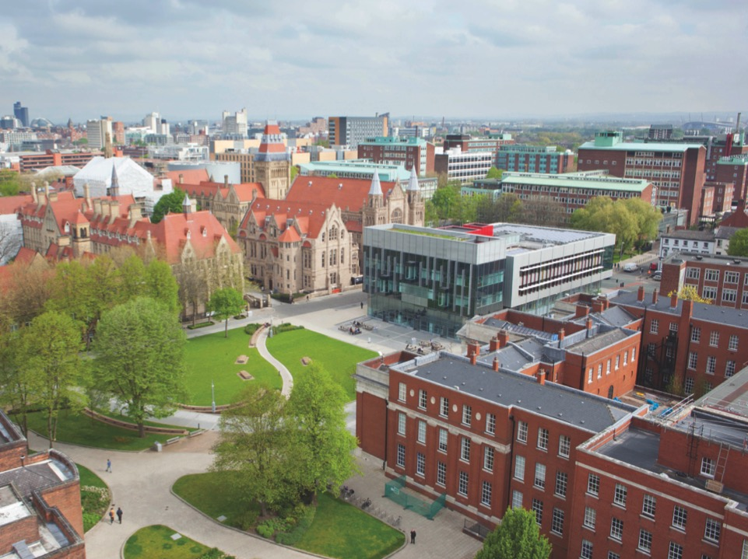


Outline
Basic Metrics for University of Manchester, including resource efficiency, student composition, and income source analysis
Russell Group Comparison metrics showing UoM's position within the group
Key Insights summarising the most significant findings

Slide 3
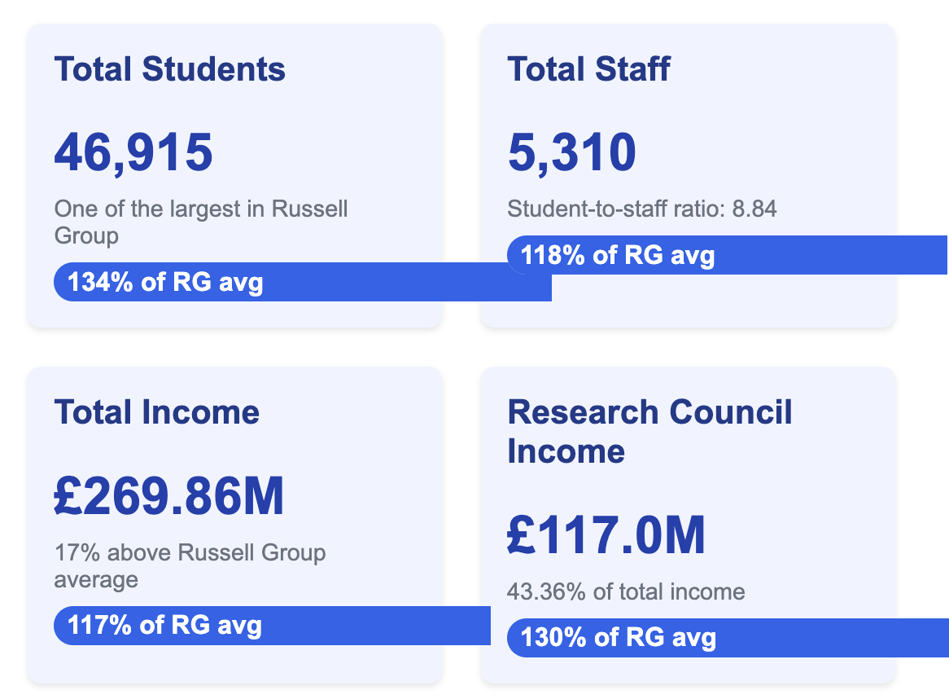
UoM: Key Figures
Key Takeaway: UoM exceeds Russell Group averages in size, staffing, and income, showing particular strength in research funding.

Slide 4
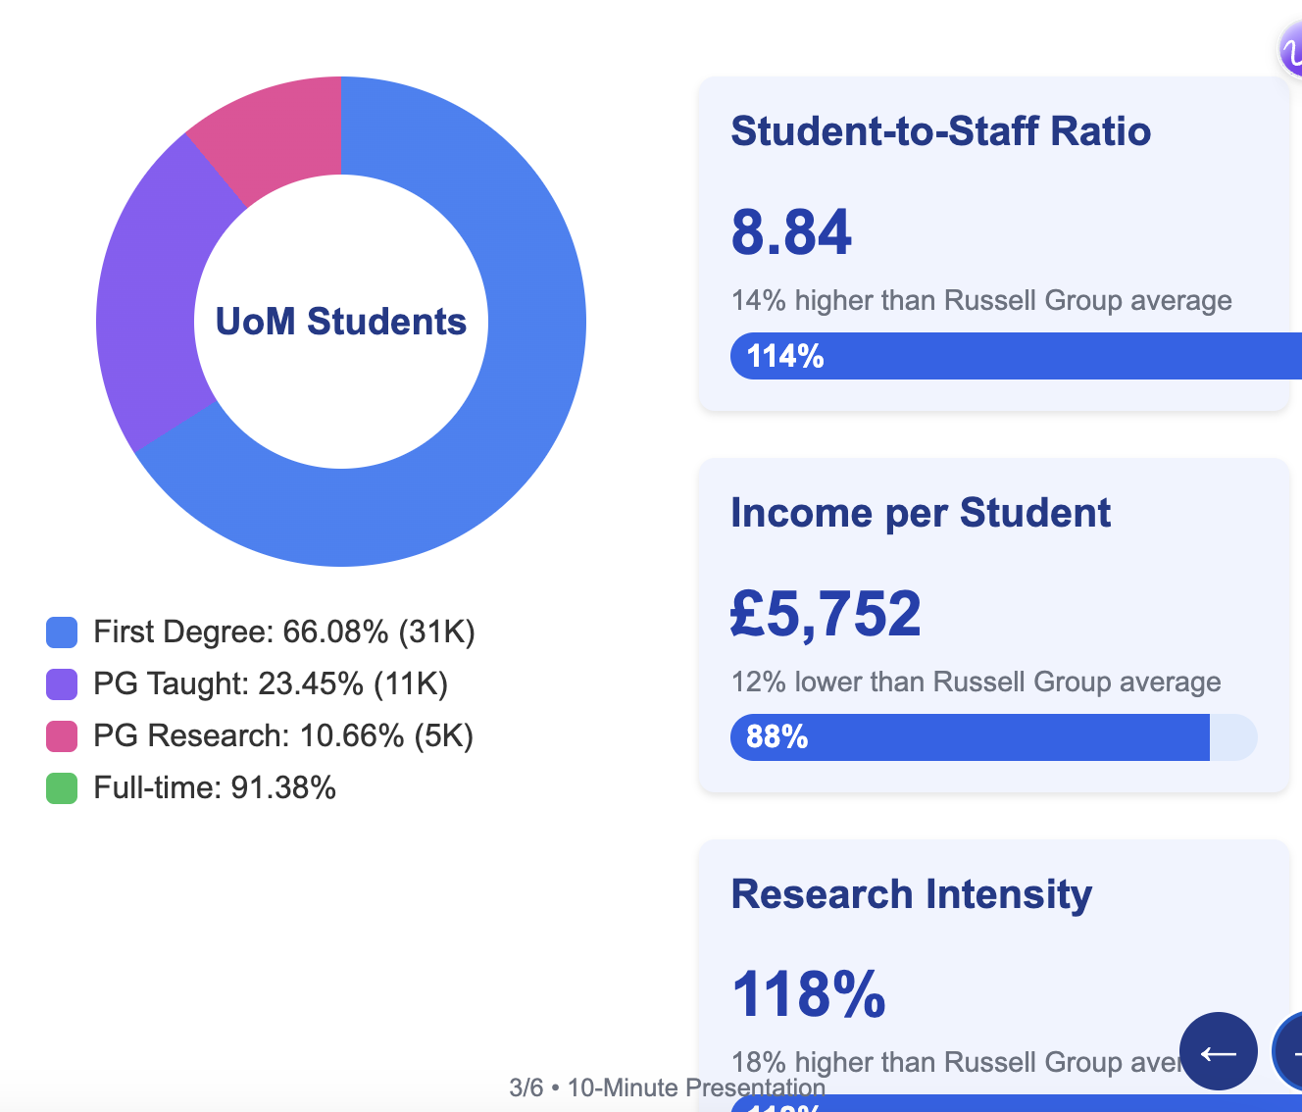
Student Composition & Resource Efficiency Metrics

Slide 5
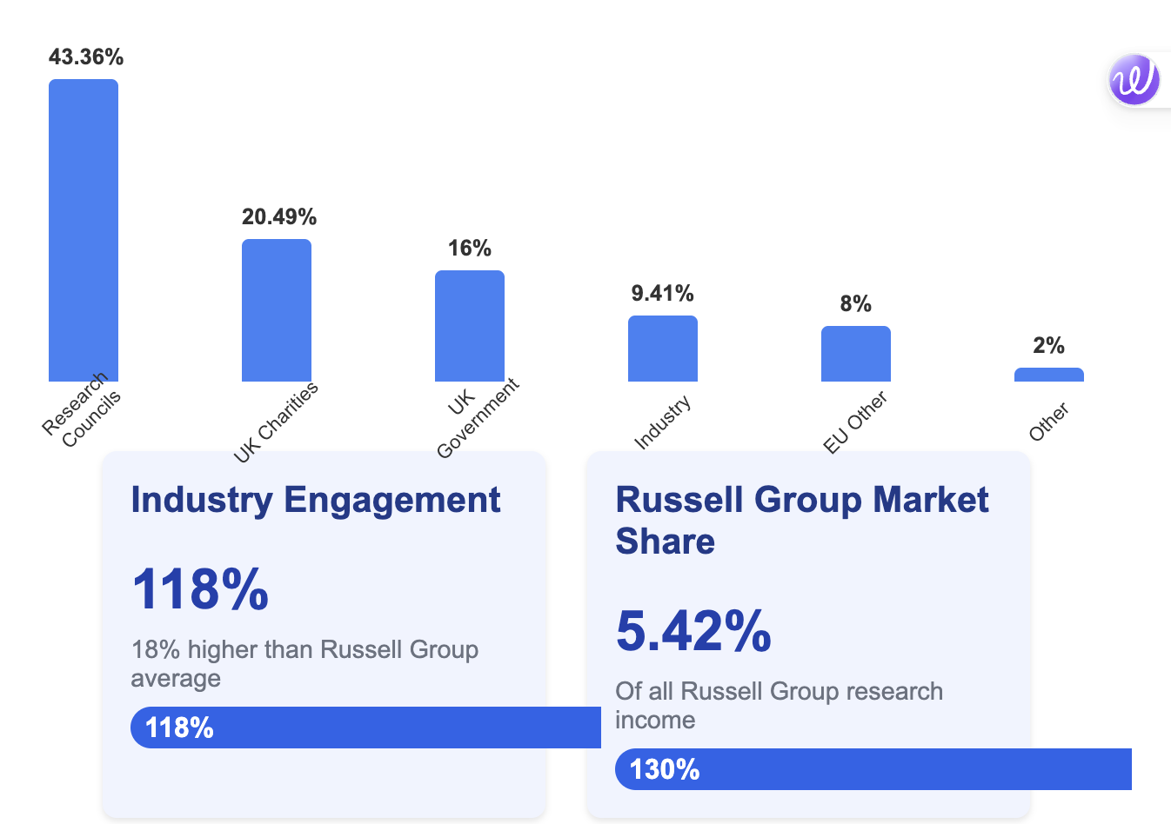
Income Source Analysis
Key Takeaway: UoM shows balanced income diversification with exceptional research funding, strong charity support, and above-average industry engagement. The university secures 5.42% of all Russell Group research income.

Slide 6
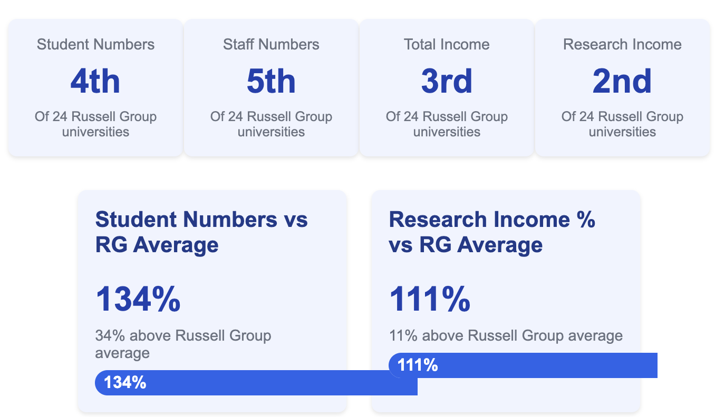
Russell Group Position
Key Takeaway: UoM holds exceptional rankings within the Russell Group, particularly in research income (2nd) and total income (3rd). The university significantly exceeds Russell Group averages in student numbers and research income percentage.

Slide 7
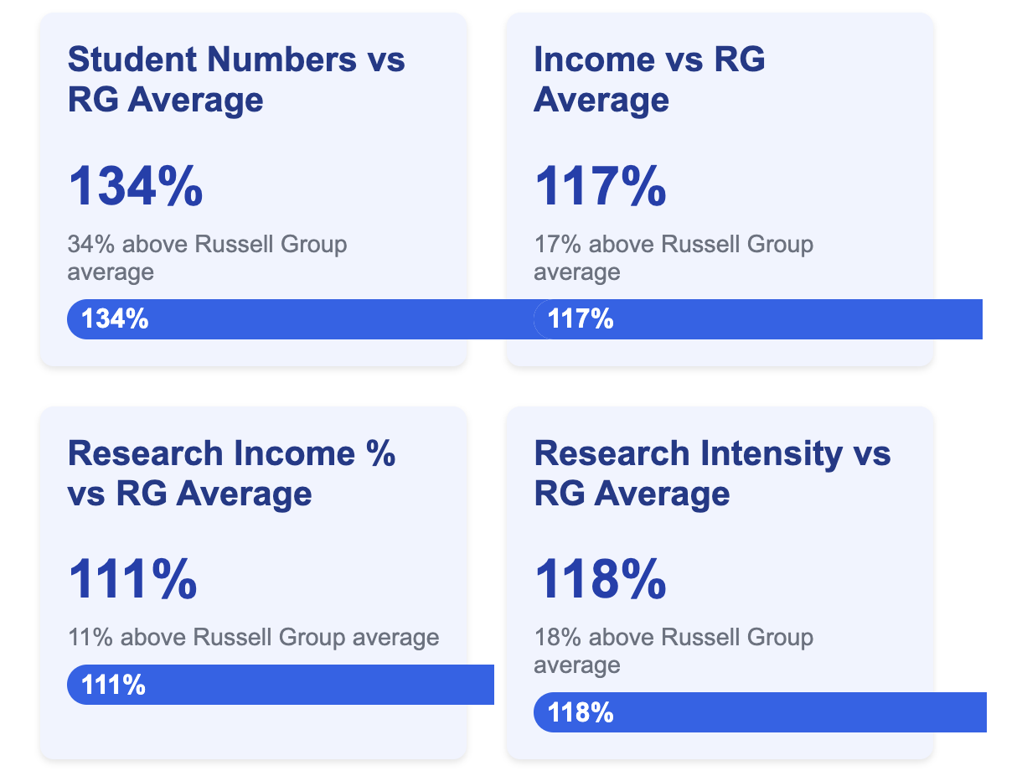
Russell Group Comparison Ratios

Slide 8
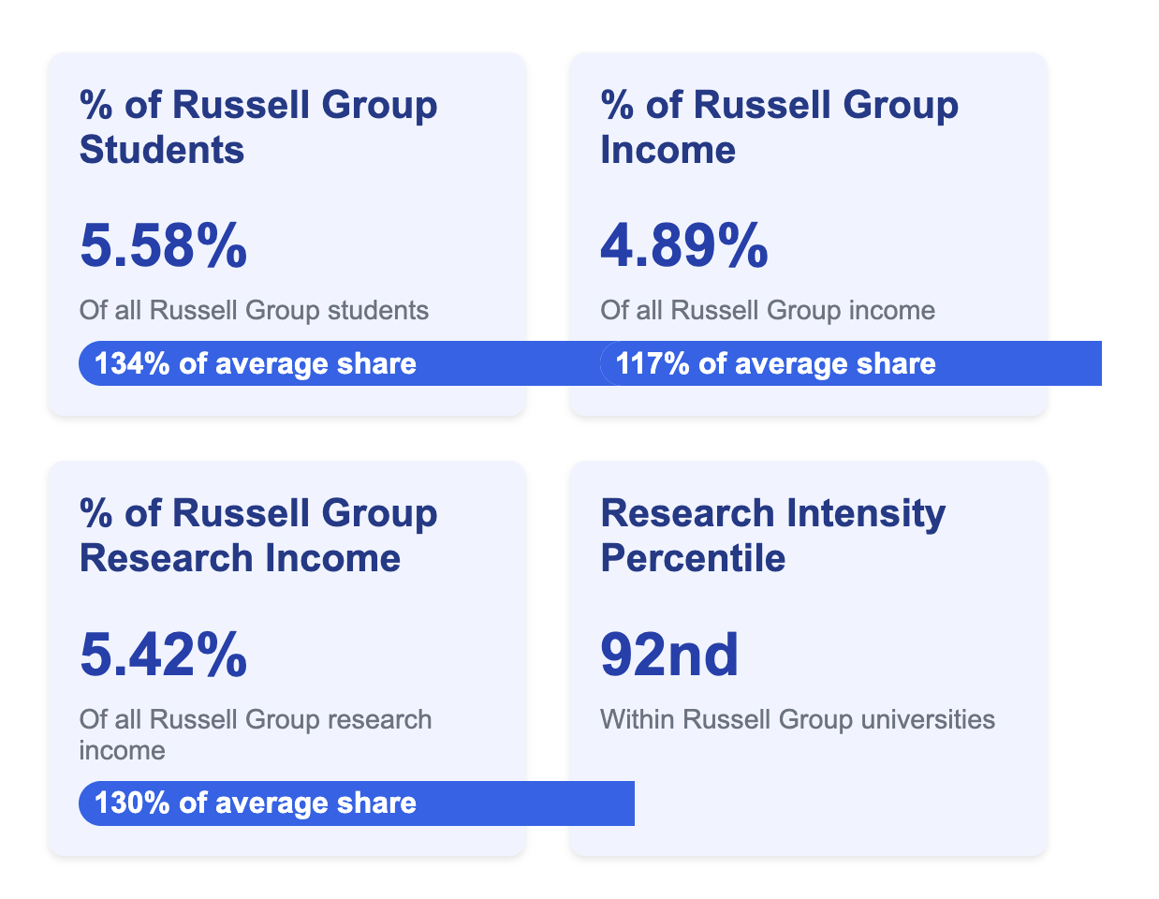
Russell Group Market Share

Slide 9
Key Insights
The University of Manchester demonstrates strong research intensity, with research income comprising 43.36% of total income, significantly above the Russell Group average.
UoM has a higher-than-average student-to-staff ratio (8.84 vs 7.78 Russell Group average), indicating potential efficiency in teaching delivery but possibly higher workloads for staff.
The university shows balanced income diversification with solid funding from Research Councils (43.36%), UK-based charities (20.49%), and industry engagement (9.41%).
UoM has a larger postgraduate research community (10.66% of students) than the Russell Group average (9%), reinforcing its research-intensive profile.
Despite being above average in size and total income, UoM's income per student is 12% below the Russell Group average, suggesting potential opportunities for revenue enhancement strategies.
The university captures approximately 5.5% of Russell Group students and 5.4% of Russell Group research income, demonstrating its significant position within the elite university group.

Slide 10
Overall Comments
The analysis reveals that the University of Manchester demonstrates strong research intensity with above-average research income, has a higher student-to-staff ratio than the Russell Group average, and maintains a well-diversified income portfolio.

