Slide 1
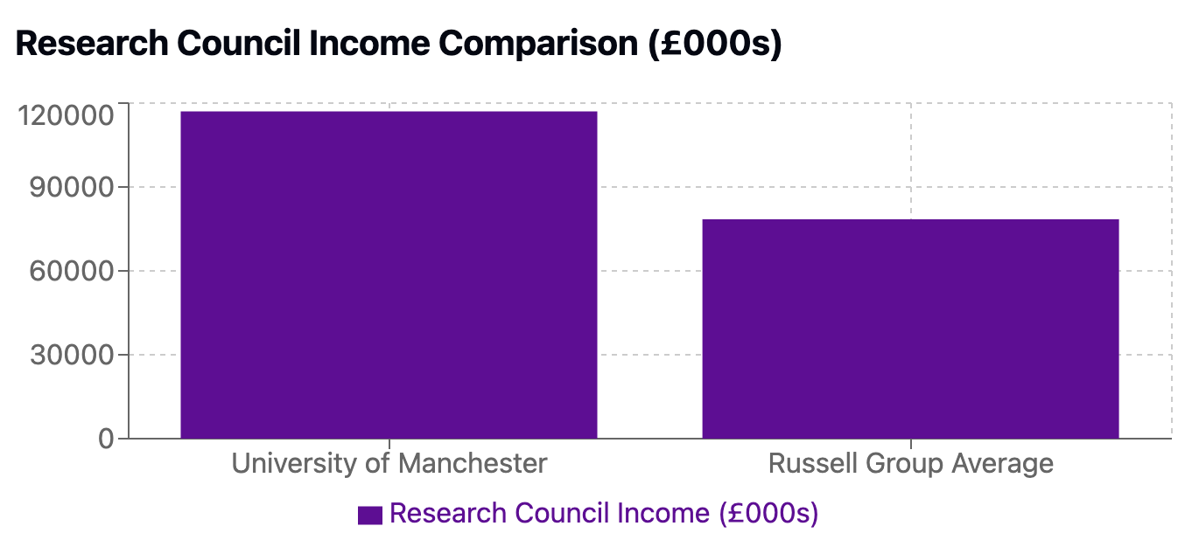
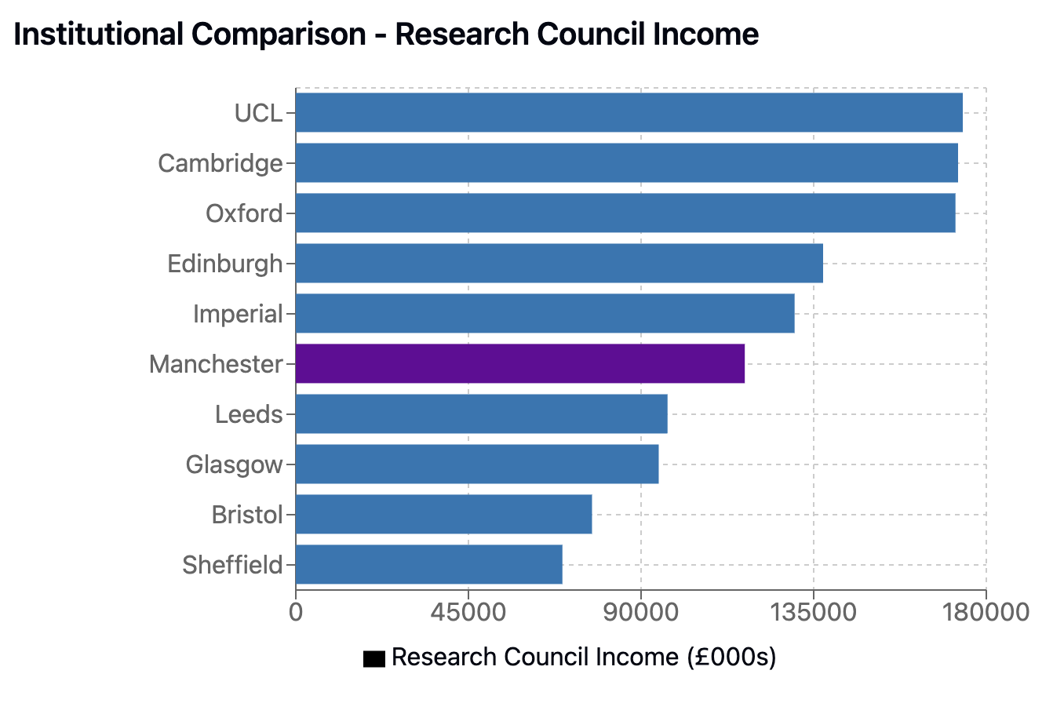
Research Income

Slide 2
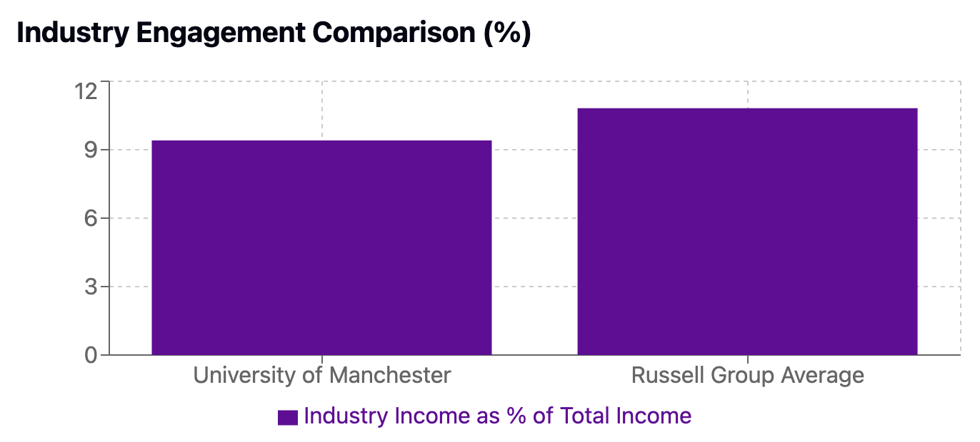
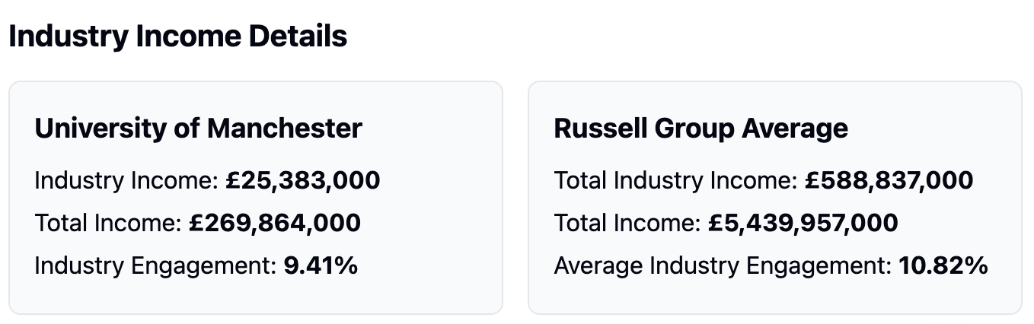
Industry Engagement Academic Year: 2023/24 | UKPRN: 10007798

Slide 3
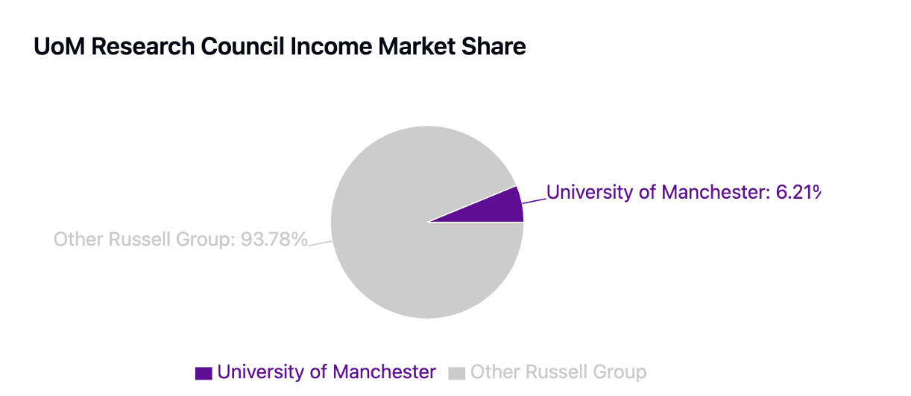
Market Share of UoM in RG
UoM’s Research Council Income (RCI): £117.0M
Total Russell Group RCI: £1,883.1M
UoM’s Market Share: 6.22% of total Russell Group RCI
UoM ranks 6th among 24 Russell Group

Slide 4
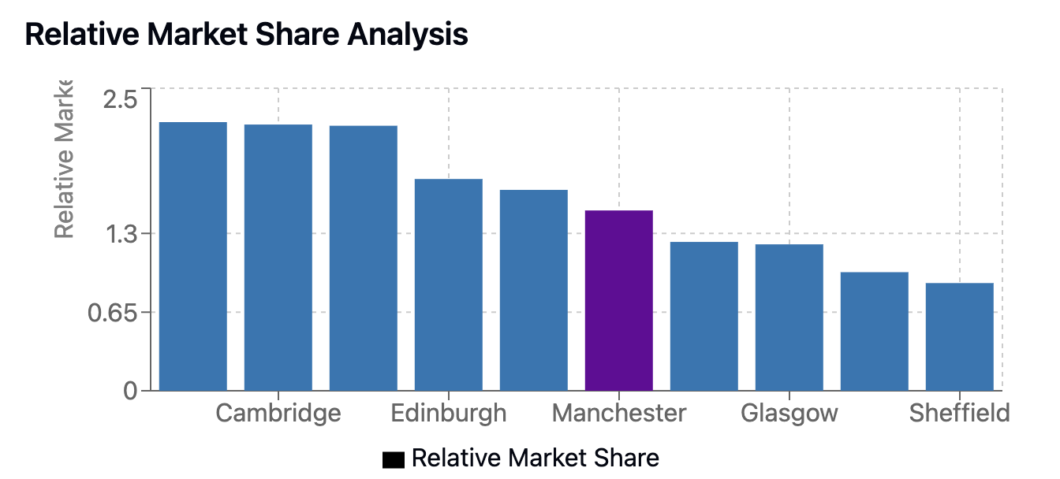
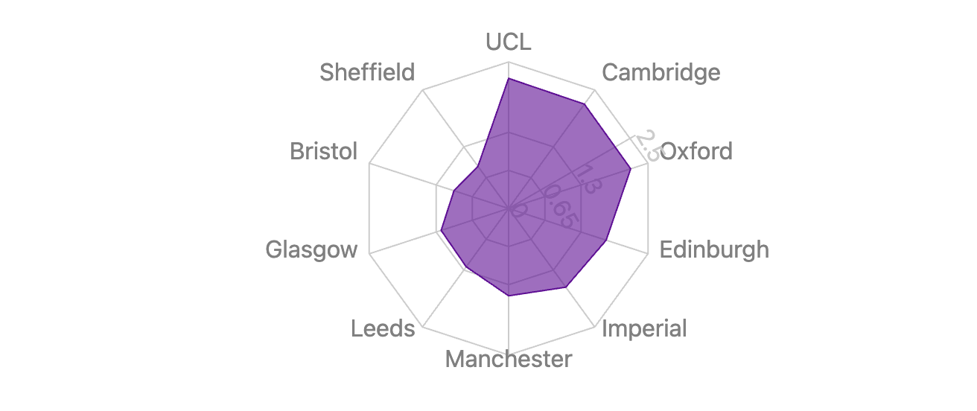
Relative Market Share in RG
Relative Market Share compares an institution's actual market share to what it would receive if funding were evenly distributed among all Russell Group institutions (1/24 ≈ 4.17%).

Slide 5
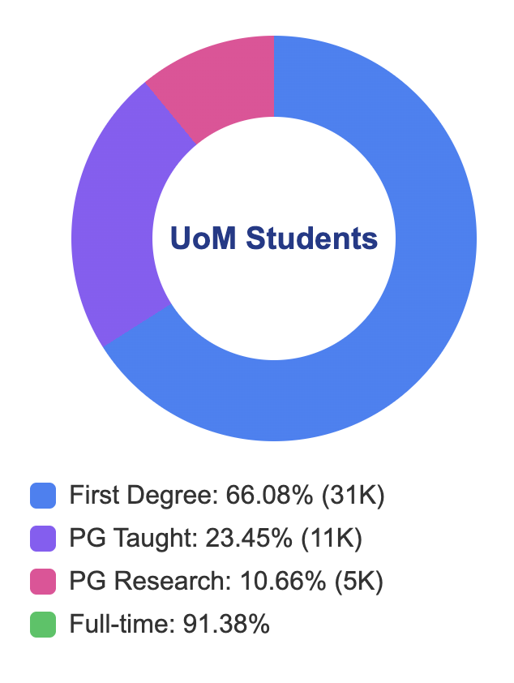
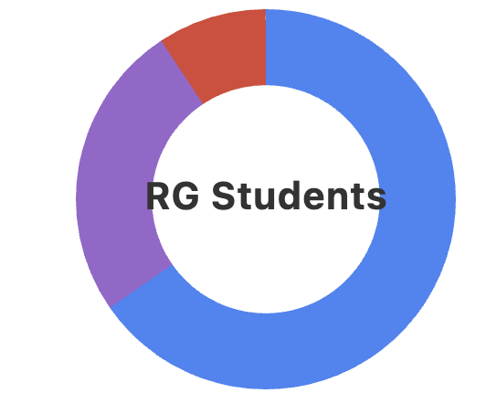
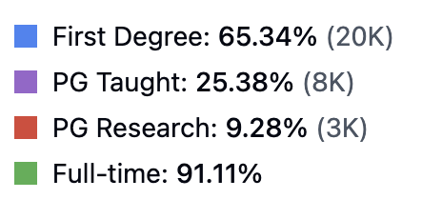
Student Composition Academic Year: 2023/24 | UKPRN: 10007798

