Slide 1

Bellabeat casestudy

Slide 2
Business Objective
Understand User Behavior and Preferences
Inform Product Development and Personalization
Design a Data-Driven Marketing Strategy
The objective of this case study is to analyze existing trends in the use of non-Bellabeat smart devices—such as fitness trackers and health-monitoring wearables—in order to gain insights into consumer behaviors and preferences
These insights will then be applied to one of Bellabeat’s products to explore how the company can leverage these trends to better serve its customers
The final goal is to use the identified trends to propose a data-driven marketing strategy or promotional campaign that aligns with the habits and needs of Bellabeat’s target audience

Slide 3
Executive Summary
Our analysis of user behavior, based on data from non-Bellabeat fitness and health tracking devices, revealed several key patterns:
Users demonstrate a clear preference for automatic tracking over manual data logging.
Physical activity is highest during weekdays, particularly on Tuesdays and Wednesdays.
Calorie burn and activity intensity tend to peak during the early evening hours.
Sleep duration shows a moderate correlation with both physical activity and calories burned.
Only a small percentage of users manually log their weight, favoring automatic measurements.
These findings contribute directly to product development and support the creation of marketing strategies that align with users' actual habits and behavioral patterns

Slide 4
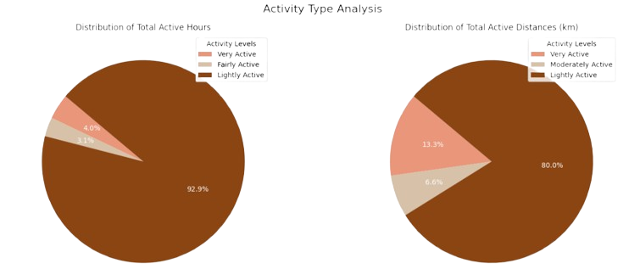
Distribution of Activity by Intensity

Slide 5
Marketing Implication of User Activity Preferences
Insight
Analysis reveals that users spend over 90% of their active minutes and 80% of their distance in light-intensity activities, such as walking. This indicates a strong preference for low-effort, accessible physical activity
Recommendation
Bellabeat should focus its marketing strategy on users who prefer low-effort, consistent activity—which represents the majority of the current user behavior pattern. This includes designing walking-based challenges, promoting light activity streaks, and delivering encouragement messages around small, daily wins

Slide 6
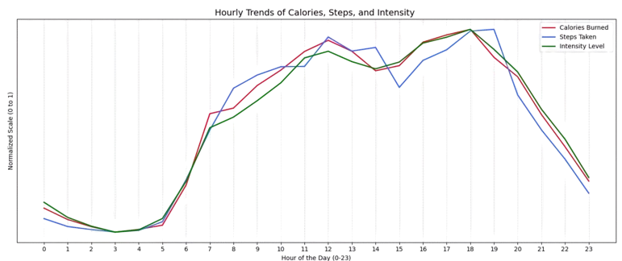
Peak Activity Time
Line chart displaying average steps, calories burned, and intensity by hour of the day

Slide 7
Marketing Implication of User Activity PEAK TIME
Insight: Users show the highest levels of activity between 5:00 PM and 7:00 PM
Strategic Recommendation: Bellabeat should capitalize on users’ natural peak in activity by launching targeted marketing campaigns, in-app challenges, and physical presence activations during this specific time window.
Examples include:
“Evening Move” Campaign: Push notifications or app banners promoting short fitness challenges at 5:00 PM—such as "Take a 15-minute walk now and earn a badge!"
On-Site Promotions: Collaborate with gyms, yoga studios, or outdoor sports parks to display Bellabeat ads or distribute samples during peak hours.
Social Media Engagement: Schedule live workouts, Instagram stories, or fitness polls around this evening slot to align with user availability.
Habit Reinforcement: Use automated reminders around 4:45 PM to prompt users before their active window begins—helping form a long-term habit

Slide 8
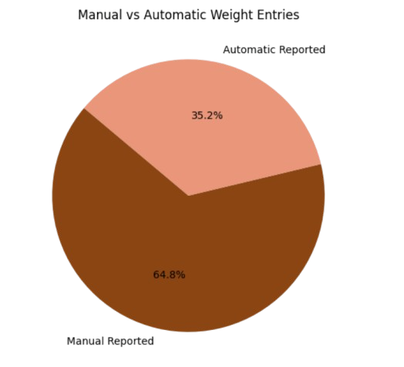
Peak Activity Time
Insight: A large portion of users (64.8%) still log their weight manually, indicating that automatic syncing is not yet widely adopted. This suggests potential barriers such as limited device compatibility, lack of awareness, or user preference for manual input.
Recommendations :
Enhance Auto-Syncing Functionality
Improve compatibility with smart scales & health platforms
e.g., Apple Health, Google Fit, Withings
Benefit: Easier tracking → increased ecosystem adoption
Educate Users on Auto-Tracking Benefits
Launch a targeted campaign to show how auto-syncing saves time, reduces errors, and provides continuous tracking

Slide 9
How Peak Burn Hours Can Drive Campaign Timing
Insight
On weekdays (Monday–Friday), calorie burn peaks between 12 PM and 6 PM, with the highest intensity around 3 PM–5 PM.
Weekends show lower overall calorie burn, with modest morning spikes (8 AM–10 AM) and minimal evening activity.
There is a clear distinction between structured, routine activity on workdays and sporadic movement on weekends.
Recommendation
Schedule in‑app challenges and promotional messages during weekday afternoons (3 PM–5 PM) to capitalize on peak engagement.
Partner with fitness venues (gyms, parks, studios) for pop‑up events or branded activities in the afternoon time slot.
Send gentle weekend nudges (e.g. “Take a 10‑minute morning walk”) between 8 AM and 10 AM to boost off‑peak engagement.

Slide 10
User Body Metrics: Strategic Marketing Insights
Insight
Average weight is 71.06 kg and average BMI is 24.81, placing most users in the upper‑normal to slightly overweight category.
This demographic is likely motivated by weight management, body composition tracking, and general wellness maintenance.
Recommendation
Segment marketing campaigns around weight goals (for example “Effortless weight tracking” and “Stay on track with your BMI”).
Highlight product features such as smart scale integration, BMI trend charts, and personalized coaching tips.
Create targeted content (email series, in‑app tips) that speaks directly to users in the upper‑normal or overweight range, offering step‑by‑step guidance.

Slide 11
Executive Summary
This case study explored user behavior based on data from non-Bellabeat smart devices.
Key patterns were found in activity, sleep, and weight tracking — especially around automated behavior, peak activity hours, and midweek engagement.
These findings offer clear opportunities to:
Improve product design (focus on passive tracking & light activity)
Personalize user experience
Target marketing at the right time and audience
The analysis supports Bellabeat's mission to deliver smart, behavior-aligned wellness solutions.

Slide 12
Mohamed yehea mohamed11710w@gmail.com
Thank
thank
Thank
You
You
You
you
Thank you

