Slide 1
hello

Slide 2


Slide 3
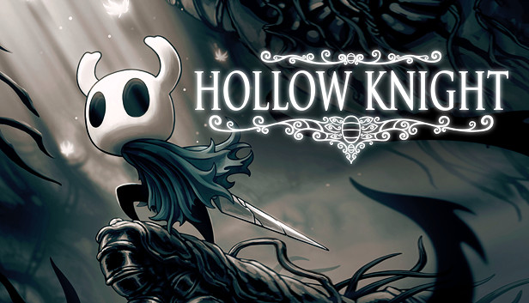
Who am I?
My name is Diyaa
I’m the founder and president of the Game Design Club
I have 4 years of experience animating in flash and a basic understanding of Actionscript and Visual Basic
My favorite game is currently “Hollow Knight”

Slide 4
Micheal Introduce yurself here
Insert bottom text

Slide 5
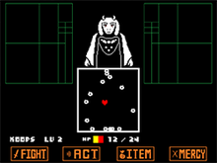
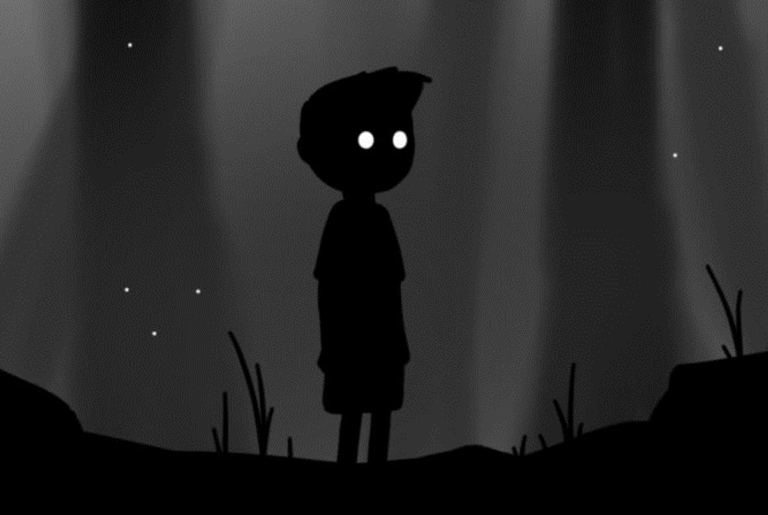
What is the GDC
We want to make games that you can be proud of
Help students with different skill sets work together to make video games

Slide 6
What we expect from you?
WE DON’T EXPECT YOU TO FINISH ALL YOUR WORK EVERY MEETING
We want to see progress.
Come to meetings.

Slide 7
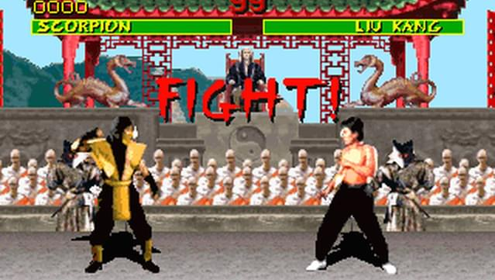
First project - Fighting game
Notes:
We decided on this because both me and micheal believe that this is the simplest and best way to introduce you to game design, as well as to understand a bit more about how all this works we hope it will take around three months to finish

