Slide 1
Behavior Risk Factors Surveillance System Survery 2015 Analysis

Slide 2
Background
BRFSS is the nation’s system of collecting health-related telephone surveys about U.S. Residents regarding their risk behaviors, chronic health, and preventive services
Allows for the analysis of behavior risk data at the state and local level and can target and build health promotion activities.
We are looking to see if we can utilize these behavior risks to help predict whether a person would have a chronic disease such as diabetes, hypertension, or stroke.

Slide 3
Questions
What are the behavior risk factors of diabetes?
Hypothesis: Age, Smoking, Weight, Physical Activity, Alcohol Consumptions
Does the amount of people who have diabetes increase as the age increases?
Hypothesis: Yes, since health problems generally grows as one ages
Is diabetes gender specific
Hypothesis: No, because there shouldn’t be any differences between the genders
Can diabetes be predicted through the behavior risks?
Hypothesis: Yes, I believe there will be patterns in behavior risks that can help us determine whether a person will have diabetes or not.

Slide 4
Gathering the data
The data was obtained on Kaggle.com. BRFSS 2015 Health data was made through cleaning and picking out specific columns that are potential behavior risks for the diseases.
Patient’s location was not utilized in this dataset
To see more information about the potential data, please go on BRFSS website

Slide 5
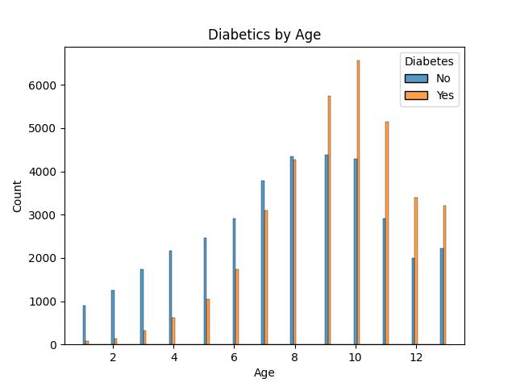
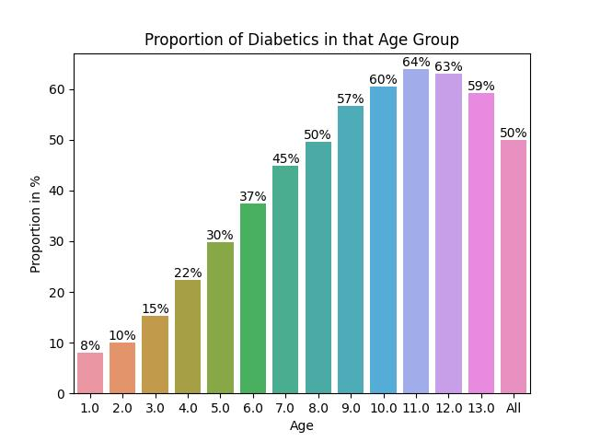
Analysis of BRF of Diabetes
As the population grows older, the proportion of diabetics in each age group increases, up until old age (70+)
The decrease in older age is most likely due to death of those with disease.

Slide 6
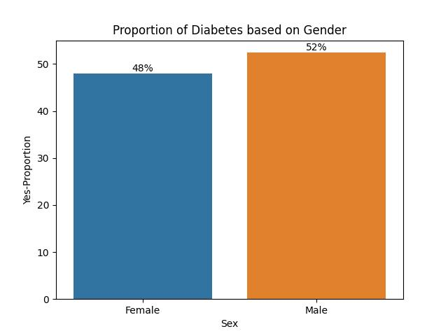
Analysis of BRF of Diabetes cont.
Of the 73,000 people, 52% of males had diabetes while only 48% of females had diabetes.
Statistically, this is an important insight indicating that males are doing something that make them much more likely to develop diabetes.

Slide 7
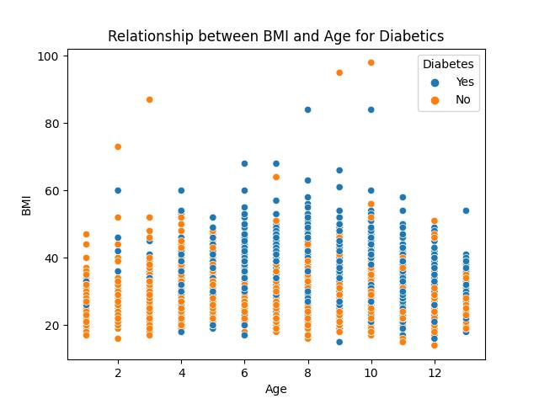
Analysis of BRF of Diabetes cont.
Mean BMI of the entire dataset is 29.86
Mean BMI of diabetics is 31.94
In a random sample of 5000, it seems that as age increases, diabetics also increases in the higher ranges of BMI (>25)

Slide 8
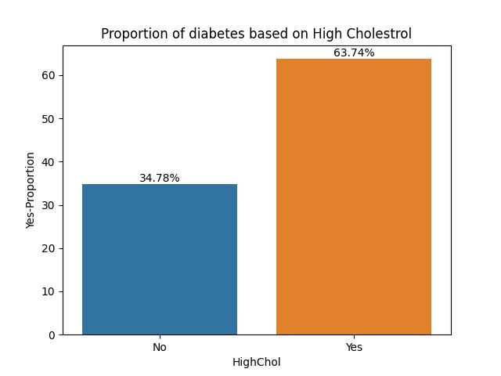
Analysis of BRF of Diabetes cont.
More than 2/3 of people who have diabetes also have high cholesterol.
Realistically, we can not determine whether high cholesterol can predict diabetes or vice-versa. This would be considered a data leakage.

Slide 9
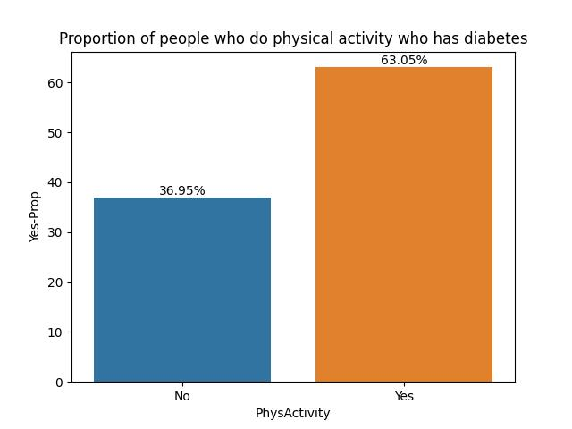
Analysis of BRF of Diabetes cont.
Around 63% of people who have diabetes do physical activity, while 36.95% do not.
Might be useful, but unknown if they do physical activity because they have diabetes or have been doing physical activity (data leakage)

Slide 10
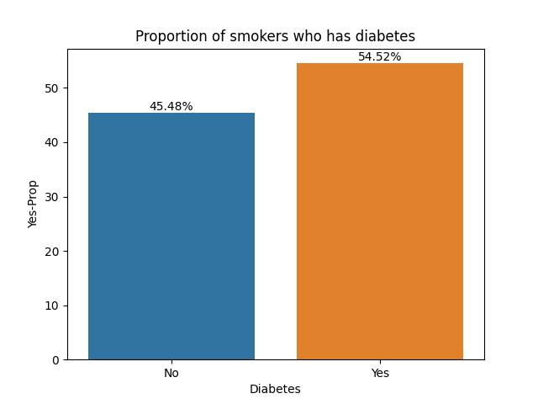
Analysis of BRF of Diabetes cont.
Smoking is generally a long-term behavior.
54.52% of people who have diabetes are also smokers while 45.48% of people who have diabetes does not smoke.
Statistically Significant behavior in that you are more likely to have diabetes if you are a smoker.

Slide 11
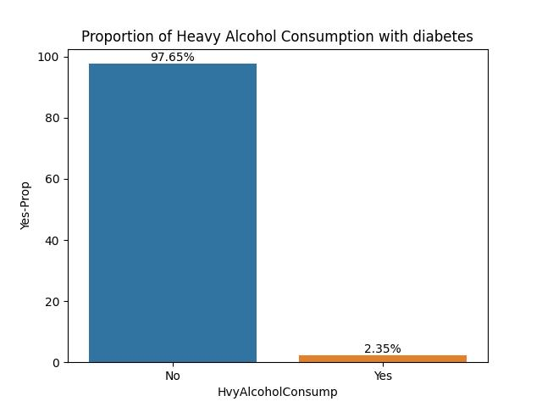
Analysis of BRF of Diabetes cont.
We see that people with heavy alcohol consumption do not usually have diabetes with only
Barely any heavy alcoholic consumers are diabetic.

Slide 12
Classification of Diabetics (Machine Learning)
Utilizing what we analyzed, we want to predict whether a person would have diabetes depending on the potential behavior risk
We will attempt to make a model utilizing XGBoost, Random Forest, and Decision Tree classifiers
Columns that are potential data leakages will not be utilized in our model (Physical Activity, High Cholesterol, etc.)
Columns used are as shown on the bottom

Slide 13
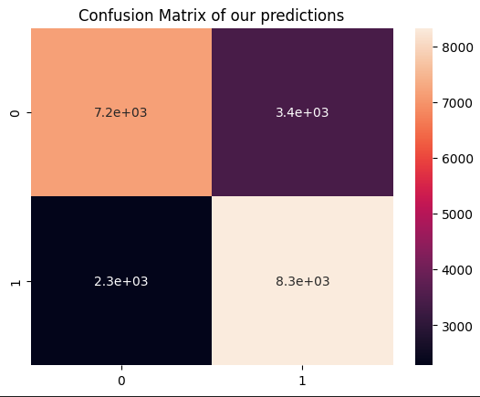
Decision Tree
Decision Tree had a training accuracy of 0.743 and testing accuracy of 0.730
Has about equal amounts of Type I and Type II errors

Slide 14
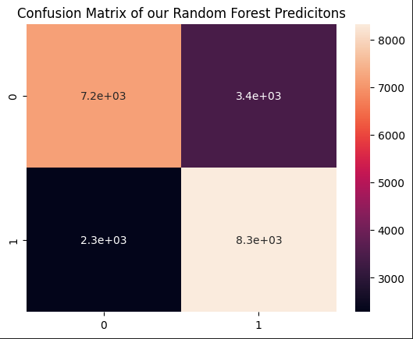
Random Forest
Training accuracy of 0.851 and testing accuracy of 0.702
Model is most likely overfitting
Worse model of the three
Has equal amounts of Type I and Type II errors

Slide 15
XGBoost Gradient
Prediction accuracy of 0.754 and a test accuracy of 0.735
Same amounts of Type I and Type II errors
Best Model of the three

Slide 16
Conclusion
Q1: Diabetes has a variety of behavior factors such as age, weight, gender, smoking, heart disease or attack, physical health, and general health
Q2: Yes. The proportion of people who have diabetes increases as age group increases. The only time it decreases is when it is at age group 12, which is around 70+
Q3: Statistically, there are more males who have diabetes then females. More testing would need to be done.
Q4: Yes. Utilizing the behavior risks, we can build a model that is around 75% accurate at predicting whether a person has diabetes.

