Slide 1



AdventureWorks
View in Power BI
Last data refresh:
2/7/2024 11:20:42 AM UTC
Downloaded at:
2/12/2024 5:27:33 PM UTC

Slide 2
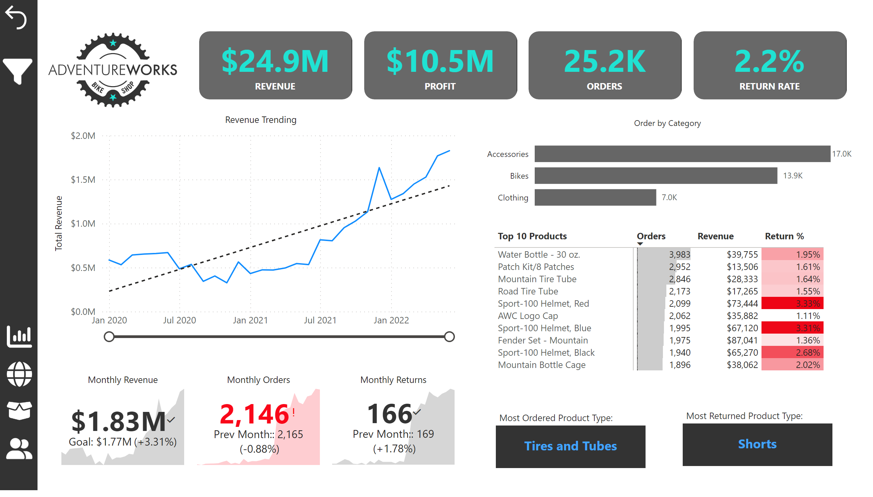
Exec Dashboard
Notes:
Logo
No alt text provided
shape
No alt text provided
shape
No alt text provided
shape
No alt text provided
shape
No alt text provided
card
No alt text provided
card
No alt text provided
card
No alt text provided
card
No alt text provided
Revenue Trending
No alt text provided
Monthly Revenue
No alt text provided
Monthly Orders
No alt text provided
Monthly Returns
No alt text provided
Order by Category
No alt text provided
pivotTable
No alt text provided
card
No alt text provided
textbox
No alt text provided
card
No alt text provided
textbox
No alt text provided
actionButton
No alt text provided
shape
No alt text provided
actionButton
No alt text provided
actionButton
No alt text provided
actionButton
No alt text provided
actionButton
No alt text provided
actionButton
No alt text provided
actionButton
No alt text provided
actionButton
No alt text provided
slicer
No alt text provided
slicer
No alt text provided
shape
No alt text provided

Slide 3
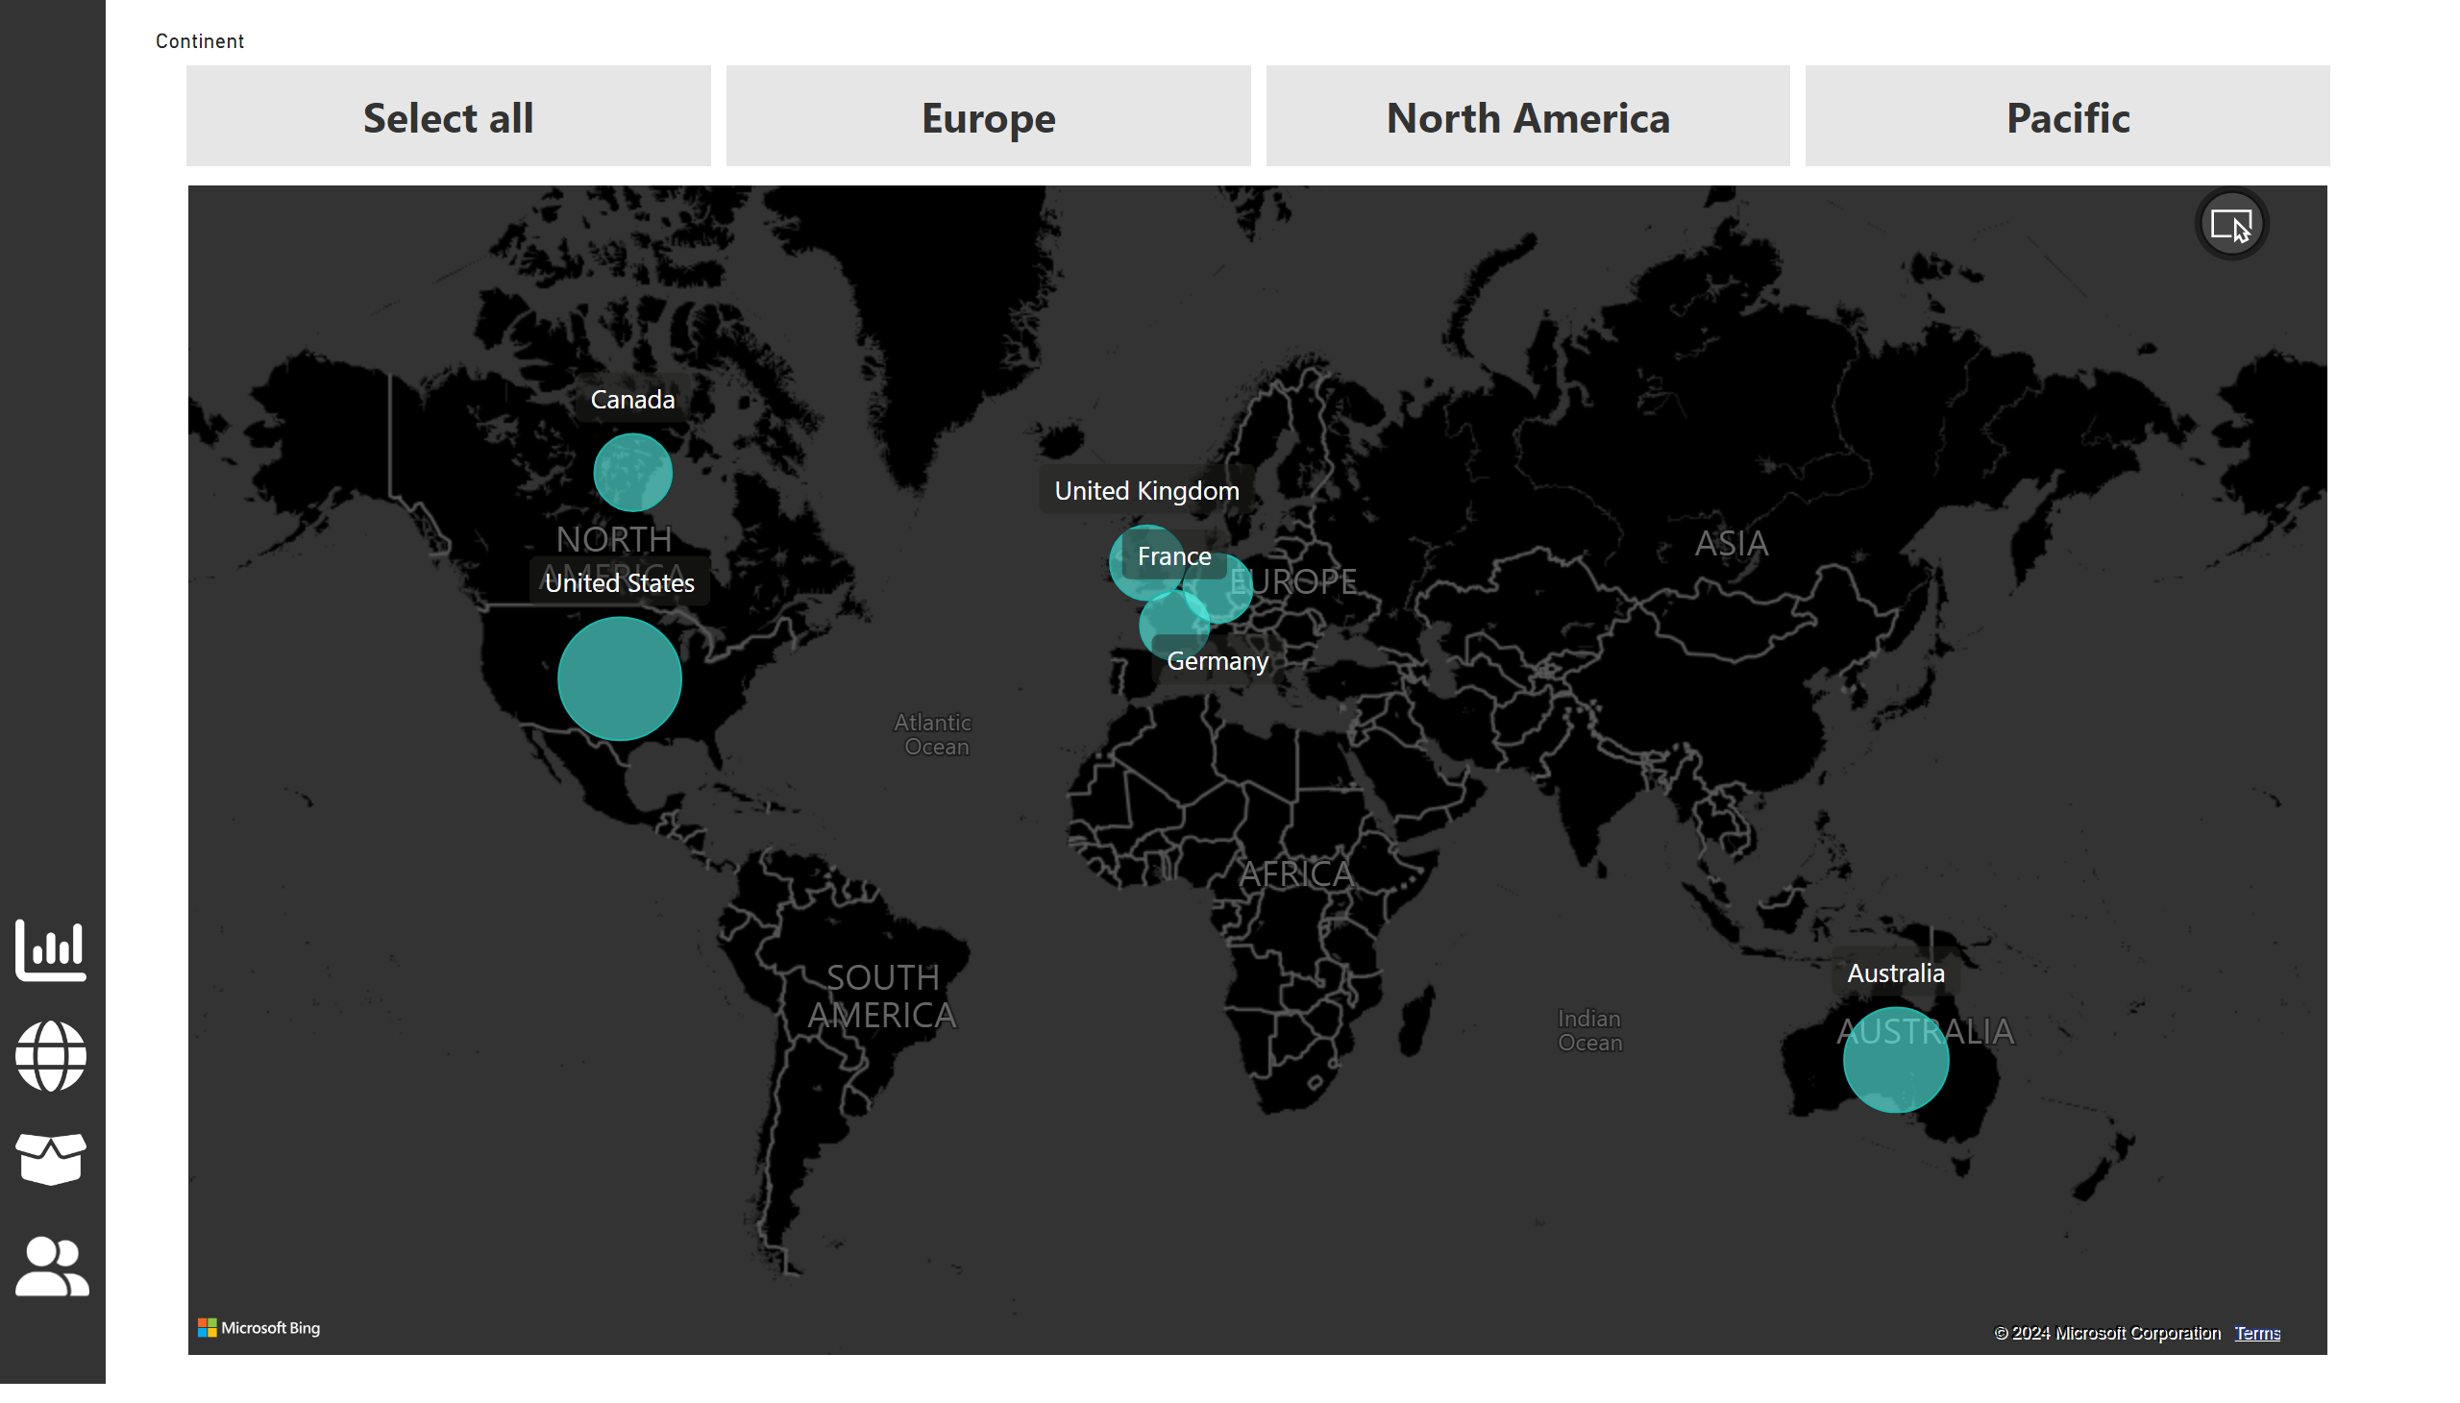
Map
Notes:
map
No alt text provided
slicer
No alt text provided
shape
No alt text provided
actionButton
No alt text provided
actionButton
No alt text provided
actionButton
No alt text provided
actionButton
No alt text provided

Slide 4
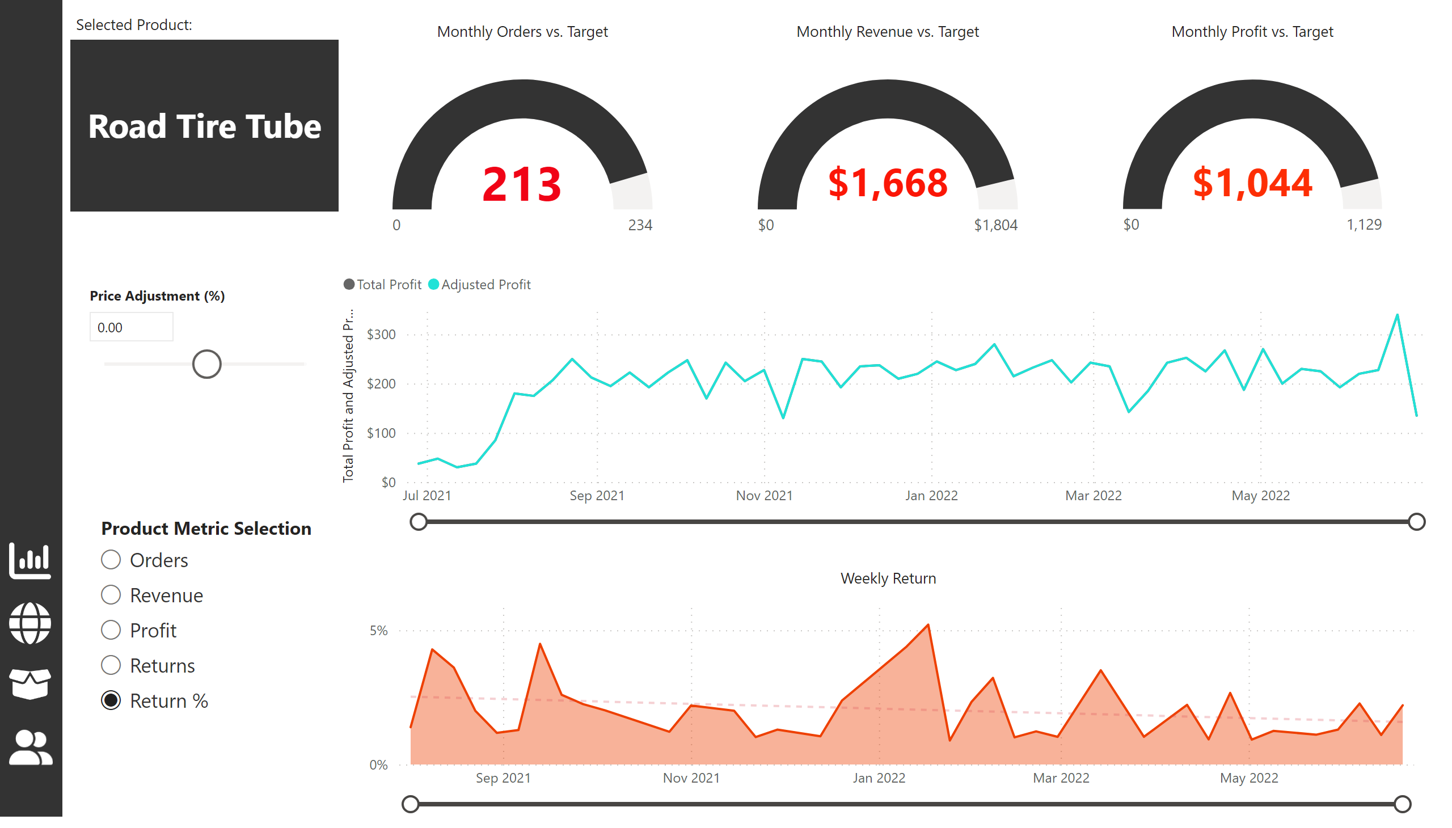
Product Detail
Notes:
Monthly Orders vs. Target
No alt text provided
Monthly Revenue vs. Target
No alt text provided
Monthly Profit vs. Target
No alt text provided
Profit Trending
No alt text provided
Weekly Return
No alt text provided
card
No alt text provided
textbox
No alt text provided
shape
No alt text provided
actionButton
No alt text provided
actionButton
No alt text provided
actionButton
No alt text provided
actionButton
No alt text provided
slicer
No alt text provided
slicer
No alt text provided

Slide 5
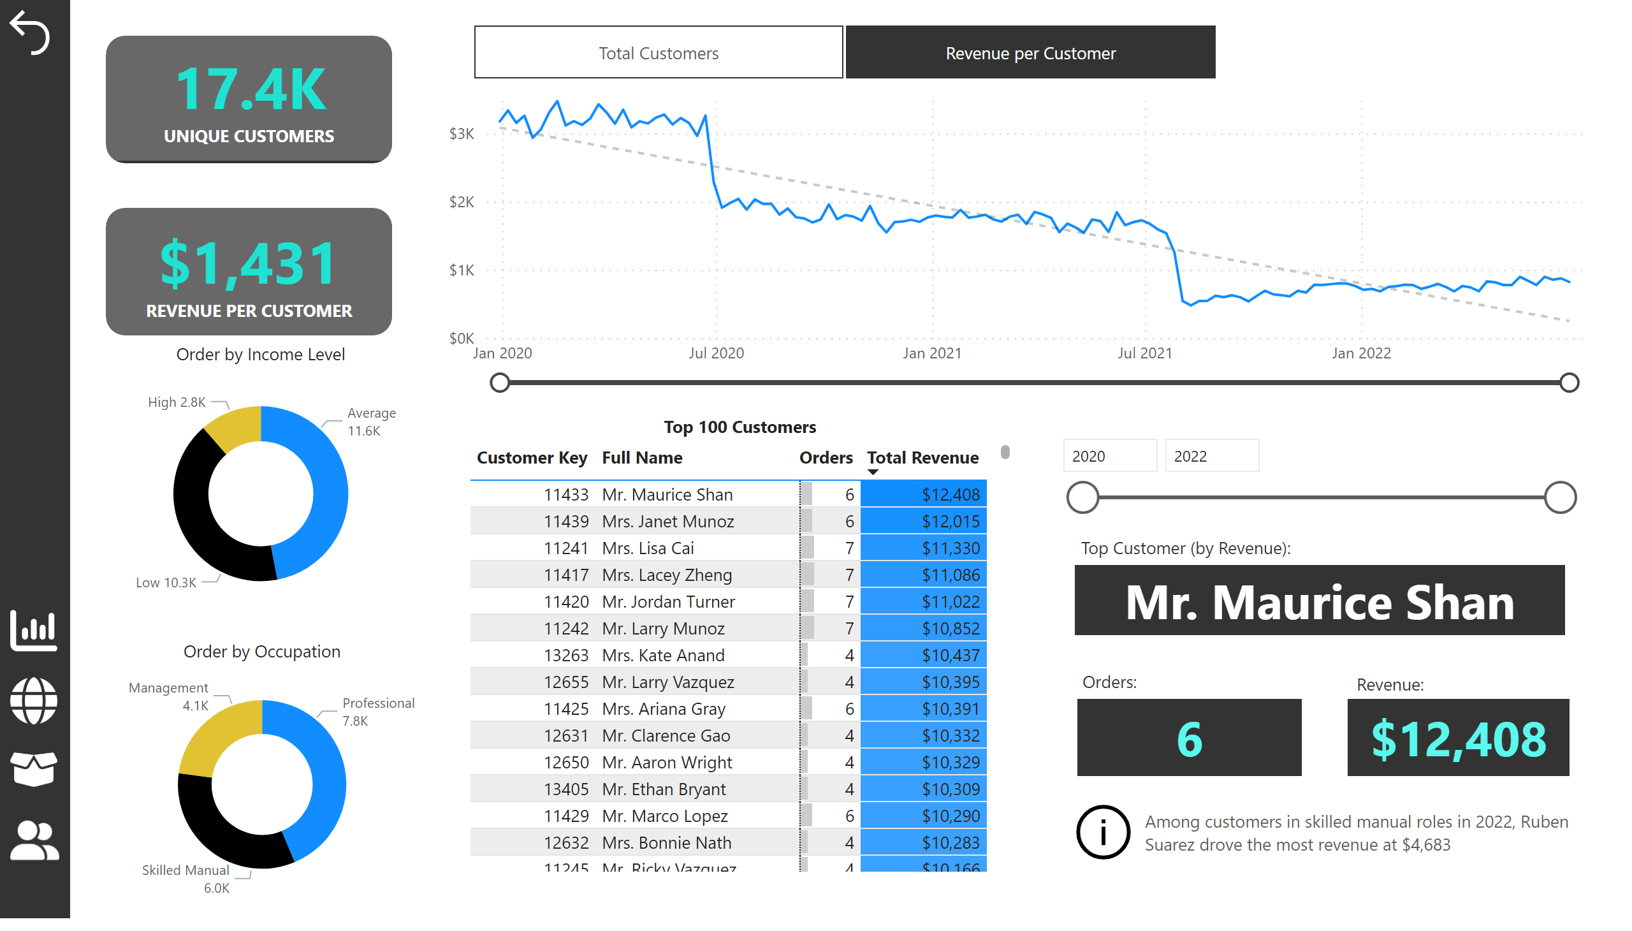
Customer Detail
Notes:
shape
No alt text provided
shape
No alt text provided
card
No alt text provided
card
No alt text provided
Customer Trending
No alt text provided
Order by Income Level
No alt text provided
Order by Occupation
No alt text provided
Top 100 Customers
No alt text provided
textbox
No alt text provided
card
No alt text provided
card
No alt text provided
card
No alt text provided
textbox
No alt text provided
textbox
No alt text provided
textbox
No alt text provided
slicer
No alt text provided
actionButton
No alt text provided
actionButton
No alt text provided
shape
No alt text provided
actionButton
No alt text provided
actionButton
No alt text provided
actionButton
No alt text provided
actionButton
No alt text provided
slicer
No alt text provided
actionButton
No alt text provided

Slide 6
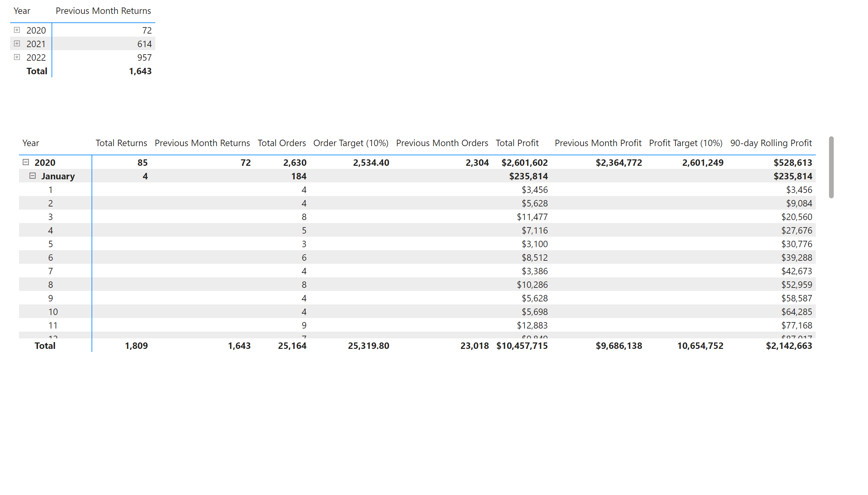
Page 1
Notes:
pivotTable
No alt text provided
pivotTable
No alt text provided

