Slide 1

Green Jobs Program Classification Prediction

Slide 2
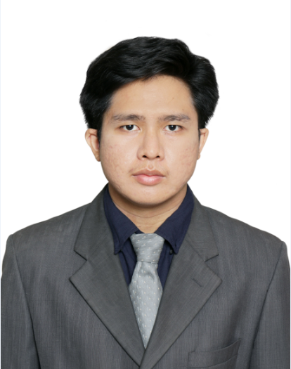


muhzahid
Muhammad Zahid
Physics Engineering, Telkom University, 2015
mzahidh

Slide 3
Green Jobs-Green NY Programs
The Green Jobs – Green New York (GJGNY) Program provides New Yorkers with access to energy assessments.

Slide 4
PROCESS
1
2
3
4
Pre-Processing
EDA
Feature Engineering
ML Modelling
Handling missing value in dataset and recheck if there are anomaly in value
Looking for insight and deeper information about the data
Selecting which column that will use as independent variable for model
Scaling, Handle imbalance data, cross validate score, Gridsearch CV, result evaluation

Slide 5
Random Forest Classifier
0.84
71%
Model Evaluation
AUC Scores
90%
69%
78%
Accuracy
Precision
Recall
F1

Slide 6
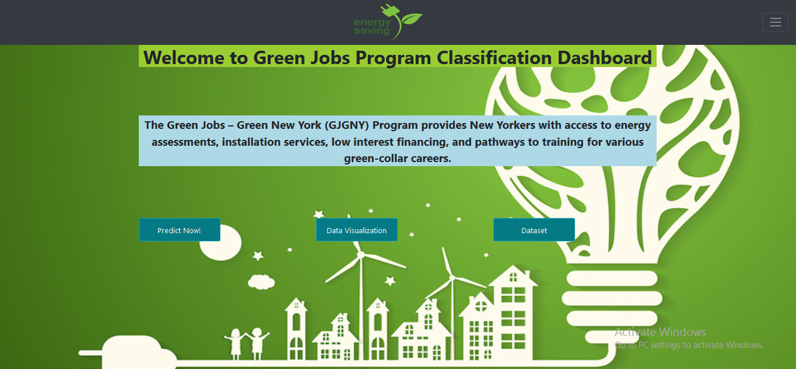
DESKTOP PROJECT
Place your screenshot here

Slide 7
THANK YOU

